Slide 1
Stress & Work Related Stress
Safety in African Aviation 2021 Conference
Dr Joan Cahill
(School of Psychology, Trinity College Dublin)
Centre for Innovative Human Systems

Slide 2
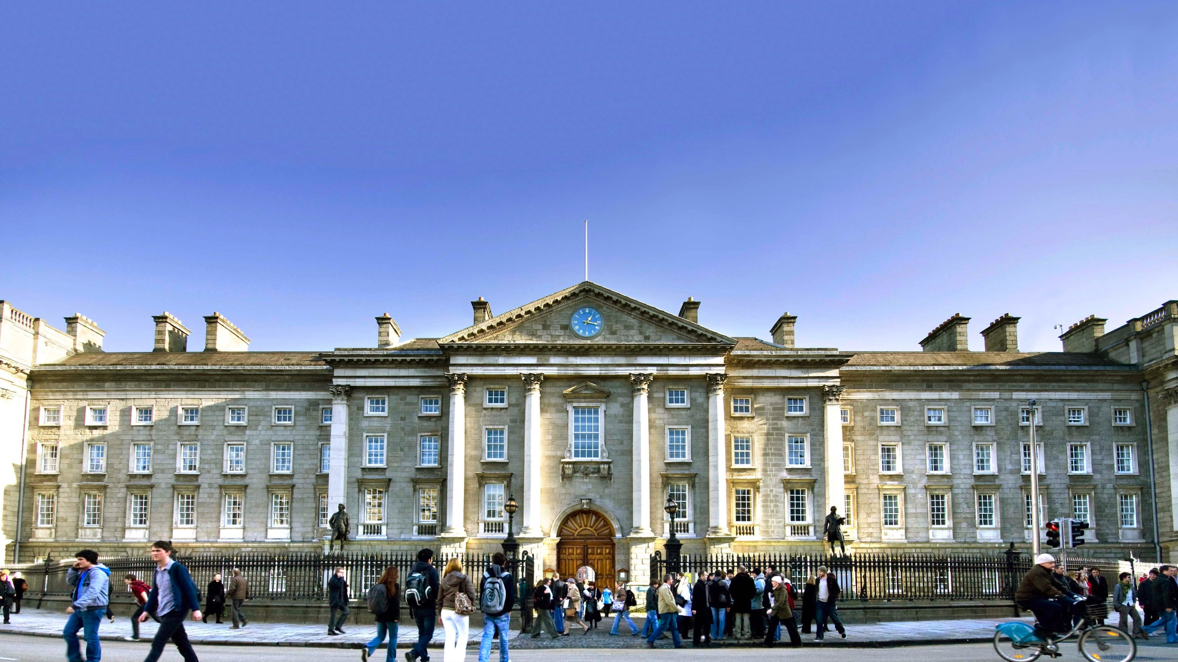


Introduction
Dr Joan Cahill
Centre for Innovative Human Systems (CIHS)
School of Psychology, Trinity College Dublin
Notes:
Research Fellow and Principal Investigator at the Centre for Innovation in Human Systems (CIHS), at the School of Psychology, Trinity College Dublin, Ireland
Research is at the nexus of people, technology and process delivery
Focusing on technology-based supports and interventions in healthcare, aviation and road transport.
Human Factors/Systems approach

Slide 3

Lived Experience & Wellbeing Project
Interdisciplinary Research Team
Trinity College Dublin (TCD), Ireland
WELLBEING AS A FACTOR IN SAFE PERFORMANCE
Health/Wellbeing, Performance & Safety
Lived Experience of Job
Stress/Work Related Stress (WRS)
Measuring Wellbeing
Stress Coping & Resilience
Integrated Wellbeing & Safety Culture
Wellbeing & Risk Assessment
Implementing Change/Solutions
Technologies

Slide 4
3 Pillars of Health
Wellbeing
Biological
Sleep
Diet
Social
Increased Social Support
Psychological
Exercise
Decreased Social Pressure
Personal Reflection
Meditation
Attitude to life
Stress Management
Coping Techniques
Support Network

Slide 5

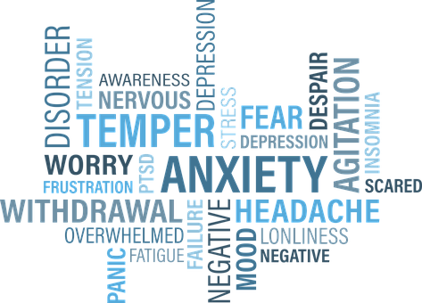
Presentation Theme…
  Work & Work Related Stress (WRS) has an impact on wellness
  Wellness has an impact on work

Slide 6
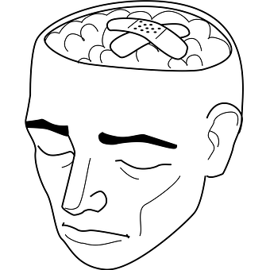
Stress
Stress is a negative reaction people have to aspects of their environment as they perceive it
Being stressed is a state, not permanent
Stress is part of life

Slide 7

Work Related Stress (WRS)
WRS is stress CAUSED or MADE WORSE by work
When a person perceives the work environment in such a way that his or her reaction involves feelings of an inability to cope

Slide 8
Work, Work Related Stress (WRS) & Health/Mental Health
WORK
WORK STRESS
HEALTH & MENTAL HEALTH
(United Nations 2030 Sustainable Development Agenda)
Notes:
Relationship between work and health/mental health
What links the two is work stress (United Nations 2030 Sustainable Development Agenda)

Slide 9
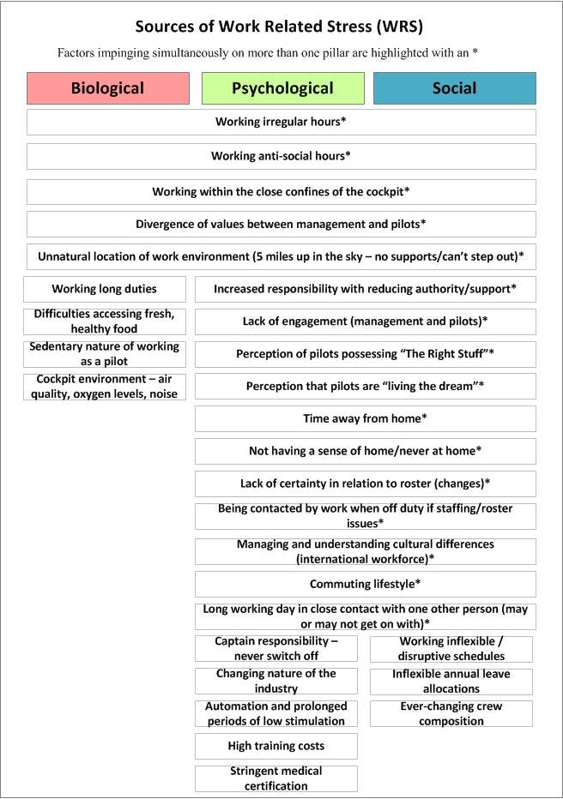
Work Related Stress (WRS)/Psychosocial Hazards

Slide 10
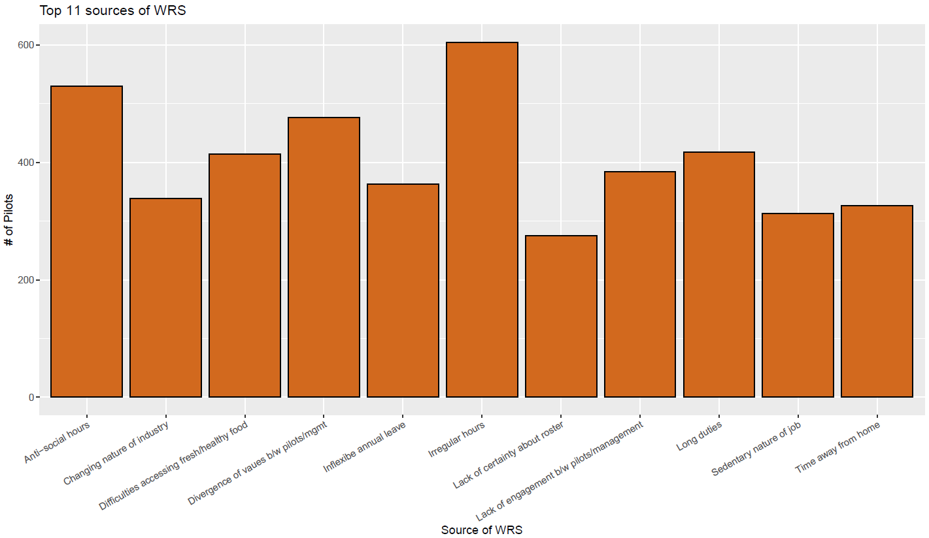
Sources of WRS
Irregular hours
Divergence of values
Sedentary nature
of job
Changing nature
Of job
Lack of
engagement
Anti-social hours
Inflexible annual leave
Roster
uncertainty
Fresh food?
Long duties
Time away
From home
Notes:
Sources of WRS – span three pillars

Slide 11

Stress Coping & Self Management
People vary in relation to their ability to cope successfully with stress (including WRS)
The practice of healthy behaviours strengthens the person’s resistance to stress
Substitution of maladaptive coping with more adaptive coping
Common stress coping strategies include exercise, the practice or relaxation techniques and seeking social support and/or social participation.

Slide 12

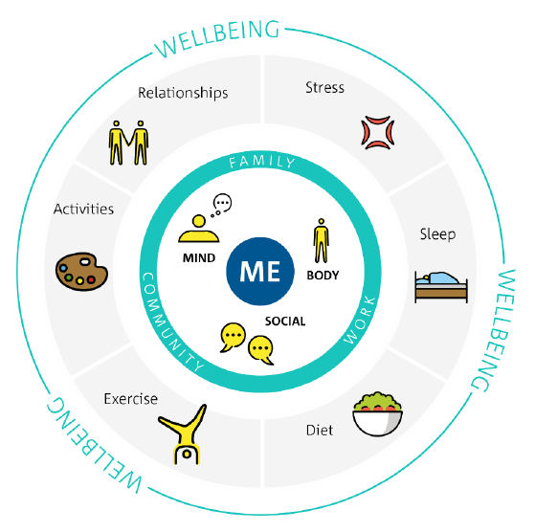
Coping Strategies & Depression Severity
The coping strategies most associated with lower depression severity levels are
Focussing on sleep daily
Focussing on physical exercise several times a week
Focussing on physical exercise daily
Focussing on physical exercise 2 to 3 times a month

Slide 13
Wellbeing II & Addressing Culture
Culture is an important component of work stress and may be a key to creating effective organizational stress interventions
(Peterson & Wilson, 2002).
Opportunity to address work stress from a positive managerial perspective
Health and safety culture as an enabler….
CULTURE
Culture of Safety (Safety Culture)
Culture of Health & Safety (Health & Safety Culture)

Slide 14

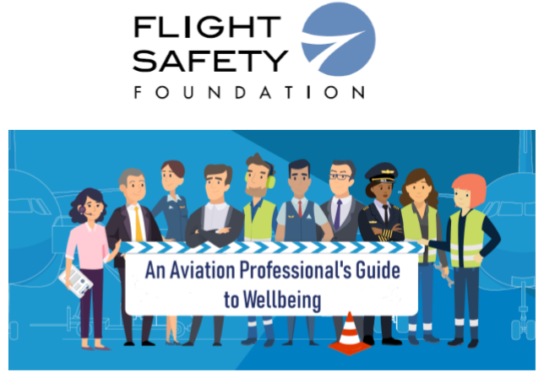

Resources & Guides
Resources & Guides
https://flightsafety.org/wp-content/uploads/2020/04/Guide-to Wellbeing.pdf
https://www.tcd.ie/cihs/
assets/pdf/TurbulentTimes.pdf
https://www.tcd.ie/cihs/projects
/pilot-lived.php

Slide 15
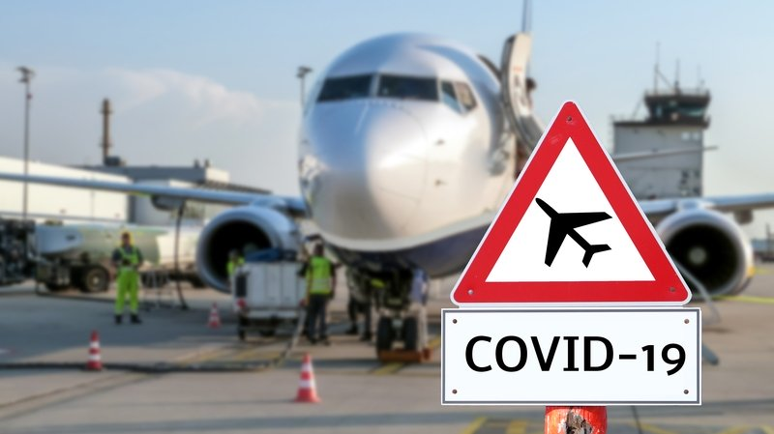

Aviation Worker Wellbeing During COVID Survey
COVID SURVEY 1
THANKS FOR YOUR PARTICPATION!
COVID SURVEY 2 IS LIVE!
PLEASE GIVE YOUR FEEDBACK!
(End July to August 2000)
(October to November 2001)
https://tcdecon.qualtrics.com/jfe/form/SV_7QA7WLi7PyoY31I

Slide 16

Airplanes are maintained to ensure that they are airworthy. We are no different!

