Slide 1


Developing students’ feedback literacy in healthcare curriculum: a supportive educational innovation.
Presented by
Siobhan Davis, Assistant Professor of Restorative Dentistry.
Dublin Dental University Hospital.
Notes:
Hello my name is Siobhan Davis and I am an Assistant Professor in Restorative Dentistry at the Dublin Dental University Hospital, Dublin, Ireland.
I’m delighted to present this project titled "Developing Student Feedback Literacy in Healthcare Curriculum: a supportive educational Innovation” on behalf of our mutlidisciplinary project team.

Slide 2
Multidisciplinary team members and associated disciplines
School of Linguistics, Speech and Communication Sciences | Dr Duana Quigley, Practice Education Coordinator
School of Medicine | Ms Mary O’Neill
Discipline of Radiation Science | Ms Claire Poole, Assistant Professor, Head of Clinical Education Ms Maeve Kearney, Assistant Professor of Radiation Science
School of Physiotherapy | Ms Lucy Alpine, Practice Education Co-Ordinator
School of Social Sciences | Dr Erna O’ Connor, Assistant Professor in Social Sciences
School of Dental Science | Dr Siobhan Davis, Assistant Professor in Restorative Dentistry
Notes:
I’m very fortunate to be part of a great team and we have collaborated previously on other feedback innovations. This team is made up of representatives from the school of medicine, physiotherapy, radiation therapy, speech and language studies, social sciences. I have found that approaching FB and involving several academic disciplines in an approach to a topic like this extremely beneficial, dynamic and catalystic. (is this even a word??) Hopefully they feel the same way working with me!

Slide 3
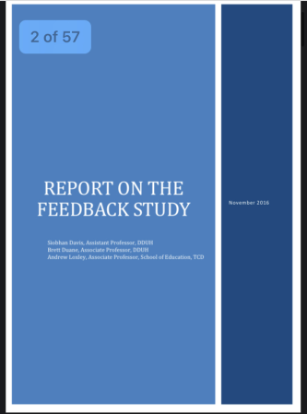
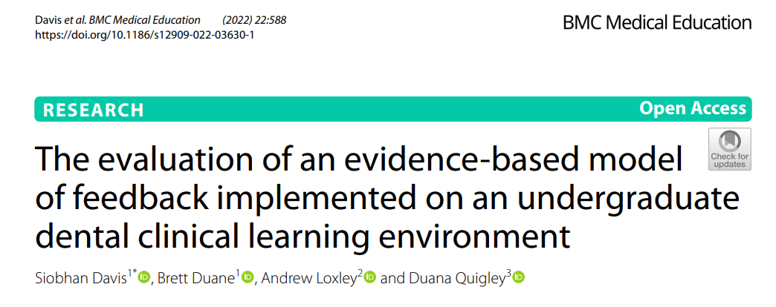
Background to current project-First phase
Change Project in Feedback - MOF was piloted on the clinical skills laboratory and subsequently implemented and evaluated on clinical sessions.
Notes:
The first phase was the based on the Dean of the dental schools desire to develop and improve on the feedback processes in the school. This resulted in a change project where a new model of feedback was developed and introduced on the Clinical skills Laboratory and then on the integrated patient care and advanced restorative sessions in the hospital. This collimated in a report in the feedback processes in the school and the publication of a paper in BMC Med Ed Date. Quan and Qualitiative data from this study showed some interesting themes and barriers around feedback in the CLE which were reflected elsewhere in the literature such as time for feedback, students afraid to approach supervisors for FB as they were afraid this would negatively impact on the grade assigned for the session and so on.

Slide 4
Model of Feedback Adapted from Nicol and MacFarlane-Dick 2006.
Learning outcomes are highlighted at the beginning of the clinical session verbally
Example of good work is shared with the student (e.g. refer to a textbook, lecture or online material) prior to the session
Feedback to the student incorporates a reflective component e.g. “How do you feel that went? What would you do differently next time?”
Clinical teacher determines if any issues arose for the student over the session based on expected performance/standards that could be improved on
5. Clinical teacher enters a dialogue with the student
Students are asked how they are progressing with their learning outcomes /goals, any areas of concern or need for clarification on subsequent sessions
Notes:
I’ve included the model of Feedback here which is very straighforward, evidence based and doesn’t take too much time to implement on sessions.
Interestingly dental students didn’t see the clincial sessions as having learning outomes at the outset of this study in the typical way that they might see a laboratory session or a lecture- maybe a link with not seeing the clinical environment as a learning opportunity persay,

Slide 5
Recommendations from the Report on Feedback
 | Recommendations from the study on feedback.
1 | Feedback is important to students, should continue to be provided and needs to be improved within DDUH.
2 | The DDUH should consider how it may alleviate the time pressures associated with giving appropriate feedback.
3 | In recognition of a reluctance to approach supervisors, the development of student literacy in the process should be addressed and prioritised.
4 | In addressing manageability of feedback practices, consideration should be given to involving student self-assessment in the senior clinical years, promoting their responsibility in recognising and achieving learning objectives in CLE.
5 | Consideration should be given to peer-to-peer discussion of cases led by CT. Consider mentoring and communication training for Clinical Teachers. Useful to discuss prior to session what the student hopes to take away from the session (i.e., individualised learning outcomes on clinical sessions)

Slide 6
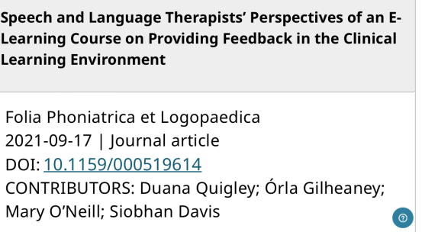
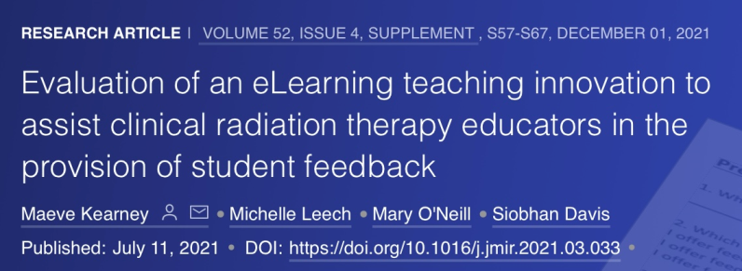
Second phase
2. Development of an eLearning tool around feedback for clinical teachers at DDUH
Recipient of Dean of Health Faculty Award 2018, Trinity College Dublin.
Adapted and made available to Faculty of Health Sciences.
Physio + OT data analysis stage
Medicine data collection
Notes:
Second phase of this project- In an effort to support the clinical teachers (which was one of the recommendations of the feedback report) and on the receipt of a Deans Award for Innovation 2018 the second phase of this project was the development of an elearning tool around feedback which was made available through Blackboard and contained evidence based knowledge on FB processes in the CLE and contained recorded AV clips of clinical teachers and their students in scenarios that might occur on the clinical sessions. This was piloted in the DDUH. Subsequently we made this available to the Faculty of Healthsciences- the AV scenarios were changed to suit the individual schools who participated and we evaluated the module and we have 2 papers from RT and SLT published and are at data collection stages in the school of physio and medicine.

Slide 7

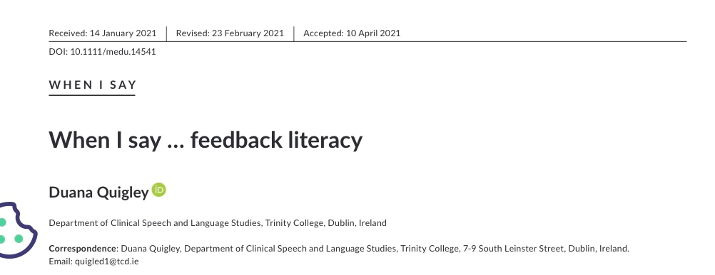
Phase 3 Development of Student Literacy in FB in
Healthcare Curriculum.
Current focus is on the ability of the assessor to give feedback rather than on how the student receives and acts on it
Lack of feedback literacy may result in students being blamed for their inability to respond to feedback well
Poor uptake of feedback may be interpreted as the student becoming defensive and disengaged in the learning process (Quigley, 2021).
Enhancing student feedback literacy in clinical teaching creates a high-quality learning environment
Notes:
Which brings me to Phase 3 of this project which is the development of a unit of elearning to address student literacy in feedback in the CLE.
There have been numerous calls for healthcare students to be explicitly supported to increase their agency and active engagement with the feedback process, that is, to intentionally support their feedback literacy skills (Winstone et al., 2017). Much of the focus of current research on feedback is on the ability of the assessor to give feedback rather than on how the student receives and acts on it.
Lack of feedback literacy may result in students being blamed for their inability to respond to feedback well.
Poor uptake of feedback may be interpreted as the student becoming defensive and disengaged in the learning process (Quigley, 2021). May lead to a less than optimal learning environment for the student and assessor.
Enhancing student feedback literacy in clinical teaching creates a high-quality learning environment that supports students to become reflective practitioners who continuously develop, think and act independently.

Slide 8

Project Aim
To enhance student feedback literacy to support students to become reflective practitioners who continuously develop, think, and act independently
Notes:
Why and how do we know animation will work here- vs AV clips???Going to pilot and see how the animation is received.
Each animation has been designed to show evidence based FB practices and where opportunities are missed as these have been well received in previous versions.

Slide 9
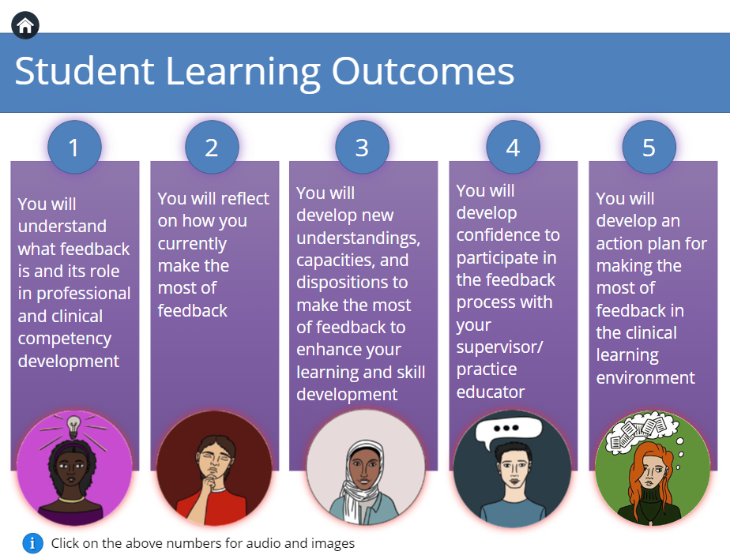
Project Objectives
Literature review, content development, online module, use of animation
Notes:
Project Objectives:
Review of the literature exploring evidence-based strategies in feedback literacy
Initiative content was developed, including: enhancing self-appraisal skills, increasing the ability to make judgements about performance, converting goals for improvement into an action plan, and managing emotions associated with receiving difficult feedback (Carless & Boud, 2018; Winstone et al., 2017).
Online module is asynchronous distributed location, independently completed and electronic-only.
Online education technologist supported the inclusion of multimodal content to include animation components to increase student engagement (Liu and Elms 2019)

Slide 10

Context – What is the importance of this Initiative?
  Investing in quality clinical teaching evidence based resources, students from all healthcare disciplines will be able to develop their feedback literacy and communication skills
  Potential to improve and transform T&L within the CLE
  Capacity to be adapted for use in non-healthcare courses across all disciplines to develop digital learning experiences
Notes:
Investing in the provision of quality clinical teaching evidence based resources, through an accessible digital platform, students from all healthcare disciplines will be able to develop their feedback literacy and communication skills.
Potential to improve and transform T&L within the clinical environment, enabling student success, enhancement of the student learning experience and quality delivery of patient care into the future.
Capacity to be adapted for use in non-healthcare courses across all disciplines to develop digital learning experiences.

Slide 11
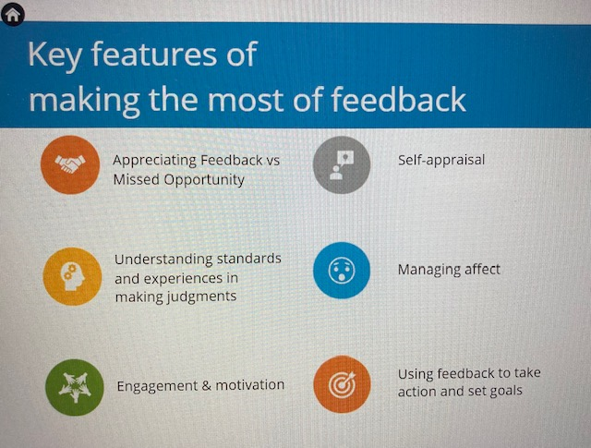

Context Continued…
In harmony with Trinity College Dublin and TCD Students Union Student Partnership Policy, invitation to healthcare students to review the resource ensuring a collaborative approach where the student voice is acknowledged in the development of course material and animations
Notes:
In harmony with Trinity College Dublin and TCD Students Union Student Partnership Policy, we will invite healthcare students to participate in reviewing the resource ensuring a collaborative approach where the student voice is acknowledged in the development of course material and animations.

Slide 12

Evaluation of Impact of Module
The initiative will have
(i) pre-course-checking prior knowledge and identifying learning needs
(ii) post-course-measuring students’ perceptions of content
(iii) three months after completion-determine long term benefits
Descriptive and inferential statistics analysing quantitative data and thematic analysis of qualitative data collected
Notes:
The initiative will have
(i) pre-course evaluation to check prior knowledge and identify learning needs
(ii) post-course evaluation to measure students’ perceptions of content (iii)evaluation three months after completion to determine long term benefits
Descriptive and inferential statistics will be completed to analyse the quantitative data collected and thematic analysis will be applied to qualitative data collected.

Slide 13

Piloting plan
Module content and animations developed July + August 2022
Ethics applications across schools September 2022
Pilot module Autumn 2022 -target groups first years of all disciplines involved in multidisciplinary group
Review and revisions
Sept 2023 roll out across Health Faculty
Evaluate and publish findings
Notes:
Need to finalise times here for future.

Slide 14

Positive potential changes in enhancing student literacy in FB
Enhance student engagement in learning and maximise the learning opportunities for students
Promote high quality learning experiences and communication in CLE
Enhance professional and clinical competency and development of lifelong skills for reflective practice
Promote positive impact and improved health and wellbeing of healthcare students, but ultimately, the quality of patient care into the future

Slide 15
Conclusion
This transdisciplinary online module will support students’ development of feedback literacy skills is innovative, engaging and novel
Asynchronous online mode of delivery provides students with the tools to develop feedback literacy skills in a flexible manner (Wentling et al., 2000)
This flexibility has become increasingly relevant in the context of COVID-19 with the rapid move to blended approaches to teaching and learning (UNESCO, 2020)

Slide 16

Take home message-
Enhancing student feedback literacy in clinical teaching can create a high-quality learning environment
Students value your feedback in this high quality clinical learning environment
SDavis@dental.tcd.ie for correspondence

Slide 17
References:
Davis S, Duane B, Loxley A, Quigley D. The evaluation of an evidence-based model of feedback implemented on an undergraduate dental clinical learning environment. BMC Medical Education (2022) 22:588 https://doi.org/10.1186/s12909-022-03630-1
Quigley D, Gilheaney O, O’Neill M, Davis S. Speech and Language Therapists’ Perspectives of an E-Learning Course on Providing Feedback in the Clinical Learning Environment. Folia Phoniatrica et Logopaedica. 2022|DOI: 10.1159/000519614
Evaluation of an eLearning teaching innovation to assist clinical radiation therapy educators in the provision of student feedback. Journal of Medical Imaging and Radiation Sciences. (2021) 52, (4) DOI: 10.1016/j.jmir.2021.03.033
Quigley D. When I say … feedback literacy. Medical Education. 2021;55:1121–1122. DOI: 10.1111/medu.14541
Wentling, et al. (2000) E-Learning—A Review of Literature. Knowledge and Learning Systems Group NCSA 9.1-73
UNESCO 2020 https://en.unesco.org/covid19/communicationinformationresponse/digitalinnovation

Slide 18
Additional reading
Burgess A, Mellis C. Feedback and assessment of clinical placements: achieving the right balance. Adv Med Educ Pract 2015;6:373–381.
Boud D, Molloy E. Rethinking models of feedback for learning: the challenge of design. Assess Eval High Educ. 2013;38(6):698-712.
Carless D, Boud D. The development of student feedback literacy: enabling uptake of feedback. Assess Eval High Educ. 2018;43(8):1315-1325.
Nash R, Winstone N. Responsibility-sharing in the giving and receiving of assessment feedback. Front Psychol. 2017; 8:1–9
Sadler DR. Beyond feedback: developing student capability in complex appraisal. Assess Eval High Educ. 2010;35(5):535-50.

