Slide 1





We Can Quit Too (WCQ2) A Pilot Cluster Randomized Controlled Trial of a Peer Delivered Outreach Community-based Smoking Cessation Intervention For Women Living In Disadvantaged Communities In Ireland
Dr Catherine Hayes, Principal Investigator WCQ2
WONCA World Rural Health Conference 2022
    18/06/2022

Slide 2
Research Team
Castello S, Darker C, O’Connell N, Burke E. Public Health & Primary Care, Institute of Population Health, School of Medicine, Trinity College Dublin
Patterson J, Dougall N. School of Health and Social Care, Edinburgh Napier University
Dobbie F, Bauld L, Usher Institute, College of Medicine and Veterinary Science, University of Edinburgh
Vance J, K O Hagan, Irish Cancer Society, Dublin
Williams P, PPI
Reynolds, C, Buggy A, HSE
Devane D, HRB Trials Methodology Research Network & School of Nursing & Midwifery, NUI Galway.

Slide 3
Tobacco, Women, Health and Health Equity
The World Health Organization (WHO) has defined tobacco use as a marker for social inequality
  Low socio-economic status (SES) groups are more impacted by the health consequences of smoking:
    high smoking use, more stressful living conditions, less access to smoking cessation services.
  Repeated calls to develop smoking cessation interventions that are tailored or adapted to the specific needs of lower SES smokers
WHO has highlighted the need for approaches tailored to gender when developing tobacco control policies in the light of increasing lung cancer rates in women
Lung cancer is the leading cause of cancer death in Irish women. Rates are highest in SED populations.
“Enhanced and targeted efforts to protect young people, women, socially disadvantaged groups and those who do not smoke but are exposed to smoking environments may be needed to achieve further prevalence declines in European countries” (WHO, 2019)

Slide 4
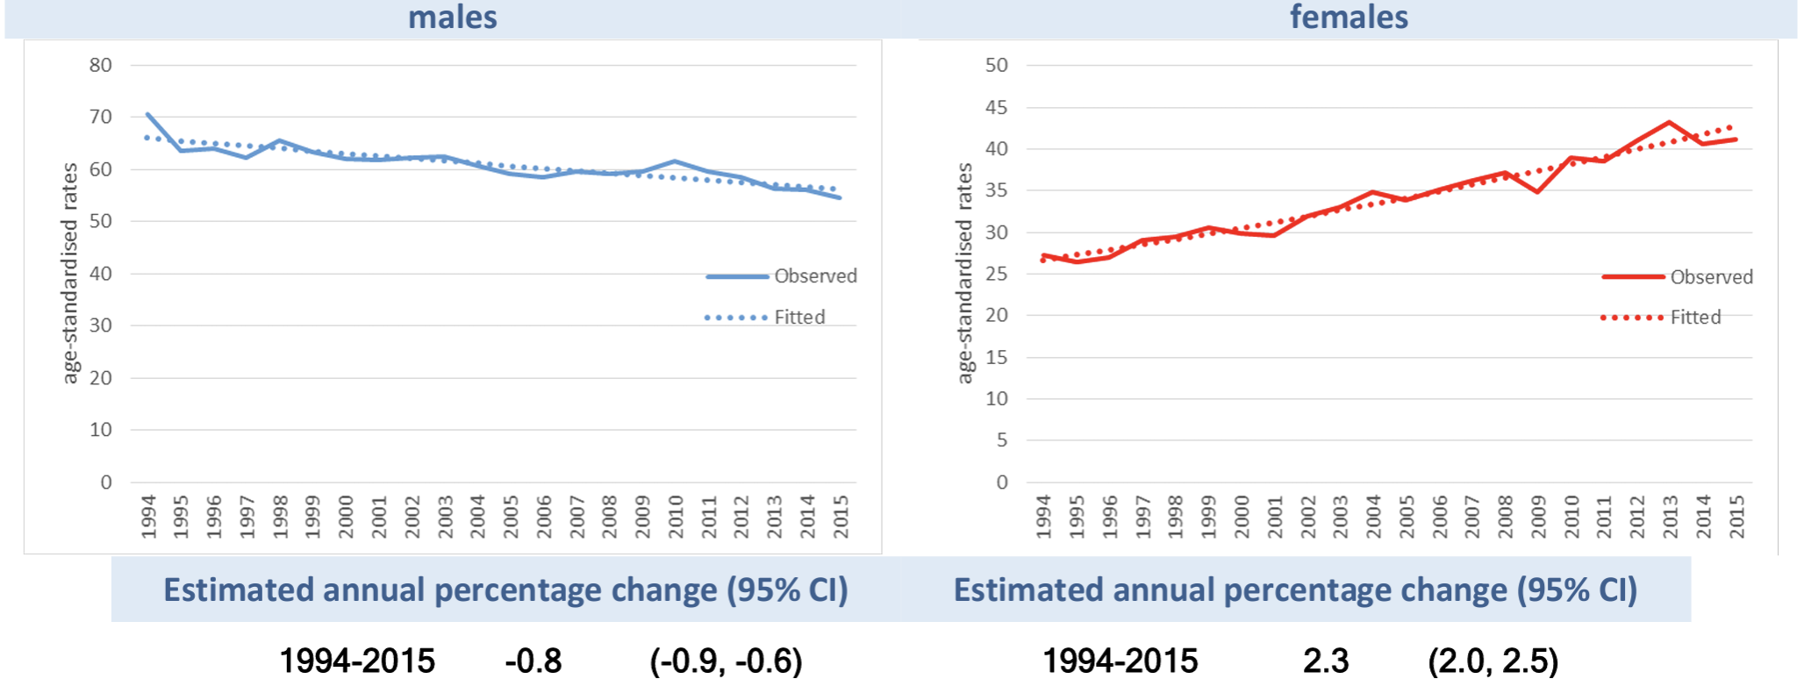
Cancer of the Lung - Trends in incidence rates 1994-2015
Source: National Cancer Registry Ireland. Cancer Incidence Projections for Ireland 2020-2045
For males, cases are projected to increase to 2,633 in 2045 (+94%), and for females, cases are projCaected to increase to 3,124 (+176%).
Between 2015 and 2045 the median projection suggests a much smaller increase for males and a much larger increase for females.
For males, cases are projected to increase to by 94% by 2045
For females, cases are projected to increase to by 176% by 2045.

Slide 5
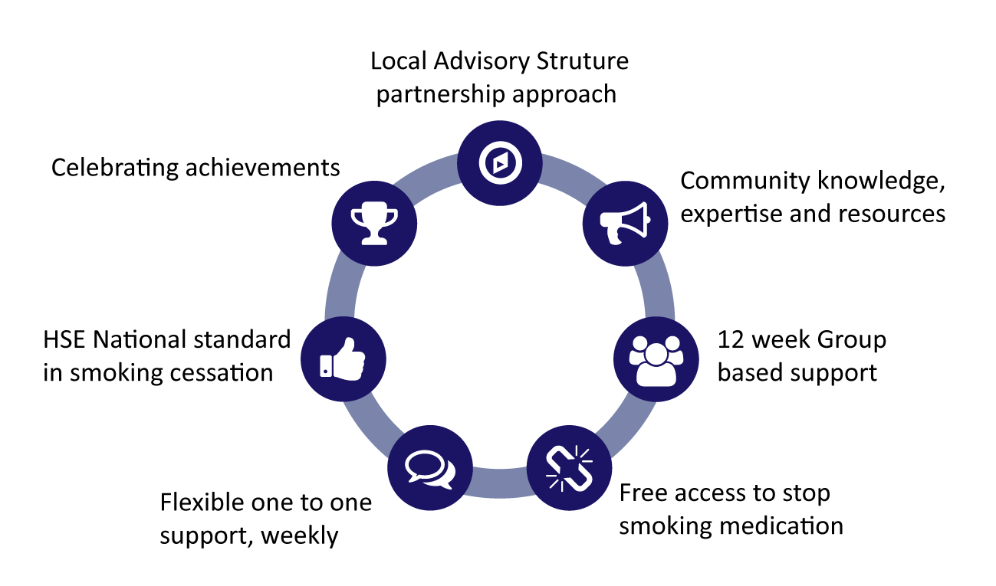
The We Can Quit intervention
We Can Quit (WCQ) is a community-based stop smoking programme specifically designed for women living in urban and rural socio-economic disadvantaged areas in Ireland.
Evidence based theory-informed intervention.
Core components:
  Group-based support once a week for 12 weeks, delivered by Community Facilitators (CFs): lay trained women living or working in target areas
  Access to Nicotine Replacement Therapy (NRT) without charge for participants who wish to take it
  Individual one-to-one text support between sessions.

Slide 6
Our study:
The We Can Quit2 trial
Two-arm, parallel group, pilot cluster randomised trial.
The main objective was to evaluate the feasibility and acceptability of running a community-based RCT and to determine preliminary smoking cessation rates in advance of a full effectiveness trial.

Slide 7
Methods and Process
Study Design: Mixed Methods, Community Participatory Action Research Approach.
Recruitment of eight districts (matched in four pairs) defined as SED (Pobal), geographically proximal, and with available HSE cessation services
  2 in Dublin, 1 Cork North City, 1 Cork County urban and rural.
Four Local Advisory Groups (LAGs) set up, one in each matched pair: to promote stakeholder engagement, assist in trial planning and promotion and recruitment of women.
Promotion: social media word-of-mouth, primary care, community stands, leaflets/posters, radio.
Eligible women
(current smokers, >18 years, interested in quitting, living/working in trial districts, English speakers, using or not using NRT).
Informed consent
Intervention: WCQ programme (group support + NRT over 12 weeks).
Control: one-to-one smoking cessation service delivered by HSE smoking cessation officers.
Randomised into one of two arms

Slide 8
Assessment and Outcomes
Hayes CB, Patterson J, Castello S, Burke E, O'Connell N, Darker CD, Bauld L, Vance J, Ciblis A, Dobbie F, Loudon K, Devane D, Dougall N. Peer-Delivery of a Gender-Specific Smoking Cessation Intervention for Women Living in Disadvantaged Communities in Ireland We Can Quit2 (WCQ2)-A Pilot Cluster Randomized Controlled Trial. Nicotine Tob Res. 2022 Mar 1;24(4):564-573. doi: 10.1093/ntr/ntab242.
Quantitative: Data collection: baseline, 12 weeks, 6/12
Qualitative: Interviews: Participants and CFs.
Primary outcomes:
  Recruitment of eight districts and 194 women in four consecutive phases (waves).
  Retention (data completion rates) of participants at 12 weeks and 6 months.
Secondary outcomes:
  Engagement with smoking cessation services and attendance rates
  Smoking abstinence at 12 weeks and 6 months
  Acceptability of the trial processes and WCQ
  Fidelity to intervention delivery.

Slide 9
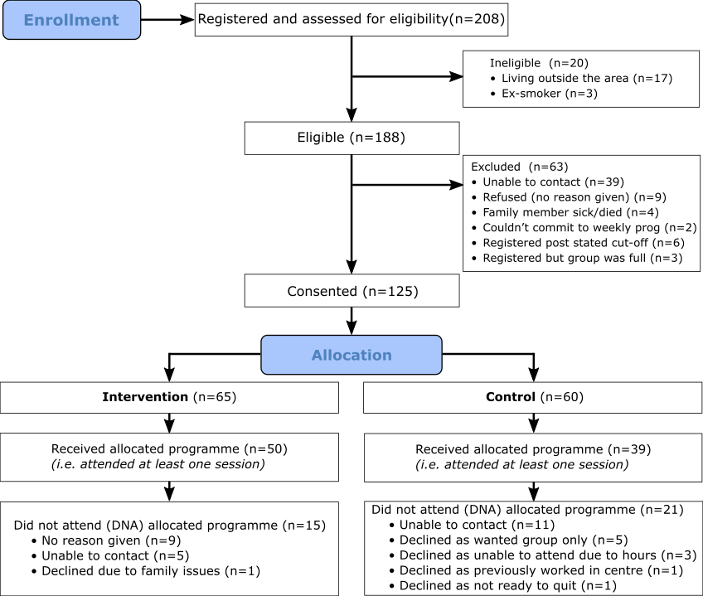

Results: Recruitment
208 women registered to participate, 188 were eligible.
125/188 women gave consent prior to randomisation (66.5% recruitment rate).
Notes:
This is the flow of chart of participants through the study.
After an intensive community mobilisation, two-hundred and eight women registered to participate, and one-hundred and eighty-eight were eligible.
We can see in the chart that the main reason for exclusions before randomisation was that women were unable to be contacted to ask them for consent.
Finally, one-hundred and twenty-five women gave consent, giving a sixty-six point five percent of recruitment rate.
More than half of consented women were medical card holders, which surpassed the target we were aiming at.
After allocation, some women were also unable to be contacted or did not give a reason to not attend the allocated programme. Five women allocated in the control arm declined their participation as they wanted the group intervention.

Slide 10
Participant characteristics
 | Intervention (n=65) | Control (n=60) | Total (n=125)
Age
Mean (SD) | 50.0 (±11.6) | 45.8 (±12.1) | 47.9 (±11.8)
Marital status | n % | n % | n %
Married / Cohabiting / civil partnership | 34 (52.3) | 23 (38.3) | 57 (46)
Single (never married) | 11 (17) | 23 (39) | 34 (27)
Other (separated, divorced, widowed) | 20 (30.7) | 13 (21.6) | 33 (27)
Children at home (0-18 years)
No children at home | 38 (59) | 39 (65) | 77 (62)
1 or more | 27 (41) | 21 (35) | 48 (38)
Education
No formal / Primary / Lower | 31 (48) | 21 (35) | 52 (42)
Secondary / Technical or Vocational Completed Secondary | 20 (31) | 23 (38) | 43 (34)
Degree (Diploma, Masters, PhD) | 14 (22) | 16 (27) | 30 (24)
Employment
Full-time | 20 (31) | 18 (31) | 38 (31)
Part time | 15 (23) | 14 (24) | 29 (23)
Not in paid employment | 30 (46) | 27 (46) | 57 (45)
Holds a medical or GP card
Yes | 41 (63) | 35 (60) | *76 (62)
No | 24 (37) | 23 (40) | 47 (38)
*Exceeded target of 50%
Notes:
This is the flow of chart of participants through the study.
After an intensive community mobilisation, two-hundred and eight women registered to participate, and one-hundred and eighty-eight were eligible.
We can see in the chart that the main reason for exclusions before randomisation was that women were unable to be contacted to ask them for consent.
Finally, one-hundred and twenty-five women gave consent, giving a sixty-six point five percent of recruitment rate.
More than half of consented women were medical card holders, which surpassed the target we were aiming at.
After allocation, some women were also unable to be contacted or did not give a reason to not attend the allocated programme. Five women allocated in the control arm declined their participation as they wanted the group intervention.

Slide 11
Smoking behaviour at Baseline
 | Intervention (n=65) | Control (n=60) | Total (n=125)
Daily cigarettes
Mean (SD) | 18.0 (±7.0) | 19.0 (±9.9) | 18.5 (±8.9)
Length of time smoking | n % | n % | n %
More than 25 years | 50 (78) | 36 (61.0) | 86 (70)
Between 5-15 / 15-25 years | 14 (21.5) | 23 (38.3) | 37 (30)
Reasons for smoking
Habit / Addicted | 35 (53.8) | 26 (43.3) | 61 (48.8)
For pleasure / to cope / both | 22 (34) | 29 (48.3) | 51 (40.8)
Other | 8 (12) | 5 (8.3) | 13 (10.4)
Time after waking before first cigarette
Within 5 minutes | 40 (62) | 30 (50) | 70 (56)
6-30 minutes | 12 (18) | 16 (27) | 28 (22)
After 30 minutes | 13 (20) | 14 (23) | 27 (22)
Determination to give up smoking
Not at all / Quite determined | 23 (35) | 18 (30) | 41 (33)
Very or extremely determined | 42 (65) | 42 (70) | 84 (67)
Using NRT/bupropion/varenicline/e-cigarettes at baseline
Yes | 14 (22) | 9 (16) | 23 (19)
No | 49 (78) | 49 (84) | 98 (81)
Support to help stop smoking
Yes | 58 (89) | 50 (83) | 108 (86)
No | 7 (11) | 10 (17) | 17 (14)
Notes:
This is the flow of chart of participants through the study.
After an intensive community mobilisation, two-hundred and eight women registered to participate, and one-hundred and eighty-eight were eligible.
We can see in the chart that the main reason for exclusions before randomisation was that women were unable to be contacted to ask them for consent.
Finally, one-hundred and twenty-five women gave consent, giving a sixty-six point five percent of recruitment rate.
More than half of consented women were medical card holders, which surpassed the target we were aiming at.
After allocation, some women were also unable to be contacted or did not give a reason to not attend the allocated programme. Five women allocated in the control arm declined their participation as they wanted the group intervention.

Slide 12
Results: Retention
Data completion rates | Intervention n (%) | Control n (%) | Control n (%) | Total n (%)
Completed Baseline | 65 (100) |  | 60 (100) | 125 (100)
Completed 12 weeks follow-up | 36/65 (55.4) |  | 31/60 (51.7) | 67 (53.6)
Completed 6 months follow-up | 31/65 (47.7) |  | 28/65 (46.7) | 59 (47.2)
Around half of the recruited women provided data at 12 weeks, and less than half at 6 months.
Notes:
Around half of recruited women provided data at 12 week and 6 month follow ups. As reported in the flow chart, most were unable to be contacted or dropped out the research for personal or family issues.

Slide 13
Results: Smoking abstinence
Measure | Smoking status | Intervention n (%) | Control n (%) | Total n (%)
12 weeks | Abstinence | 15 (23.1) | 8 (13.3) | 23 (18.4)
 | Continued smoking | 50 (76.9) | 52 (86.7) | 102 (81.6)
6 months | Abstinence | 9 (13.8) | 7 (10.8) | 16 (12.8)
 | Continued smoking | 56 (86.2) | 53 (89.2) | 109 (87.2)
23 women quit smoking at 12 weeks. Most received the WCQ intervention.
More women from the WCQ group reduced the number of daily cigarettes between programme start and both follow up points
Women who quit smoking in each group attended over twice as many sessions than those women who continued smoking

Slide 14
Process evaluation
Darker C, Burke E, Castello S… Hayes CB. A Process Evaluation of ‘We Can Quit’: a Community-Based Smoking Cessation Intervention Targeting Women From Areas of Socio-Disadvantage in Ireland. Under Review https://doi.org/10.21203/rs.3.rs-1039705/v1
Objective: to offer explanation for the trial findings in terms of understanding the barriers to accessing smoking cessation support
Method: Semi-structured interviews with 26 women (18 participants and 8 Community Facilitators)
Results:
  Group support – hugely positive active ingredient of the Programme:
      Peer-modelling, CFs supportive role
      Importance of non-judgemental interactions
  NRT
      free NRT helpful for cessation; some concerns re: addictive nature, costs, and access issues going forward.
      Role of the community pharmacist – additional supportive role
  Low literacy was a barrier for engagement with programme and completing trial-related materials.
W1-P0004: I feel like there’s a spell broken
W2-P0026: …because I think they (the other women and CF’s) understood what you were going through
W2–CF1: …. they’d arrive in the door to him [pharmacist] …And he’d a little room to the side and he’d take them in and talk it through
W1–P0040: I can’t spell for diamonds, so I found it difficult if I was to write in it.
Notes:
Around half of recruited women provided data at 12 week and 6 month follow ups. As reported in the flow chart, most were unable to be contacted or dropped out the research for personal or family issues.

Slide 15
Conclusions
Successfully recruited women smokers from socioeconomically disadvantaged areas to a community-based smoking cessation trial via community mobilisation
Most women were heavily dependent smokers
Women engaged well with their assigned cessation programme
Group support - hugely positive
Free access to NRT important facilitator
Role of community pharmacist positive
Retention rates were low. Low literacy was a barrier to recruitment and retention.
Higher attendance was associated with quitting, direction of effect towards WCQ at 12 weeks

Slide 16
Policy Implications
Results provide important evidence on the enablers and barriers to delivering a tailored smoking cessation service to marginalised groups in Ireland
  Removing the cost barrier to NRT access was a key enabler
  Low literacy is a fundamental issue which must be addressed
More supports needed to prevent relapse after programme completion
HSE have taken over We Can Quit programme and included it in the 19 Slaintecare Healthy Communities.

Slide 17
Acknowledgements
Women who participated in the programme
Local Area Advisory Groups
Local Area Primary Care Centres - GPs and practice staff
PPI
Community Facilitators
Irish Cancer Society Coordinators
HSE Smoking Cessation Officers and Tobacco Control Programme
Welcome Clinical Research Facility
Trial Steering Committee
Funders Health Research Board Ireland, Definitive Interventions and Feasibility Awards, DIFA-2017-048.

Slide 19
Thank You

