Slide 1





Translating and disseminating research findings to stakeholders: The We Can Quit 2 Pilot Trial of Smoking Cessation in Disadvantaged Women
Prof Catherine Hayes
School of Medicine, Trinity College Dublin and HSE Health Intelligence
Share and Learn Seminar No. 4
21st September 2022

Slide 2
Background
Traditional research dissemination
    reinforces passive relationships among research producers and users
    fails to reach practitioners and policy makers who can translate findings into practice.
    Active research dissemination
    A two-way dialogue between researchers and non-academics to disseminate evidence-based interventions using planned strategies
      incorporation of evidence-based interventions into routine care
      enable researchers to identify practice and policy priorities, new research, reducing evidence to practice gap
    Engagement of different types of stakeholders - patients, practitioners and policy makers is at the centre.

Slide 3
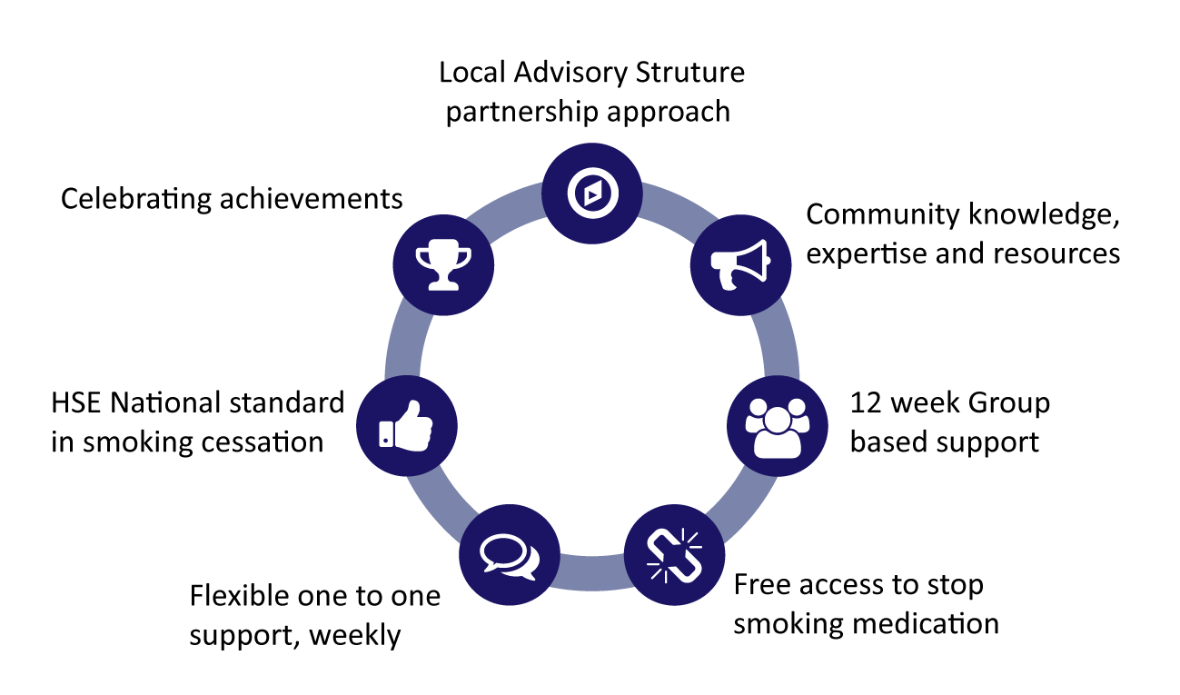
The We Can Quit intervention
We Can Quit (WCQ) - a community-based stop smoking programme developed in Ireland tailored to SED women
Socio-Ecological Model
Community-based Participatory Research (CBPR)
Core components:
  Group-based support once a week for 12 weeks, delivered by trained lay Community Facilitators (CFs):
  Access to Nicotine Replacement Therapy (NRT)
  Individual one-to-one text support between sessions.

Slide 4
We Can Quit2 trial
Two-arm, community-based pilot cluster randomised controlled trial (RCT)^{1,2} in four matched pairs of SED districts in Ireland with embedded process evaluation
Main objective - to evaluate the feasibility and acceptability of WCQ and trial processes
Recruitment – four consecutive waves
Comparison – one to one smoking cessation service by Health Service Executive
Engagement of non-academic stakeholders through establishing community-organised Local Advisory Groups (LAGs) central to all phases of the RCT, from design to implementation.

Slide 5
We Can Quit2 trial – Knowledge Exchange Activities
Knowledge Exchange
interactive interchange of knowledge between research users and research producers used to disseminate scientific evidence.
Secondary Objective of WCQ2
to develop strategies to optimise the recruitment and dissemination of findings to trial stakeholders to inform knowledge exchange and future research.
  KE Activities
    Academic publications
    Accessible policy brief
    Knowledge Exchange workshop.
Notes:
Around half of recruited women provided data at 12 week and 6 month follow ups. As reported in the flow chart, most were unable to be contacted or dropped out the research for personal or family issues.

Slide 6
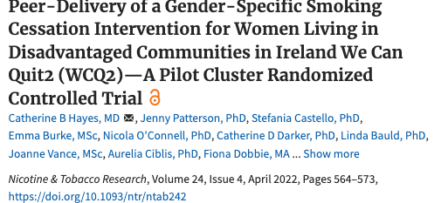
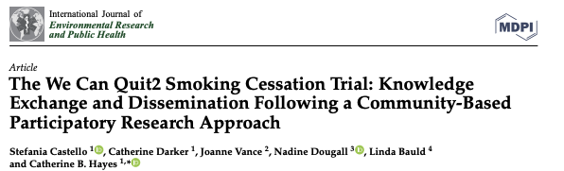
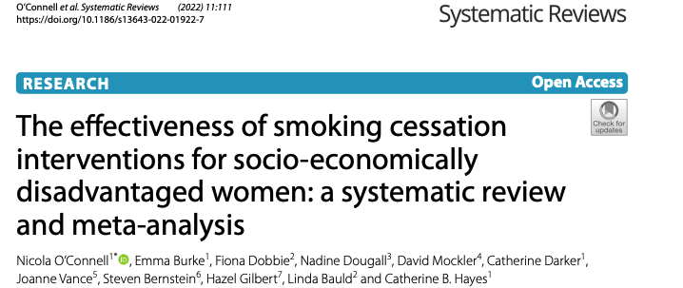
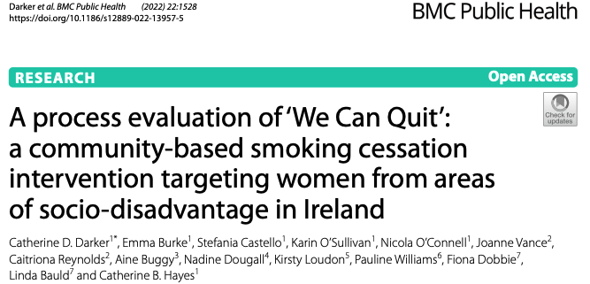
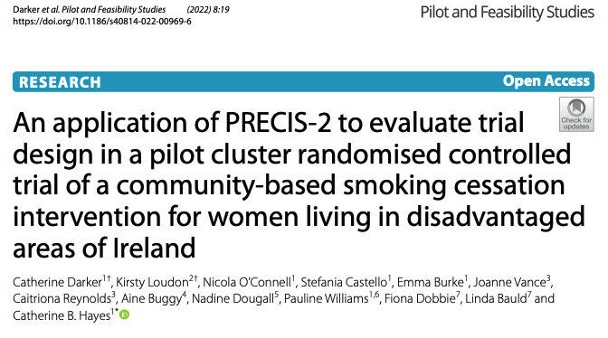

Slide 7
We Can Quit2 trial – Policy Brief
Plain English summary
  trial methodology
  main findings and recommendations.
Distribution
  local stakeholders involved in the conduct of WCQ2
  key regional and national practitioners and policy makers in Ireland with an interest in tobacco control.
Notes:
Around half of recruited women provided data at 12 week and 6 month follow ups. As reported in the flow chart, most were unable to be contacted or dropped out the research for personal or family issues.

Slide 8

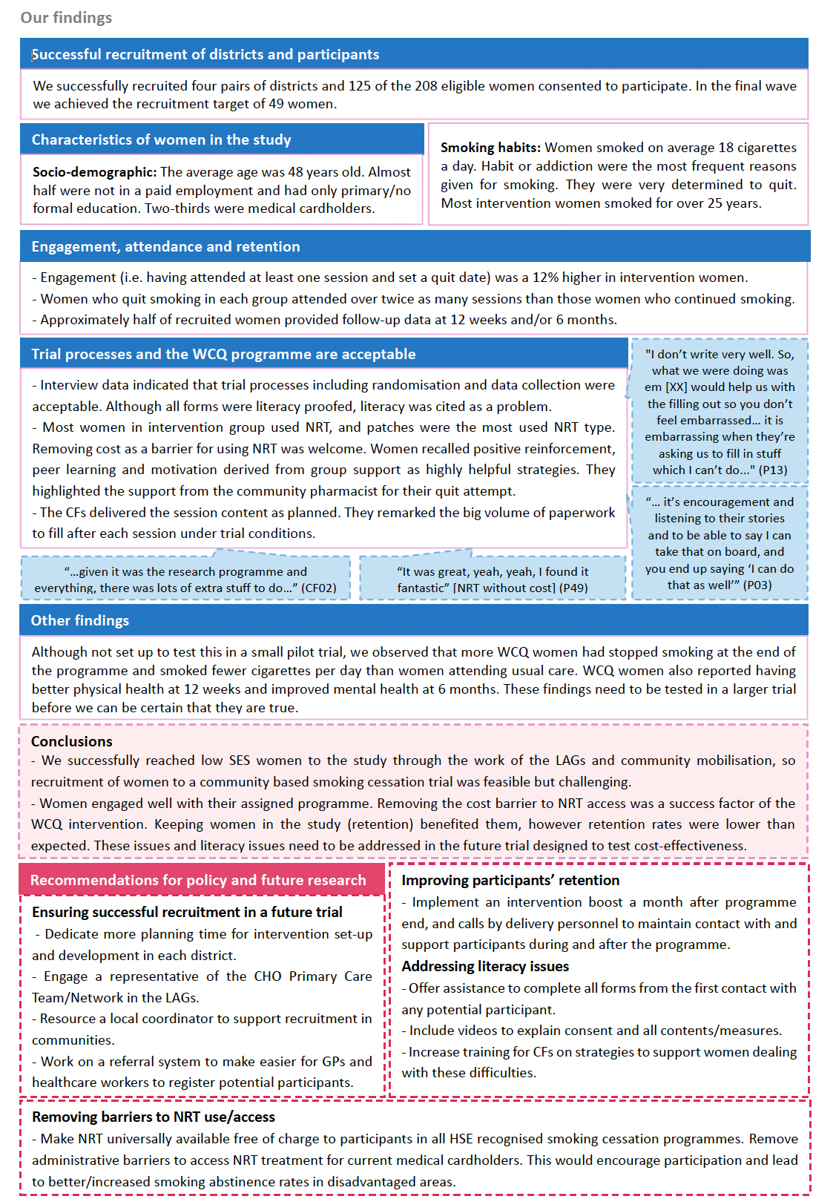

Slide 9
We Can Quit2 trial – KE workshop
Single online workshop Nov 2020
stakeholders’ views on trial findings and the experiences of being involved in research – feedback loop
Implications for policy and practice
  All received policy brief
Predefined topics
key improvements to enhance community engagement, participant recruitment and retention to inform design of a potential future definitive trial
key policy and practice priorities arising from the WCQ2 research.
Separate anonymous online questionnaire
Analysis
  Field notes and questionnaire responses
Invitees (n=176)
  LAG members
  research partners
  HSE, ICS representatives
  programme delivery personnel (community facilitators and HSE smoking cessation officers)
  local area partnerships, community development organisations
  community pharmacies, GPs, primary care centres
  regional and national policy makers and
  non-governmental organisations interested in tobacco control policies.
Notes:
Around half of recruited women provided data at 12 week and 6 month follow ups. As reported in the flow chart, most were unable to be contacted or dropped out the research for personal or family issues.

Slide 10
Results - Workshop Participants
Attendees (n=41) | Involved in trial planning and/or delivery | Description
HSE and ICS representatives (n=7) | Yes | Delivery partners involved in setting up Local Advisory Groups and delivery of the recruitment in each trial district. HSE representatives who were experts in smoking cessation and trained the trial programme delivery personnel.
Programme delivery personnel (n=9) | Yes | Community facilitators and HSE Smoking Cessation Officers who delivered trial interventions. They were also involved in retention during intervention delivery.
Local Advisory Group members (n=18) | Yes | Representatives from Community development organisations, Local Area Partnerships, Primary Care workers who were involved in trial planning and in promotion and delivery of the recruitment strategy. Local Authority representatives from the cities and counties in which the trial took place, who were involved in planning trial delivery.
Regional Policy Makers (n=3) | No | HSE Community Health Officers, Primary Care Development and Health Promotion representatives from trial areas.
National Policy Makers (n=4) | No | Representatives from the tobacco and cancer prevention national programmes Representative from a voluntary organisation working to reduce tobacco use and related disease Representative from a public education charity interested in addressing inequalities.

Slide 11
Results – Themes and subthemes
Predetermined theme | Subthemes
Community engagement and participant recruitment | Increase the research set -up time to build trust relationships with community stakeholders Variety of methods to recruit participants Increase Engagement of GPs and primary care workers Participants’ low literacy in interpreting research information
Retention | Reasons for discontinuing with the research Tools for encouraging attendance during programme delivery Planned support after intervention delivery to reinforce quit attempts and improve the collection of data at 6 months Participants’ low literacy – programme materials
Policy priorities arising from the research | Barriers to access NRT Smoking cessation interventions in SED groups

Slide 12
Retention
Retention
Reasons for participants’ dropout (barriers)
Feelings of not being ready or able to quit
Fear of admitting the need for help to quit smoking
Women’s families and social environment may be a source of stress or represent complex realities that can hinder participation.
  Lack of support
  family members’ smoking behaviour
Low literacy
Solutions
Strategies to encourage attendance
  Avoiding summer holidays /winter nights
  ‘Introduction night’ with former WCQ participants
  Dedicated week with participants’ families and friends during programme delivery
Strategies to encourage sustainability
  keeping in contact with women by text or email 1-3 months after intervention delivery
  Encouraging joining other community programmes
Strategies for low literacy
  Replacing some material with short videos
  More resources for Community Facilitators

Slide 13
Policy Priorities
NRT
Cost and
administrative barriers to access NRT.
Prioritise funding
Need to prioritise funding for smoking cessation interventions tailored to lower socioeconomic groups, based in community settings.
Improve Literacy
W4–CF 2: … one of the ladies said sure ‘I can’t even get an appointment; it takes 3 weeks to get an appointment’…
W4–CF 1: And then when the pharmacists confronted the ladies about the prescription they …felt em they were being put under a bit of pressure to get the prescription off their doctor and they were stressing over it .
W1–P0040: I can’t spell for diamonds, so I found it difficult if I was to write in it (journal)

Slide 14
Conclusions
Dissemination Workshop successfully engaged a mix of community and statutory stakeholders representing different voices and perspectives
It provided a final feedback loop with key trial stakeholders as a part of a longer community engagement process which included multiple interactions during the trial process with our PPI and community organisation.
Joint reflection among non-academic stakeholders and researchers facilitated new insights and a deeper understanding of local women’s needs to allow them to fully participate in a smoking cessation trial and engage with smoking cessation services
Trial team gleaned a set of practical strategies to enhance the design of future research implementation
Dedicated additional time to build relationships with local stakeholders with a tacit knowledge of their local context and connecting with existing social prescribing networks, were key recommendations
Despite the low response rate, the online approach was a successful medium for stakeholder engagement.

Slide 15
Impact
Dissemination of results following the CBPR approach encouraged the joint reflection of community, statutory and academic stakeholders on new research findings
It increased understanding of barriers and facilitators to SED women’s engagement in a smoking cessation intervention, and assisted in developing recommendations and outlining policy priorities which can be implemented in practice
We expect our findings to be generalisable to the development of other community-based behavioural change interventions in lower SED groups
WCQ has now been included as a programme under the national Healthy Ireland Strategic Action Plan 2021-2025 to address health inequalities
The findings may be used to optimise the design of definitive RCTs to test the effectiveness of these interventions, and to enhance their sustainability thus contributing to a reduction of health inequalities

Slide 16
Acknowledgements
Workshop participants
PPI
Local Area Advisory Groups
Local Community Organisations
Participants and Community Facilitators in the We Can Quit2 trial
Irish Cancer Society Coordinators
HSE Smoking Cessation Officers and Tobacco Control Programme
Welcome Clinical Research Facility
Funders: Health Research Board Ireland, Definitive Interventions and Feasibility Awards, DIFA-2017-048.

Slide 17
Thank You hayesc9@tcd.ie

