Slide 1




“What do you think, Doctor Google ?”
An Assessment of Online Information Concerning Smoking in Pregnancy
Martin O’Donnell, Catherine Hayes
RAMI Intern Study, #200

Slide 2
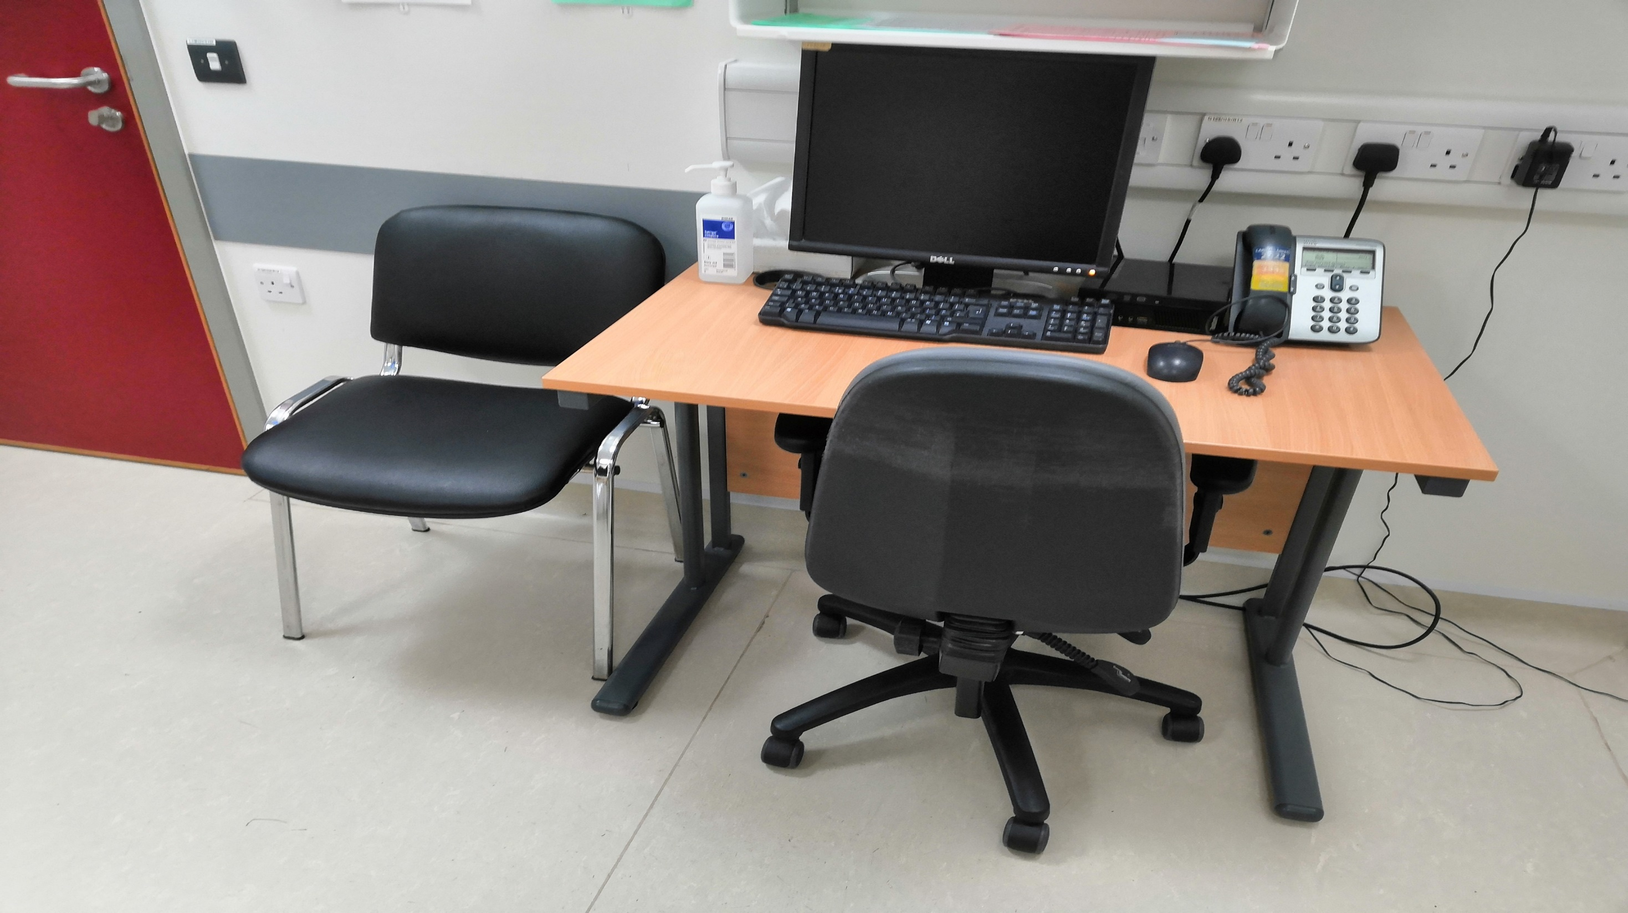

Slide 3

Background
Introduction
Healthcare users increasingly want more knowledge to enable them to make informed choices about their own care
Internet fulfils this need → easy-to-use, immediate, vast
Majority of internet users use the internet for health purposes (1), including pregnant women (2) and expectant fathers (3)
Smoking in pregnancy remains a real issue in Ireland and worldwide (4), but there has been no previous description of the information available on this topic

Slide 4

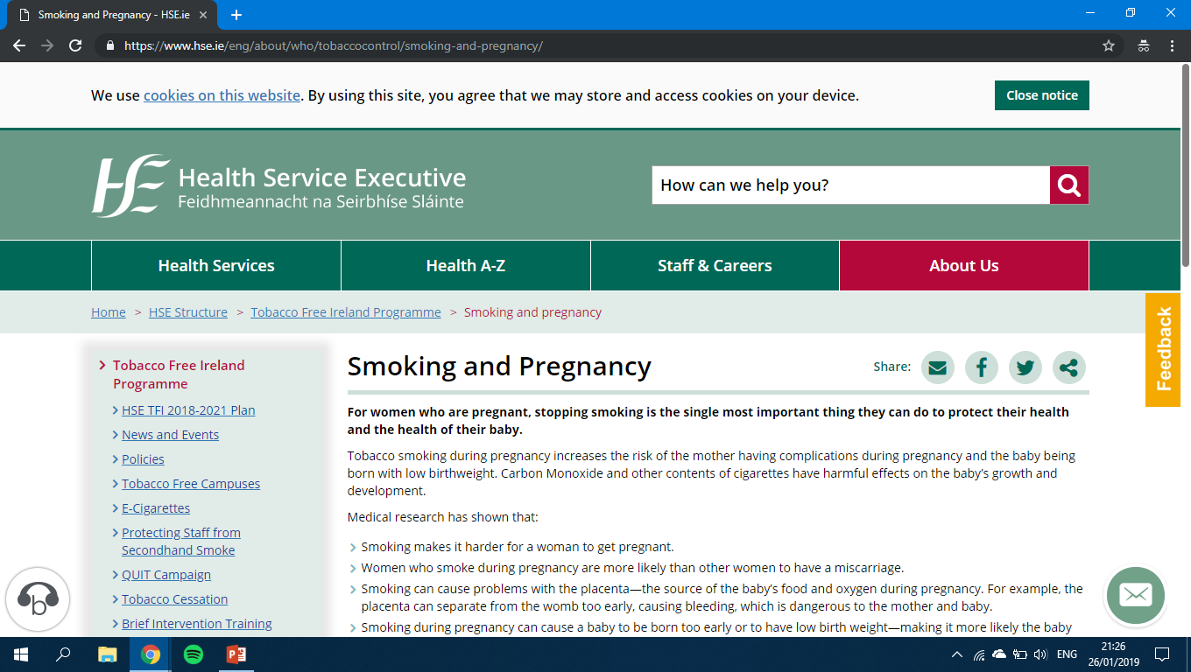
Methods
TERMS: “smoking in pregnancy” and “smoking and pregnancy”
Methods
Search Strategy
Google Adwords
Search Engines
Results noted
Screening
Assessment
Authorship
Accessibility
Readability
Content
Accessibility
Author
Readability
Content

Slide 5

Results
Results
Accessibility
Readability
Mean score was 69.22/100 (SD =17.618)
  13/89 good (≥90)
  62/89 average (50-89)
  14/89 poor (<50)
Author category differences
SMOG grade mean 9.06 (SD = 1.78)
  Only 1/89 webpages ≤ grade 5
NALA design guidelines – 26/89 fully compliant

Slide 6
Table 2: Topics covered based on Literature Reviews (5-7)
Results
Topic | % (n=89)
Smoking Effects (Pregnancy)
Miscarriage | 59.6 (53)
Stillbirth | 47.2 (42)
PPROM | 7.9 (07)
Preterm Birth | 75.3 (67)
Placental Complications | 32.6 (29)
BW/ LBW / SGA / IUGR | 75.3 (67)
Smoking Effects (Offspring)
Congenital Anomalies | 34.8 (31)
Respiratory | 57.3 (51)
Cardiovascular | 15.7 (14)
SIDS | 59.6 (53)
Obesity | 11.2 (10)
Behavioural Problems | 25.8 (23)
Options for Quitting in Pregnancy
Support | 51.7 (46)
NRT | 42.7 (38)
E-cigarettes | 25.8 (23)
Table 1: Credibility Indicator by Item
Item | % (n=89)
Author | 44.9 (40)
Affiliation | 95.5 (85)
Editor | 20.2 (18)
Date of Creation | 42.7 (38)
Date of Update | 42.7 (38)
Backing | 57.3 (51)
Accreditation | 22.5 (20)
Finance | 14.6 (13)

Slide 7

Discussion
Discussion
Accessibility of webpages were poor overall → Is there a need for a statutory obligations?
Readability results are concerning especially given adult illiteracy in Ireland and among pregnant smokers
Content results suggest a need for improvement of webpages → Is there a role for healthcare professionals?
Strengths and Limitations – English, first 50 webpages, automated tool use.

Slide 8

Conclusion
Conclusion
Study highlights need for healthcare professionals to be:
aware of webpages available on their area of interest
cognisant of the needs of their individual patients
part of solutions – content creation, curation
References: https://sites.google.com/view/ramimod/

