Slide 1

Developing students’ feedback literacy in healthcare curriculum: a supportive educational innovation.
Presented by
Siobhan Davis, Assistant Professor of Restorative Dentistry.
Dublin Dental University Hospital.
Notes:
Hello my name is Siobhan Davis and I am an Assistant Professor in Restorative Dentistry at the Dublin Dental University Hospital, Dublin, Ireland.
I’m delighted to present this project titled "Developing Student Feedback Literacy in Healthcare Curriculum: a supportive educational Innovation” on behalf of our mutlidisciplinary project team.

Slide 2
Learning Outcomes
To have insight into the dental learning environment
To present some challenges around feedback
To understand why reconceptualisation of feedback as a sense making process is coming to light in the literature
To present some research around student feedback literacy underway at DDUH
To review the central role of feedback in learning

Slide 3
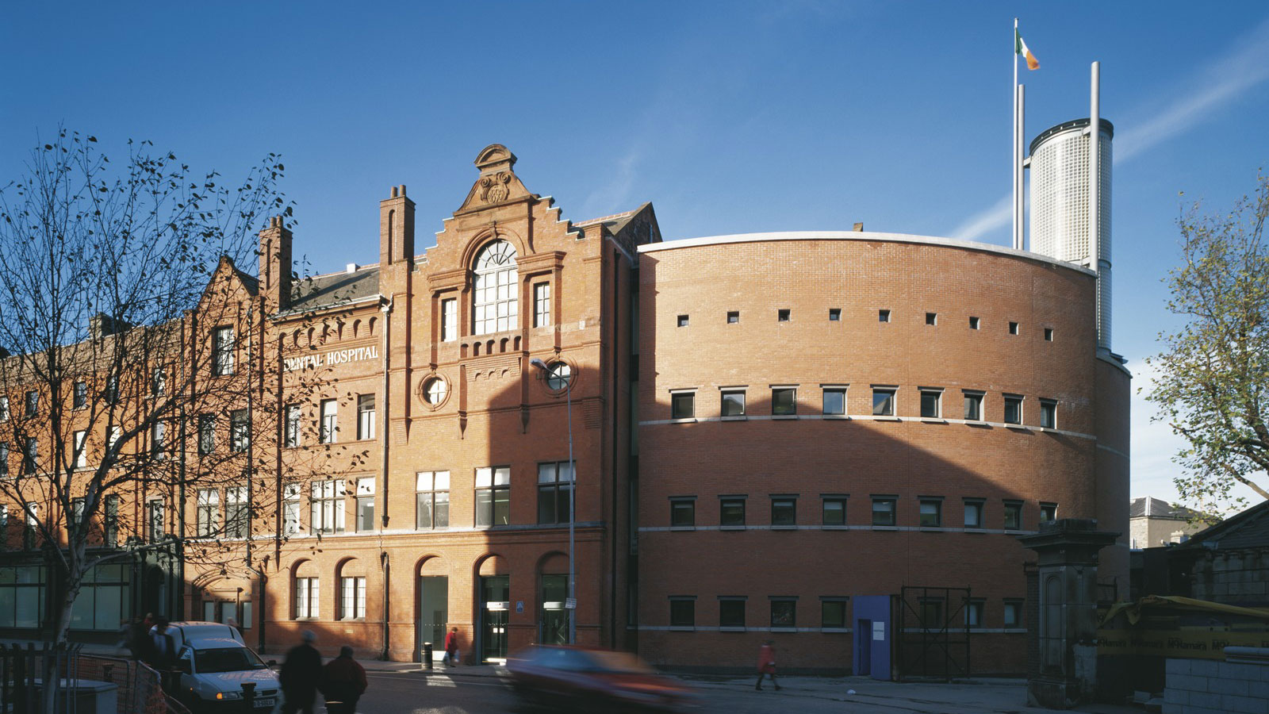
Dublin Dental University Hospital

Slide 4
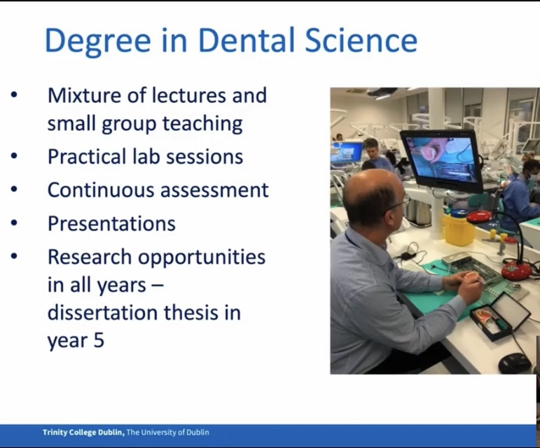

Slide 5
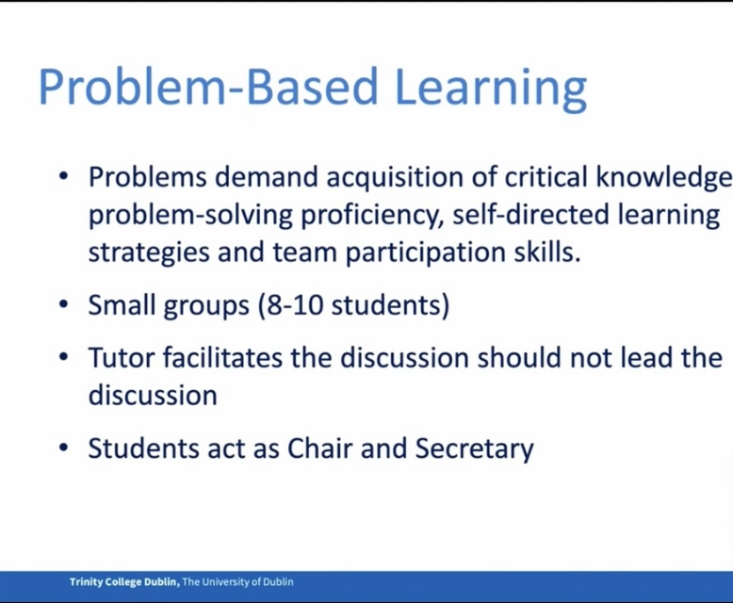

Slide 6
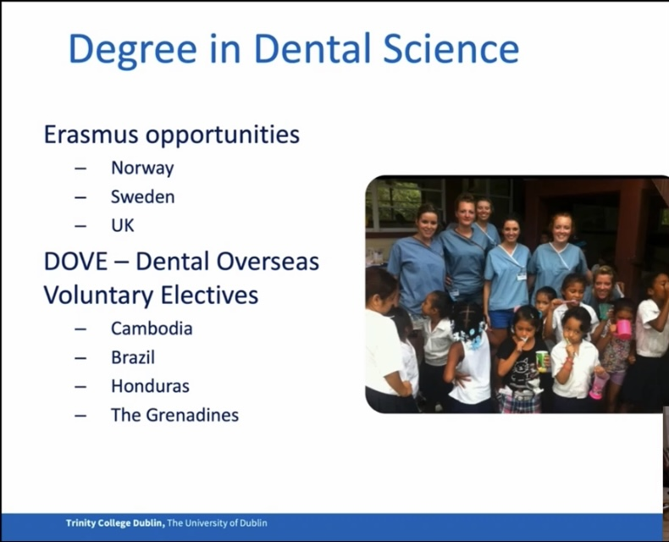

Slide 7
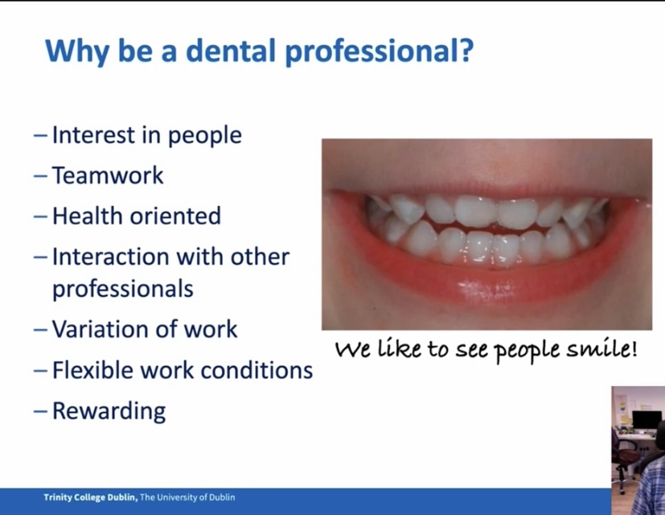

Slide 8
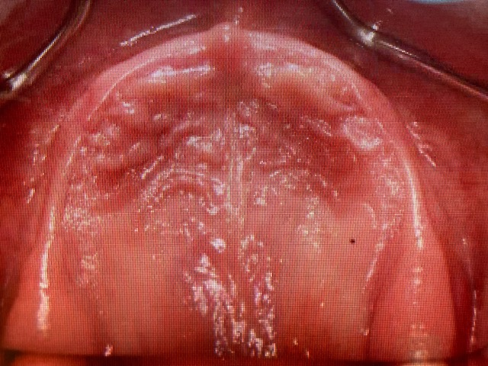
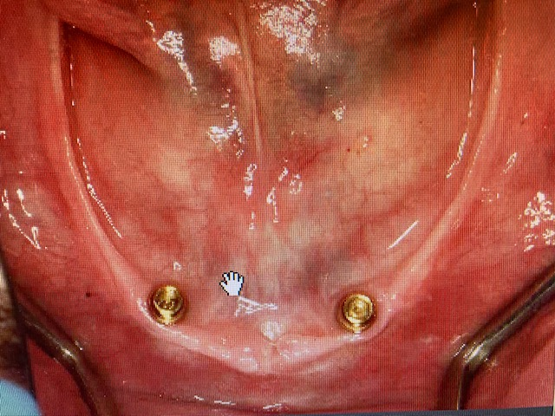
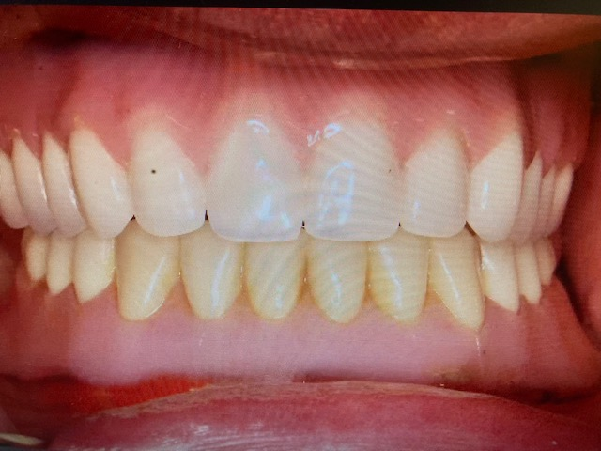
Prosthodontist

Slide 9
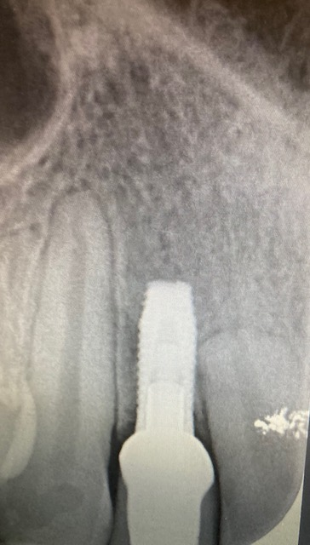
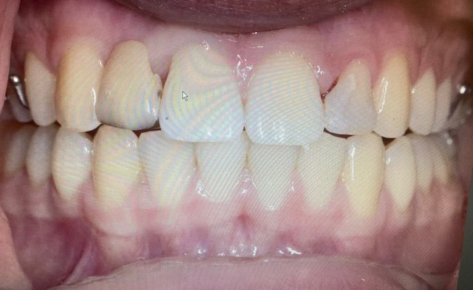
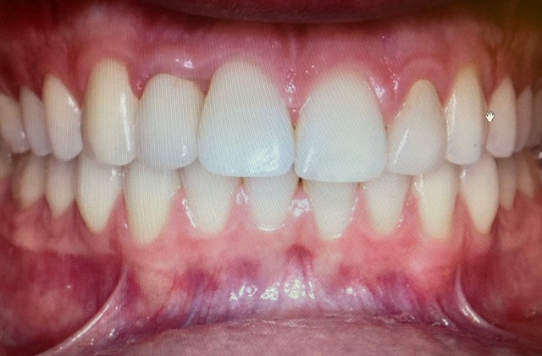
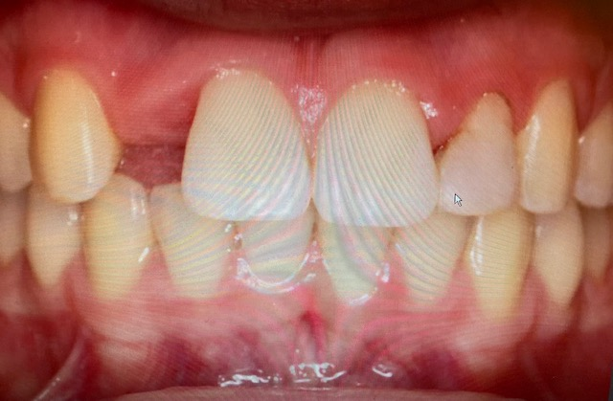
Clinical cases

Slide 10
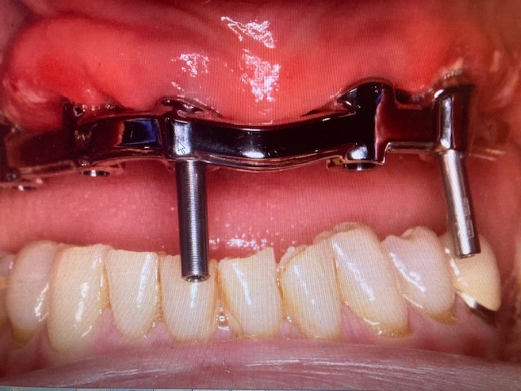
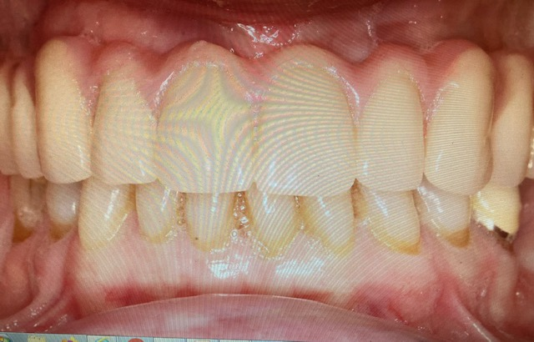
Clinical case implant supported maxillary complete prosthesis

Slide 11
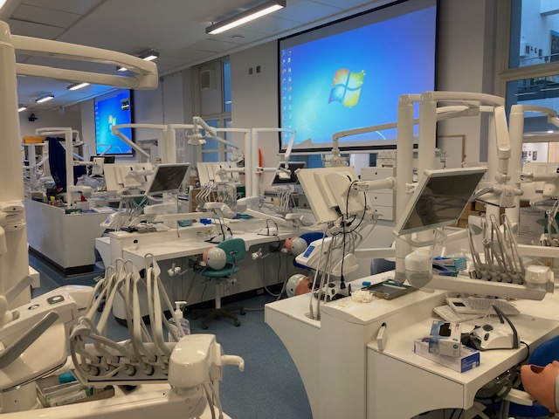
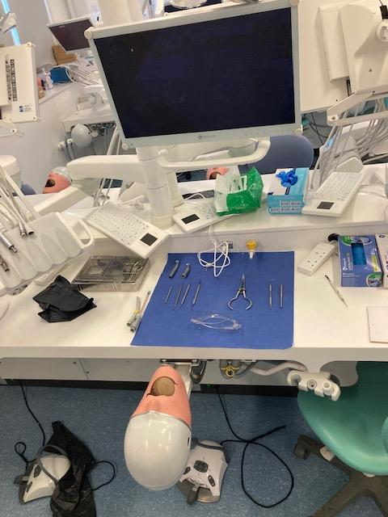
Dental clinical skills laboratory.

Slide 12
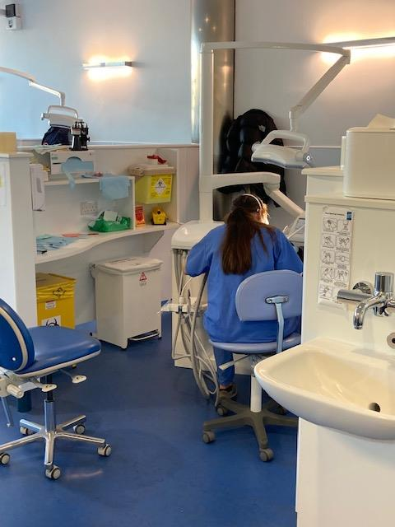
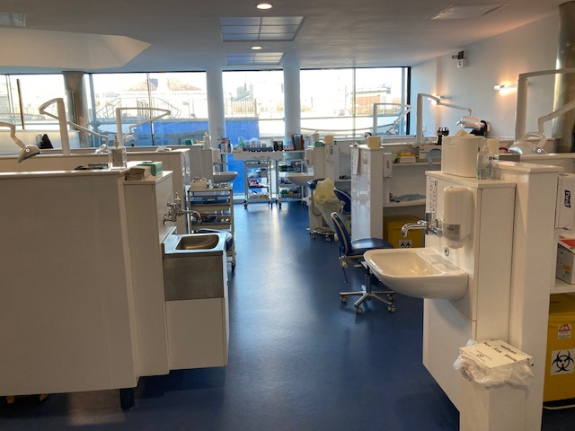
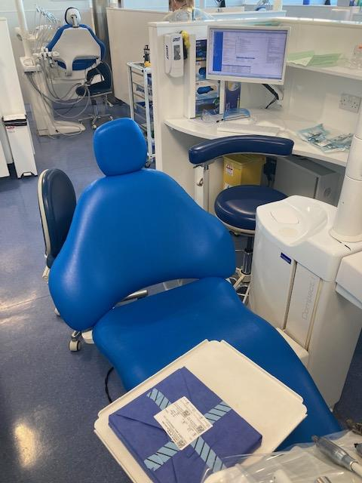
Dental clinical learning environment.

Slide 13

Feedback

Slide 14
Central role of feedback in learning
Important life skill esp in healthcare professional education
Information or comments received on performance (Ajjawi et al 2019)
Expect FB receivers to use comments and change their actions as a result
FB central to communication skills
Robust to FB. Improvement in self evaluation, improved communication in teams and improved patient outcomes.

Slide 15
Challenges around feedback
Due to avoid upsetting students with honest and critical feedback- lead to vanishing FB where meaningful feedback is avoided.
Lack of direct observation of task
Inadequate time set aside for FB
Busy clinical environment where the patient quality care and education occur concurrently
Inappropriate tone in message delivery
Limited external FB leading to generation of incorrect self assessment.
High performers understate performance
Low performers overstate performance.

Slide 16

Challenges to effective feedback
Measuring the effectiveness of FB-lack of clarity about the purpose and meaning of FB (Price et al 2010)
Must be clear what it is trying to achieve otherwise success and evaluation cannot be measured
Input measures e.g. timing, quantity, frequency can only measure some of the conditions for effective FB
Temporal nature and multiple purposes of FB- measuring with simplistic approaches can only gauge effectiveness- only give a partial picture (Price et al 2010)
Depends on who is judging effectiveness of FB practices- learner is often in the best position to gauge the effectiveness of FB - may not recognise the benefit it provides
Notes:
Whilst FB is an essential tool in med Ed it is often difficult for both faculty and learners (Milan 2006).
Staff and students must have a clear purpose of what the FB process has otherwise evaluation will be compromised.
Student dissatisfaction with FB (Sumit et al 2004) and difficulties resourcing FB (Price et al 2010) means that effectiveness has become very important.
Debates on enhancing student access, retention, completion and satisfaction within a university context have thrown a focus on assessment FB in HE (Eckel and King 2004).
Measuring the time dedicated to FB can only indicate that FB processes are being facilitated and not the quality of the FB

Slide 17
Challenges to effective feedback
Measurement such as learner understanding of the learning process may be more appropriate to measuring effectiveness (Price et al 2012)
Educators should remind students about their central role in the feedback process and support them in confidence in meeting this role(Rudland et al 2013)
Relationship between the student and the educator- need to speak the language and do they understand the FB they are getting-ability to pitch the message being critical
Notes:
May not be in a position to act on it
Price et al 2012 stated that the pedagogic literacy or the assessment of literacy of the students is key to FB and FB practices.

Slide 18

Student Feedback Literacy- a sense making process
Student feedback literacy denotes the understandings, capacities and dispositions needed to make sense of information and use it to enhance work or learning strategies.
Carless and Boud. (2018) The development of student feedback literacy, enabling uptake of feedback. Assessment and Evaluation in Higher Education 43, 8,1315-1325.

Slide 19
Reconceptualisation of FB as a sense-making process
Recently argued process of using FB information more important than what and how info is delivered.
FB without further engagement is only viewed by them as non-essential info
Suttons suggestion of FB as sense making process- 4 features
-Appreciating FB
-Making judgements
-Managing Affect
-Taking actions

Slide 20
Video of feedback interaction
A psychologically safe space is created for the feedback conversation
Student’s self assessent on strengths and challenges is promoted
FB includes future-focused actions ,learners are guided to formulate action plans for improvement
Expected standards of performance area clarified by using specific criteria
Enter into a dialogue about the student’s learning
Emotional respsonses are acknowledged and addressed students motivation and self-esteem are encouraged

Slide 21
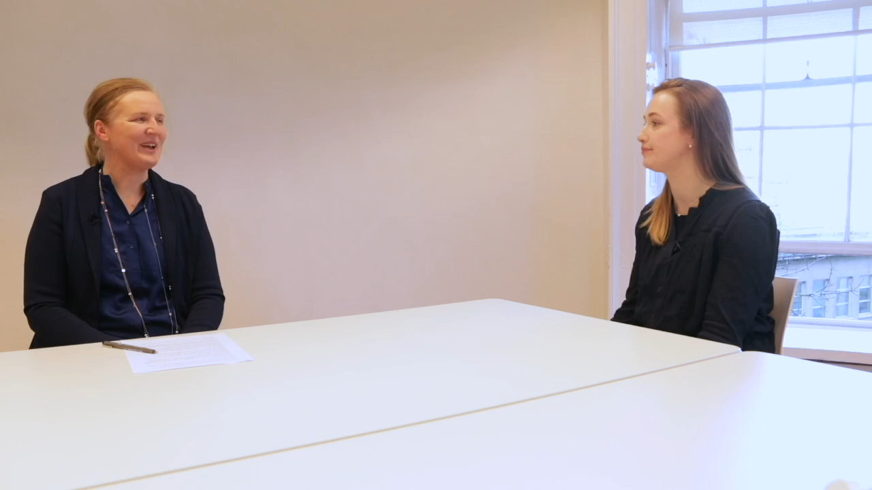
Video of FB interaction

Slide 22
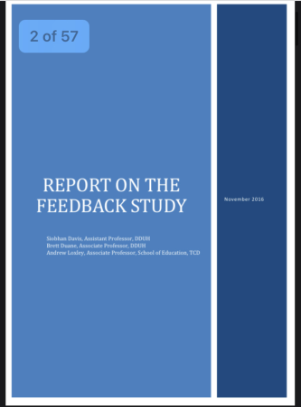
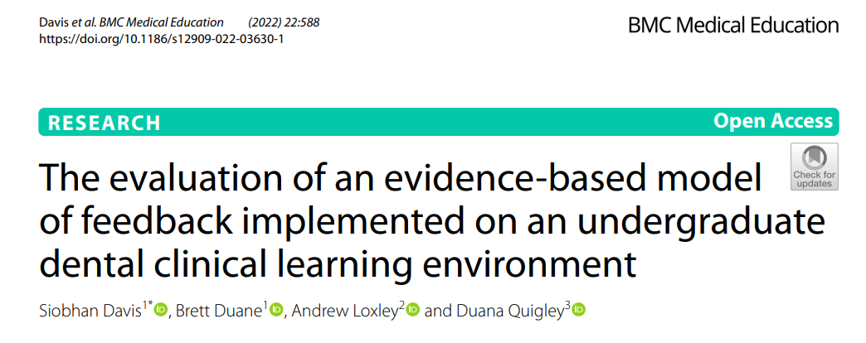
Background to current project-First phase
Change Project in Feedback - MOF was piloted on the clinical skills laboratory and subsequently implemented and evaluated on clinical sessions.
Notes:
The first phase was the based on the Dean of the dental schools desire to develop and improve on the feedback processes in the school. This resulted in a change project where a new model of feedback was developed and introduced on the Clinical skills Laboratory and then on the integrated patient care and advanced restorative sessions in the hospital. This collimated in a report in the feedback processes in the school and the publication of a paper in BMC Med Ed Date. Quan and Qualitiative data from this study showed some interesting themes and barriers around feedback in the CLE which were reflected elsewhere in the literature such as time for feedback, students afraid to approach supervisors for FB as they were afraid this would negatively impact on the grade assigned for the session and so on.

Slide 23
Model of Feedback Adapted from Nicol and MacFarlane-Dick 2006.
Learning outcomes are highlighted at the beginning of the clinical session verbally
Example of good work is shared with the student (e.g. refer to a textbook, lecture or online material) prior to the session
Feedback to the student incorporates a reflective component e.g. “How do you feel that went? What would you do differently next time?”
Clinical teacher determines if any issues arose for the student over the session based on expected performance/standards that could be improved on
5. Clinical teacher enters a dialogue with the student
Students are asked how they are progressing with their learning outcomes /goals, any areas of concern or need for clarification on subsequent sessions
Notes:
I’ve included the model of Feedback here which is very straighforward, evidence based and doesn’t take too much time to implement on sessions.
Interestingly dental students didn’t see the clincial sessions as having learning outomes at the outset of this study in the typical way that they might see a laboratory session or a lecture- maybe a link with not seeing the clinical environment as a learning opportunity persay,

Slide 24
Recommendations from the Report on Feedback
 | Recommendations from the study on feedback.
1 | Feedback is important to students, should continue to be provided and needs to be improved within DDUH.
2 | The DDUH should consider how it may alleviate the time pressures associated with giving appropriate feedback.
3 | In recognition of a reluctance to approach supervisors, the development of student literacy in the process should be addressed and prioritised.
4 | In addressing manageability of feedback practices, consideration should be given to involving student self-assessment in the senior clinical years, promoting their responsibility in recognising and achieving learning objectives in CLE.
5 | Consideration should be given to peer-to-peer discussion of cases led by CT. Consider mentoring and communication training for Clinical Teachers. Useful to discuss prior to session what the student hopes to take away from the session (i.e., individualised learning outcomes on clinical sessions)

Slide 25
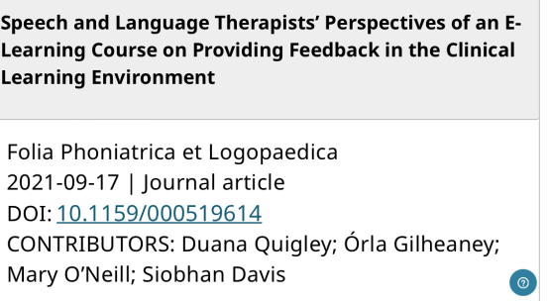
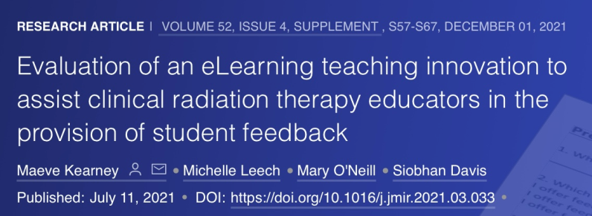
Second phase
Report on feedback DDUH
2. Development of an eLearning tool around feedback for clinical teachers at DDUH
Recipient of Dean of Health Faculty Award 2018, Trinity College Dublin.
Adapted and made available to Faculty of Health Sciences.
Physio + OT paper preparation stage
Medicine data collection
Notes:
Second phase of this project- In an effort to support the clinical teachers (which was one of the recommendations of the feedback report) and on the receipt of a Deans Award for Innovation 2018 the second phase of this project was the development of an elearning tool around feedback which was made available through Blackboard and contained evidence based knowledge on FB processes in the CLE and contained recorded AV clips of clinical teachers and their students in scenarios that might occur on the clinical sessions. This was piloted in the DDUH. Subsequently we made this available to the Faculty of Healthsciences- the AV scenarios were changed to suit the individual schools who participated and we evaluated the module and we have 2 papers from RT and SLT published and are at data collection stages in the school of physio and medicine.

Slide 26

Phase 3 Development of Student Literacy in FB in
Healthcare Curriculum.
Current focus is on the ability of the assessor to give feedback rather than on how the student receives and acts on it
Lack of feedback literacy may result in students being blamed for their inability to respond to feedback well
Poor uptake of feedback may be interpreted as the student becoming defensive and disengaged in the learning process (Quigley, 2021).
Enhancing student feedback literacy in clinical teaching creates a high-quality learning environment
Notes:
Which brings me to Phase 3 of this project which is the development of a unit of elearning to address student literacy in feedback in the CLE.
There have been numerous calls for healthcare students to be explicitly supported to increase their agency and active engagement with the feedback process, that is, to intentionally support their feedback literacy skills (Winstone et al., 2017). Much of the focus of current research on feedback is on the ability of the assessor to give feedback rather than on how the student receives and acts on it.
Lack of feedback literacy may result in students being blamed for their inability to respond to feedback well.
Poor uptake of feedback may be interpreted as the student becoming defensive and disengaged in the learning process (Quigley, 2021). May lead to a less than optimal learning environment for the student and assessor.
Enhancing student feedback literacy in clinical teaching creates a high-quality learning environment that supports students to become reflective practitioners who continuously develop, think and act independently.

Slide 27
Multidisciplinary team members and associated disciplines
School of Linguistics, Speech and Communication Sciences | Dr Duana Quigley, Practice Education Coordinator
School of Medicine | Ms Mary O’Neill
Discipline of Radiation Science | Ms Claire Poole, Assistant Professor, Head of Clinical Education Ms Maeve Kearney, Assistant Professor of Radiation Science
School of Physiotherapy | Ms Lucy Alpine, Practice Education Co-Ordinator
School of Social Sciences | Dr Erna O’ Connor, Assistant Professor in Social Sciences
School of Dental Science | Dr Siobhan Davis, Assistant Professor in Restorative Dentistry
Notes:
I’m very fortunate to be part of a great team and we have collaborated previously on other feedback innovations. This team is made up of representatives from the school of medicine, physiotherapy, radiation therapy, speech and language studies, social sciences. I have found that approaching FB and involving several academic disciplines in an approach to a topic like this extremely beneficial, dynamic and catalystic. (is this even a word??) Hopefully they feel the same way working with me!

Slide 28

Project Aim
To enhance student feedback literacy to support students to become reflective practitioners who continuously develop, think, and act independently
Notes:
Why and how do we know animation will work here- vs AV clips???Going to pilot and see how the animation is received.
Each animation has been designed to show evidence based FB practices and where opportunities are missed as these have been well received in previous versions.

Slide 29
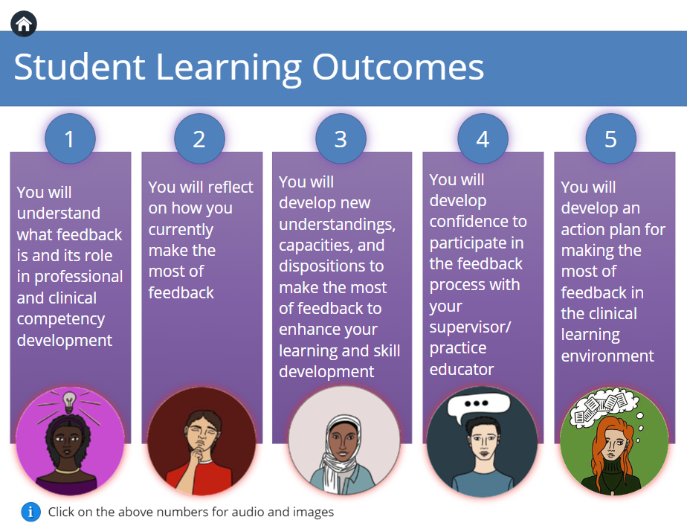
Project Objectives
Literature review, content development, online module, use of animation
Notes:
Project Objectives:
Review of the literature exploring evidence-based strategies in feedback literacy
Initiative content was developed, including: enhancing self-appraisal skills, increasing the ability to make judgements about performance, converting goals for improvement into an action plan, and managing emotions associated with receiving difficult feedback (Carless & Boud, 2018; Winstone et al., 2017).
Online module is asynchronous distributed location, independently completed and electronic-only.
Online education technologist supported the inclusion of multimodal content to include animation components to increase student engagement (Liu and Elms 2019)

Slide 30
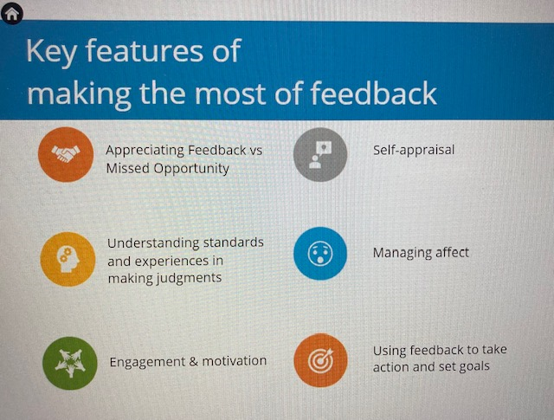
Context – What is the importance of this Initiative?
Investing in quality clinical teaching evidence based resources, students from all healthcare disciplines will be able to develop their feedback literacy and communication skills
Potential to improve and transform T&L within the CLE
Capacity to be adapted for use in non-healthcare courses across all disciplines to develop digital learning experiences
Notes:
Investing in the provision of quality clinical teaching evidence based resources, through an accessible digital platform, students from all healthcare disciplines will be able to develop their feedback literacy and communication skills.
Potential to improve and transform T&L within the clinical environment, enabling student success, enhancement of the student learning experience and quality delivery of patient care into the future.
Capacity to be adapted for use in non-healthcare courses across all disciplines to develop digital learning experiences.

Slide 31

Evaluation of Impact of Module
The initiative will have
(i) pre-course-checking prior knowledge and identifying learning needs
(ii) post-course-measuring students’ perceptions of content
(iii) three months after completion-determine long term benefits
Descriptive and inferential statistics analysing quantitative data and thematic analysis of qualitative data collected
Notes:
The initiative will have
(i) pre-course evaluation to check prior knowledge and identify learning needs
(ii) post-course evaluation to measure students’ perceptions of content (iii)evaluation three months after completion to determine long term benefits
Descriptive and inferential statistics will be completed to analyse the quantitative data collected and thematic analysis will be applied to qualitative data collected.

Slide 32
Piloting plan
Module content and animations developed July + August 2022
Ethics DDUH December 2022
Pilot module in DDUH Feb 2023 -target years 3rd and 4th years
Evaluation, review and revisions
Sept 2023 roll out across Health Faculty
Evaluate and publish findings
Notes:
Need to finalise times here for future.

Slide 33
Positive potential changes in enhancing student literacy in FB
Enhance student engagement in learning and maximise the learning opportunities for students
Promote high quality learning experiences and communication in CLE
Enhance professional and clinical competency and development of lifelong skills for reflective practice
Promote positive impact and improved health and wellbeing of healthcare students, but ultimately, the quality of patient care into the future

Slide 34
Conclusion
This transdisciplinary online module will support students’ development of feedback literacy skills is innovative, engaging and novel
Asynchronous online mode of delivery provides students with the tools to develop feedback literacy skills in a flexible manner (Wentling et al., 2000)
This flexibility has become increasingly relevant in the context of COVID-19 with the rapid move to blended approaches to teaching and learning (UNESCO, 2020)

Slide 35
Take home message-
Enhancing student feedback literacy in clinical teaching can create a high-quality learning environment
Students value your feedback in this high quality clinical learning environment
SDavis@dental.tcd.ie for correspondence

Slide 36
References:
Davis S, Duane B, Loxley A, Quigley D. The evaluation of an evidence-based model of feedback implemented on an undergraduate dental clinical learning environment. BMC Medical Education (2022) 22:588 https://doi.org/10.1186/s12909-022-03630-1
Quigley D, Gilheaney O, O’Neill M, Davis S. Speech and Language Therapists’ Perspectives of an E-Learning Course on Providing Feedback in the Clinical Learning Environment. Folia Phoniatrica et Logopaedica. 2022|DOI: 10.1159/000519614
Evaluation of an eLearning teaching innovation to assist clinical radiation therapy educators in the provision of student feedback. Journal of Medical Imaging and Radiation Sciences. (2021) 52, (4) DOI: 10.1016/j.jmir.2021.03.033
Quigley D. When I say … feedback literacy. Medical Education. 2021;55:1121–1122. DOI: 10.1111/medu.14541
Wentling, et al. (2000) E-Learning—A Review of Literature. Knowledge and Learning Systems Group NCSA 9.1-73
UNESCO 2020 https://en.unesco.org/covid19/communicationinformationresponse/digitalinnovation

Slide 37
Additional reading
Burgess A, Mellis C. Feedback and assessment of clinical placements: achieving the right balance. Adv Med Educ Pract 2015;6:373–381.
Boud D, Molloy E. Rethinking models of feedback for learning: the challenge of design. Assess Eval High Educ. 2013;38(6):698-712.
Carless D, Boud D. The development of student feedback literacy: enabling uptake of feedback. Assess Eval High Educ. 2018;43(8):1315-1325.
Nash R, Winstone N. Responsibility-sharing in the giving and receiving of assessment feedback. Front Psychol. 2017; 8:1–9
Sadler DR. Beyond feedback: developing student capability in complex appraisal. Assess Eval High Educ. 2010;35(5):535-50.

