Slide 1

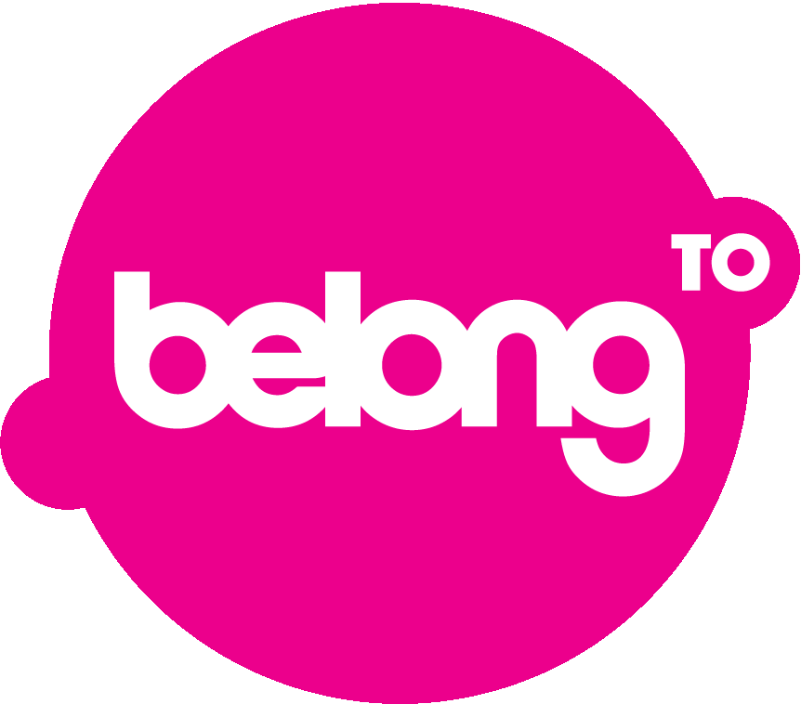


LGBTQIA+ Mental health: Minority Stress and Cognitive Dissonance
Dr. Jan de Vries, PhD, MA, MSc, BSc
School of Nursing and Midwifery, Trinity College Dublin, Ireland
19 September 2023: 14:00-16:00
TBSI rooms B2.72, B2.73 and B2.74
Trinity College Dublin &
University College London
EDI (Equality Diversity and Inclusivity) Seminar 1: LGBTQI+ Global Health

Slide 2
Content
LGBTQIA+ diversity and mental health
Perspective I: A social evolutionary perspective on divergence
Perspective II: Minority Stress (external stressors)
Perspective III: Cognitive Dissonance (internal stressors)
LGBTIreland study: mental health and distress
Questions for Discussion

Slide 3
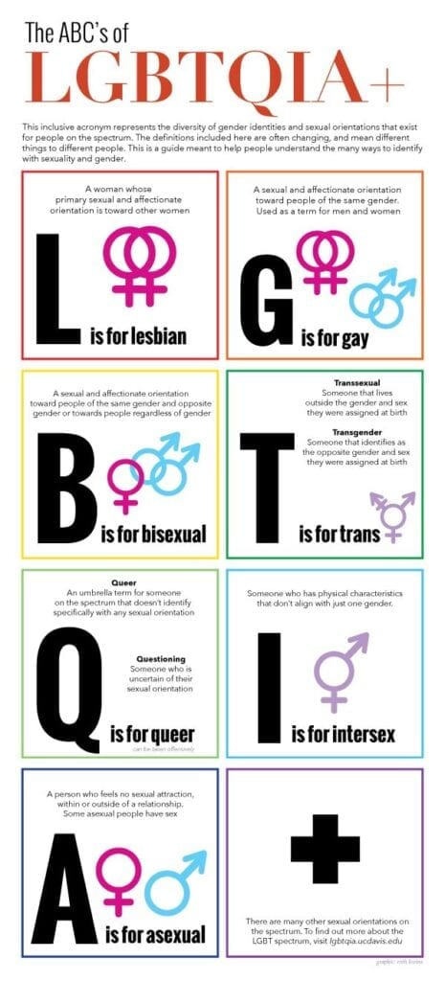
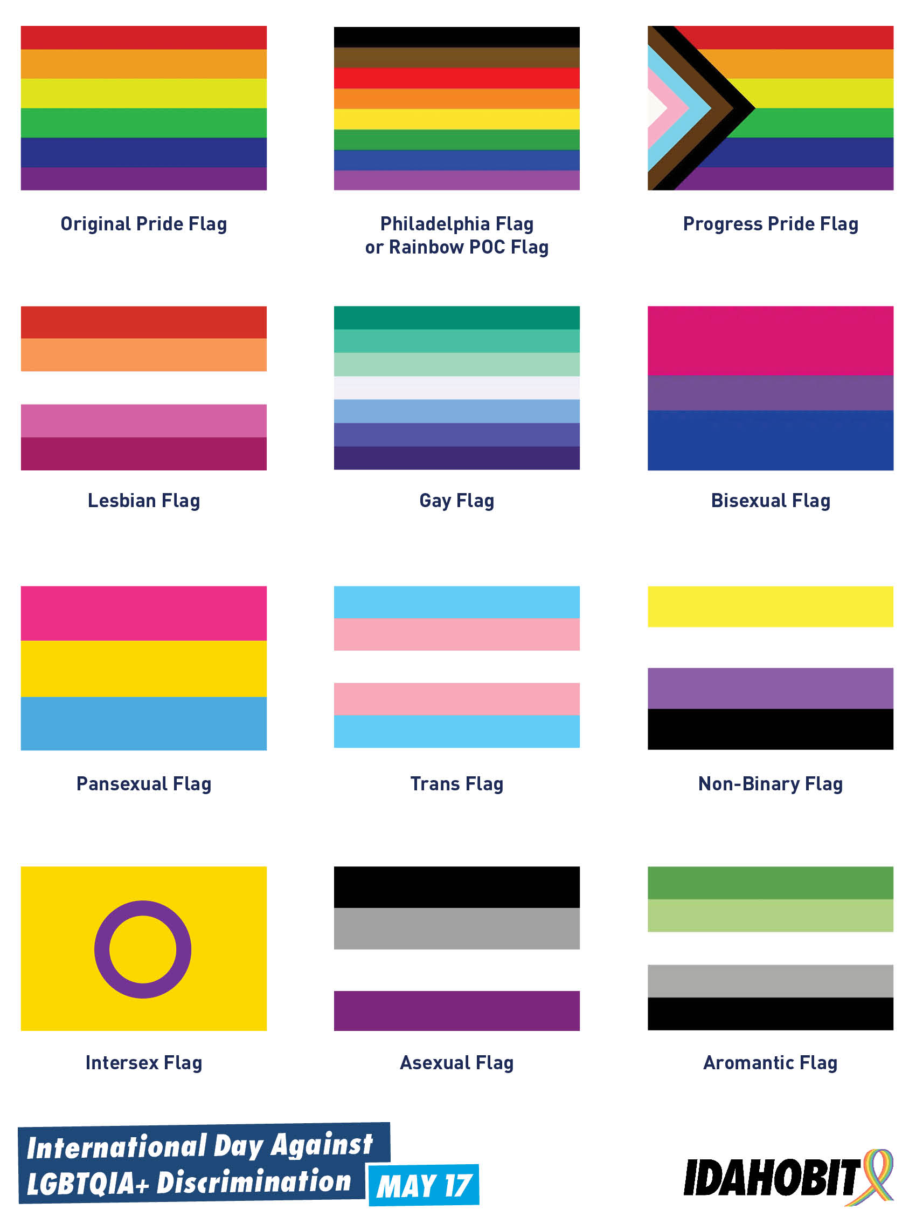

Slide 4
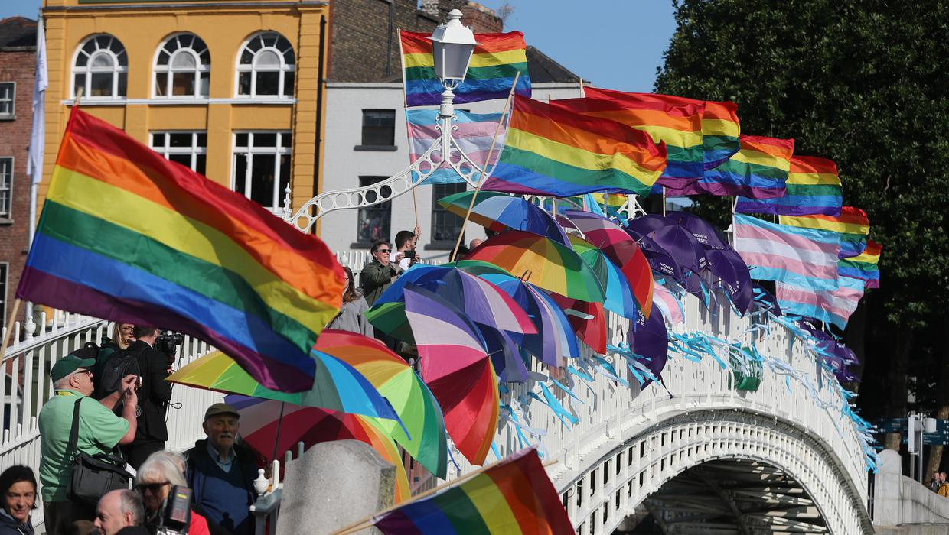
Perspective I: a Social
Evolutionary Perspective on Divergence
Being ‘visibly’ different sets us apart in a homogeneous community?
Being ‘importantly’ different may set us more apart.
Being different can be adaptive and maladaptive?
What if those who are different form a minority community within the community?
Expect ambivalence towards divergence from the mainstream population, because this is in our genes.

Slide 5
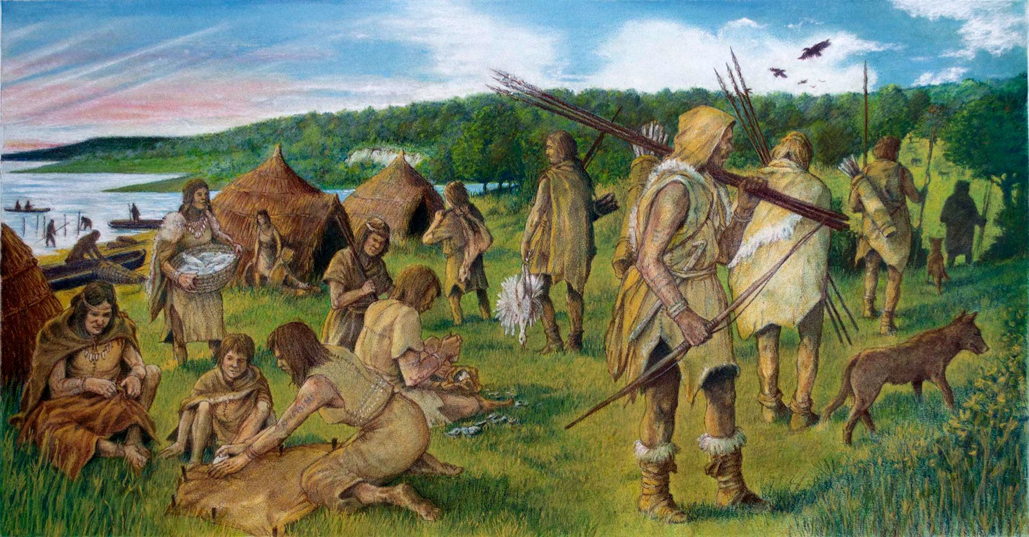
To explain this, we need to go back in time to when humans lived as hunter-gatherers in small tribes ……..
Since this is the longest period in human history, this shaped
the genetic basis of social behaviours, thinking and emotions

Slide 6


Tendencies or adaptations that helped us live together effectively at that time still affect our social life now ……

Slide 7
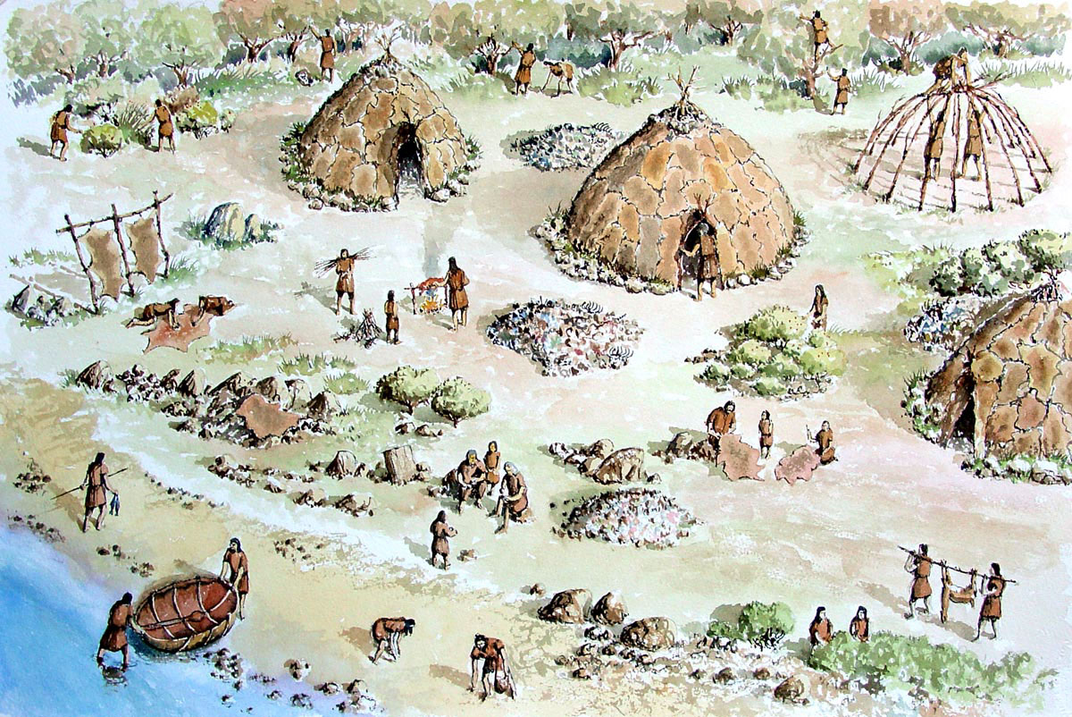
this includes tendencies to:
  reciprocate, collaborate
  conform, comply
  be altruistic towards our kin
but also
  be competitive, aggressive
  prejudiced, biased
  fearful of strangers
  suspicious of who is different
IN-GROUP
OUT-GROUP

Slide 8
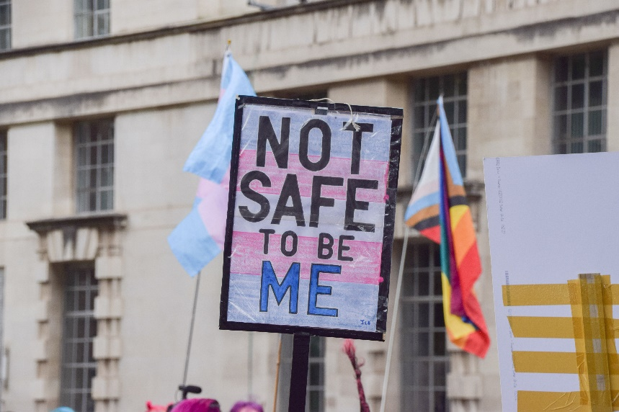
Perspective II: Minority Stress (external stressors)
Meyer’s model (2003,2007, 2013, 2015) argues that minorities experience more stress:
experiences of prejudice
discrimination, stereotyping
violence, harassment
rejection
heightened vigilance
expectations of the above
Each of these may lead to frequent and high activation of the autonomic nervous system, which is the essence of the ‘stress response’ (Selye, 1956)

Slide 9
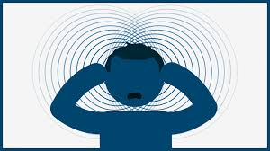
Perspective III:
Cognitive Dissonance (internal stressors)
  Divergent sexual orientation or gender identity may generate inner conflict or dissonance
  Cognitive Dissonance is an ‘unpleasant state of tension that occurs whenever an individual simultaneously holds two cognitions that are psychologically inconsistent’ (Festinger (1957).
  Aronson (1969) emphasised that ‘self-related’ dissonance may lead to the strongest tension or discomfort
  This discomfort motivates efforts to reduce it
  Prolonged dissonance is a form of mental distress.
  Happiness = effective management of dissonance

Slide 10
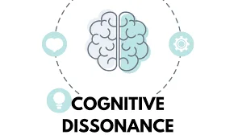
Examples of LGBTQIA+ related dissonance
I think I am Gay/Lesbian
My church is against LGBTQIA+
I look like a man
I feel like I am a woman
I want to come out
My friends don’t like LGBTQIA+ people
  Reduction through change in behaviour, change cognitions, ideally self-acceptance, but there is also denial, seeking distraction, trivialisation ……

Slide 11
External Factors
Internal Factors
Liberal political, social and religious climate
Social support
LGBTQI+ specific support
Partner relationship
Positive home/work/ school/local impact
High self-esteem
Resilience
Self-acceptance
Self-compassion
Adaptive coping
Outcome variables:
Happiness
Life-satisfaction
Quality of life
Wellness
Wellbeing
Mental health
Mental distress
Mental illness
Suicide / Self-harm
LGBTQI+
Minority
Stress & Dissonance
+
+
Coming out
Self-disclosure or concealment
Gender non-conformity
Discrimination
Violence/victimisation
Prejudice/stereotyping
Heteronormative bias
Cisnormative bias
Social isolation
Negative home/work/ school/local impact
Internalised homo/bi/ trans negativity/phobia
gender identity / sexual orientation discomfort
Rumination
Maladaptive coping
High vigilance
Substance misuse
-
-

Slide 12
Study Overview
LGBTIreland
Module 1:
Survey of LGBTI people
N=2,264
Module 2:
Survey of General Public
N=1,008
Aim: identify mental health and distress in LGBTI community
Aim: assess attitudes towards LGBT people in a representative sample
Notes:
Intersex excluded: The general public’s knowledge and understanding of intersex people was perceived to be too limited to ensure reliable responses. Based on the recommendation of the Steering Group public attitudes towards intersex people not explored.

Slide 13
The
LGBTIreland study: an exploration of mental health and distress
Largest study of its kind in Ireland (n=2,264)
  Lesbian (572)
  Gay (865)
  Bisexual (320)
  Transgender (279)
  Intersex (39)
Initial report (Higgins et al. 2016) + several peer reviewed publications.
Follow-up ‘Being LGBTQI+ in Ireland’ is underway.
Funding: Irish Health Service Executive (HSE) National Office for Suicide Prevention (NOSP); commissioned by GLEN (Gay and Lesbian Equality Network) and BeLonG To Youth Services.

Slide 14
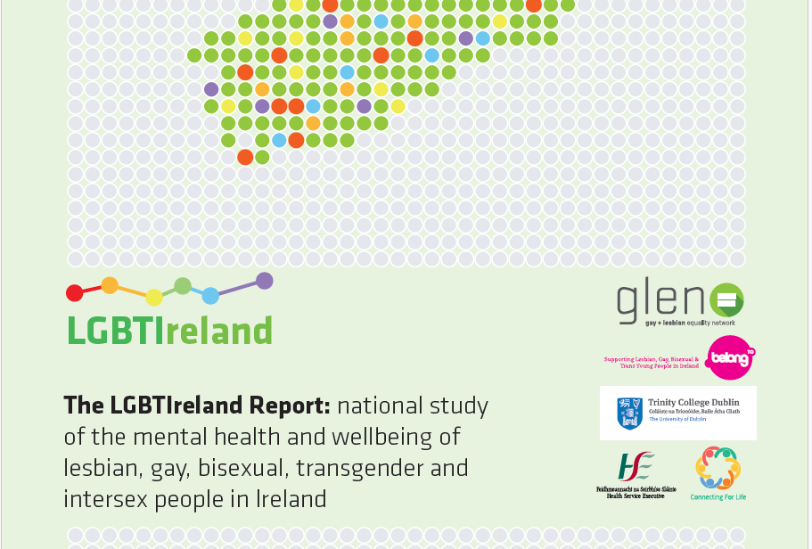
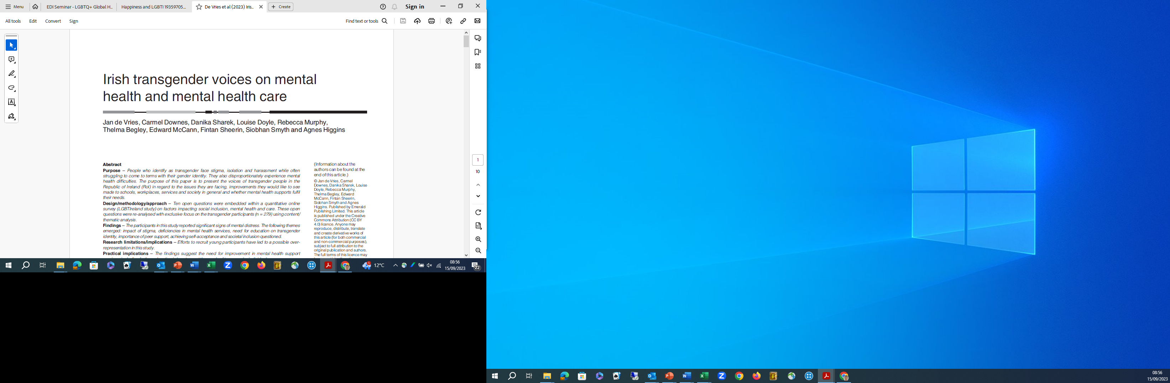
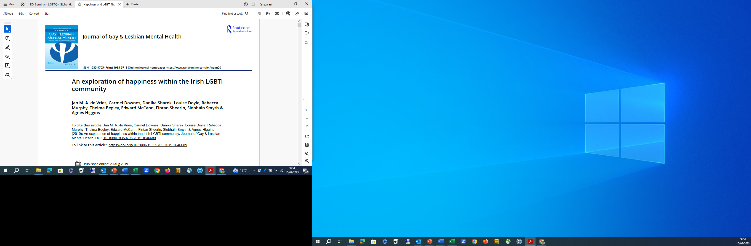


Slide 15
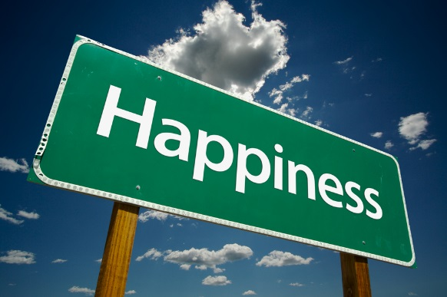
Two questions on Happiness as a mental health indicator included in survey:
Quantitative
Happiness rating
0 …1… 2 … 3 … 4 … 5 … 6 … 7 … 8 … 9 … 10
(extremely unhappy) (extremely happy)
Qualitative
What about being LGBTI makes you happy or proud?

Slide 16
Overall outcome
general population in Ireland:
mean = 7.54
based on several studies (1974–2014)
This is around the EU average (Veenhoven, 2019).
Happiness rating
0 …1… 2 … 3 … 4 … 5 … 6 … 7 … 8 … 9 … 10
(extremely unhappy) (extremely happy)
mean: 6.58
SD: 2.26
mode: 7
n = 2134

Slide 17
Happiness per LGBTI group

Slide 18
Happiness per age group

Slide 19
Happiness correlations with mental distress indicators
(n=2134) | Life-satisfaction | Rosenberg Self-esteem | Depression scale in DASS 21 | Anxiety scale in DASS 21 | Stress scale DASS 21 | CSI – avoidant coping | CSI –planned coping | CSI – support focused coping | AUDIT alcohol use | Eating Attitudes test SUM 9 items
Happiness | .877 (.000) | .703 (.000) | -.696 (.000) | -.517 (.000) | -.533 (.000) | -.519 (.000) | .342 (.000) | .314 (.000) | -.092 (.000) | -.302 (.000)

Slide 20
Which factors provide the strongest predictor of happiness in LGBTIreland study?
  Multiple regression procedure (Enter mode; all quantitative and demographic variables entered; dependent: Happiness score
  The overall model succeeded in explaining almost 60% of the variance in happiness (R² = .59, F(16, 1205) = 108.68, p < .000***)
    self-esteem as measured with the Rosenberg scale (b = .14, t(1205) = 14.93, p < .000***) was the main predictor (51% of variance predicted)
    DASS-21 depression scale was a significant predictor (b = -.15, t(1205) = -10.76, p < .000***) (added 7% of variance predicted).
    age (b = -.14, t(1205) = -3.51, p < .000***) and comfort with sexual orientation (b = .22, t(1205) = 2.41, p < .016*) (added further 2%)

Slide 21
Themes and subthemes identified in ‘What about being LGBTI makes you happy or proud?’ (n=1,308)
Social aspects (n=761) | Personal aspects (n=675) | LGBTI activism (n=346) | Questioning the question (n=185)
Inclusion in LGBTI community and support received (n=293) Partner (n=119) Identity accepted by others (n=95) Friends (n=81) Love (n=40) Coming out (n=35) Family (n=35) Being out (n=34) Helping others (n=29) | Identity accepted by oneself (n=348) Own growth and development (n=169) Glad to be different (n=97) Freedom (n=61) | Involvement in LGBTI rights movement (n=219) Fighting spirit (n=69) Progress in LGBTI cause (n=58) | LGBTI identity considered irrelevant (n=150) Unhappiness/ambiguous feelings (n=35)

Slide 22
Social aspects: Inclusion in LGBTI community (n=293)
The role of the LGBTI community figured prominently, with happiness and pride being derived from a sense of inclusion, belonging, and support derived from engagement with the LGBTI community.
  Having such a supportive and accepting community makes me very happy. Upon entering, I was amazed at the ease at which I was accepted, whereas in school I was often shunned. I'm proud to be a part of such a non-judgmental community (pp 1267).
  I am engaged with the LGBT community and proud to be. I am proud of the community and proud to be part of it. I think I am lucky to have a readymade community. I am happy, proud and comfortable being gay but I am acutely aware that I live in an urban bubble and surround myself with people where I am less likely to feel discriminated or made to feel 'less than' (pp 608).
  I have a tribe. A big extended family (pp 1123).

Slide 23
Personal aspects: Identity accepted by oneself (n=348)
The most common theme mentioned was having accepted or being proud of one’s own identity as LGBTI. This does not hinge on acceptance by others.
  I'm only 18 years old, so it's nice to know that I have at least one thing that I fully know about myself. I'm happy about it because I have no shame or negative feelings toward myself because of it. None of my problems are related to being LGBTI, they're just problems, which makes my being LGBTI "normal". It's not a source of stress. I'm proud that it took me zero effort to accept this part of me, just took a while to figure out exactly what was going on (pp. 8).
  to feel happy with who I am and being able to accept myself (pp 187).
  I am unique. My own person and I refuse to let anyone change me. I cannot wait until I can make it to a city and go to university and finally be myself to everyone (pp 309).
  I have found my true self. I feel I am on the right path in life for me (pp 670).

Slide 24
The Transgender Journey
Although my physical transition isn't complete yet and I am not sure whether I will ever get it as it doesn't seem to be that successful...I generally feel good about myself. I have become happier, the more I accept and value myself. I feel unique and special and yet part of a broad spectrum of exceptional individuals. Without the LGBTI community, support and the friend I've made, I wouldn't have made it this far. It has taken a long time but, within the next few days, I should be getting a new passport with my preferred name + gender...and I'm still young...The world is ahead (pp 1633).

Slide 25
A long journey
I survived my own demons about being gay, I survived the demons that were so prevalent when I was growing up in Dublin in the 80's and the 90's when I first went to gay places, I survive today as I surround myself with people who see me for the person I am, in all my LGBTI-ness and all my me-ness, and I survive today by talking & objecting & educating the people I share this country with about the need, right and expectation that being LGBTI is just another way, an equal way and a wonderfully different way. I'm proud of the life I have lived so far, with all the bumps, the lows and the highs. I'm proud that I feel hopeful too, hopeful for everyone - that we will learn to live together (pp 1804)!

Slide 26
Summary
Three perspectives can each provide a lens to examine mental health pressures in the LGBTQIA+ communities:
- Perspective I: A social evolutionary perspective
- Perspective II: A minority stress perspective (external)
- Perspective III: A cognitive dissonance perspective (internal)
The LGBTIreland study has demonstrated that mental distress in the LGBTQIA+ communities is higher than in the general population and that happiness is lower.
Much is done to improve matters, but what more can be done?

Slide 27
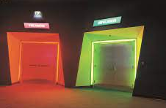
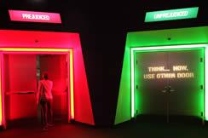

The Museum of Tolerance
Los Angeles, California
Which door would you use?
Question: Should we have high hopes that negative bias against LGBTQIA+ communities can be reduced through education?

Slide 28

Acknowledgements
thanks to participants, collaborators and funders of the LGBTIreland study
thanks to the organisers of the EDI seminar for inviting me:
Dr. Meg Ryan at the Trinity Centre for Global Health (TCGH)
Dr. Stephen Roberts at UCL Institute for Global Health (IGH), University College London
and Dr. Donal Wallace at the Institute of Population Health in TCD for co-presenting at this event
Feel free to email me at jan.devries@tcd.ie

Slide 29
Selected references
de Vries, J., Downes, C., Sharek, D., Doyle, L., Murphy, R., Begley, T., McCann, E., Sheerin, F., Smyth, S. & Higgins, A. (2020). An exploration of happiness within the Irish LGBTI community. Journal of Gay & Lesbian Mental Health, 24(1), 40-76.
de Vries, J., Downes, C., Sharek, D., Doyle, L., Murphy, R., Begley, T., McCann, E., Sheerin, F., Smyth, S. & Higgins, A. (2022). Mental distress in transgender people in Ireland: minority stress and dissonance. International Journal of Transgender health (under review 2022).
Festinger, L. (1957). A theory of cognitive dissonance. Stanford CA: Stanford University Press.
Higgins, A., Doyle, L., Downes, C., Murphy, R., Sharek, D., de Vries, J., Begley, T., McCann, E., Sheerin, F. & Smyth, S., (2016). LGBT Ireland Report: national study of the mental health and wellbeing of lesbian, gay, bisexual, transgender and intersex people in Ireland. Dublin: Gay and Lesbian Equality Network and Belong To Youth Services.
Higgins, A., Downes, C., Murphy, R., Sharek, D., Begley, T., McCann, E., Sheerin, F., Smyth, S., de Vries, J. & Doyle, L. (2021). LGBT+ young people’s perceptions of barriers to accessing mental health services in Ireland. Journal of nursing management, 29 (1), 58–67.
Meyer, I. H. (2007). Prejudice and discrimination as social stressors. In I. H. Meyer & M. E. Northridge (Eds.), The health of sexual minorities: Public health perspectives on lesbian, gay, bisexual, and transgender populations (pp. 242–267). Springer Science + Business Media. https://doi.org/10.1007/978-0-387-31334-4_10
Meyer, I. H. (1995). Minority stress and mental health in gay men. Journal of Health and Social Behavior, 36, 38– 56.

