Slide 1


Stress and Stress Management Session 1:
What is stress and how do we manage it?
1 Feb 2024
Dr. Jan M.A. de Vries

Slide 2
Overall Learning Outcomes
This morning
You will learn to understand the physiological foundation, and health and performance risks of excessive stress
You will learn about stress-provoking life events, and your own thinking and behaviour
You will learn how stress can be managed.
You will learn to understand and discuss the foundation of post-traumatic stress and trauma interventions
Afternoon

Slide 3
1) What is stress?
  Stress is something we experience when we must adjust or adapt
  Stress is normal
  Stress is a fact of life
  Stress may motivate amazing achievements
  Stress may sometimes hamper our performance
  Eustress (positive) <> Distress (negative)
Stressors or pressure may come from our surroundings or from within. It motivates us to be active. Without it not much gets done!

Slide 4
2) What is a stress reaction?
A stress reaction is essentially a physiological reaction that allows the body to respond and adapt to the stressors and pressure present
Our environment always challenges us …….
Our environment may not always meet our needs ……..
  It is good that we have the ability to switch into a ‘higher gear’

Slide 5
How do we move into a higher gear
…………………..?
Our nervous system does that for us
……. whether we like it or not!!
……. whether it is appropriate or not!!
(Examples: near miss in traffic, being attacked,
difficult exam, public speaking, mean boss,
general pressure to perform, etc. ………)

Slide 6
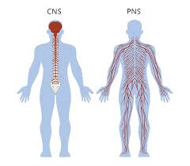
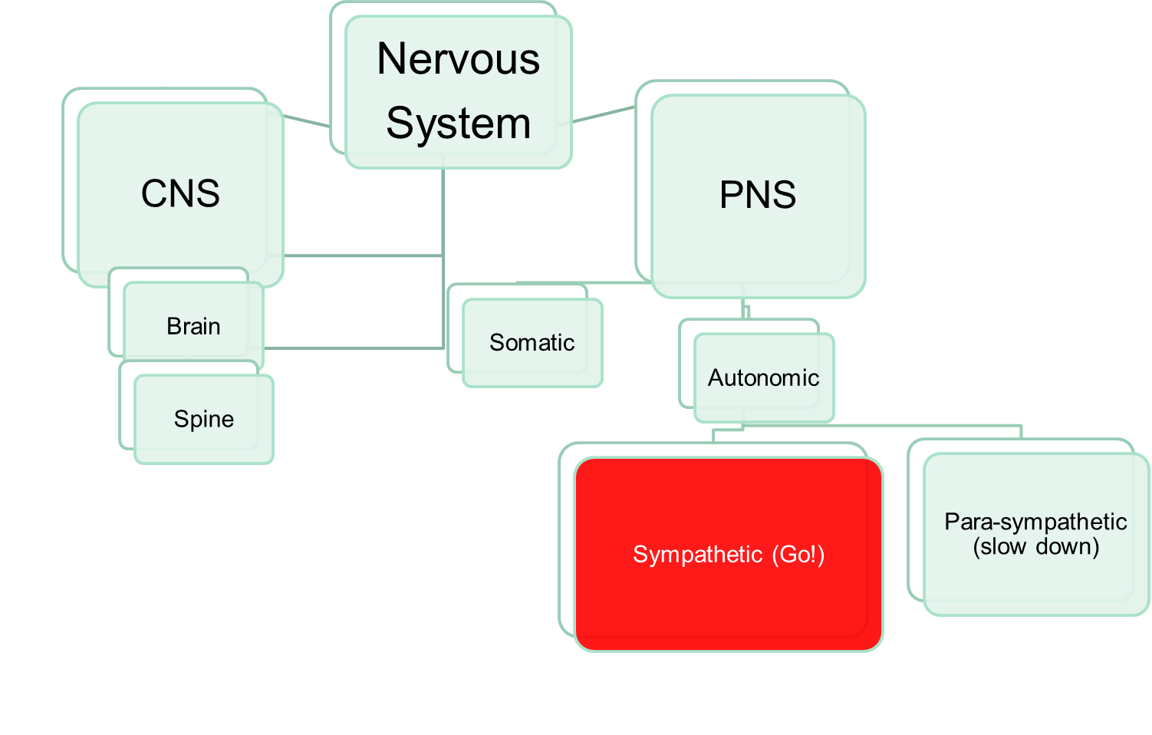

Slide 7
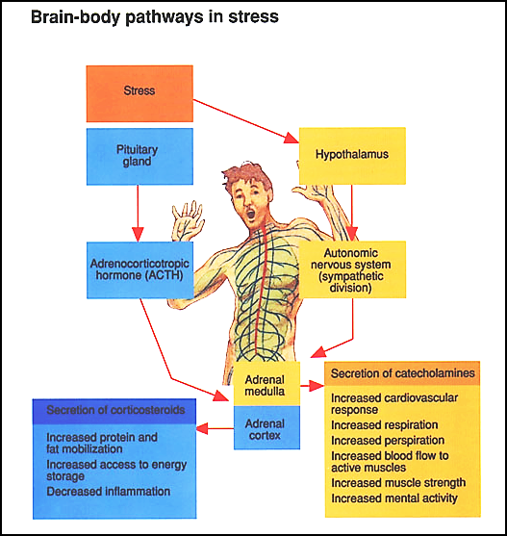
the HPA axis
Fight or flight (Cannon, 1922):
> prepares for reaction
Provides fuel, neural connectivity for sympathetic response + protective response

Slide 8
Model 1: General Adaptation Syndrome (GAS) (Selye, 1956)
This model captures a continuum of bodily reactions to pressure in three stages:
  Alarm Reaction: Sympathetic nervous system is activated to enable vigorous response to pressure (fight-flight)
  Stage of Resistance: Body adjusts to stress but resistance is lowered (long term response)
  Stage of Exhaustion: Body’s resources are drained and stress hormones are depleted. Results might be:
    impaired physical and mental health
    loss of motivation and interest
    Burnout (Maslach et al, 1996)

Slide 9
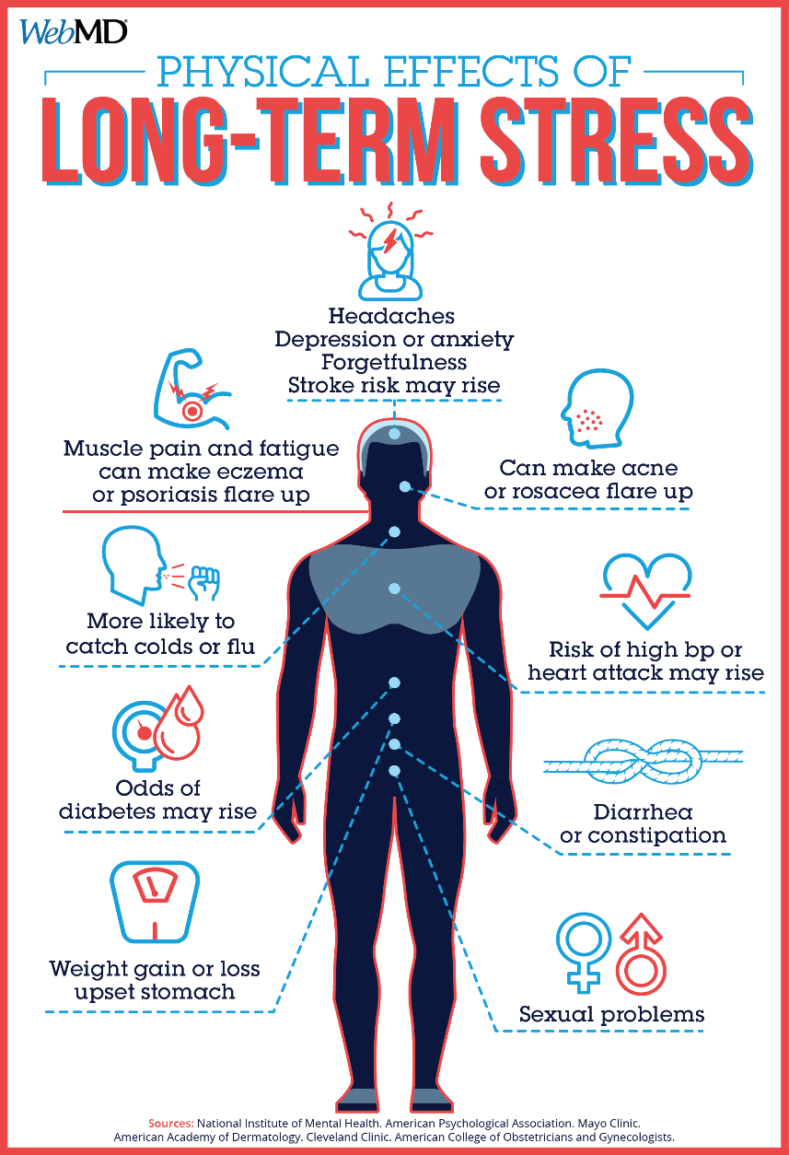
3) Prolonged excessive stress is a health risk

Slide 10
Most common health impact
Cardiovascular system
Digestive system
Immune system
Sleep

Slide 11
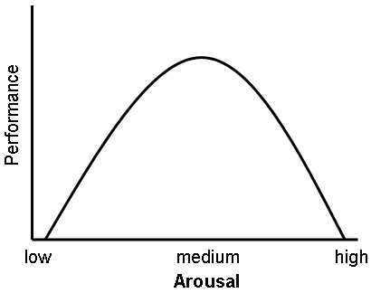
4) Excessive arousal is a performance risk
Moderate complexity
Complex task
Simple task
Yerkes-Dodson
(1908)

Slide 12
How being over-aroused can affect us
Road Rage
Penalty Misses in Football
https://www.youtube.com/watch?v=gsD4ad5puJ0
https://www.youtube.com/watch?v=-KqAQJMjQns

Slide 13
Stress as a performance: accidents
If Sympathetic Nervous system is continuously too highly activated we are more at risk of making mistakes causing accidents
Anger > conflict > excessive stress response > loss of control > accidents
Time pressure > hurried behaviour > less control > accidents
Stress > mental shortcuts > wrong decisions > accidents
Stress to meet deadlines > cutting corners > design flaws > structural dangers > accidents
….. Consider your own possible chain of events …….

Slide 14
5) Stress provoking life events
Change
Encountering something new
Obstacles to reaching desired goals
Conflict
Being evaluated
Unpredictable events
Lack of control
Continuous threats
Anxiety: Feelings of tension, uneasiness, apprehension, worry and vulnerability.
  We are motivated to avoid experiencing anxiety
  Anxiety can be the result of hyper-vigilance

Slide 15
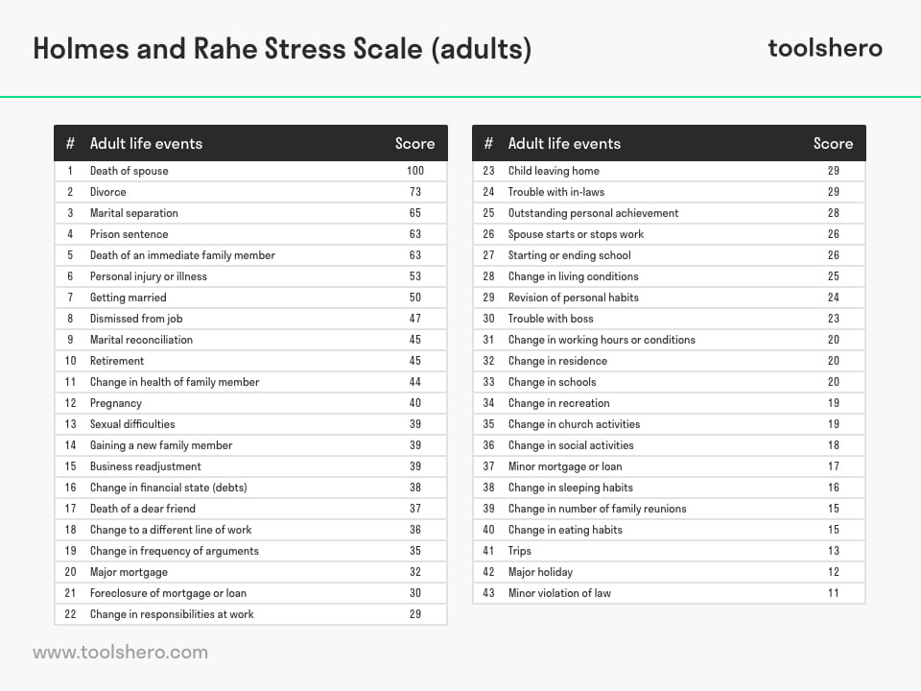
0-150: normal; 150-300: 50% chance of breakdown; + 300: 80% chance of breakdown

Slide 16
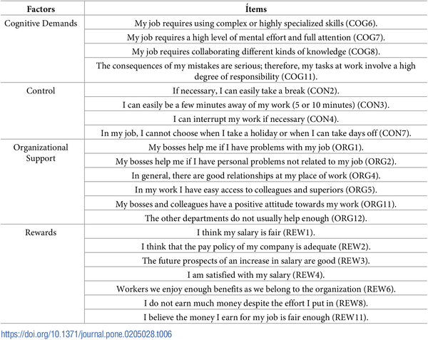

Table 6. Items of the DECORE-21 questionnaire.
Talavera-Velasco B, Luceño-Moreno L, Martín García J, Vázquez-Estévez D (2018) DECORE-21: Assessment of occupational stress in police. Confirmatory factor analysis of the original model. PLOS ONE 13(10): e0205028. https://doi.org/10.1371/journal.pone.0205028
https://journals.plos.org/plosone/article?id=10.1371/journal.pone.0205028

Slide 18
6) Stress provoking thinking and behaviour
Inner conflict
Anger
Frustration
Worry and rumination
Pessimistic thinking
Irrational expectations
The stress response can become habitual in tandem with automatic negative thought and emotional processes

Slide 19
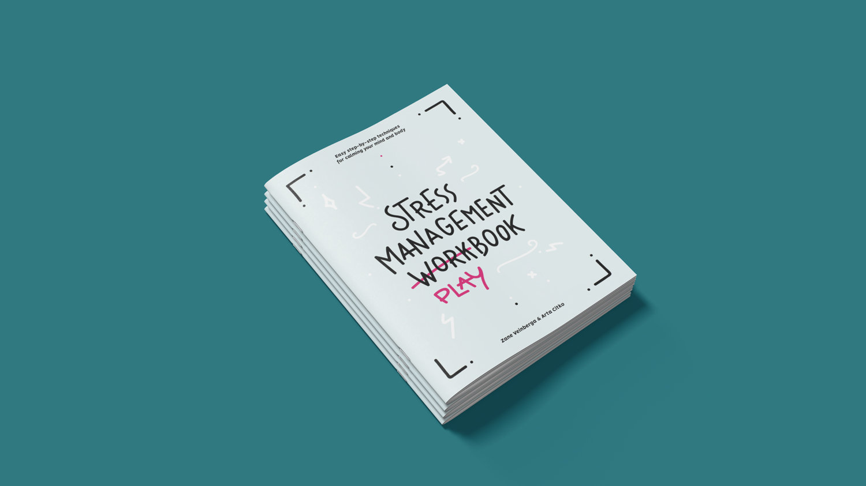
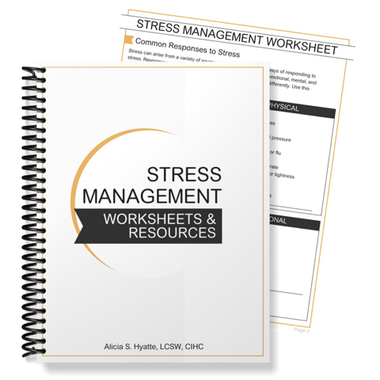
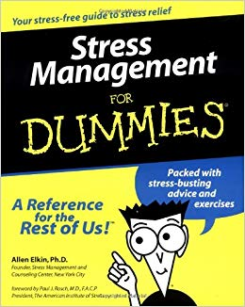
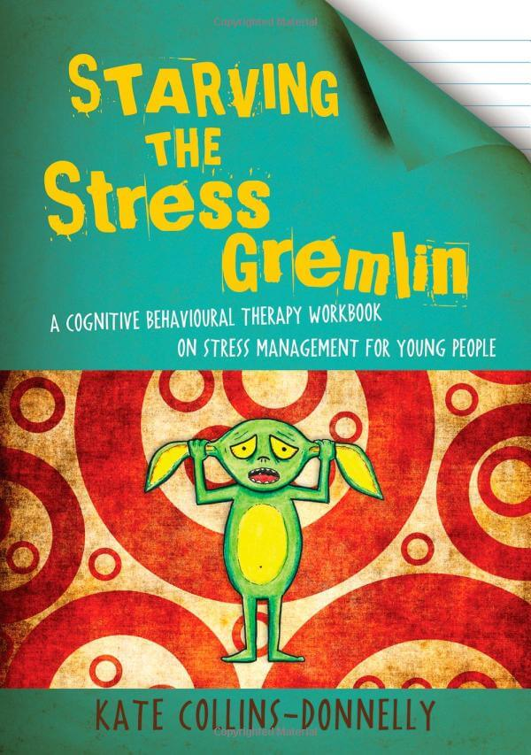
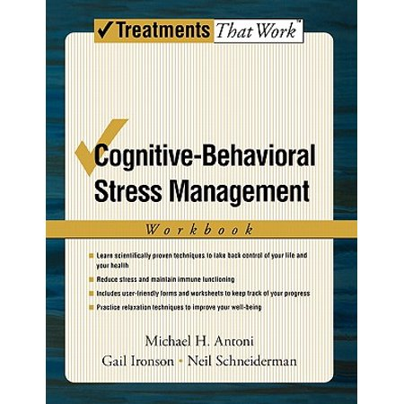
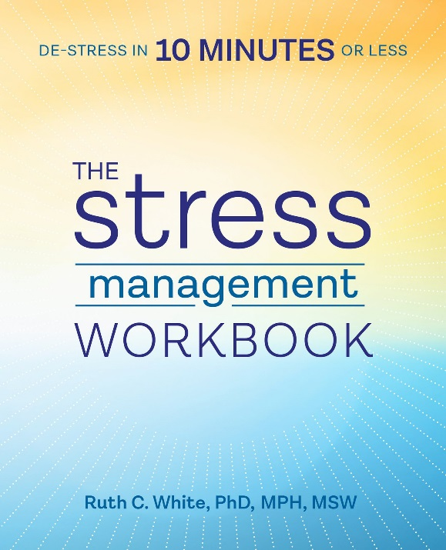
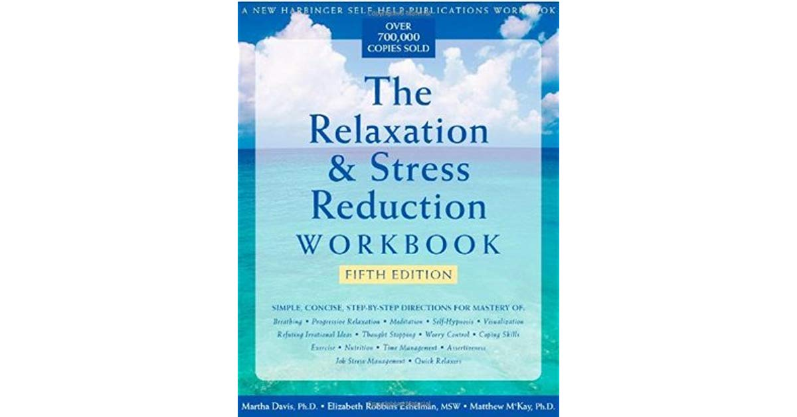
7) Stress Management
Principles

Slide 20
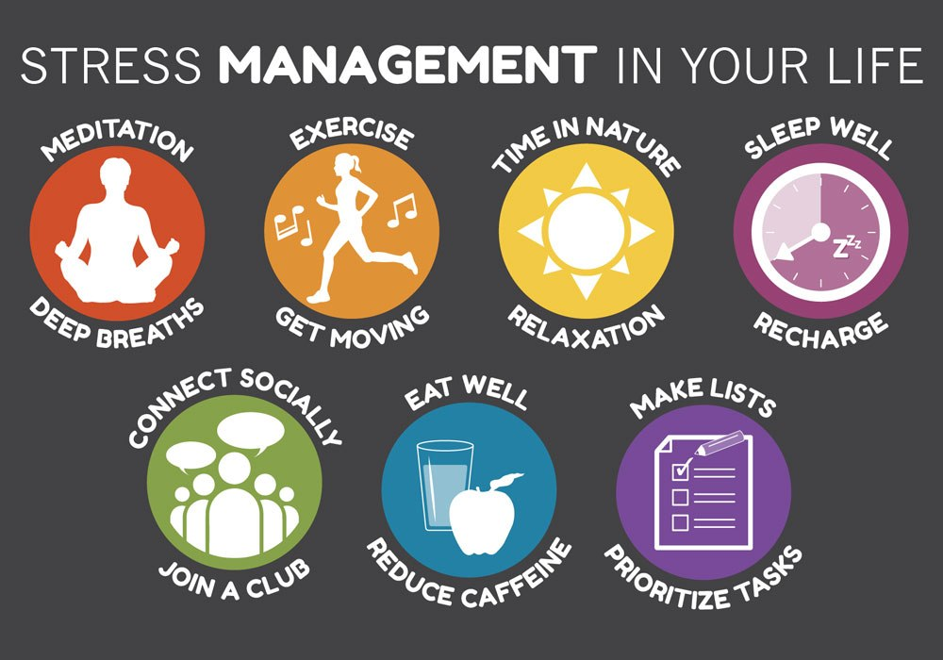
Effective stress management is the basis of a healthy life-style: plan it !

Slide 21
Stress Management: four core messages
manage demands and exposure to pressure in your life with rewarding and positive experiences
control how you think about the stressors in your life (rational and positive thinking)
maintain a balance between sympathetic (vigorous activity) and para-sympathetic (relaxation) neural activity
seek support from others when your need it

Slide 22
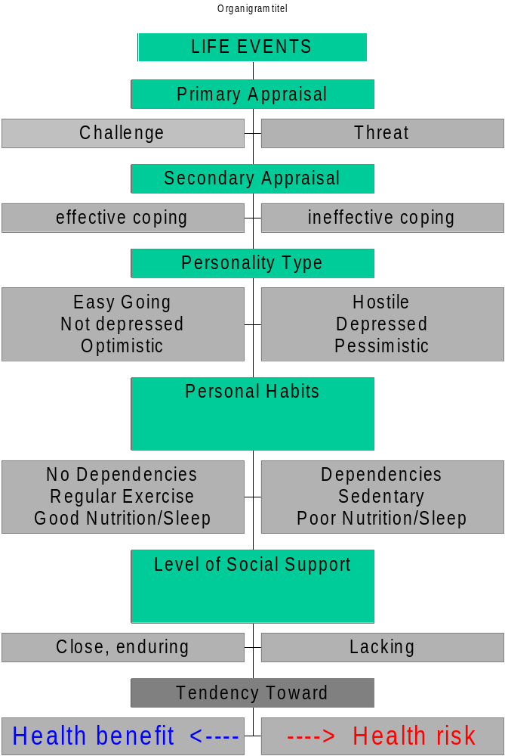
Model 2:
Stress
Management
(Myers, 2004)

Slide 23
Apply the two models to the scenario:
1) Which factors are likely to cause stress? Map them.
2) How might these factors interact? Likely outcome?
3) Suggest ideas for prevention / intervention.
The manufacturing division of the company moved to China, so a large part of the workforce was laid off. To the considerable surprise of the employees, the two remaining divisions were forced to merge. One location was closed, with the employees of this branch moving in with the only other branch left in the country. This means a rather considerable commute for these employees. They have little choice because there are not a lot of similar employment opportunities in the area. They are retrained to suit the present needs of the company and getting used to the open plan offices they are put in. There are rumours that the company will cease its activities in Ireland entirely.

Slide 24
Apply the two models to the scenario:
1) Which factors are likely to cause stress? Map them!
2) How might these factors interact? Possible outcome?
3) Suggest ideas for prevention / intervention.
Gerry (28) had an accident. He fell off a ladder that broke while he was on it. He broke a leg and both of his arms but survived. Three months later he is more or less recovered except his leg is still not ok. It may never be entirely the way it was. Gerry’s wife works from the home, so she took care of him after he got out of the hospital. The company has been slow offering compensation and so Gerry put it in the hands of a lawyer. The lawyer advises Gerry to stay home unless he is 100% recovered. Gerry’s three colleagues are taking over his work. The company has not hired a replacement for Gerry. Gerry was a very good football player in a local team, but it is unlikely that he will ever play again.

Slide 25
8) Practical Stress Management:
3 techniques
Long-term benefits of awareness of the role of stress in one’s life and work:
Technique 1: Increasing Awareness of Stress
Technique 2: Rationalising your Thinking
Immediate impact on sympathetic activation (arousal reduction)
Technique 3: Cue-Controlled-Relaxation

Slide 26
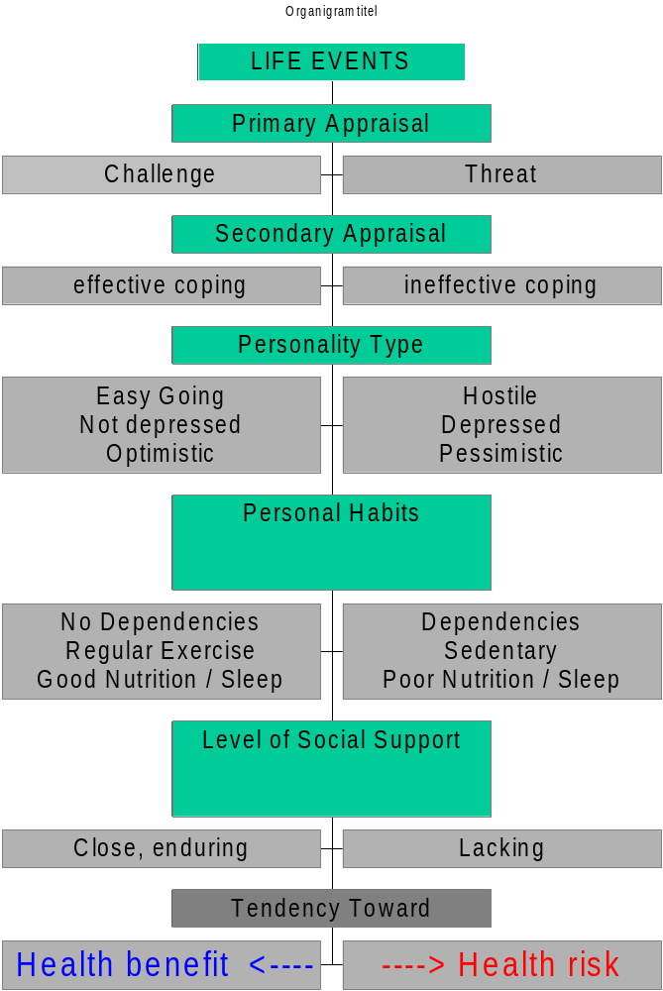
Model 2:
Stress
Management
(Lazarus &
Folkman, 1984;
Myers, 2002)
Impact of Technique 1 and 2

Slide 27
Yerkes-Dodson Inverted U-Hypothesis (1908)
Impact of
Technique 3: reduction of arousal level
… to here!
to take you from here …..

Slide 28
Technique 1: Increasing Awareness of Stress (affects primary & secondary appraisal)
All change starts with awareness. You can use the models presented in the lectures to analyse what causes you stress, and what you are already trying to do about it. The nature of stress is such that we often resist thinking about it in detail, and therefore we may not find out what is at the basis of it, how we cope and how we can make improvements. This simple exercise will assist you in increasing your awareness in preparation for making other improvements.
Further reading: Greenberg, J.S. (2002) Comprehensive Stress Management (8th ed.). New York: McGraw-Hill.
Please, write down something that causes you an unpleasant form of stress.
Why do you think it causes you stress? (external aspects <> internal aspects)
What could you do to reduce the cause of your stress?
If it is not under your control, what could you do to cope effectively?

Slide 29
Technique 2: Rationalising your thinking (affects primary and secondary appraisal)
The cognitive psychological perspective on mental health emphasises that most of our mental suffering is not the result of life’s events directly, but the thoughts we have about them.
In particular unrealistic expectations and irrational thoughts can cause us anxiety, fear, or stress.
This exercise makes a start with trying to point out and changing irrational or unrealistic aspects of your stress related thinking.
Source and further reading : Ellis, A. (1977) Reason and emotion in psychotherapy: The rational-emotive approach. New York: Julian Press.

Slide 30
Technique 2: Instructions (15 min, including discussion afterwards)
When you experience stress you may fear that something really unpleasant will happen. What is it you sometimes fear might happen?
………………………………………………………………………….
Analyse as follows:
        How do you know this unpleasant thing could happen?
        Have you experienced it before?
        Have you heard about it happening to others?
        Do you know someone to whom this happened?
What is the worst that could happen?
        What would be the consequences?
        How tolerable would they be?
        What could you do to cope?
        How likely is it that worst will come to worst?
Look for logical flaws in your thinking. Are you perhaps …
    Overgeneralising (example: … when something goes wrong once, it will always go wrong)
    entangled in black-and-white thinking (...things go 100% right or 100% wrong; no grey areas)
    disqualifying the positive (… only the negative things matter, positive aspects don’t count)
    Catastrophising (… when something goes wrong, everything will go wrong)
After this analysis, how reasonable do you think your fear is?
………………………………………………………………………
Formulate a rational response to your fear and write it down here.
……………………………………………………………………………

Slide 31
Outcomes of technique 1 & 2
What do you think …….?
More awareness and therefore control over stress
With these techniques you have tools to reduce the impact of stressful and fearful thinking
You have experienced how rational thinking can help reduce fear and resulting stress
You can use these techniques every time you encounter stress provoking thoughts

Slide 32
Technique 3: Cue - Controlled – Relaxation (adapted from: Benson, 1975) (aims to reduce arousal levels) (15-20 min)
There are many different relaxation techniques. Each of them works in a slightly different way. It depends on your preference what you should use. This exercise is particularly practical because it can be done in a chair, and after some practice it can be done in a matter of a few minutes. It aims to reduce your arousal/activation level and can be particularly effective when you feel tense and over-aroused to perform well. Source: Benson, K. (1975) The relaxation response. New York: Morrow books. Further reading: Rice, P.L. (1999) Stress and Health (3rd ed). Pacific Grove, CA: Brooks Cole.
1. Sit in a relaxed position and close your eyes. Try not to have too many expectations of what this might do for you and don’t worry if you are not sure how to follow the instructions. It is okay if you feel slightly uncomfortable in the beginning. Just try to enjoy it.
2. Begin to concentrate on your breathing, and slow it down. Breathe through your nose, making your exhalation longer than your inhale. You will notice a little tension associated with inhaling, and relaxation brought about by your exhaling. Concentrate on making exhaling feel as pleasurable as possible.
3. Become aware of the position of your body, and feel each part of you being supported by the chair so that you can relax your muscles further.
4. Begin searching your body for any signs of tension. Start at your feet and work your way up the body. Use the following order: feet, lower legs, upper legs, pelvis, belly, breast, shoulders, upper arms, lower arms, hands, neck, mouth, forehead. As you find any tension, focus your attention on it, and as you exhale, relax it. Ensure that you take time for this, at least 5 breaths per muscle group. It helps to suggest that that the particular part of your body should feel soft.
5. When you have completed step 4, keep breathing slowly through your nose, and begin to think or say the word ‘one’ to yourself. You do not have to say it, but allow your mouth to mime the word, long and drawn out during your exhalation. Keep doing this for five to ten minutes. If you get distracted, do not worry but simply go back to thinking the word ‘one’.
When you are ready to end your relaxation training session, open your eyes, take one or two deep, slow breaths and finish the exercise.
Notice that after a while you will feel both relaxed and alert. You have increased the amount of oxygen going to your brain, while reducing sympathetic activation.

Slide 34
Summary
What we addressed:
  the physiological basis of the stress response and how useful it is
  prolonged excessive stress as a health risk
  stress provoking life events
  the role of your thinking and behaviour
  core aspects of stress management
  three stress management techniques
Laughter as a way to manage stress (from 0:59): https://www.youtube.com/watch?v=0N60nBD-_Mc

