Slide 1


Decision making and support
A study by the Inclusive Research Network
https://doi.org/10.25546/108507

Slide 2
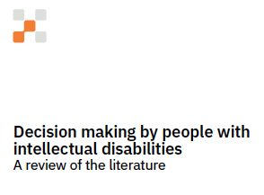
Accessible version of article “Decision making by people with intellectual disabilities. A review of the literature.”
Published in Pedagogia i Treball Social. Revista de ciències solcials aplicades. Univeristat de Girona. DOI: 10.33115/udg_bib/pts.v13i1.

Slide 3



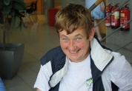

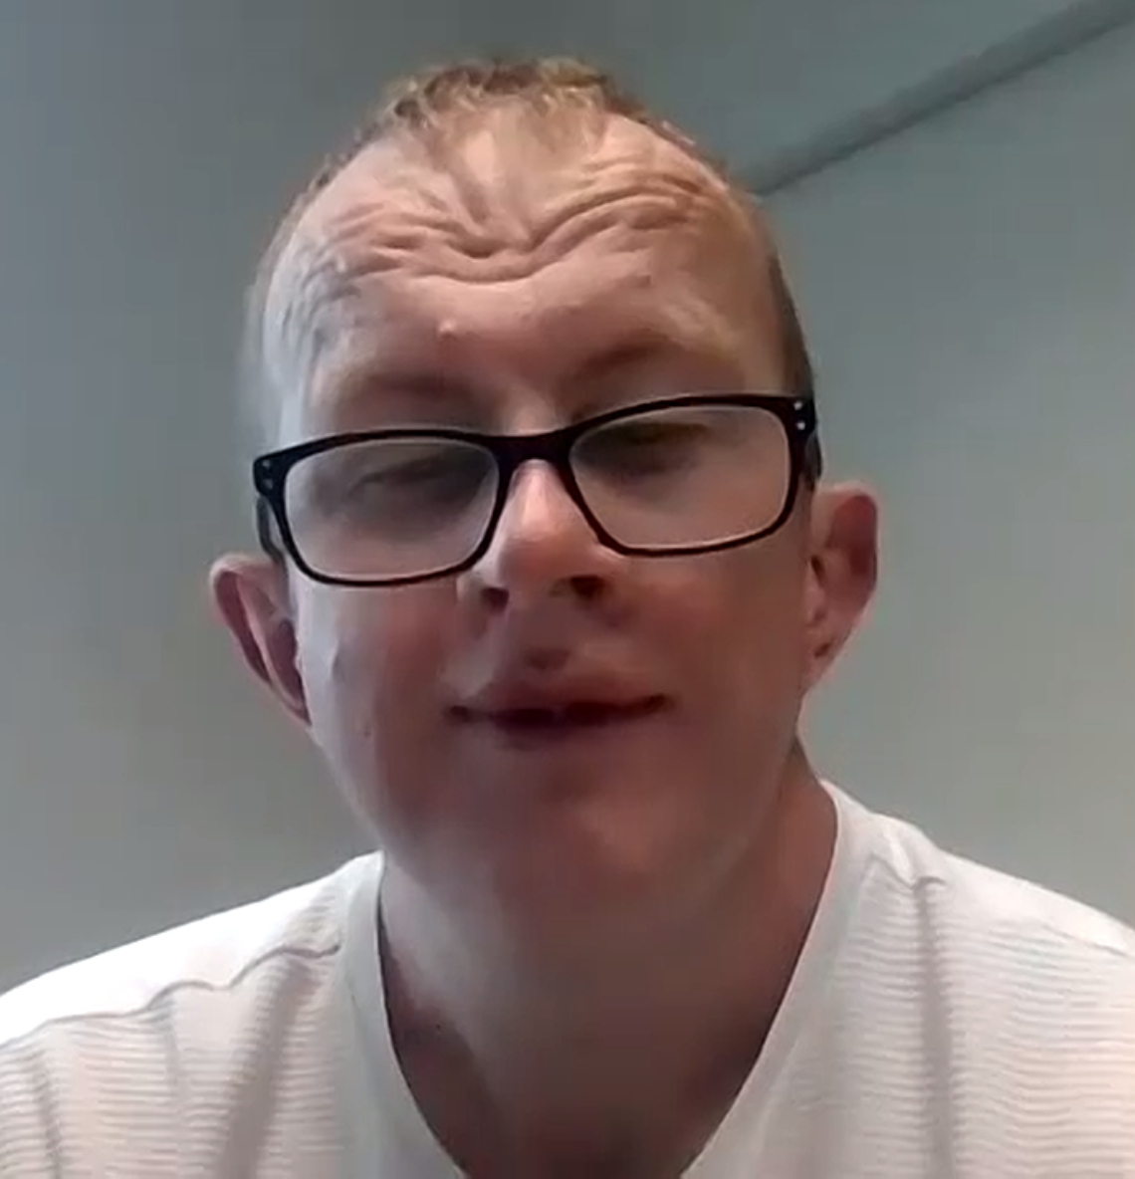


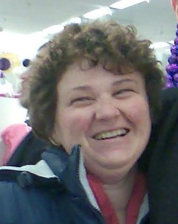



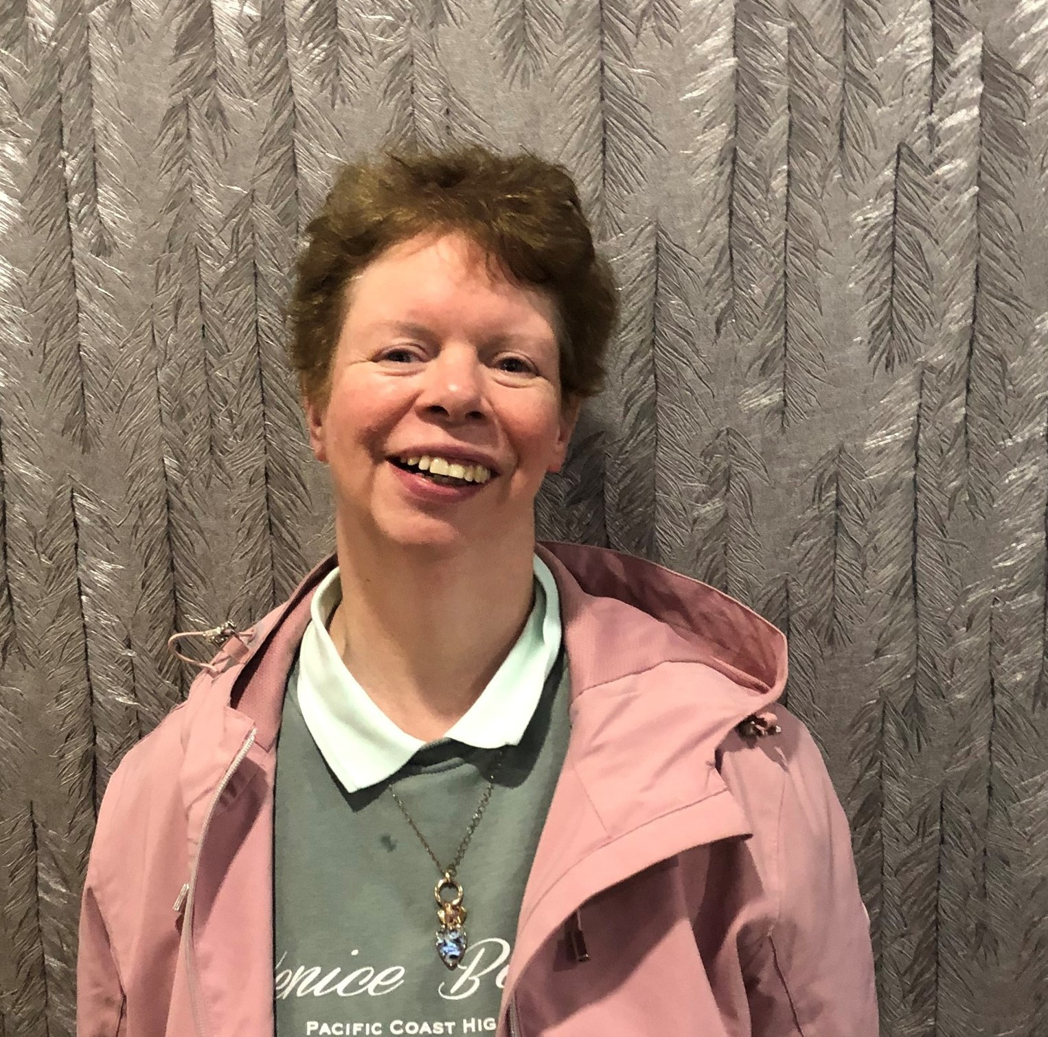

Authors
Maialen Beltrán
Helen O’Regan
Gavin Morris
Derek Murphy
James Delaney
Edurne García
Kathleen McMeel
Christina Burke
Elaine Leonard
Jackie Moran
Rob Hopkins
Pauline Skeehan
Orla McMahon
Michael Doolan

Slide 4

What this paper is about
It is about what is like for people to make decisions and what is like for others to support them.
This paper talks about what other researchers have said about decision making and support.

Slide 5



Why is decision making important
The United Nations says that people have the right to make decisions and to get support to make them.
In the past, and still today, others made decisions for people.
It is the right of people to make their own decisions.
In Ireland, there is a law about support to make decisions.
Notes:
Why is decision making important
The United Nations says that people have the right to make decisions and to get support to make them.
In the past, and still today, others made decisions for people.
It is the right of people to make their own decisions.
In Ireland, there is a law about support to make decisions.

Slide 6

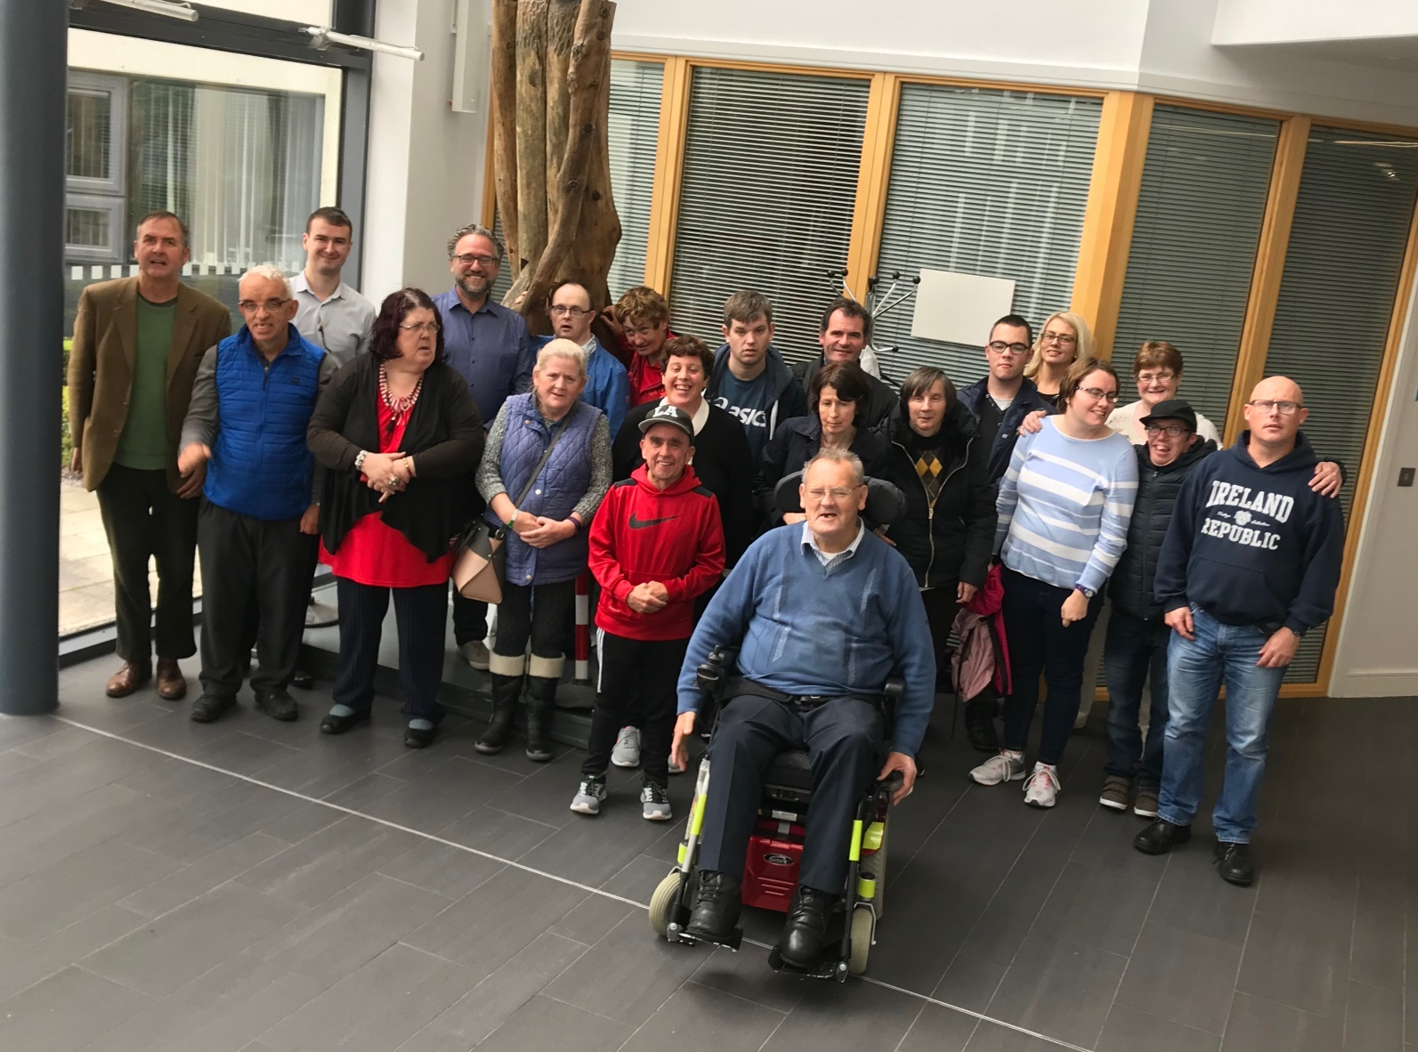
The Inclusive Research Network (IRN)
The IRN is a group of people who do research about intellectual disability in Ireland. There are IRN members, university researchers, and supporters in the group.
The IRN did a study about what is like to make decisions and what is like to support people to make them. We used photovoice and interviews to find out.
We also wanted to know if there were other studies about decision making and what had they found.
Notes:
The Inclusive Research Network (IRN)
The IRN is a group of people who do research about intellectual disability in Ireland. There are IRN members, university researchers, and supporters in the group.
The IRN did a study about what is like to make decisions and what is like to support people to make them. We used photovoice and interviews to find out.
We also wanted to know if there were other studies about decision making and what had they found.

Slide 7
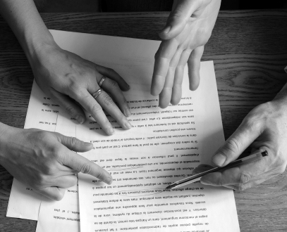
How we wrote this paper
Two researchers read papers that had been written about decision making and met with IRN members 2 times.
  Researchers talked about the papers they had read and came up with key ideas. They asked IRN members questions about these ideas.
IRN members gave them feedback on the ideas. The researchers used the feedback to write this paper.
Researchers and IRN members looked at the final paper together and we all decided if we were Ok having our names next to the things we had said.
IRN researchers also gave feedback on the accessible summary.
One university researcher and two IRN members worked on this presentation. Gavin Morris, Derek Murphy and Edurne Garcia. We all looked at the presentation, gave feedback and said if we were Ok with it.
This presentation tells what the paper is about, in plain English, and with pictures.
Notes:
How we wrote this paper
Two researchers read all the papers and met with IRN members 2 times.
Researchers talked about the papers and came up with key ideas. They also wrote our paper.
IRN members gave them feedback on the ideas and comments to include in our paper. They also looked at the accessible summary.
We all looked at the final paper and said if we were Ok having our names next to the things we had said.
One researcher and two IRN members worked on this presentation to make it accessible: Gavin Morris, Derek Murphy and Edurne Garcia. We all looked at it, gave feedback and said if we were Ok with it.

Slide 8
These are the questions researchers asked IRN members.
What do you think about these 3 ideas?
What are your views on these?
These are the ideas that researchers came up with from reading the papers:
Power and control
Support by family and staff for decision making
Other supports to make decisions
Are we using the right words for these ideas?
What other words do you have for these ideas?
How important are these ideas for you, to make decisions?
Are there other important ideas?
Do you have other comments?

Slide 9

What we found out
We came up with key ideas from the papers. We present these ideas and the comments by IRN members next.
People make decisions about different things in their lives, day to day decisions such as what to eat and big ones such as where they live or work.
Gavin said ”It’s excellent people are making these decisions.”
Pauline added ”People have their own right to make decisions.”
Notes:
What we found out
We came up with key ideas from the papers. We present these ideas and the comments by IRN members next.
People make decisions about different things in their lives, day to day decisions such as what to eat and big ones such as where they live or work.
Gavin said ”It’s excellent people are making these decisions.”
Pauline added ”People have their own right to make decisions.”

Slide 10

What we found out
However, staff and families have control over many decisions people make.
James said “it’s hard to say what you want.”
Christina agreed ”it is hard to think about this.”
One supporter said ”sometimes it is hard to find the confidence for people “to speak out your mind”.
Notes:
What we found out
However, staff and families have control over many decisions people make.
James said “it’s hard to say what you want.”
Christina agreed ”it is hard to think about this.”
One supporter said ”sometimes it is hard to find the confidence for people “to speak out your mind”.

Slide 11

What we found out
Trusting relationships with families and staff who provide support is very important to make decisions.
James said “I think you need help and support to make your own decisions” and Christina stated ”I need support because I have a bit of memory loss.”
A point was raised by Orla ”people with disabilities can be more dependent but are not always dependent” and Christina, who said “families might intervene too much”.
Notes:
What we found out
Trusting relationships with families and staff who provide support is very important to make decisions.
James said “I think you need help and support to make your own decisions” and Christina stated ”I need support because I have a bit of memory loss.”
A point was raised by Orla ”people with disabilities can be more dependent” but are not always dependent and Christina, who said “families might intervene too much”.

Slide 12

What we found out
Other support such as understanding information, learning opportunities and planning were important for decision making.
Christina and Helen said: ”Having enough time for planning is very important to enable decision making.”
However, even when the decision is made, Christina said that “there is no support to follow it through”, and often, Helen and Elaine found that “the supports are not there when you need them”.
Notes:
What we found out
Other support such as understanding information, learning opportunities and planning were important for decision making.
Christina and Helen said: ”Having enough time for planning is very important to enable decision making”
However, even when the decision is made, Christina said that “there is no support to follow it through”, and often, Helen and Elaine found that “the supports are not there when you need them”.

Slide 13

Our conclusions
People with intellectual disabilities have the right to get support to make their own decisions. Not everyone needs support.
We looked at what other researchers had found out about people making their own decisions.
We found that many people make their own decisions.
We also found that families and staff still have control over people’s decisions.
There are things that help people make their own decisions such as accessible information, learning opportunities and planning.
Even when the decision is made, some people don’t have support to follow it through.
For people to exercise their rights, they need to have access to support, if they want, to make decisions and to follow them through.

Slide 14
Thank you
iriartee@tcd.ie

Slide 15
Photos in this presentation (slides 1, 4, 5, 7, 9, 10, 11, 12, 13) are by Unknown Authors licensed under CC BY-SA-NC.

