Slide 1
Being LGBTQI+ in Ireland:
The National Study on the Mental Health and Wellbeing of the LGBTQI+ Communities in Ireland
Professor Jan de Vries
  Date 04/07/2024
  Research Club Presentation, Department of Children, Equality, Disability, Integration and Youth, Dublin, Ireland

Slide 2
Team members
Professor Agnes Higgins, P.I.
Dr. Jan de Vries, P.I.
Ms. Carmel Downes
Dr. Mark Monahan
Ms. Renee Molloy
All School of Nursing and Midwifery, Trinity College Dublin
Dr. Thelma Begley
Dr. Louise Doyle
Dr. Brian Keogh
Dr. Karen O’Sullivan
&
Dr. Paul Corcoran
University College Cork (UCC)

Slide 3
Content
Focus of the presentation
Theoretical background of the research
Background to the study
Study overview
Module 1 Sample profile
Module 1 Selected Findings
Overall conclusions Module 1
Module 2
Overall conclusions Module 2
Final Commentary

Slide 4
1) Focus of the presentation
‘ This presentation (followed by a discussion) will not only address the concerns raised by the findings of the study but also highlight where there is cause for optimism.’

Slide 5
2) Theoretical Background of the Research
External Factors
Internal Factors
Liberal political, social and religious climate
Social support
LGBTI specific support
Partner relationship
Positive home/work/ school/local impact
High self-esteem
Resilience
Self-acceptance
Self-compassion
Adaptive coping
Outcome variables:
Happiness
Life-satisfaction
Quality of life
Wellness
Wellbeing
Mental health
Mental distress
Mental illness
Suicide / Self-harm
+
+
LGBTQI+
Minority
Stress
Coming out
Self-disclosure or concealment
Gender non-conformity
Discrimination
Violence/victimisation
Prejudice/stereotyping
Heteronormative bias
Heterosexism
Social isolation
Negative home/work/ school/local impact
Internalised homo/bi/ trans negativity/phobia
Attachment insecurity
Rejection sensitivity
Rumination
Maladaptive coping
Vigilance
Substance misuse
-
-

Slide 6
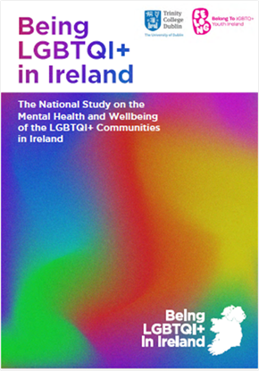
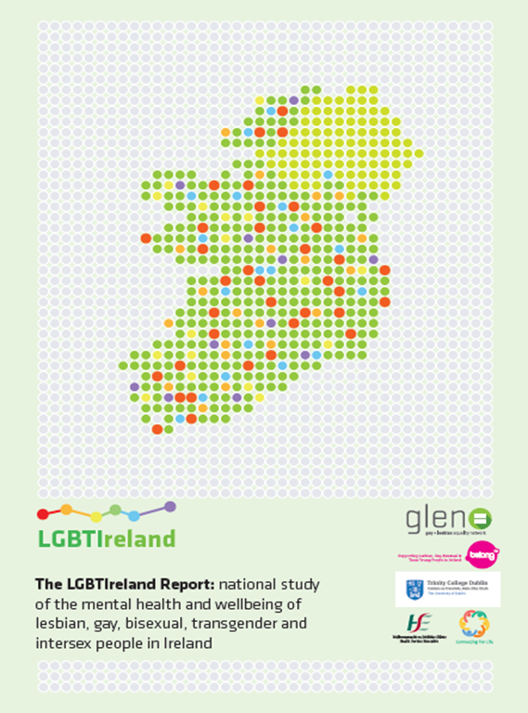
3) Background to the study
2016

Slide 7


4) Study overview
MODULE ONE:
Survey of LGBTQI+ people
MODULE TWO: Survey of representative sample of general public
Online Survey
N=1,024
TELEPHONE SURVEY
(Repeat of 2014 Survey)
N=1,000
N=2,806
37 statements: Focus on attitudes towards transgender and intersex people
39 statements regarding attitudes towards LGBT people
TOPICS:
-- LGBTQI+ wellbeing in context
-- Mental health and distress
-- Being LGBTQI+ in school
-- Safety within Irish society
-- Healthcare utilisation and experiences of healthcare
Being LGBTQI+ in Ireland
Comparison with LGBTIreland 2016

Slide 8
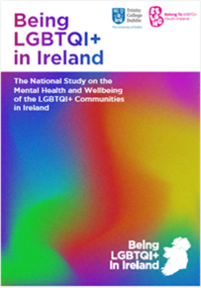
5) Sample Profile
 | Groupings | n | %
Gender Identity | Cis men | 889 | 32
 | Cis women | 1050 | 38
 | TGNC | 839 | 30
 | total | 2778
Sexual Orientation | Gay | 884 | 32
 | Lesbian | 510 | 18
 | Bisexual | 606 | 22
 | Queer | 326 | 12
 | Asexual | 108 | 4
 | Pansexual | 169 | 6
 | other | 175 | 6
 | total | 2778

Slide 9

Sample Profile (cont.)
Notes:
Neary 70 percent were under the age of 35
Range 14-84

Slide 10
Commentary on sample profile Module 1
- Representativeness of the sample is unclear
- Different prevalence of grouping complicated the comparison between Being LGBTQI+ in Ireland study (2024) with the LGBTIreland (2016)
- Comparison with the mental health and wellbeing in the General Population not possible within the study

Slide 11
6) Selected Findings
Focus on wellness aspect, but pattern is the same for mental distress

Slide 12
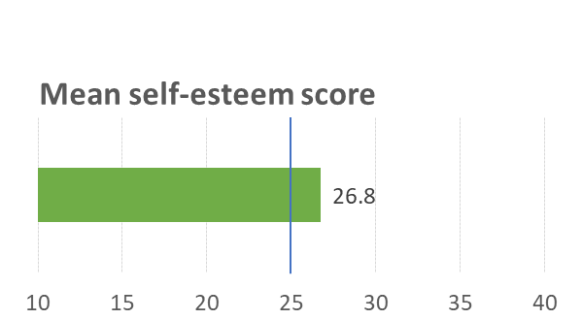
Wellbeing: Self esteem
Rosenberg Self-Esteem Scale
HIGH
LOW

Slide 13
Happiness and Comfort among subgroups

Slide 14




Celebration of LGBTQI+ Identity
Belonging to Community & Friendships
Personal Growth & Development
Being Open Out & Proud
Joy of Relationships & Attraction
LGBTQI+ Culture & Politics
“I have a family of queer people that I’ve surrounded myself with who love me more fully than my own family could. This community accepts me and understand me completely.” (28, non-binary, queer)
“I love finally living my life as [was] hiding for so long.”
(48, woman, trans woman, pansexual)
“How beautiful being a lesbian is and just connecting with other lesbians is so lovely”. (16, non-binary, lesbian)
“It’s all I’ve known. I love being gay and I would never change it. I feel if I was any other sexuality I wouldn’t be the ‘me’ I am today. It was a long road but I eventually got to a comfortable place mentally and I’m happy with who I am.”
(27, gay, man)
“Also proud of all the activists in our community that have worked and continue to work to improve life for LGBTQI+ people.” (37, woman, lesbian)

Slide 15
7) Overall Conclusions Module 1
- Significant mental health concerns within the LGBTQI+ community
- Most concerns for young participants and trans and gender non-conforming communities
- Ageing seems to benefit participants
- Extent of support from LGBTQI+ networks and support groups is significant
- Participants have benefitted from legislative progress, visibility in the media, and improved acceptance by the general population (work, college, but secondary schools are still problematic)

Slide 16

8) Module Two: Public Attitudes LGBT people
Telephone survey: comparison with 2016
School
Education
Support
Prejudices
Discrimination
Comfort
Being in company
Friendships
Displays of affection
Perceptions
Beliefs
Choice
Cured
Sin
39 items

Slide 17
9) Conclusions Module Two: Public Attitudes
Overall positive anti-discrimination views; improvement in comparison with LGBTIreland specific for LGB
People who reported more knowledge and more frequent interaction with LGBTQI+ people were significantly more likely to have positive attitudes on all statements
Attitudes towards TGNC less positive: correlated with knowledge and interaction levels
Perceptions
Beliefs
Choice
Cured
Sin
Notes:
A minority would not be in favour or comfortable with including education on transgender experiences (28%) and intersex variations (26%) in school.

Slide 18
10) Final Commentary
Theoretical model confirmed by findings:
  Reductions in Minority Stress + Self-acceptance + Social Support = Improved Wellness
Progress for LGB groups in Ireland evident, but should not be taken for granted
Young LGBTQI+ people need support going through secondary education
Knowledge of QIA+ among general public is sketchy; Education needed
Research on LGBTQI+ needed which includes the general population to ensure more robust comparisons can be made

Slide 19
Thanks to
Participants of both survey
Organisations that supported advertising and recruitment
Commissioners Belong TO
Funders: the National Office for Suicide Prevention (NOSP) & Social Inclusion, Health Service Executive (HSE) and the What Works and Dormant Accounts Fund, Department of Children, Equality, Disability, Integration and Youth through Belong To.
Research Advisory Group
Research team: Agnes, Carmel, Karin, Brian, Louise, Mark, Paul, Renee, Thelma
You for coming along today

Slide 20
jan.devries@tcd.ie

Slide 21

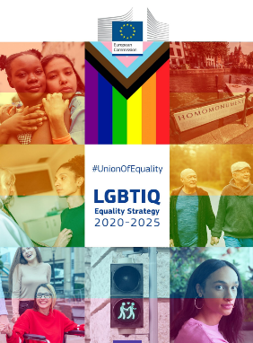
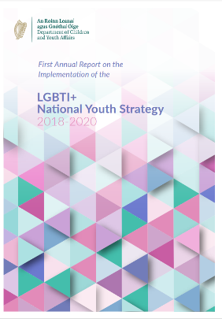

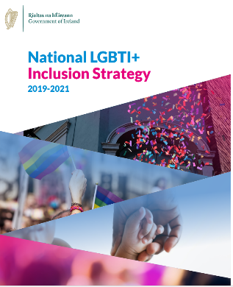

Positive legislative and policy changes
2015 Gender recognition Act
2017 Adoption Act
2021 Family Leave and Miscellaneous Provisions Act
2015 Marriage equality
2015 Employment Equality Act
2015 Children and Family Relationships Act
2010 Civil partnership
Notes:
In recent decades, legislative developments and policy initiatives have improved many people’s lives and helped us building more equal and welcoming societies for lesbian, gay, bisexual, trans, non-binary, intersex and queer (LGBTIQ2 ) people
Homosexuality removed from DSM
Employment Equality Act in 2015 which made it illegal for religious-run institutions to discriminate against workers on the basis of their sexuality, the Children and Family Relationships Act 2015 which gave some same-sex parents a pathway to be legally recognised as parents, the Adoption (Amendment) Act 2017 which allowed unmarried heterosexual and same-sex couples to adopt a child together and the Family Leave and Miscellaneous Provisions Act 2021 which granted male-sex couples adoptive leave. At present, there are plans to introduce hate crime legislation while research into conversion therapy to inform legislation that will ban the practice is also underway.

