Slide 1

Critical Reflection in Health Care
INMO Professional development Centre
CPC LEADERSHIP Embracing the Challenges
Venue: The Richmond Education and Event Centre,
North Brunswick Street, Dublin D07 TH76
Dr. Jan de Vries
Thu 17 May 2018

Slide 2

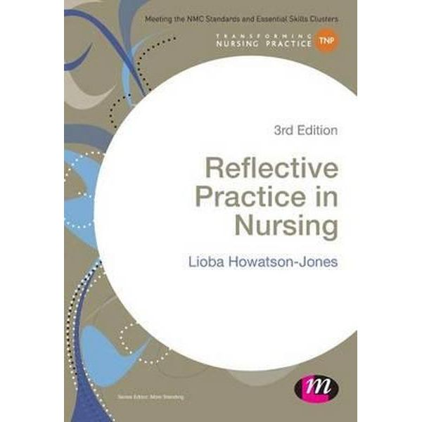
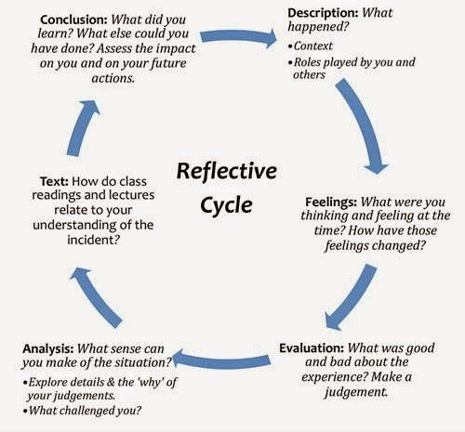
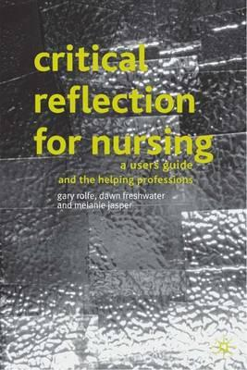
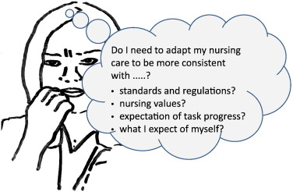

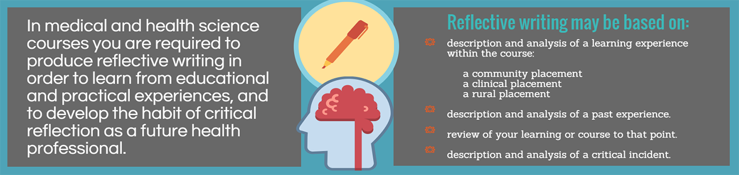

Slide 3
What is reflective practice?
Clinical practice in which reflection is integrated (writing or conversation)
Distinction between superficial, dialogic, critical (or deep) reflection
There are many models of differing degrees of complexity (Gibbs 1988; Johns 1994; Murphy & Atkins 1994)
Some efforts have been made to simplify the process: What? So What? Now What? (Rolfe 2005, Rolfe, Jasper & Freshwater 2011)
Distinction between reflection ‘in action’ or reflection ‘on action’ (Schön 1983)
There are interesting materials on-line you might want to access: https://blogs.bmj.com/ebn/2017/01/30/the-power-of-reflection-in-nursing/ http://libguides.scu.edu.au/c.php?g=185038&p=1548939

Slide 4
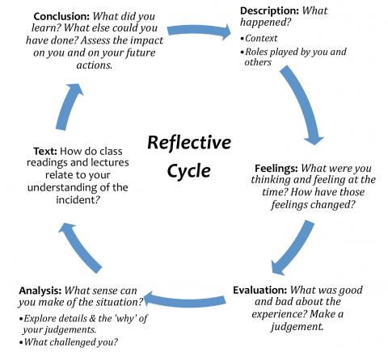
(Gibbs 1988)

Slide 5
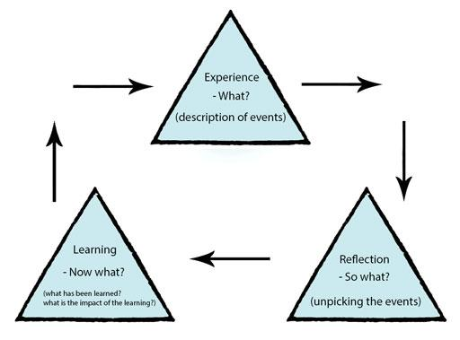
(Rolfe 2005)

Slide 6
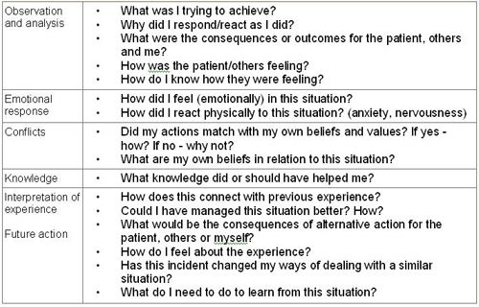
????

Slide 7
What is critical reflection?
Reflection in which a critical or self-critical approach is taken (De Vries and Timmins 2016).
Finding ways of enabling students to raise unconsciously held personal beliefs, so that they can be consciously inspected (Rolfe 2005).
It requires ‘slowing down’ thought processes (Kahneman 2011)

Slide 8
Why do we not reflect as often as we should?
models are complex
expectations of reflective abilities are too high
overly time consuming
motivation may be lacking
If done right, reflection is likely to be unpleasant …..!
This is a core point of this session!

Slide 9

Conjuring up the genie ……

Slide 10
Discussion of vignettes for reflection in action
Create small groups (4-5 participants)
Open the envelope, read vignette and discuss questions in groups.
Each of the vignettes contains an ‘OOPS’ moment. Please discuss how you would experience this moment and how you respond to it.
Put key points from your discussion on flip chart page to present (briefly)

Slide 11
Vignette I: Hand hygiene forgotten
a) You have forgotten to wash your hands but just before patient contact you realise this.
  Establish what you feel and think during the ‘oops’ moment.
  What would you do?
b) A colleague has forgotten to wash hands and performed a procedure that required hand hygiene. When realising the mistake your colleague feels bad.
    What might your colleague think to feel less bad?
    What might your colleague do to feel less bad?

Slide 12
Vignette II: Omitted to give information
a) You have visited a patient at home. You have delivered new medication but just after you’ve left the patient’s house you realise that you have not explained how it should be used.
  Establish what you might feel and think during the ‘oops’ moment.
  What would you do?
b) A colleague has visited a patient at home. The visit included the delivery of new medication. A week later your colleague realises that the patient has taken too much of the medication, because its use had not been explained. Your colleague feels bad.
  What might your colleague think to feel less bad?
  What might your colleague do to feel less bad?

Slide 13
Vignette III: Crying patient ignored
a) You are passing through a room with four patients to do something highly urgent. You see from the corner of your eye that one of the patients is crying. You are already out the door when you fully realise what you saw.
  Establish what you might feel and think during this moment.
  What do you do?
b) A colleague tells you that a patient was crying, but that there was no time to attend to it. When he/she returned the next day, the patient had been moved to a different ward. Your colleague feels bad.
    What might your colleague think to feel less bad?
    What might your colleague do to feel less bad?

Slide 14

The OOPS moment and what happens afterwards is best explained by Cognitive Dissonance Theory
(Festinger 1957, Aronson 2004)
Dissonance is an unpleasant state of tension
that occurs whenever an individual
simultaneously holds two
cognitions that are
psychologically inconsistent.
It motivates efforts to reduce it.

Slide 15
In nursing or midwifery reflective practice ……….
Dissonance is the inner conflict that occurs whenever
we DO something that is against our principles,
beliefs, values, or expectations of ourselves.
This leads to significant psychological discomfort
which triggers efforts to reduce it,
to restore our peace of mind.

Slide 16

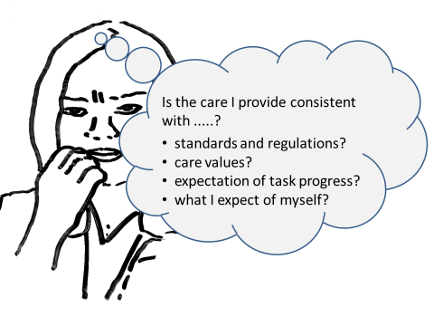
Critical Reflection in action

Slide 17
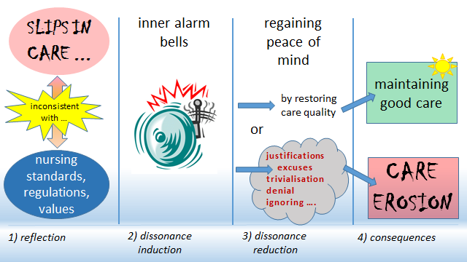
A process model of critical reflection in action and what to avoid ………………..

Slide 18
Common justifications
Nurses should examine common justifications used, including:
  There is not enough time.
  There are not enough members of staff.
  I can only focus on really important tasks.
  Others are doing this too.
  Most people do worse than I do.
  I cannot do any more than I do.
  If the organisation does not care, why should I?

Slide 19
Conclusion
Critical Reflection in action needs to imply:
being prepared to see what we are doing wrong, and putting it right.
this involves allowing ourselves to ‘feel bad’
‘feeling bad is good’, when it motivates us to restore quality of care, correct a mistake, etc.

Slide 20
Take home questions
Based on what we’ve discussed today, what can go wrong if we only engage in ‘retrospective reflection’? What can we do about it?
Which values, principles or standards are competing, and generating dissonance because we can’t be consistent with each of them at the same time? How do we hold on to values under pressure?

Slide 21
references
Aronson, E. (2004). The social animal (9th ed). New York: Worth.
de Vries, J. & Timmins, F. (2016). Care erosion in hospitals: problems in reflective nursing practice and the role of cognitive dissonance. Nurse education today, 38, 5-8.
Festinger, L. (1957). A theory of cognitive dissonance. Stanford CA: Stanford University Press.
Gibbs, G. (1988). The reflective cycle. In: Kitchen S (1999) An appraisal of methods of reflection and clinical supervision. Br J Theatre Nurs, 9(7), 313-7.
Johns, C. (1994). Nuances of reflection. Journal of clinical nursing, 3(2), 71-74.
Kahneman, D. (2011). Thinking, fast and slow. New York: Macmillan.
Murphy, K. & Atkins, S. (1994). Reflection with a practice-led curriculum. In Palmer AM, Burns S, Bulman C. Reflective practice in nursing. The growth of the professional practitioner. Oxford: Blackwell Scientific Publications.
Rolfe, G. (2005). The deconstructing angel: nursing, reflection and evidence‐based practice. Nursing Inquiry, 12(2), 78-86.
Rolfe, G., Jasper, M., & Freshwater, D. (2011). Critical reflection in practice: Generating knowledge for care. London: Palgrave Macmillan.
Schön, D. (1983). The reflective practitioner. London: Maurice Temple Smith Ltd.

Slide 22
Thanks for your attention.
Feel free to email me at jan.devries@tcd.ie

