Slide 1


AN investigation to facilitate and evaluate the development of dental students’ feedback literacy in the dental science undergraduate curriculum.
Dr Siobhán Davis*, Dr Maria van Harten, Professor Blánaid Daly.
*Assistant Professor in Restorative Dentistry
Dublin Dental University Hospital, Dublin, Ireland.

Slide 2
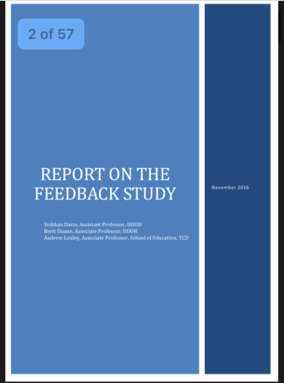
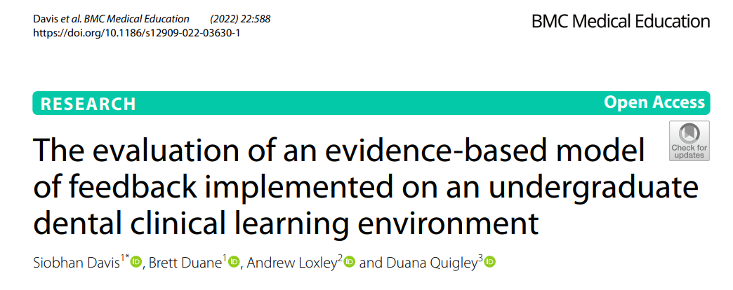
Background to current project-First phase
Change Project in Feedback - MOF was piloted on the clinical skills laboratory and subsequently implemented and evaluated on clinical sessions.

Slide 3
Recommendations from the Report on Feedback
 | Recommendations from the study on feedback.
1 | Feedback is important to students, should continue to be provided and needs to be improved within DDUH.
2 | The DDUH should consider how it may alleviate the time pressures associated with giving appropriate feedback.
3 | In recognition of a reluctance to approach supervisors, the development of student literacy in the process should be addressed and prioritised.
4 | In addressing manageability of feedback practices, consideration should be given to involving student self-assessment in the senior clinical years, promoting their responsibility in recognising and achieving learning objectives in CLE.
5 | Consideration should be given to peer-to-peer discussion of cases led by CT. Consider mentoring and communication training for Clinical Teachers. Useful to discuss prior to session what the student hopes to take away from the session (i.e., individualised learning outcomes on clinical sessions)

Slide 4
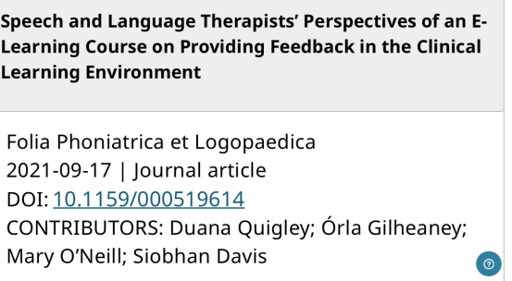
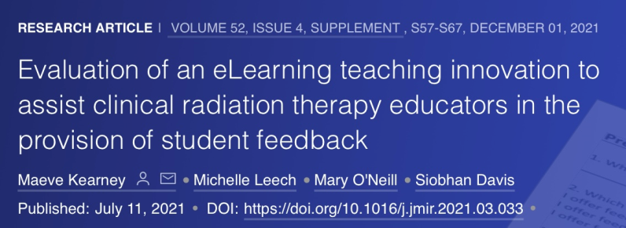
Second phase- development of e-learning tool feedback for clinical teachers in the clinical learning environment.
Report on feedback DDUH
2. Development of an eLearning tool around feedback for clinical teachers at DDUH
Recipient of Dean of Health Faculty Award 2018, Trinity College Dublin.
Adapted and made available to Faculty of Health Sciences.
Physio + OT paper preparation stage
Medicine data collection

Slide 5

Phase 3 Development of Student Literacy in FB in Healthcare Curriculum
Current focus is on the ability of the assessor to give feedback rather than on how the student receives and acts on it
Lack of feedback literacy may result in students being blamed for their inability to respond to feedback well
Poor uptake of feedback may be interpreted as the student becoming defensive and disengaged in the learning process (Quigley, 2021).
Enhancing student feedback literacy in clinical teaching creates a high-quality learning environment

Slide 6
Interprofessional team members involved in development of the elearning module
School of Linguistics, Speech and Communication Sciences | Dr Duana Quigley, Practice Education Coordinator
School of Medicine | Ms Mary O’Neill
Discipline of Radiation Science | Ms Claire Poole, Assistant Professor, Head of Clinical Education Ms Maeve Kearney, Assistant Professor of Radiation Science
School of Physiotherapy | Ms Lucy Alpine, Practice Education Co-Ordinator
School of Occupational Therapy | Ms Claire Gleeson, Practice Education Co-ordinator
School of Social Sciences | Dr Erna O’ Connor, Assistant Professor in Social Sciences
School of Dental Science | Dr Siobhan Davis, Assistant Professor in Restorative Dentistry

Slide 7
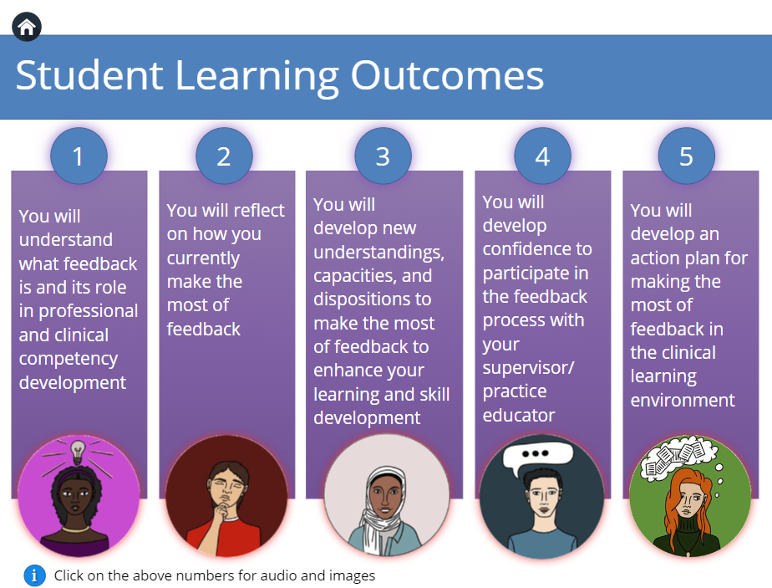
Project Objectives
Literature review, content development, online module, use of animation

Slide 8
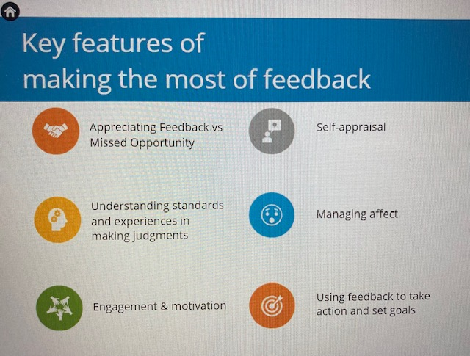
Context – What is the importance of this Initiative?
Investing in quality clinical teaching evidence based resources, students from all healthcare disciplines will be able to develop their feedback literacy and communication skills
Potential to improve and transform T&L within the CLE
Capacity to be adapted for use in non-healthcare courses across all disciplines to develop digital learning experiences

Slide 9

Evaluation of Module
(ii) post-course-measuring students’ perceptions of content
(iii) three months after completion-determine long term benefits
(i) pre-course-checking prior knowledge and identifying learning needs
The initiative had

Slide 10
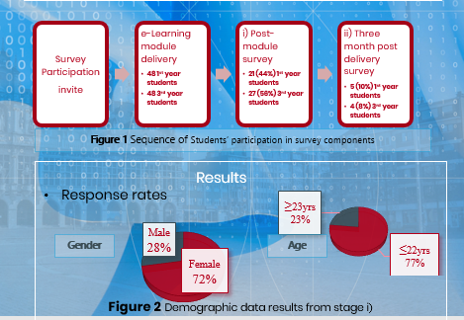
Piloted DDUH Feb 2024
Response rate 50%
91.6%found it helpful in the feedback process
83.8% they would apply their learning to
their clinical practice
93.8% would be more confident in the FB
process directly after completion
Few demographic characteristics associated
with attitudes towards FB
Tendency for older groups who are further along in
their studies to have more mature attitudes towards FB

Slide 11
CONCLUSION
Potential for curriculum-embedded support and structured FB literacy training to develop feedback literacy skills in DS students
Long term impact is less clear
Tendency for students who are further along in their dental studies to have more mature attitudes towards FB but this finding must be treated with caution due to small sample size
Contact: SDavis@dental.tcd.ie

