Slide 1


Men’s Interactions with Midwives:
Do they have an Impact on Men’s Transition to Fatherhood?
Andrews, L., Lalor, J and Devane, D.
Notes:
Introduction
Good afternoon everyone. My name is Lorraine Andrews and I am a Doctoral Student and a Lecturer in Midwifery in the School of Nursing and Midwifery in Trinity College Dublin. I’m absolutely delighted to be here and this is my first time to talk about my study in front of a large group of midwives. So I would really value any comments, or suggestions you may have which would only enhance the study.
Plan of presentation
Firstly, I am going to provide a little background information about the entrance of men into maternity care, this will then be followed by some reasons why men should be involved.
The methodology for the study will then be provided, and this will be followed by the findings from this study of men’s experiences of their interactions with midwives within antenatal, intrapartum and postnatal care.
These findings will then be discussed within the wider literature on this area and implications for practice and education. You may ask questions along the way or at the end.

Slide 2
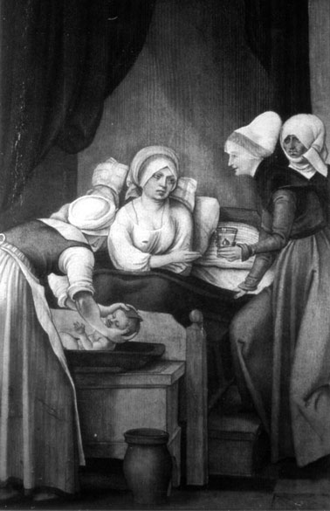
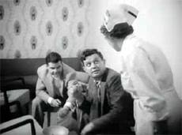
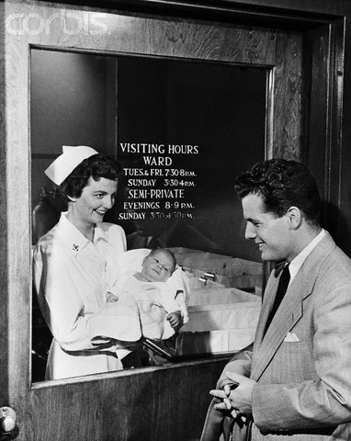
Men’s entrance into the maternity hospital
IMAGE:
1953
© Bettmann/CORBIS
Notes:
A brief background of men’s entrance into the maternity hospital
Prior to the 1930’s most births happened in the home
Rituals men would enact include putting on the woman’s jumper when she was in labour,
1950’s, 60’s 70’s – men’s main role was to transport women to the maternity hospital
Men not allowed attend the birth of their baby because they were considered carriers of infection, considered a nuisance, perverted, legal cases, fainting.
Men first gathered as a group in maternity waiting rooms in the 1940 and 1950’s
They then moved from the waiting room to the labour room in the 1960’s
Some hospitals allowed men to visit their partner in first stage of labour
Or women went out to the waiting room

Slide 3
Men’s entrance in the labour ward
UK : 1968+
Ireland : 1975
1984: Fathers permitted into OT
1984: UK, 40% of units included fathers (Garcia and Garforth, 1989)
1989 : Coombe Women’s Hospital 60% (The Irish Independent, 1989)
Notes:
Moved to the delivery room and birthing room in the 1970’s and 1980’s
Today's opposition to men in the labour ward
Dr Michele Odent - The fathers presence is hazardous to the woman’s health
Doctors procedures
Fathers not wanting to be present/absent father
Mothers preference for a different birth partner

Slide 4
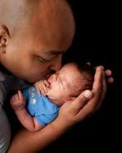
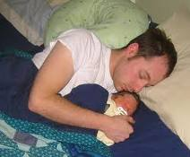

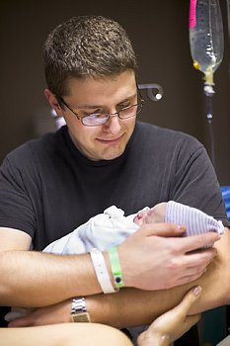
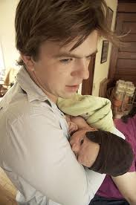

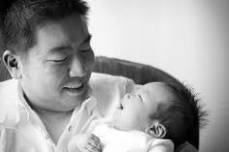

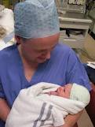
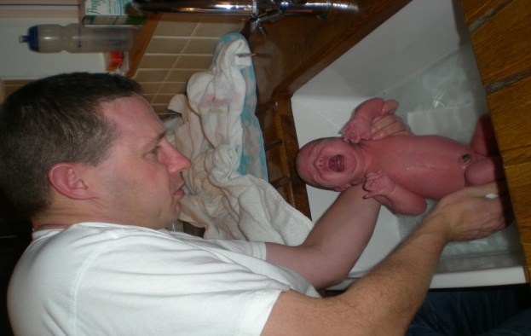
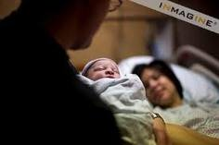
Present

Slide 5
Why involve men in maternity care
Benefits of his involvement for his child
positive behavioural, psychological, educational, social wellbeing and physical development (Allen & Daly, 2007; Sarkadi et al., 2008)
Lack of involvement - behavioural problems, lower self esteem, lower educational achievement and higher criminality (Flouri, 2005)
Notes:
A fathers positive involvement Benefits to his child
positive behavioural, psychological, educational, social and physical development and well-being of his child (Allen & Daly, 2007; Sarkadi, Kirstiansson, Oberklaid, & et al., 2008).
On the other hand his lack of involvement contributes to behavioural problems, lower self esteem, lower educational achievement and higher criminality (Flouri, 2005).

Slide 6
Benefits of men’s involvement to his partner
Main source of social support (Fatherhood Institute, 2008)
His positive attitude towards breastfeeding, impacts strongly with the length and success
  (Gamble & Morse, 1993; Swanson & Power, 2005; Tohotoa et al., 2011)
Lack of support - women experience more physical symptoms and more depressive symptoms
(Hildingsson et al, 2008)
Notes:
A father’s positive involvement is also important to the mother, as they are their partner’s main source of social support (Fatherhood Institute, 2008).
A father’s positive attitude towards breastfeeding, also impacts strongly with the length and success of the mother’s breastfeeding (Gamble & Morse, 1993; Swanson & Power, 2005; Tohotoa et al., 2011).

Slide 7
Benefits of men’s involvement for himself
Increases self confidence
Greater satisfaction with life (Eggebeen & Knoester, 2001)
Indulge in less health risk behaviours (Richardson & Carroll, 2008)
Notes:
Becoming a father is also important to men themselves as it increases their self confidence and provides greater satisfaction with life (Eggebeen & Knoester, 2001), it makes them think more about their health and they indulge in less health risk behaviours (Richardson & Carroll, 2008). Considering the many benefits a father has on his child, his partner and himself, it is important that he is involved with his partner’s pregnancy from the outset.

Slide 8

Aim
To explore men’s experiences of their interactions with midwives during the antenatal, intrapartum and postnatal period and discuss whether these interactions impact on their transition to fatherhood
Notes:
The aim of this presentation is men’s experiences of their interactions with midwives during the antenatal, intrapartum and postnatal period and discuss whether these interactions impact on their transition to fatherhood.

Slide 9
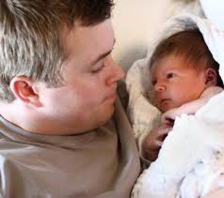
Methodology
Classic grounded theory approach
Two urban maternity care sites and one rural area in Ireland
N = 37 first time fathers
One to one interviews (before and after birth)
Eligibility and exclusion criteria
Notes:
Methodology used for this study
This Qualitative study used Glaser's Classic Grounded theory approach. The sample includes 37 first time fathers who were recruited from two maternity care sites and one rural area in south west Ireland
Men were interviewed on a One to one basis during his partners pregnancy and again after the birth of his baby. Through the process of theoretical sampling I have talked to men at varying stages during pregnancy from 12 weeks, 15, 20 25, 28+, - 1 weeks before birth and again after from 17 days to 5 months after to help fill in the gaps and build a theory of men’s experiences of becoming a father. Men over 18, single, co-habit, any nationality, age, twins, adverse outcome were Eligible to be included in the study. Men were excluded if less than 18 and could not speak English fluently due to the absence of funding for interpreters.

Slide 10

Demographic profile
Nationality
  - Irish 26
  - Non Irish 11
Age range 18- 51 (mean 33 years old)
Married - 27; Cohabitating - 9; Single -1
Employment: 28 Fulltime; 3 Part time;
4 Unemployed; 2 students
Notes:
Demographic profile of men in the study
Sample size: N=37
Irish national: 26;
Non-Irish nationals: 11
10 different Nationalities, 33 Caucasian
Age:
Range 18-51
Mean 32.91
Marital status
Married = 27
Co-habitating = 9, Single = 1
Level of education:
Second level = 15
Third level =15
Fourth level =5
Student=2
Employment status;
Fulltime =28
Part-time/freelance/unstable = 3
Unemployed = 4, Student = 2

Slide 11
Types of maternity care accessed
Notes:
Generally it’s not until the second trimester of pregnancy (usually between 14-18 weeks gestation) that a woman registers for care with the maternity hospital. A pregnant woman’s first point of contact is her GP, unless there is a first trimester bleed or some other complications then they go directly to the maternity hospital.

Slide 12
Men’s interactions with midwives within antenatal care
“She asked me have I any fears or anything I am worried about … she was quite reassuring, they been great that way” (22.1 Dylan)
“I was very impressed with the midwives in Hospital Y” (13.1 Aaron)
“Once the mother is looked after I don’t mind if they involve me or not. The main priority is the mother and baby” (36.2 Henry)
Notes:
The vast majority of couples availed of obstetric led care and only two couples attended a midwife led clinic. Men whose partners attended midwife led care were very satisfied with their level of inclusion.
Interestingly most men accompanied their partner to the first antenatal visit. Sixteen men went to all maternity care hospital visits; five went to most, while the remainder went to as many appointments as they could. Many men noticed that not all men attend appointments with their partner but they observed that expectant mothers often had a friend or their mother with them.

Slide 13
Men’s interactions with midwives within antenatal care cont.
“You were just sheparded from one point to the next; unaware of what was going to happen”(32.1 Christopher)
“It’s just rather chaotic and if you don’t know what’s going on, where you are or where you should be, you just feel a bit in the way”(Rob 18.1)
Notes:
On the whole men’s experiences at attending antenatal care appointments were mixed. It was down to the man’s disposition, the busyness of the clinics and the staff they met whether they felt involved or accepted as part of the family unit within antenatal care.
Other men felt as if they were bystanders, in the way and superfluous to the requirements of maternity care. They had made an effort and wanted to be there because they cared about their partner and their baby.
Some men were not made feel involved by staff, where they were ignored or left waiting on the bench outside and they didn’t know whether it was acceptable to go in for the visit or not. It was only when these men saw that other men go into the consultations with the obstetrician that they then went in with their partner at the next antenatal appointment.
Men find that the clinics are extremely busy and understaffed. They find the queues very long and there is no-where for them to sit as they give up whatever seating places there are for pregnant women. On the whole men found staff to be courteous and they are very satisfied with the level of care their partner received.
However, midwives (and other maternity care staff) did not always engage with men in antenatal care. Men are an untapped support person to their partner during these visits. Men don’t purposely set out to be involved by midwives at the antenatal care appointments, in fact they have little expectations of being involved, that is primarily because they want the focus to be on their partner and baby. But they accompany their partner because they want to be involved fathers and it does make a difference to them if they are made feel welcome.

Slide 14
Impact of midwives interactions - Antenatal
Positive interactions
  Engaged with them
  Acknowledged their presence
  Asked if any questions
  Facilitated them to hear fetal heartbeat
Negative interactions
  Ignored
  Made them feel in the way or a nuisance
  Excluded them from involvement
Notes:
The positive impact midwives made was by inviting them along and making them feel welcome during these appointments, acknowledging their presence and providing them with time to ask questions or voice any concerns they have and when this happened they felt involved and part of the pregnancy.
The negative impact midwives can make to men’s transition to fatherhood within antenatal care is making them feel unwelcome, ignoring them, making them feel like they are in the way and a nuisance. This further removes the expectant father from involving himself with his unborn child. Men have nothing physical to go on when becoming a father and they depend on external sources in facilitating their transition to fatherhood, such as maternity care staff welcoming and engaging with them, acknowledging their presence, facilitating them to listen to the baby’s heartbeat and/or visualise their baby. Some men make themselves involved whereas other want to be involved but don’t know their place within antenatal care.

Slide 15
Mode of delivery
Notes:
All men accompanied their partner to the labour ward and were present for the birth of their baby. Twenty one of the men’s partners experienced a normal delivery and 12 experienced a caesarean section (figure 2), where only one of these was an elective section. For the purpose of this paper only men’s experiences of midwifery care in the labour ward are discussed here.

Slide 16
Men’s interactions with midwives within intrapartum care
“They were really very professional” (Aaron 29:2)
“She was great. She was very reassuring, she was very calm. She was in control” (Rob 18:2)
“The midwife was so extremely helpful, so friendly. Great. She stayed over her time to finish with us” (Paul 8:2)
Notes:
On the whole, men provided very positive accounts of the care they received from midwives when their partner was in labour. Most of them recalled their names and many talked about the qualities that midwives displayed which included professionalism, confidence, knowledgeable, skill and in control of the situation.
Other qualities men said that midwives exhibited were respect, sensitivity, humaneness and friendliness. What came up during several conversations how professional the midwives were and many men were amazed by this.
Men used words like “they were fantastic”, “amazing”, “totally professional”, “first class”, “fantastic” and “unbelievably good” to describe their experiences of midwifery care in the labour ward.
However, men were involved by midwives to different extents which varied from being very involved to less involvement.

Slide 17
Intrapartum interactions with midwives
Positive interactions
  Made feel part of the process
  Updated on progress of labour
  Skin to skin, cut the umbilical cord, spent time holding the baby
Negative interactions
  Men are nervous and worried
  Disposition
  Unfamiliar territory
  Timing of when asked to cut the umbilical cord
Notes:
When it comes to the care men received from the midwife in the labour ward, midwives make a major impact on men’s transition to fatherhood. Labour is an anxious and worrying time for men because they are concerned for the welfare of two people, their partner and their baby. They are in unfamiliar territory, out of their comfort zone and lack a sense of control. How midwives make an impact on men in their transition to fatherhood at this time is by involving them in the labour, by answering their questions, keeping them updated with the progress of labour and explaining any deviations from normal. Men need encouragement from midwives to show their involvement as they see the midwife as the professional who will facilitate the delivery of their baby and some men might stand back if they feel they have nothing to offer to the situation. Several men like to be involved in cutting the baby’s umbilical cord, but this needs to be discussed in the early stages of labour and men should not be put in a spot after the birth of the baby as some feel this procedure is best performed by the midwife because they were afraid they would do something wrong.
Men really value and treasure the time they get to hold the baby after birth. This is their first opportunity to feel this baby for themselves and they introduce themselves for the first time.

Slide 18
Men’s interactions with midwives within postnatal care
“It was lovely to be shown how to do that. It gives a great sense of confidence”(13.2 Aaron)
“The post natal ward, they were under so much pressure they didn’t deliver really on anything. You pretty much had to look after yourself…”(25.5 Justin)
Notes:
This group of fathers wanted to be involved with the care of their baby from the outset. However, fathers did not have very high expectations of how the midwife might involve them in caring for their baby and it was not until they got home that some fathers felt they had missed out on skills and information when they were grappling with the care of the baby themselves. Overall, most fathers had positive experiences of postnatal care and wanted to be included in information and practical sessions concerning the care of their baby. They valued learning this information from the midwife, who they looked upon as the professional with the expert knowledge in this area. Men’s involvement in postnatal care was enhanced by two main factors, that is, the disposition and the personality of the man himself, by asking questions and making himself involved and the midwives who engaged them in their postnatal care.
Many men felt midwives do their job with passion, and many said they had an enormous respect for them as a team. Most found the midwives to be friendly and when they asked questions they were always answered and their responses put them at ease.
However, eight men in this study were not included by midwives in their postnatal care and were not shown how to change their baby’s nappy or bath their baby. The reasons men cited for this is that most of the care of the baby and demonstrations were conducted in the morning and they had missed these. In addition many men found the postnatal ward staff to be very busy and understaffed.

Slide 19
Postnatal impact of midwives interactions
Positive interactions
Midwives have a major impact
Perceived as the person with expert knowledge
Those involved from the outset were involved more often in the home
Negative interactions
Not involving or encouraging them
Not invited to postnatal classes
Inflexibility of care

Slide 20
Discussion
Claiming their place
Steen et al (2011) in their metasynthesis on father’s experiences of maternity care found that men are neither a patient nor a visitor
they are in “an undefined space” (both emotionally and physically)
Feel excluded, uncertain and fearful
Men had a strong desire to support their partners and fully engaged with the process of becoming a father
Notes:
Midwives have a major impact on men’s transition to fatherhood after the birth of their baby. Men by their very presence, wanted to be involved with the care of the baby from the outset. For the vast majority of men, they don’t know how to care for a newborn baby and it’s very new to them and once which they are nervous about initially. Several men were encouraged by the midwife from the outset to bath and change their baby. Men who were involved from the outset in caring for their baby did this more often in the home situation. Whereas other men who were not shown how to bath the baby didn’t do this for a few weeks at homes and do it less often than their partner. How midwives make an impact on men during this period is that they instil confidence in them that they can do it, and with practice they build their confidence. Men want to be involved with their child and some need encouragement to do so. The care environment needs to be flexible to do certain baby caring demonstrations when men are present. If there are any postnatal demonstrations need want to be encouraged and invited to attend.

Slide 21
Discussion
In the UK, Deave, Johnson and Ingram (2008) found that men often had only health care professionals and work colleagues to turn to for support.
The men felt very involved with their partners pregnancy, but excluded from antenatal appointments, antenatal classes and the literature that was available
Women in this study identified their partner as being their main support person.

Slide 22
Discussion
Jungmarker et al (2010) found that men are happy to be secondary to the needs of their partner during prenatal care.
“Playing second fiddle”
Men felt excluded from prenatal appointments
3.6% attended no antenatal appointments

Slide 23
Recommendations
Practice
  Encourage, welcome and engage men from the outset
  Discuss questions, fears, concerns and how they feel about their role in labour
  Involve them in the birthing process, keep them informed and updated
  Encourage them to care for their baby from the outset
  Instil confidence
  RCM
Education
  The role of the father in pregnancy, birth and beyond

Slide 24
Conclusion
Although it’s not about them men do value being included in maternity care
Midwives do make a difference to men’s transition to fatherhood
Involvement by midwives provides them with a very positive experience
Holistic family centred maternity care
Consider those men who do not want to be present/involved

Slide 25

Thank You
The Men who participated
Supervisory and mentoring team
This research was funded by
Stipend, TCD
Health Research Board [HPF/2010/59]

Slide 26
References
Allen, S., & Daly, K. (2007). The Effects of Father Involvement: An Updated Research Summary of the Evidence. In F. I. R. Alliance (Ed.). University of Guelph: Guelph Centre for Families, Work & Well-Being.
Deave, T., Johnson, D., & Ingram, J. (2008). Transition to parenthood: the needs of parents in pregnancy and early parenthood. [Article]. BMC Pregnancy & Childbirth, 8, 1-11. doi: 10.1186/1471-2393-8-30
Eggebeen, D. J., & Knoester, C. W. (2001). Does fatherhood matter for men? Journal of Marriage and the Family, 63(2), 381-393.
Fatherhood Institute (2008). The Dad Deficit: the Missing Piece in the Maternity Jigsaw. Abergavenny: The Fatherhood Institute.
Finnbogadóttir, H., Crang Svalenius, E., & K Persson, E. (2003). Expectant first-time fathers' experiences of pregnancy. Midwifery, 19(2), 96-105.
Flouri, E. (2005). Fathering & Child Outcomes. Chichester: John Wiley & Sons Ltd.
Gamble, D., & Morse, J. M. (1993). Fathers of breastfed infants: postponing and types of involvement. Journal of Obstetric, Gynecologic, and Neonatal Nursing, 22(4), 358-365.

Slide 27
References
Steen, M., Downe, S., Bamford, N., & Edozien, L. (2011). Not-patient and not-visitor: A metasynthesis fathers' encounters with pregnancy, birth and maternity care. Midwifery(0). doi: 10.1016/j.midw.2011.06.009
Swanson, V., & Power, G. (2005). Initiation and continuation of breastfeeding: theory of planned behaviour. [Original research]. Journal of Advanced Nursing, 50(3), 272-282.
The Irish Independent ( 1989) More dads present at childbirth, Date: Sep 27, Section: None; Page: 11
Tohotoa, J., Maycock, B., Hauck, Y., Howat, P., Burns, S., & Binns, C. (2011). Supporting mothers to breastfeed: the development and process evaluation of a father inclusive perinatal education support program in Perth, Western Australia. Health Promotion International, 26(3), 351-361. doi: 10.1093/heapro/daq077

Slide 28
References
Hildingsson, I., Tingvall, M., & Rubertsson, C. (2008). Partner support in the childbearing period—A follow up study. Women and Birth, 21(4), 141-148. doi: 10.1016/j.wombi.2008.07.003
Jungmarker, E. B., Lindgren, H., & Hildingsson, I. (2010). Playing Second Fiddle Is Okay-Swedish Fathers' Experiences of Prenatal Care. Journal of Midwifery & Womens Health, 55(5), 421-429. doi: 10.1016/j.jmwh.2010.03.007
RCM. (2011). Reaching Out: Involving Fathers in Maternity Care. London: The Royal College of Midwives
Richardson, N., & Carroll, P. (2008). National Men’s Health Policy 2008-2013: Working with men in Ireland to achieve optimum health and well-being. Dublin: Department of Health and Children.
Sarkadi, A., Kirstiansson, R., Oberklaid, F., & et al. (2008). Fathers' involvement and children's developmental outcomes: a systematic review of longitudinal studies. [Systematic review]. Acta Paediatrica, 97(2), 153-158.
Singh, D., & Newburn, M. (2000). Becoming a Father: Men’s Access to Information and Support about Pregnancy, Birth, and Life with a New Baby. London: National Childbirth Trust.

Slide 29
Questions ?

