Slide 1

Catering for different user’s profiles in
HELIO
TCD & The HELIO Consortium
Vilnius, 11.04.11

Slide 2






Introduction
HELIO is designed to help scientists: finding, retrieving, and analyzing data regarding the sun,
its related phenomena and their effects on: the Earth, and, the other planets of the Solar System.
HELIO
???

Slide 3
Technological Challenge
Different User’s Profiles
Data and Metadata
from the various instruments are:
Dispersed
Non completely standardized
There is a complex feedback between data and metadata.
HELIO
Codes and Computational facilities are:
Dispersed
Non completely standardized

Slide 4
Different users
Users that possess a Grid Certificate
HELIO Access Layer
+
HELIO API
+
Community Interaction Service
Users that do not possess a Grid Certificate BUT are willing to login to the HELIO portal
Security
Users that do not possess a Grid Certificate AND are NOT willing to login to the HELIO portal
Prefer to
use IDL code
Prefer to
use HELIO
Portal
Prefer to write workflows

Slide 5
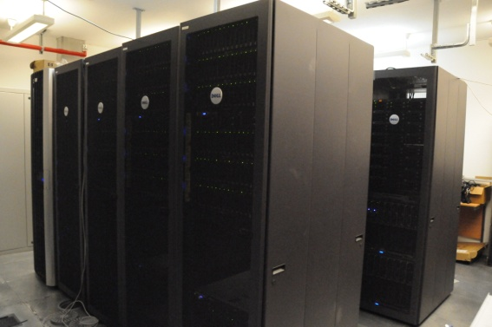
Different Resources
Low
Security
Security
High
Security
Authentication
Authentication
Authorization
Simple User Profile

Slide 6
HELIO Architecture (Abstract)
Access
Layer
HELIO
API
HELIO
Service
Resources
HELIO
Service
Resources
HELIO
Service
Resources
Connects to services independently
Use them in a workflow
Use a GUI
IDL, Java
Decoupling layer
Hides unnecessary Information
Data & Metadata
Storage
Computation
Existing Code
Security
Web Service
Based

Slide 7
The Access Layer and API
Workflow
Engine
(Server)
Workflow
Engine
(Desktop)
HFE
API
Service
I
Standalone GUI

Slide 8
The Community Interaction Service
Community
Interaction
Service
Authentication
Back End
HELIO Identity Token
Access Layer &
API
Service

Slide 9
The HELIO Identity Token 1/2
 | Through Portal and API | Directly through API
Grid Certificate | UID Personal proxy certificate User Profile | UID Personal proxy certificate User Profile
Login/Password | UID Robot Proxy certificate User Profile | UID User Profile
Anonymous | UID Robot Proxy certificate User Profile | UID User Profile

Slide 10
The HELIO Identity Token 2/2
Proxy-based component
(for high level of security)
KM234454353GD
UID-based component
(for low level of security)
User Profile
(Based on the ClassAd
language)
[Service=HEC;
Preference=...;]

