Slide 1
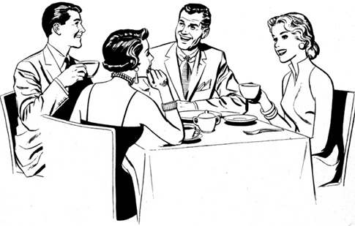
The conversation at dinner parties is of a mind-numbing calibre. No discussion of any clarifying rigor — be it political, spiritual, artistic or financial — can take place in a context where fervent conviction of any kind is frowned upon, and the desire to follow through a sequence of ideas must give way every time to the impressionistic, breezy flitting from topic to topic. Talk must be bubbly but not penetrating. Illumination would only slow the flow. Some hit-and-run remark may accidentally jog an idea loose, but in such cases it is better to scribble a few words down on the napkin for later, than attempt to "think" at a dinner party.
Phillip Lopate, Against joie de vivre

Slide 2
A discourse analytic framework for conversational Engagement in Online Discussion Tasks
Breffni O’Rourke, Gillian Martin, Helen O’Sullivan
Trinity College Dublin
Eurocall 2014, Groningen

Slide 3
The Context: speakwise

Slide 4
speakwise
Speakwise is
a telecollaborative learning project
focussed on intercultural communication (ICC)
Involving Trinity College Dublin and the University of Hildesheim
Blended with classroom module on ICC
Undergraduate students:
  In Dublin, in final year of a degree in Business and German; module is compulsory
  In Hildesheim, various backgrounds; module is elective
Uses asynchronous (e.g., PowerPoint uploads) and synchronous (webchat) communication, in Blackboard (prev. Moodle)
Running annually since 2007

Slide 5
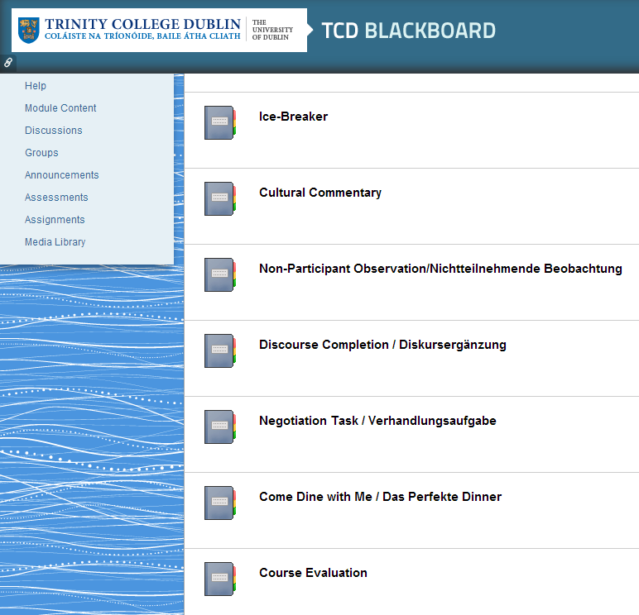
Module content
Ice-breaker – write a postcard
Cultural commentary – La double vie de Veronica
Negotiation task – video conference
Come Dine With Me – comparision of Ge/Ir versions of reality show

Slide 6
The pedagogical problem

Slide 7
The pedagogical problem
Some chat groups do not engage well with the discussion tasks. Discussions sometimes seem superficial, unfocused, or staccato – there isn’t the kind of engagement with the subject that we expect.
But what is it about a conversation that gives us intuitions about engagement?
To put it another way,
What are the properties of engaged discussion?
And concretely, what would we change about a superficial or less-engaged discussion among our students, if we could?

Slide 8
The objective
To create a discourse-analytic framework for characterising topic-based discourse in text-based SCMC that will
Allow us to formalise our intuitions regarding engagement with discussion topics
Give us a descriptive vocabulary to facilitate awareness-raising
Allow us to formulate precise hypotheses in empirical studies
Investigate more systematically what kind of task specs will give rise to engaged discussion

Slide 9
The good discussion: properties

Slide 10
What would “thinking at a dinner party”
(or in online chat) look like?

Slide 11
Discussions: normative properties
A good discussion is a joint enterprise.
  A discussion, in the sense that we’re concerned with, is not just the elicitation and individual presentation of information and opinions: we expect participants to engage with the contributions of others.

Slide 12
Discussions: normative properties
A good discussion involves sustained topic development.
  An engaged discussion involves long topic threads that show development of participants’ understanding, rather than many shorter topic threads without strong connections between them.

Slide 13
Discussions: normative properties
A good discussion has analytical depth.
  Engagement with a topic (even individually) involves formulating generalisations, and justifying them with evidence – moving from particular to general; from concrete to abstract (and sometimes back again).

Slide 14
contingency
Properties 1 and 2 (joint enterprise; sustained topic development) are entailed by Van Lier’s (1996) notion of contingency in discourse:
In contingent discourse, each turn is based on what has gone before (it’s backward-looking), but also opens up a range of possibilities for the next turn (it’s forward-looking).
“Two contingently related utterances are unintelligible except in terms of their relation to one another, like two moving hands in a handshake” (p. 170)
Van Lier proposes that “contingency is the quality of language use that can most directly be associated with engagement and learning” (p. 171)

Slide 15
The framework

Slide 16
What the framework doesn’t address
Complexities of threading and turn sequencing (tidied up in analysis)
Affect
Interlocutor roles and relationships (e.g., equality and mutuality – Storch 2002)
The substantive quality of the discussion – how logical, systematic, comprehensive, well-informed it is
Small-talk
Meta-talk (e.g., incidental metalinguistic talk, task management talk)

Slide 17
The framework
Analysis on a per-turn basis (taking into account prior and following turns)
(We note that in SCMC, it isn’t straightforward to determine the boundaries of a ‘turn’)
Two tiers of analysis:
Tier 1 categorises act types, and deals with topic development through engagement with others’ contributions
We’ll call these ‘discussion acts’ (narrower, specialised subset of ‘dialogue acts’ or ‘speech acts’)
Tier 2 categorises level of analytic depth

Slide 18
Framework Tier 1 – act types
In the framework, discussion act types can have the following attributes:
1. Contingency – None, Low, High, for each of two types:
Retrospective – prompted by a prior utterance
Prospective – sets up expectation of a next utterance
2. Congruence: two values –
Positive (stance agrees with prior)
Negative (stance conflicts with prior)
3. Consensus: two values –
Yes (establishes a prior point as accepted)
No (prior point remains in contention)

Slide 19
Inventory of discussion act types
Initiations
Bare agreement
Elaborated agreement
Agree + dissent
Concessions
Dissent
Challenges
Developers
Clarification/informa-tion requests
Elicited clarifications or information
Unelicited clarifications
Acknowledgements
Summarisers
Generalisers
Tangents
Prompts
Receipts

Slide 20
Inventory of discussion act types
Initiations
Bare agreement
Elaborated agreement
Agree + dissent
Concessions
Dissent
Challenges
Developers
Clarification/informa-tion requests
Elicited clarifications or information
Unelicited clarifications
Acknowledgements
Summarisers
Generalisers
Tangents
Prompts
Receipts

Slide 21

“La double vie de veronica”
A text by a woman exploring her experiences as a Chinese person who moved to Australia.
Open discussion task using webchat

Slide 22
Examples: initiations
Questions or assertives introducing a new topic or weakly-connected sub-topic
15:15 Dierk: how did you like the text about that chinese girl?
15:47 Julia: war denn hier irgendjemand schon mal in china?
Has anybody here been to China?
15:49 Julia: ich finde es schon krass, wenn man diese fotos von den vollgestopften bahnen sieht […] und von den obervollen schwimmbädern
I do find it gross when you see these photos of trains crammed full of people, and of overcrowded swimming pools

Slide 23


Initiations: attributes

Slide 24
Examples: bare agreements
Assertives that establish a prior point as agreed but don’t develop the point or project further responses
15:16 Julia: I agree with Dierk // 15:16 Julia: and with you ryan
15:28 Dierk: but are there as many latin americans as chinese people? […] 15:29 Dierk: in a comparably small place?
15:29 Julia: not at all!!!
15:29 Ryan: Don't think so.

Slide 25
Bare agreements: attributes

Slide 26
EXAMPLES: ELABORATED AGREEMENTS
Display explicit agreement with point and develop it further, leading to higher prospective contingency
15:22 Marcus: i was just thinking about that and i agree with you julia // it would be real hard to keep everything to yourself
15:36 Julia: marcus hat recht... und sie [hat] auch beschrieben wie sie sich einiges, was sie sich angewöhnt hat, nur schwer wieder abgewöhnen konnte, wenn sie wieder in china war
Marcus is right… and she also describes how, when she was back in china, she found it difficult to give up some things that she had got used to

Slide 27

Elaborated agreements: attributes

Slide 28
Examples: DEVELOPERS
Further develop a point (own or other’s) further, by adding further evidence, adducing consequences or corollaries, etc. Retrospective contingency need not be overt.
15:32 Abad: das ist ja das schwierige an "interkulturellen "beziehungen" // 15:33 Abad: ich hab einen freund der eine chinesische freundin hatte und es gab immer schwierigkeiten // aber so muss das ja nicht immer sein
15:23 Ryan: From an Irish perspective, showing affection and love for someone is a regular occurrence, obviously depending on the surroundings and location.
15:24 Julia: i think in this point irish people and germans are quite similar

Slide 29

developers: attributes

Slide 30
Examples: dissentS (demurrals?)
Display disagreement with a prior – other is wrong, overlooking something, etc.
15:37 Dierk: […] warum kommt sie dann so wenig klar wenn sie nach australien geht
15:38 Julia: aber sie meinte ja, dass sie kaum etwas über das land wusste und ziemlich unvorbereitet war
Dierk: then why does she cope so poorly when she goes to australia
Julia: but she said that she hardly knew anything about the country and was rather unprepared
15:34 Abad: naja, sie hat keine ironie verstanden, ich glaube, das ist mehr etwas europäisches […]
15:34 Julia: gibts in den usa, kanada, nz und oz aber auch, abad
Abad: yeah, well she didn’t understand irony, I think that’s something more European
Julia: it exists in the usa, canada, nz and oz too though, abad

Slide 31
dissents: attributes

Slide 32
Possible metrics

Slide 33
Comparing two groups
Group 1: 102 discussion acts
  Impressionistic assessment: More topical and mutual engagement
Group 2: 56 discussion acts
  Impressionistic assessment: Less topical and mutual engagement

Slide 34
Range and ranking of acts
Top 5 act types includes 73% of tokens

Slide 35
Range and ranking of acts
Top 5 act types includes 95% of tokens

Slide 36
Top 5 discussion acts
Group 1 | Group 2
Dissents | Elicited clarifications/info/opinions
Developers | Clarification and info requests
Elicited clarifications/info/opinions | Developers
Bare agreements | Elaborated agreements
Initiations | Initiations

Slide 37
Comparing proportions of contingent acts

Slide 38
Tier 2: level of analytic depth
From ‘shallowest’ (most concrete) to ‘deepest’ (most abstract):
Reference to stimulus material (in this case, the ‘Veronica’ text)
Reference to relevant personal experience
Argument, generalisations based on evidence at level 1 or 2
Reference to technical and theoretical concepts (in this case, of intercultural communication)

Slide 39
limitations
Discrete values (none, low, medium) for continuous attributes like contingency – forces subjective analytical decisions
Lumping / splitting problems – e.g.,
  Should Developers be split into Own vs. Other?
  Should Requests be split into Clarification, Information, and Opinion?
  Is the distinction between Elaborated Agreements and (other-) Developers worth making?
  Or between Dissents and Challenges?
  Resolving these questions should help to clarify and define the precise nature of the phenomena under investigation.

Slide 40
Future work
Develop Tier 2 of framework
Validity: check against engagement intuitions of participants, and of observers
Establish inter-rater reliability
Extend to more chat logs and fine-tune (or even coarse-tune)
Develop method (e.g., graphical, statistical pattern identification) for applying framework to turn sequences

Slide 41

THANK YOU
…and many thanks to the Hildesheim and Trinity Speakwise student participants over the years, and to our colleagues in Hildesheim.
This work was funded in part by a Benefaction Grant from the Faculty of Arts, Humanities, and Social Sciences of Trinity College Dublin.

Slide 42
references
O'Sullivan, H., G. Martin, and B. O'Rourke (2011). 'The Irish are too polite': Analysing stereotype and identity dynamics in student webchat. In A. Witte and T. Harden (Eds.), Intercultural competence: Concepts, challenges, evaluations, pp.393-409. Oxford: Peter Lang.
O'Sullivan, H., G. Martin, and B. O'Rourke (2013). Introducing Blended Learning into Tertiary Level German: An Activity Theoretical Analysis. In J. L. Plews & B. Schmenk (Eds.), Traditions and Transitions: Curricula for German Studies, pp.315-332. Waterloo: Wilfrid Laurier University Press.
Storch, N. (2002). Patterns of interaction in ESL pair work. Language Learning, 52(1), 119–158.
Van Lier, L. (1996). Interaction in the language curriculum : awareness, autonomy, and authenticity. London: Longman.

