Slide 1

All of the best recollections of wisdom and friendship, from Plato’s “Apology” for Socrates to Boswell’s Life of Johnson, resound with the spoken, unscripted moments of interplay and reason and speculation. It’s in engagements like this, in competition and comparison with others, that one can hope to hit upon the elusive, magical mot juste. For me, to remember friendship is to recall those conversations that it seemed a sin to break off: the ones that made the sacrifice of the following day a trivial one.
Christopher Hitchens, Mortality
Milton Avery, “Conversation 1956” http://www.bertc.com/subfour/g123/avery13.htm

Slide 2
A discourse analytic framework for conversational Engagement in Online Discussion Tasks
Breffni O’Rourke, Gillian Martin, Helen O’Sullivan
Trinity College Dublin
Eurocall 2015, Padova

Slide 3
Pedagogical context: speakwise
Speakwise is
a telecollaborative learning project
focussed on intercultural communication (ICC)
Involving Trinity College Dublin and the University of Hildesheim
Blended with classroom module on ICC
Undergraduate students:
  In Dublin, in final year of a degree in Business and German; module is compulsory
  In Hildesheim, various backgrounds; module is elective
Uses asynchronous (e.g., PowerPoint uploads) and synchronous (webchat) communication, in Blackboard (prev. Moodle)
Running annually since 2007

Slide 4
(Part 1, Eurocall 2014: joint topic development through “discussion acts”)
Breffni O’Rourke, Gillian Martin, Helen O’Sullivan
Trinity College Dublin
Eurocall 2015, Padova

Slide 5

Part 2: topic engagement in synchronous online discussions
Breffni O’Rourke, Gillian Martin, Helen O’Sullivan
Trinity College Dublin
Eurocall 2015, Padova

Slide 6
The pedagogical problem

Slide 7
The pedagogical problem
Some chat groups do not engage well with the discussion tasks. Discussions sometimes seem superficial, unfocused, or staccato – there isn’t the kind of engagement with the subject that we expect.
But what is it about a conversation that gives us intuitions about engagement?
To put it another way,
What are the properties of engaged discussion?
And concretely, what would we change about a superficial or less-engaged discussion among our students, if we could?

Slide 8
The objective
To create a discourse-analytic framework for characterising topic-based discourse in text-based SCMC that will
Allow us to formalise our intuitions regarding engagement with discussion topics
Give us a descriptive vocabulary to facilitate awareness-raising
Allow us to formulate precise hypotheses in empirical studies
Investigate more systematically what kind of task specs will give rise to engaged discussion

Slide 9

“Engagement”?

Slide 10
Emotional engagement

Slide 11
Political engagement
Emotional engagement

Slide 12
Political engagement
Emotional engagement
Engagement with artefacts – e.g., HCI

Slide 13
Political engagement
Emotional engagement
Engagement with artefacts – e.g., HCI
being “greatly interested” – “emotional involvement or commitment” – the state of having one’s attention or interest attracted and held fast

Slide 14
Engagement 1 - task
Engagement 2 - topic
Engagement 3 - interpersonal

Slide 15
Discussion Task
Topic engagement
Interpersonal engagement

Slide 16
The framework

Slide 17
The framework
Analysis on a per-turn basis (taking into account prior and following turns)
(We note that in SCMC, it isn’t straightforward to determine the boundaries of a ‘turn’)
Two tiers of analysis:
Tier 1 categorises act types, and deals with topic development through engagement with others’ contributions
We’ll call these ‘discussion acts’ (narrower, specialised subset of ‘dialogue acts’ or ‘speech acts’)
Tier 2 categorises intensity of collaborative engagement with the topic

Slide 18
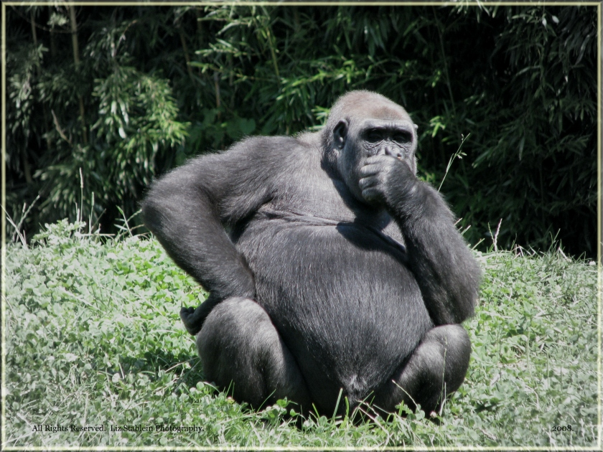
Topic engagement = critical thinking?
http://james-mcwilliams.com/?p=1544

Slide 19
Topic engagement = critical thinking?
Judge the credibility of sources
Identify conclusions, reasons and assumptions
Judge the quality of an argument including the acceptability of its reasons, assumptions, and evidence
Develop and defend a position on an issue
Ask appropriate clarifying questions
Plan experiments and judge experimental designs
Define terms in a way appropriate for the context
Be open-minded
Try to be well-informed
Draw conclusions when warranted, but with caution
Ennis 1993, p. 180

Slide 20
Topic engagement = critical thinking?
Problems:
Critical thinking is an individual process, therefore…
  Applied to analysis of individual posts in forums
  Less suited to the rough-and-tumble of synchronous discussion
CT is goal-oriented and directional: it is “reasonable reflective thinking focused on deciding what to believe or do” (Ennis 1993, emphasis added)
Looking for CT processes sets the bar too high – discussion may fall short of this but still be useful to people seeking to learn
Lastly, CT pre-supposes engagement.

Slide 21
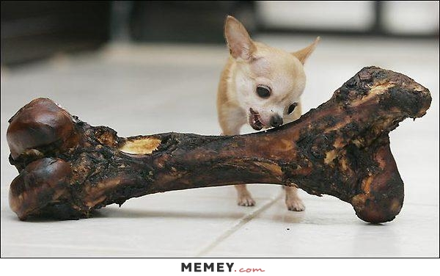
So what shows engagement with a topic?
Efforts – successful or not – to…
  See multiple aspects of the topic
  Relate the topic to personal experience
  Formulate defensible generalisations
  Relate generalisations to exemplars:
    Inductively (exemplars as evidence for generalisations)
    Deductively (generalisations as explanations for exemplars)
  Go beyond value judgements, but also…
  Scrutinise value judgements in light of evidence

Slide 22
Referential domain
Propositional mode
Specificity
Stimulus
Self
World
Normative
Analytical
Exemplar
Generalisation

Slide 23
Referential domain what you’re talking about
Stimulus
Self
World

Slide 24
Referential domain what you’re talking about
A case study, an example, a problem, a question, a set reading…
Stimulus
15:15 Dierk: how did you like the text about that chinese girl?
15:17 Dierk: […] she never talks about her love to her husband
15:29 Ryan: I think the purpose of her article was only to highlight the aspects of her life in Australia that were different to that of life in China.

Slide 25
Referential domain what you’re talking about
Personal experience of one or more of the discussants as it relates to the topic
Self
15:22 Julia: i couldn´t imagine never telling anybody about my true feelings
15:47 Julia: war denn hier irgendjemand schon mal in china?
So has anybody here been to China?
15:33 Abad: ich hab einen freund, der eine chinesische freundin hatte und es gab immer schwierigkeiten
I have a friend who had a Chinese girlfriend and there were always difficulties

Slide 26
Referential domain what you’re talking about
Observed reality, particulars or generalities, experienced or inferred
World
15:23 Ryan: From an Irish perspective, showing affection and love for someone is a regular occurrence, obviously depending on the surroundings and location.
15:24 Ryan: I think this theme also links in with the idea of private space and public space.
15:34 Abad: naja, sie hat keine ironie verstanden, ich glaube, das ist mehr etwas europäisches
Well, she didn‘t get irony, I think that‘s more a European thing

Slide 27
Referential domain what you’re talking about
Stimulus
Self
World

Slide 28
Propositional mode how you’re talking about it
Normative
Analytical
Normative encompasses affective; Analytical encompasses descriptive

Slide 29
Propositional mode how you’re talking about it
Normative
15:49 Julia: ich finde es schon krass, wenn man diese fotos von den vollgestopften bahnen sieht
I do find it gross when you see these photos of trains crammed full of people
15:25 Dierk: for me, too, i wouldnt want to see the things i do for my partner and the things he does for me as standard for which you don´t have to thank each other
15:22 Marcus: it would be real hard to keep everything to yourself

Slide 30
Propositional mode how you’re talking about it
Analytical
15:18 Ryan: I think the purpose of her article was only to highlight the aspects of her life in Australia that were different to that of life in China.
15:35 Abad: nein, er ist franzose, sie aus shanghai
No, he‘s French, she‘s from Shanghai [friends of Abad‘s]
15:24 Ryan: I think this theme also links in with the idea of private space and public space.

Slide 31
Propositional mode how you’re talking about it
Normative
Analytical

Slide 32
specificity the relationship between what you’re saying and what’s been said
Exemplar
Generalisation

Slide 33
specificity the relationship between what you’re saying and what’s been said
Exemplar
Generalisation
Induction

Slide 34
specificity the relationship between what you’re saying and what’s been said
Exemplar
Generalisation
Deduction

Slide 35
specificity the relationship between what you’re saying and what’s been said
Exemplar
15:20 Marcus: I think the fact that she doesn’t mention her love for him is part of her culture.
15:25 Ryan: […] large empty spaces in Australia are very different to the closeness in China. This could also have an effect on how they express themselves as individuals.
15:27 Abad: but what about other cultures, i'm thinking of some latinamerican cultures, where closeness exists as well? // they are not like chinese people talking about showing affection
15:33 Abad: ich hab einen freund, der eine chinesische freundin hatte und es gab immer schwierigkeiten
I have a friend who had a Chinese girlfriend and there were always difficulties

Slide 36
specificity the relationship between what you’re saying and what’s been said
Generalisation
15:40 Dierk: ja offen sein ist schon gut. aber ich habe manchmal das gefühl, dass man diese interkulturellen probleme auch aufbläht [...]
Well sure, it‘s good to be open. But I sometimes have the feeling that these intercultural problems get inflated too [...]
15:22 Marcus: it would be real hard to keep everything to yourself
15:41 Abad: der text behandelt ja auch mehr die problematik, die dahintersteckt
But the text is more about the problem behind it

Slide 37
specificity the relationship between what you’re saying and what’s been said
Exemplar
Generalisation

Slide 38
Referential domain
Propositional mode
Specificity
Stimulus
Self
World
Normative
Analytical
Exemplar
Generalisation

Slide 39
Are these variables independent?
All but two of the twelve possible combinations occur in a 193-turn chat.
The two that don’t are
Personal – Analytic – Exemplar (PAE)
Personal – Normative – Exemplar (PNE)
…that is, no-one gives examples from direct personal experience (though they do relate examples from friends and acquaintances, which are coded ‘Personal / World’)

Slide 40
how common are the values of each variable?

Slide 41
How are the variable combinations distributed?
Approximately Zipfian – top five types:

Slide 42
Examples of top 5 types
World – Analytic – Generalisation (24 tokens):
  “ich glaube, die differenzen zwischen der chinesischen und anderen kulturen sind wohl auch enorm“
  I think the differences between the Chinese and other cultures are huge alright
Stimulus – Analytic – Exemplar (15 tokens):
  “aber sie meinte ja, dass sie kaum etwas über das land wusste und ziemlich unvorbereitet war”
  But she said she hardly knew anything about the country and was quite unprepared

Slide 43
Examples of top 5 types
  Stimulus – Analytic – Generalisation (12 tokens):
    “I think the purpose of her article was only to highlight the aspects of her life in Australia that were different to that of life in China”
Stimulus – Normative – Generalisation (11 tokens)
“she was quite courageous to move to australia”
Personal – Normative – Generalisation (10 tokens)
“i couldn’t imagine never telling anybody about my true feelings ”

Slide 44
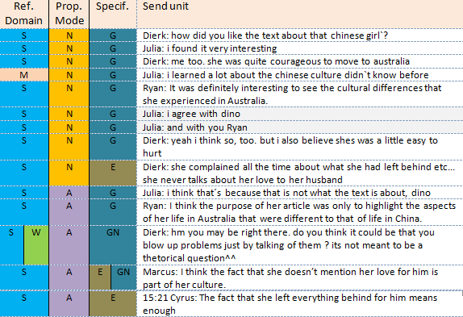

Slide 45
Work in progress!
This is work in progress!
Operational definitions of attributes and values are still somewhat unstable. So need to:
  Extend to more chat logs and adjust operational definitions of values
Per-turn analysis may be too fine-grained, and that stretches of discourse, defined by continuous topic-focus, might be a more natural unit (or an additional unit)
Validity: check against engagement intuitions of participants, and of observers
Establish inter-rater reliability

Slide 46
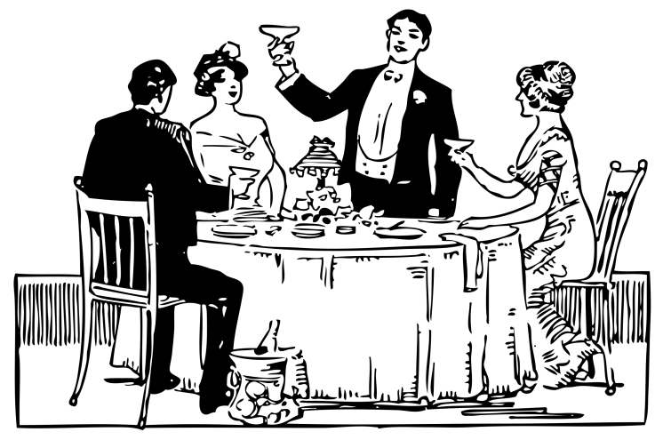
THANK YOU
…and many thanks to the Hildesheim and Trinity Speakwise student participants over the years, and to our colleagues in Hildesheim.
This work was funded in part by a Benefaction Grant from the Faculty of Arts, Humanities, and Social Sciences of Trinity College Dublin.

Slide 47
references
Ennis, R. H. (1993). Critical Thinking Assessment. Theory into Practice, 32(3), 179–186.
O'Sullivan, H., G. Martin, and B. O'Rourke (2011). 'The Irish are too polite': Analysing stereotype and identity dynamics in student webchat. In A. Witte and T. Harden (Eds.), Intercultural competence: Concepts, challenges, evaluations, pp.393-409. Oxford: Peter Lang.
O'Sullivan, H., G. Martin, and B. O'Rourke (2013). Introducing Blended Learning into Tertiary Level German: An Activity Theoretical Analysis. In J. L. Plews & B. Schmenk (Eds.), Traditions and Transitions: Curricula for German Studies, pp.315-332. Waterloo: Wilfrid Laurier University Press.
Perkins, C., & Murphy, E. (2006). Identifying and measuring individual engagement in critical thinking in online discussions : An exploratory case study Development of a model, 9, 298–307.
Storch, N. (2002). Patterns of interaction in ESL pair work. Language Learning, 52(1), 119–158.
Van Lier, L. (1996). Interaction in the language curriculum : awareness, autonomy, and authenticity. London: Longman.

