Slide 1
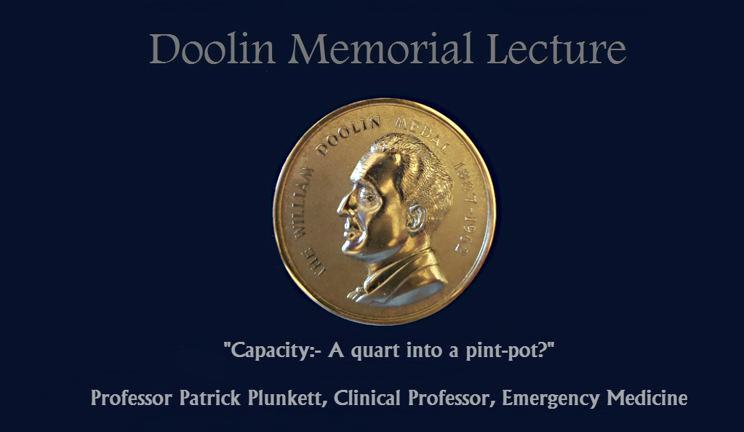
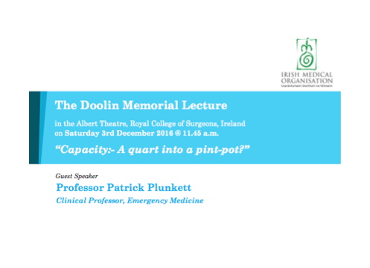
Notes:
A dhaoine uaisle, táim fíor-bhuíoch faoin chuireadh chun an léacht seo a chur I bhfúir láthair, agus tá mé, freisin, an-áthasach é a dhéanamh.
Ladies and Gentlemen, Friends and colleagues, I was deeply honoured to be invited to give this prestigious address and am delighted to do so.

Slide 2
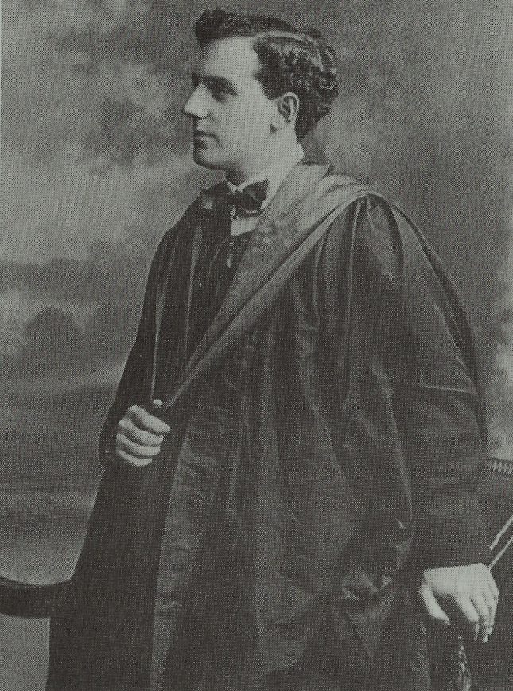
1910
Notes:
William Doolin, the eldest son of Walter G Doolin, an architect, and Marion (neé Creedon) was born on 19th July 1887 in 20 Ely Place, 600 metres from this spot, a building which currently houses a Chiropractic clinic. They moved further out, to 471 Pembroke Road during his early childhood.
When he left Clongowes College, he entered the Cecelia St Medical School in 1904.
However, when he graduated it was as the very first Honours graduate in Medicine from the newly created University College Dublin, in 1910.

Slide 3
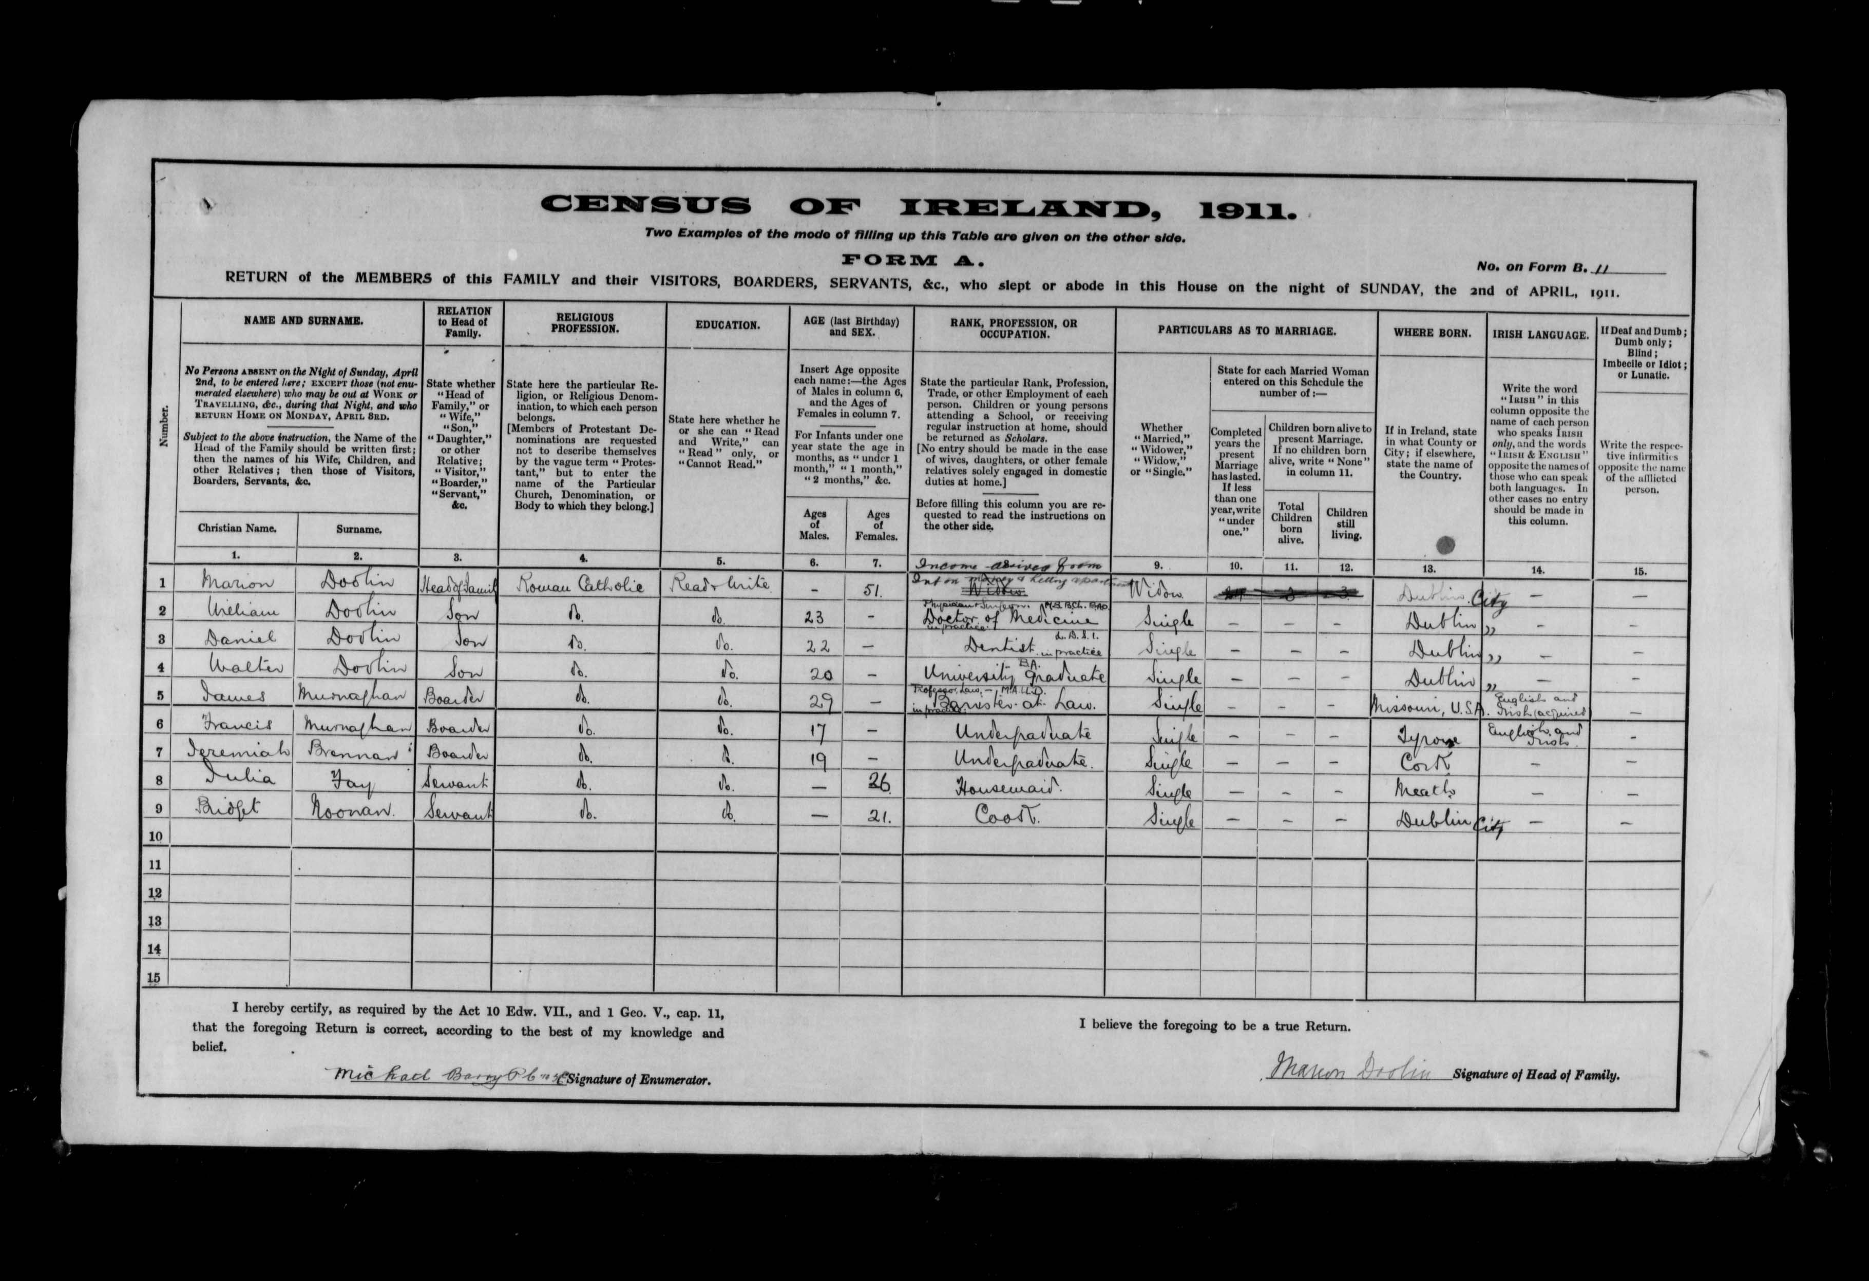
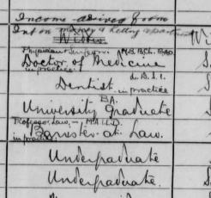
1911
Notes:
By that time, his mother, Marion, had been widowed and was supporting her family by taking lodgers into a smaller house on Pembroke Road.
Given their academic backgrounds, dinner conversations in that household must have been very interesting indeed
CLICK twice for close up

Slide 4
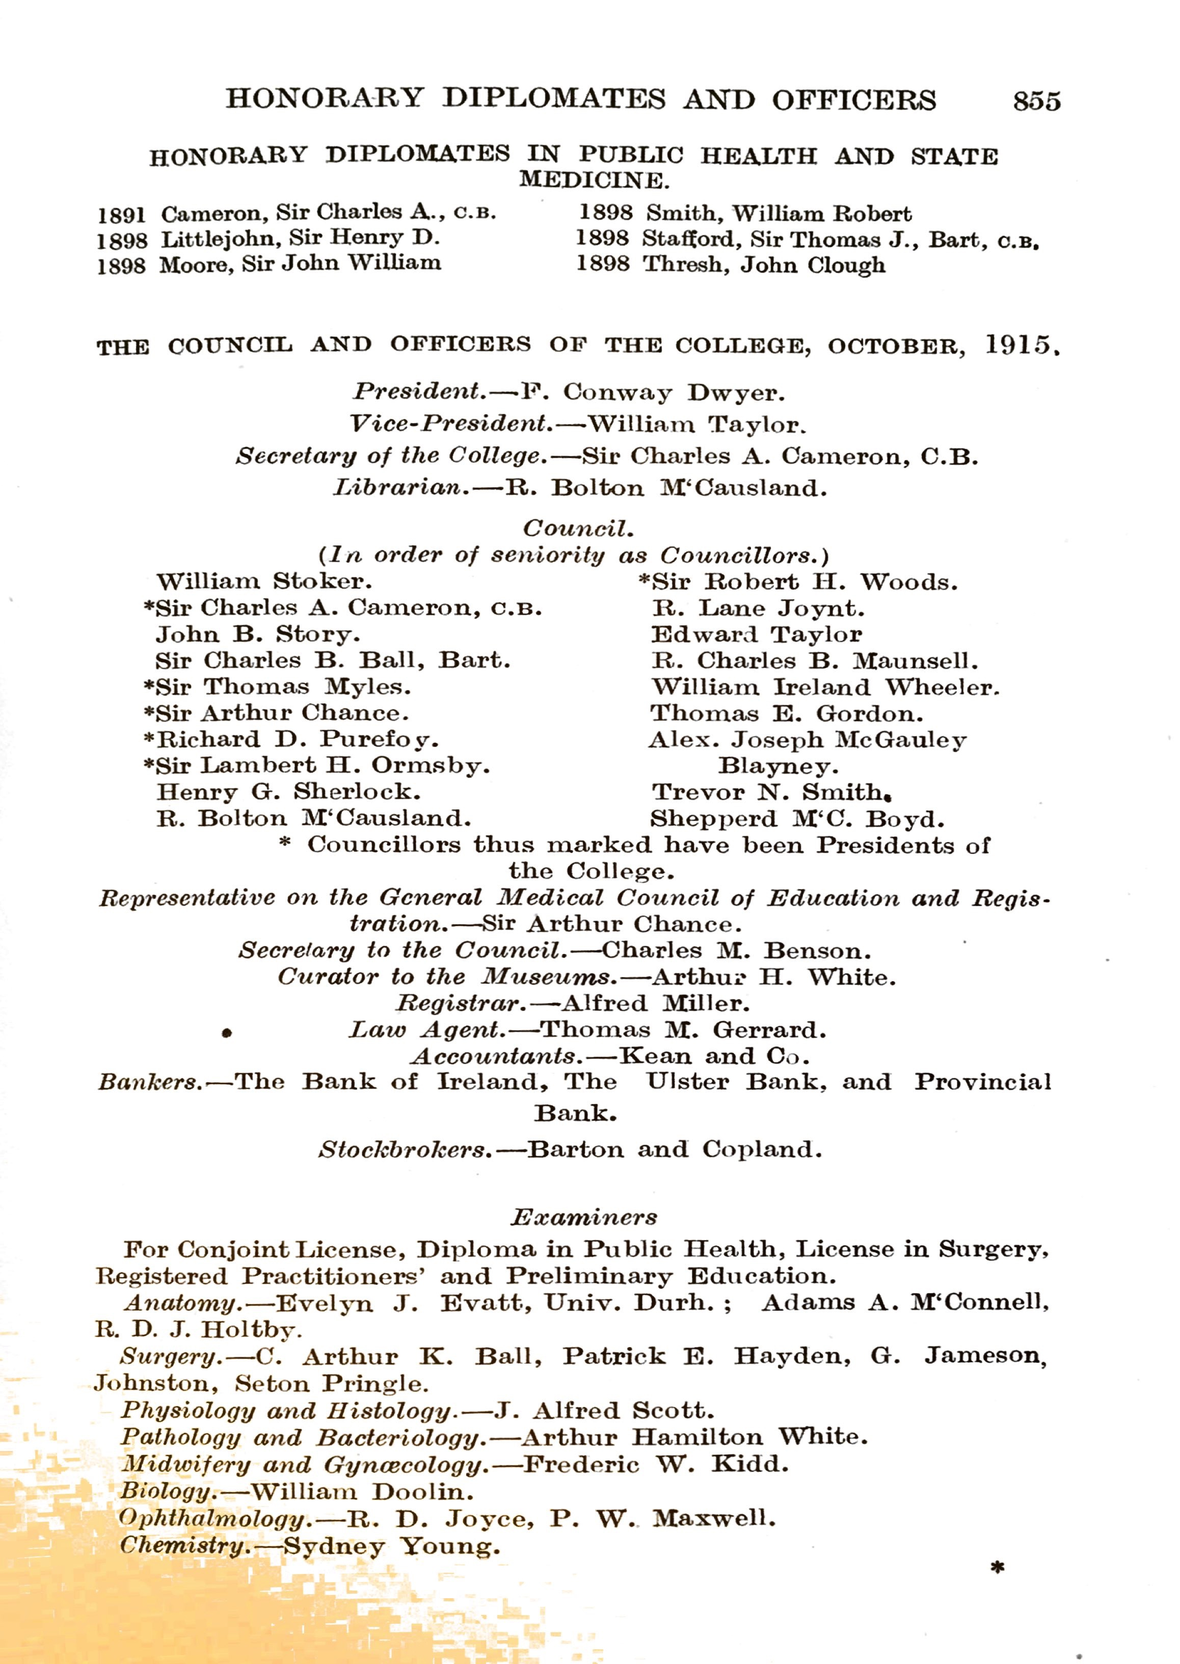
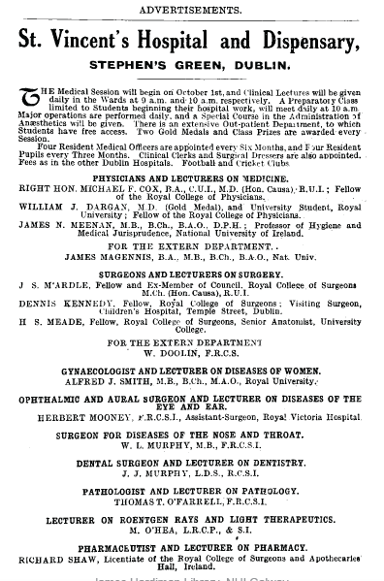
1915
Notes:
Doolin went abroad for a Wanderjahre, but by 1912 had achieved the Fellowship of the College in which we stand today.
He began a tenuousprofessional existence demonstrating anatomy in Cecelia Street, and giving dental anesthetics, although Sir Charles Cameron has him recorded as an Examiner in Biology at RCSI by 1915, the year he married Claire Kennedy, with whom he had 5 children.

Slide 5
1917
Notes:
By 1917, he was acting as Surgeon to the extern department of St Vincent’s Hospital, directly across St Stephen’s Green.

Slide 6
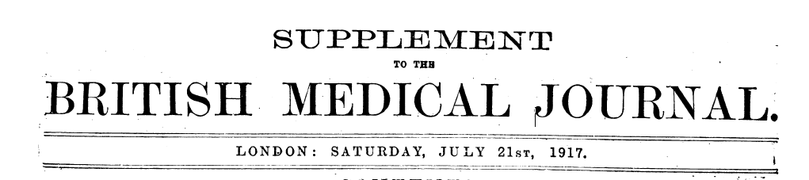
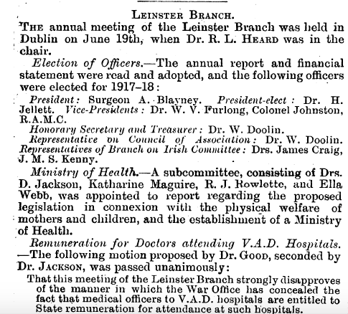
1917
Notes:
He was already becoming busy in other spheres, acting as both Secretary and Treasurer of the Leinster Branch of the British Medical Association, and as the Leinster representative on BMA Council

Slide 7
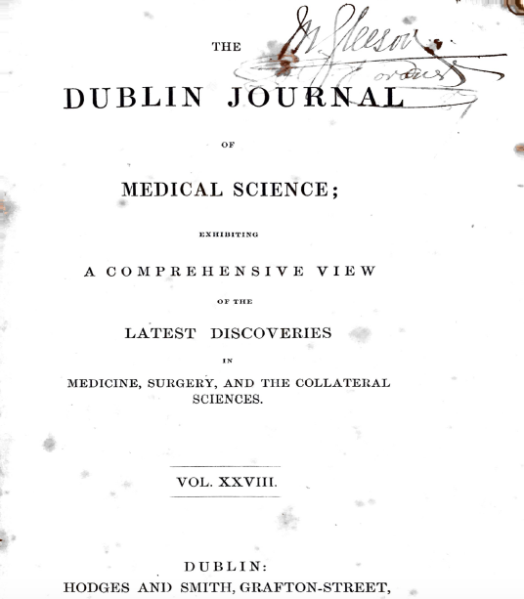
1926
Notes:
In 1926, he took on the role of Editor of what was previously the Dublin Quarterly Journal of Medicine, but which had been re-named the Irish Journal of Medical Science for its 6th Series.
He wrote many original pieces, both clinical and on the subject of medical history, as well as multiple Book Reviews and Editorials.

Slide 8
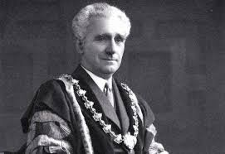
1938
Notes:
As an active surgeon, medical editor and medical politician, it seemed inevitable that William Doolin would take a major role in the Royal College of Surgeons in Ireland, being elected to Council in 1932, becoming Secretary to the College in 1936 and ultimately being elected President of RCSI for the period 1938-1940.

Slide 9
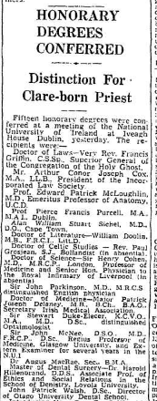
1952
Notes:
In 1952, he took on an additional editorial role for the Journal of the Irish Medical Assocation and was awarded an honorary Litt D from the National University of Ireland
At about this time, he took a firm personal position against State-sponsored medicine, which he felt would stultify the higher motives of the doctors.
This seems to have been in line with the stance taken by Archbishop John Charles McQuaid, in his battle with the Minister for Health, Dr Noel Brown, over the Mother and Child Scheme.

Slide 10
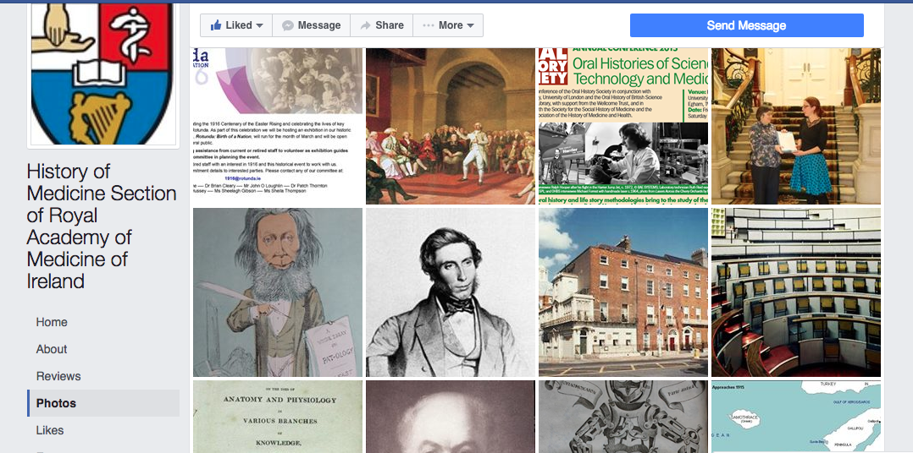
1952
Notes:
By 1954, Doolin was a founding member of the Section of the History of Medicine at the Royal Academy of Medicine in Ireland which, as you can see, remains active to this day.

Slide 11
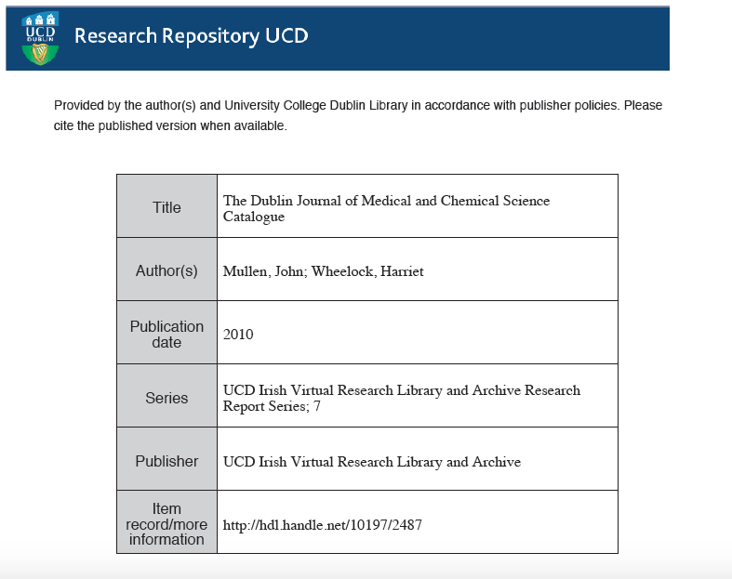
Notes:
Whilst the First series of the DQJMS had printed a General Index in 1849, the index thereafter did not help with searching as it left many gaps.
For those of you who might consider delving into the fascinating archive of Doolin’s main journal, John Mullen and Harriet Wheelock have together produced a wonderful paper on the history of the Journal from its inception and a searchable catalogue of all the issues from 1832 to 1949.
This is freely available online.

Slide 12
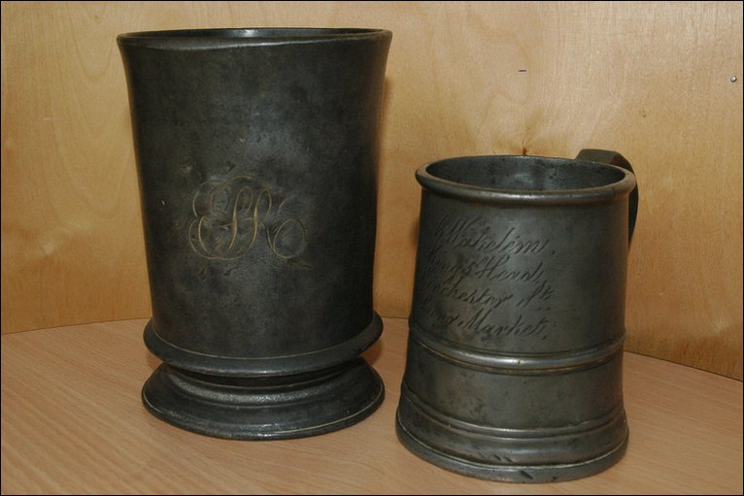
Capacity
Notes:
William Doolin died on 14th April 1962 in his Alma Mater, so to speak, of St Vincent’s Private Nursing Home.
This Lecture was set up in his honour only two years later, and I am grateful for the opportunity to speak on a topic close to my own heart.
Capacity: A quart into a pint-pot?
Lest there be any lingering doubt, this is about the supply:demand mismatch in Irish health care

Slide 13

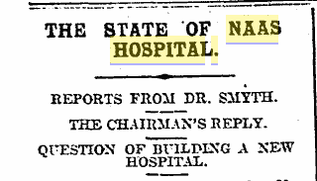
1910
Notes:
If we go back to the year that Doolin qualified in medicine, a local newspaper printed a very negative report on the state of Naas Hospital, which was responded to in a characteristically aggressive fashion by the local politicians.
It reads somewhat like a modern day adverse report from HIQA:-
“The extreme overcrowding of the infirmary and the other unsatisfactory conditions disclosed at the inspection are not only an injury, but a grave danger to the sick. Under such conditions, proper nursing and treatment are obviously an impossibility.
When wards are so overcrowded, the staff must of necessity be overwhelmed and demoralised.
The cleanliness, order and economy essential to hospital administration cannot be duly observed.
The first and urgent change to be made in the way of reform is to prevent overcrowding, so that every patient may have not less than the required minimum of hospital accomodation specified by the hospital authority.”
This does not seem to have been an isolated issue.

Slide 14
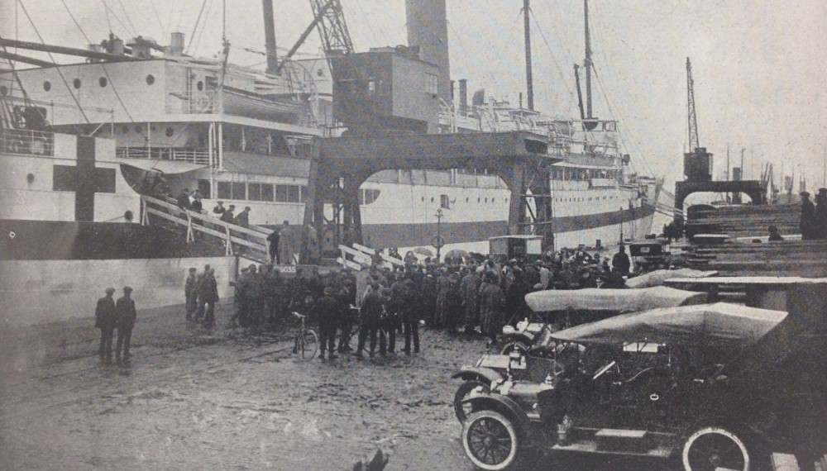
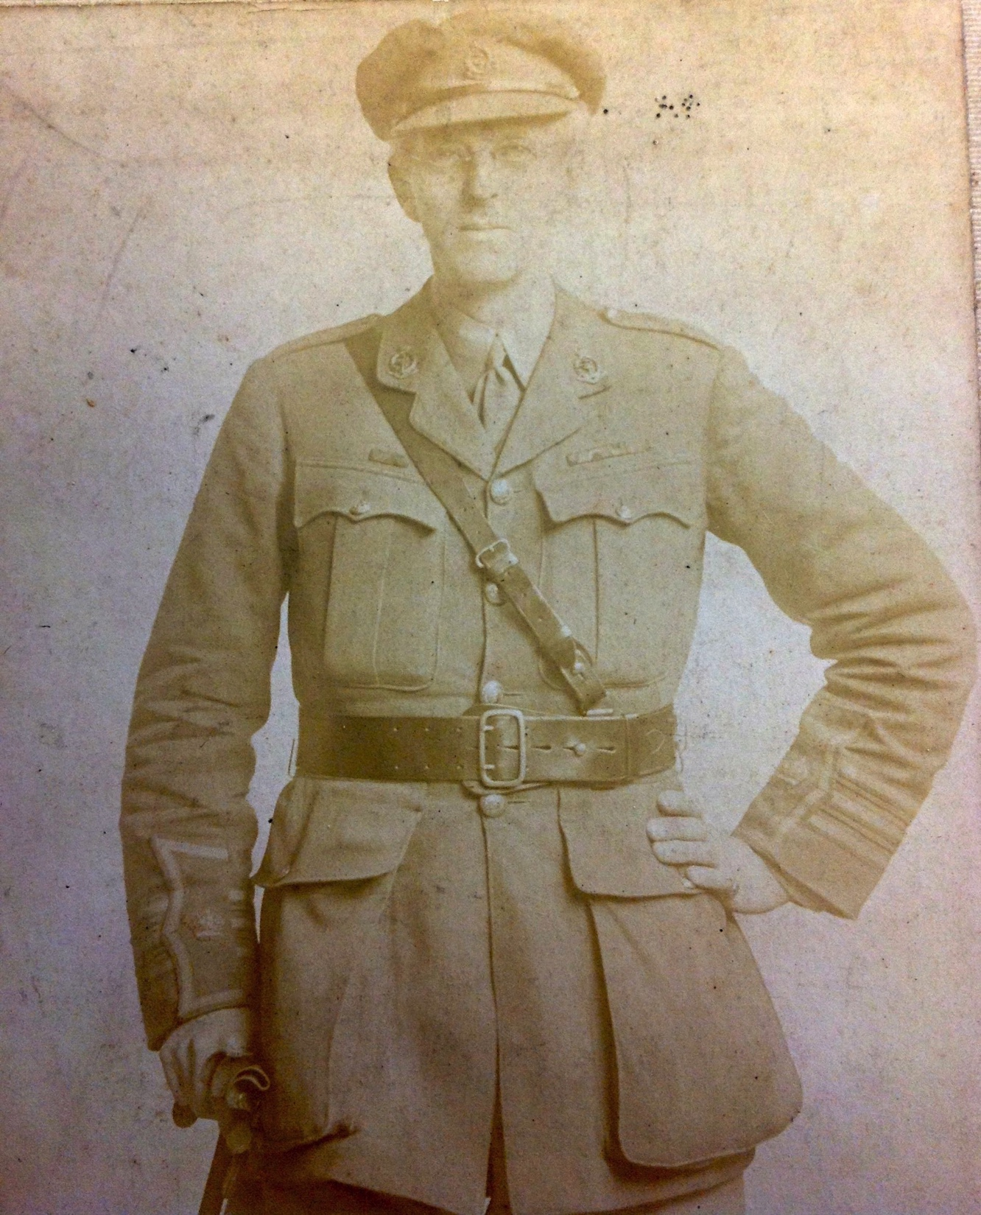
1917
Notes:
The First World War had a major impact on hospital care in Ireland, with the opening of several rehabilitation hospitals across the country.
Hospital ships docked at the North Wall on a regular basis, bringing home wounded soldiers of the British Expeditionary Force, many coming from the 83rd (Dublin) General Hospital at Wimereux, near Boulogne. This was a 1500-bedded military hospital staffed on short-term commissions by Dublin physicians and surgeons.
The individual shown here is Dr John Lumsden, a Consultant Physician at Mercer’s Hospital and Chief Medical Officer at the Guinness Brewery, who was gazetted as a temporary Major in the Royal Army Medical Corps and worked in the 83rd General Hospital for three months from November 1917.

Slide 15
I have met them at close of day
Coming with vivid faces
From counter or desk among grey
Eighteenth-century houses.
I have passed with a nod of the head
Or polite meaningless words,
Or have lingered awhile and said
Polite meaningless words,
And thought before I had done
Of a mocking tale or a gibe
To please a companion
Around the fire at the club,
Being certain that they and I
But lived where motley is worn:
All changed, changed utterly:
A terrible beauty is born.
W B Yeats
“Easter 1916”
Notes:
These words of one of our greatest poets were penned in relation to the Easter Rising, but equally might refer to the War of Independence and the Civil War, which devastated this country and had very negative effects on the economy and healthcare.
Many of the old workhouses were closed, due a vehement revulsion for the Poor Law provision, being converted ultimately to County Homes or District hospitals.
However, there was little appetite for real investment, given the other pressures on the economy.
Furthermore, the attitude of the Civil Service, privately, was to exclude those who previously had influence in matters of health, with phrases such as “ we don’t want their type” cropping up in internal memoranda.
The official externally-delivered response to some offers of assistance was ”we do not have the funds for such activity at present”

Slide 16
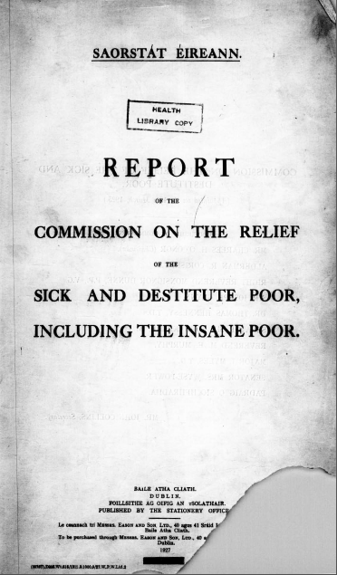
1927
Notes:
Over the first decade of the new state, the inefficiency of hospital care, provided primarily in Dublin by the voluntary hospitals, was highlighted.
Amalgamation of some of the Dublin voluntary hospitals was mooted.

Slide 17
9
We are in full accord with the policy of establishing, without overlapping or duplication, in the most accessible centres of population, public hospitals where the poor are likely from the medical assistance available, to obtain modern and skilled treatment in surgery and medicine.
1927
10
We are not in sympathy with the attempt to preserve in small towns district or cottage hospitals on the plea that the distances to the central hospital are too great.
Notes:
In that report, there was also an attempt to rationalise the situation elsewhere, with suggestions which seem almost current in their content
The idea that the poor should get good treatment was supported, but I regret to say that the approach to unmarried mothers in this report was, shall we say, “of its time”
The report warrants careful reading given the revelations over the past few years in regard to that cohort of women..

Slide 18
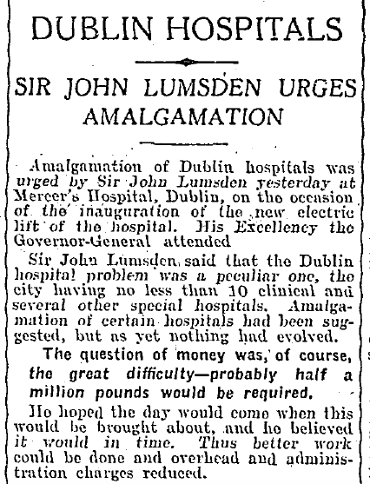
1929
Notes:
Sir John Lumsden, who was well known for his attempts to improve the social situation of his patients and their families, and who had been prominent in the introduction of pasteurisation of milk and the development of TB sanatoria, called for the amalgamation of Dublin Hospitals into newer, fewer, larger institutions, to give economies of scale.
Mind you, he felt at one stage that one hospital on the north side of Dublin and one one the south side would be sufficient and could be run with a matron and a registrar for each!
This was truly a two-tier health service, with the wealthy engaging their doctors privately and the poor relying on access to hospitals, which relied on subscriptions from patrons to fund their service. The consultants were paid by their private patients, but worked free of charge on hospital inpatients on a visiting consultant basis.

Slide 19
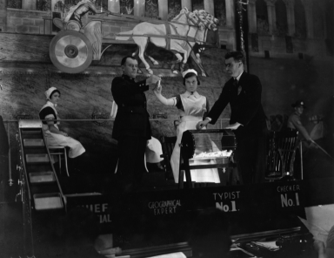
1933
Notes:
By the 1930s, the financial position in regard to hospital refurbishment and expansion was made much more secure by the inception of a Lottery, clearly designed to bring money into the country, as the sums involved were untenable for the Irish population alone.
The three entrepreneurs who devised and ran this project were each able to extract 10 times the annual salary of the Taoiseach of the day, for each of the first 10 years of the project.
That seems to contrast sharply with current thinking on relative pay scales.
Interestingly, I met the 85 year old son of one of these three entrepreneurs as a patient in my emergency department a few years ago.
He told me that his father had said the very best advice he could give his son was to “Never buy a lottery ticket”!
The only hospital not to accept funding from the Sweepstakes was the Adelaide Hospital, on grounds of immorality.

Slide 20
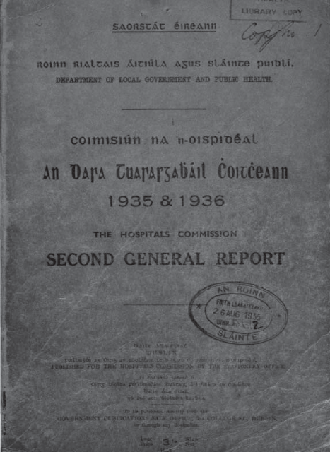
1936
Notes:
The 400-page Second General Hospitals report for 1935-1936 was a significant piece of audit work, which identified multiple deficiencies in provision of hospital care throughout the country, but reserved much of its commentary for what was described as the unsatisfactory relationships between the Dublin Voluntary hospitals.

Slide 21
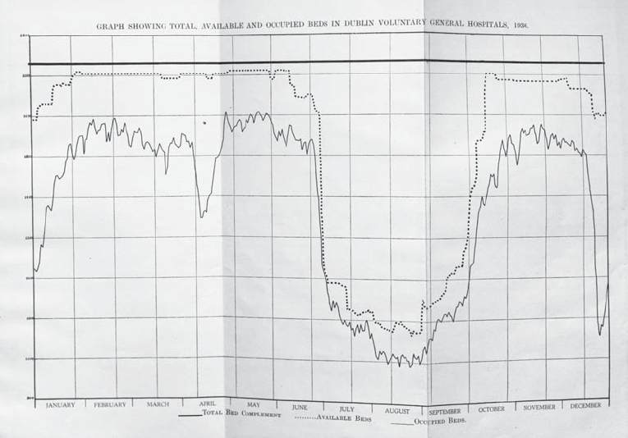
1936
Notes:
The report indicated that there were seasonal variations in availability of beds in the hospitals covered, most especially in the Dublin General Hospitals and reiterated the view, expressed in the First General Hospital report of 1933, that greater cooperation and coordination between hospitals was required. There was concern that patients were being turned away for frivolous reasons
Two reasons were adduced for the variation in bed availability, namely ward closure for refurbishment and accomodation of the holiday demands from staff for the months of July, August and September. Clearly they went on Christmas hoildays also and, lest you had any doubts, Easter Sunday 1936 was April 12th.

Slide 22
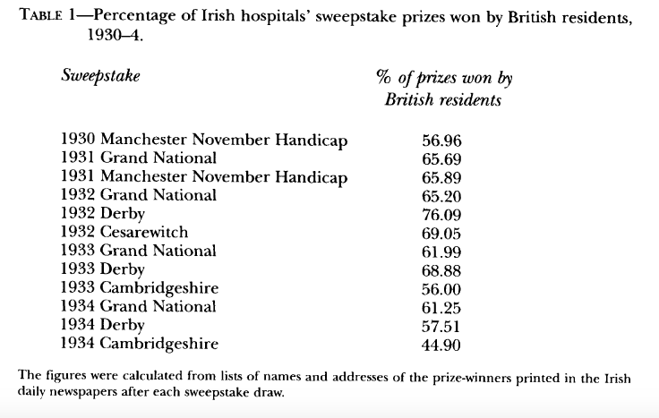
1936
M Coleman
Proc RIA Vol 105C (5) 197-220 (2005)
Notes:
The Irish Hospital Sweepstakes was extremely successful with, during the 1930s alone, gross income from the sweepstake of £71 million, of which £45 million was allocated in prizes and £13.5 million to hospital building.
It generated heat elsewhere, with cries of “Foul” from both British and American authorities, who felt their money should be invested in their own economies.
This is hardly surprising, especially given the disproportionate involvement of people resident in Britain and the cash flow from that country into Ireland.
It even led to the British Prime Minister, Ramsay McDonald, describing the Irish Hospital Sweepstakes as
“A terrible danger to the morals of the country “

Slide 23
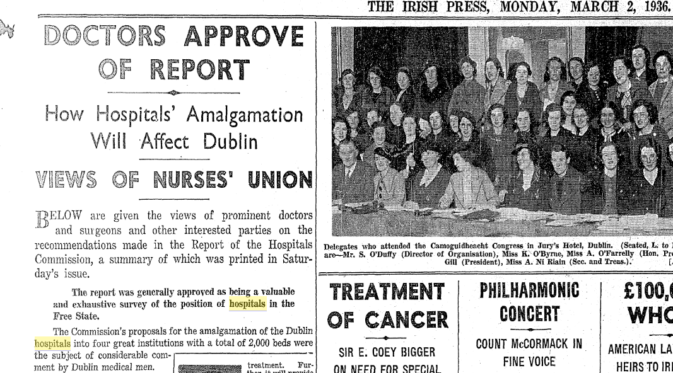
1936
Notes:
The previous suggestion of the 1927 Commission and of Sir John Lumsden, now re-iterated by the General Hospitals report, was accepted by the Dublin medical fraternity as the best way forward. As usual, the devil was in the detail.
Whilst several of the smaller south Dublin hospitals agreed to the heads of a bill for merger, the Meath Hospital held out against this.
There was still some investment in hospital facilities, but the war years meant that this was relatively constrained.
In 1949, The Meath Hospital board members had their ”come-uppance”, when the Knights of Columbanus ousted the Freemasons from the Board, leading to a High Court action and eventually to emergency legislation, the Meath Hospital Act of 1951, which forced some degree of external control on the hospital.

Slide 24
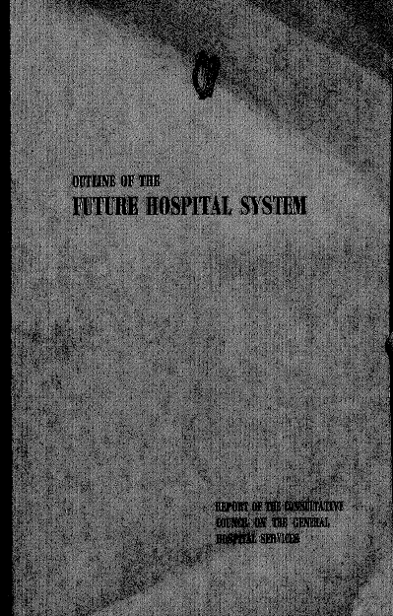
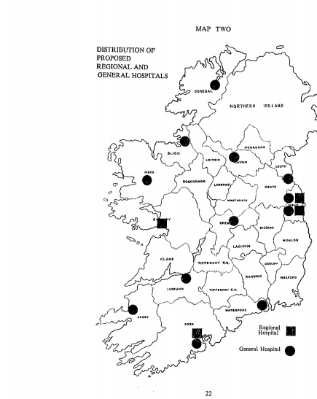
1969
Notes:
If we fast-forward from the war years and the major emigration period immediately afterwards, with a fall in the population of the 26 Counties to only 2.1 Million people at the 1961 Census , we come to the Fitzgerald Report of 1969 which, once again, suggested rationalisation of hospital provision throughout the country, particularly in Dublin, where the presence of three medical schools was seen as a hindrance.
Yet again, this was side-stepped, for various reasons.

Slide 25
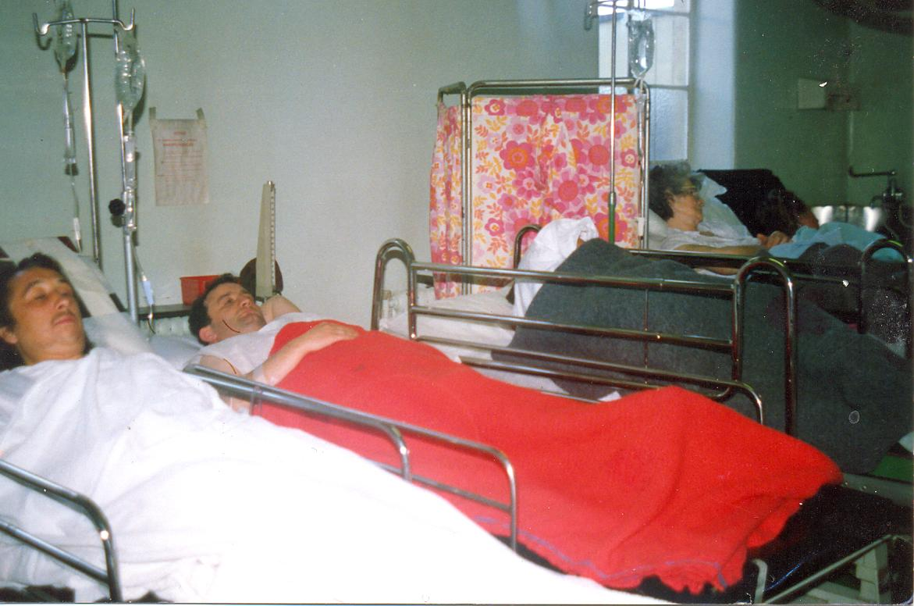
1989
Notes:
Which brings me to present times and the main theme of my talk.
In 1989, this was the situation in my own department. Each of these patients is awaiting admission to an in-patient bed.
From September of that year, the previous on-call system where only two emergency departments were open overnight in Dublin, one north and one south fo the river, was replaced by all departments open round the clock.This was done at short notice, purely for reasons of political expediency, and caused grave difficulty in engaging suitable junior staff for several months.
We moved into a new department In St James’s that December, as part of the phased opening of the new hospital, which had been built in the recession, but was now capable of being commissioned and its running expenses funded. This eased matters - for a while.

Slide 26
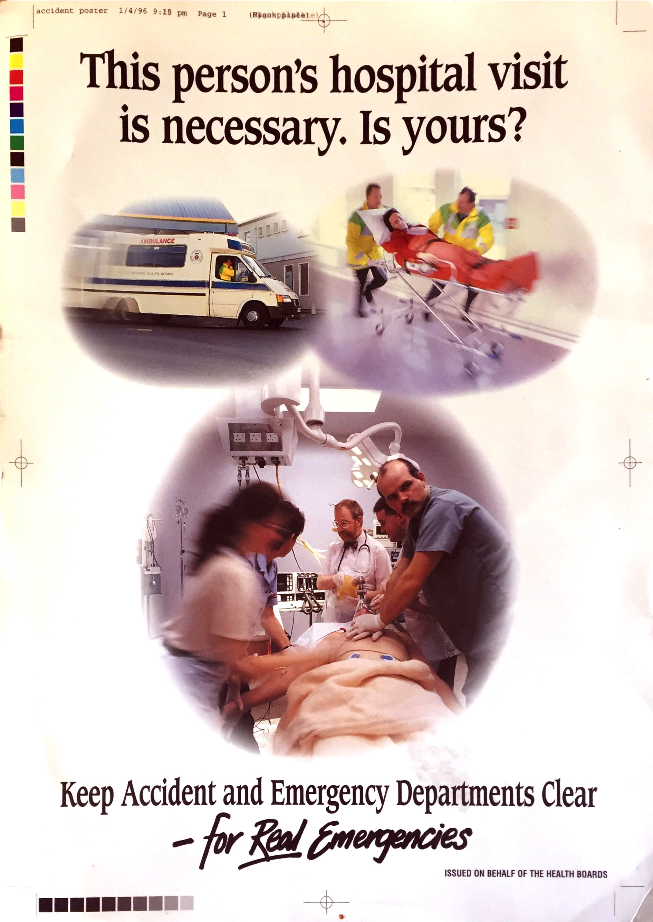
1996
Notes:
In 1996, against my better judgement, I took part in this national ad campaign to persuade people not to attend emergency departments unless they had a REAL emergency – what ever that might mean. When we surveyed patients in the waiting room, who were there with relatively minor injuries or illness, they all agreed with this approach. However, they also indicated that the only reason they were there was that they perceived that they had experienced a REAL emergency.
When the health service suggested re-running this campaign at a much later juncture, I refused permission to re-use my image, as I was convinced it was inappropriate, and unlikely to have any signficant impact.
Indeed, there is an argument to be made that any delay in presentation for stroke, sepsis or myocardial infarction will lead to increased risk of death or of chronic ill-health, with greater downstream personal and finacial cost. The idea that patients with minor problems should go elsewhere has never been shown to work, anywhere in the civilised world. But these patients do not take up much time, or resource. The only time they might waste is their own, as they will always fall behind a critically ill patient. Any delay in admission of the critical patients will mean a filling up of cubicles, reducing the available clinical space to see any patient. Doctors and nurses pull trolleys out of cubicles, to push other ones in – wasting valuable clinical time.

Slide 27
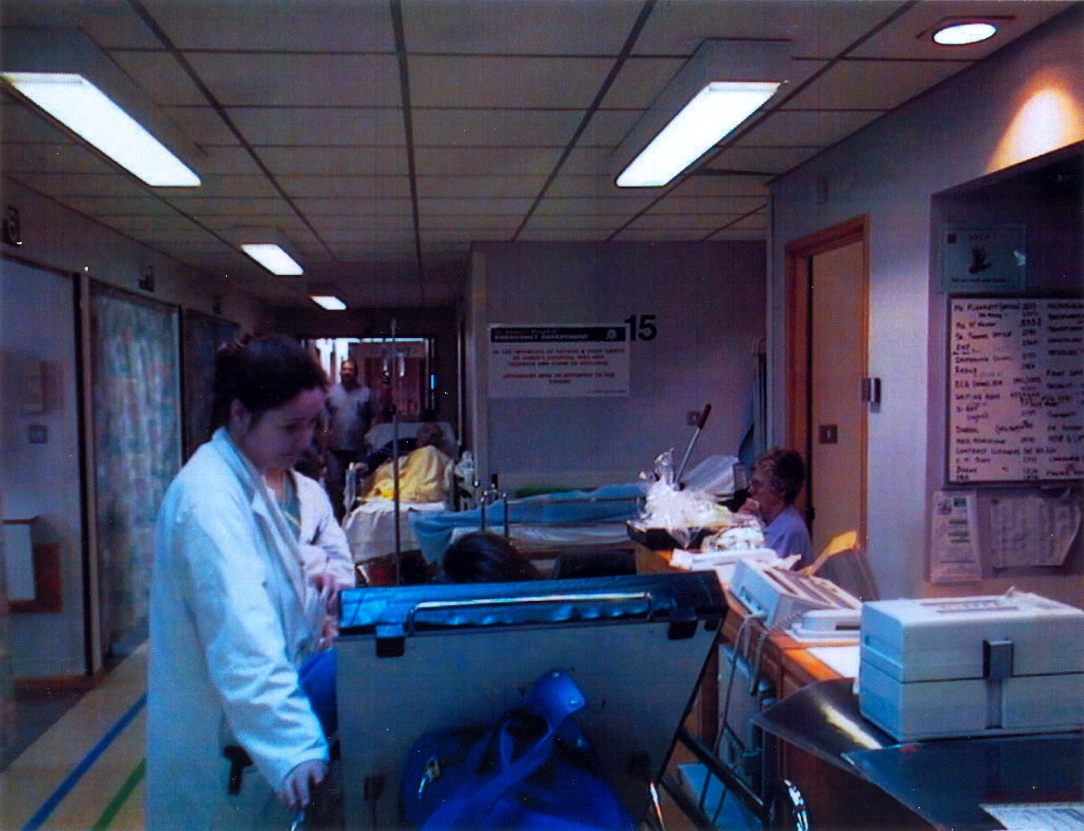
1999
Notes:
By 1999, the situation was really no better than before and the pressure on patients, relatives and staff was excessive.
Trolley counts became the order of the day.

Slide 28
Time 0
Corridor
Notes:
This is how overcrowding develops, in a diagrammatic, simplified fashion.
Start with five empty cubicles.

Slide 29
Time 0
Time 1
Corridor
Notes:
Add three patients per hour, each taking one hour to manage, between history examination blood testing and imaging – over 60% have imaging

Slide 30
Time 0
Time 1
Corridor
A
Time 2
Notes:
Discharge two of the first cohort after one hour, agreeing with the in–house team that one - marked A – requires admission - currently awaiting a bed
As no bed is immediately available, we must wait for a bed to be emptied and prepared in the hospital.
In this hypothetical model each admitted patient will wait four hours for a bed
Three more patients arrive and go directly into cubicles

Slide 31
Time 0
Time 1
Corridor
A
Time 2
A
A
Time 3
Notes:
This repeats a few times

Slide 32
Time 0
Time 1
Corridor
A
Time 2
A
A
Time 3
A
A
A
Time 4
Notes:
Eventually leading to a patient who is waiting in the corridor to be seen.

Slide 33
A
A
A
A
Time 5
Notes:
That patient on the corridor takes longer than one hour to process, as the inefficiencies of moving patients in and out of cubicles slows things down, or they are simply left until a space becomes free. This patient may remain even longer on the corridor if one of the arriving patients is deemed in greater need of the cubicle.
By the end of the 5th hour, there are always patients on the corridor and if you need to assess any new patient, you must move one of the others out into the corridor
There is much time and energy wasted in this activity.

Slide 34
A
A
A
A
Time 5
A
A
A
A
Time 6
Notes:
Even a minor delay in going to the ward, or the team all leaving to deal with a resuscitation for an hour, will cause a significant backup and an even worse steady-state.

Slide 35
A
A
A
A
Time 5
A
A
A
A
Time 6
Notes:
An option often used to improve workflow, is to put two patients into a single cubicle, with barely enough space to get a very thin person between the trolleys.
This is predictably uncomfortable for the patients, who also want their relatives with them.
It is also uncomfortable professionally for those of us who trained in a less pressured time, but this has now become the norm for our trainees.

Slide 36
A
A
A
A
Time 5
A
A
A
A
Time 6
A
A
A
Time 7
A
A
Notes:
I have even had to stop a trainee performing an abdominal paracentesis in a cubicle with a second patient looking on.
When challenged, the response was – “It’s OK – I asked and he was happy for us to go ahead”
It was unclear which patient was happy, but I know one consultant who wasn’t

Slide 37
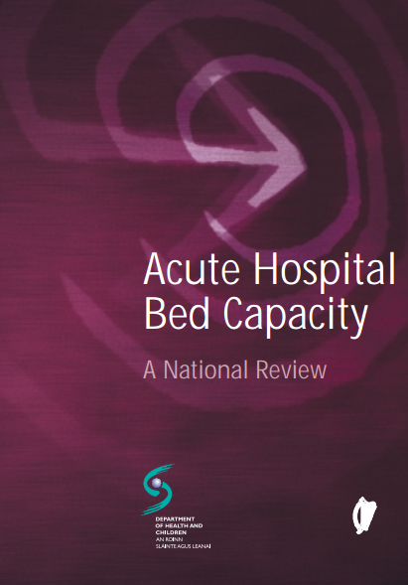
2002
Notes:
A national review of acute hospital capacity was commissioned and was published in 2002, showing that from 1980 until the year 2000, there had been a reduction in beds from 17, 665 to 11, 832, with about the first 4000 being taken out of the public system between 1984 and 1988 . A further 2,000 had been removed between 1991 and 1993, and then the number of beds in the system remained relatively unchanged at 11,832, until the year 2002.

Slide 38
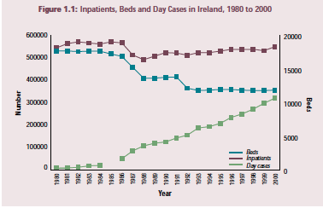
Notes:
Despite this 33% reduction in bedstock, the number of in-patients treated remained almost constant, with 544,000 in 1988 and 549,000 in the year 2000, which was facilitated by a reduction in the ALOS. It should be noted that just prior to the first removal of the acute beds in 1986, there was a peak of 571,000 inpatients treated.
By 2002, the number of beds was amongst the lowest in the OECD at 3.1 beds per 1,000 population (down from 5.1 in 1980).
In that time, average length of stay had been driven down from 9.7 days to 6.6 days, with a concomitant major increase in day case work
This activity had been only 2% of non-outpatient care in 1980, but was 38% of non-outpatient care by 2000.
It has been argued that the OECD figures do not reflect the private bedstock in Ireland, and the private hospitals claim to make available approx 1 Million bed days per annum.
However, they do not, presumably for commercially sensitive reasons, provide clarity on bed numbers and actual activity, allied to a very restricted form of access.
Furthermore, there has not been any significant increase in these bed numbers, or their availability, over the past two decades.

Slide 39
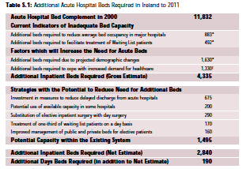
Notes:
The GROSS estimate of additional bed requirement in the 2002 report was for 4,335 new beds, but this was whittled down by various mathematical modelling to 2,840 additional beds.
Up to the year 2005, rather than an increment of 4,335, or even 2,840, there was actually an increase of only 262 beds.
That 2% increase in beds had to cater for a 21% increase in inpatient discharges. At the same time, day-case activity also soared.

Slide 40
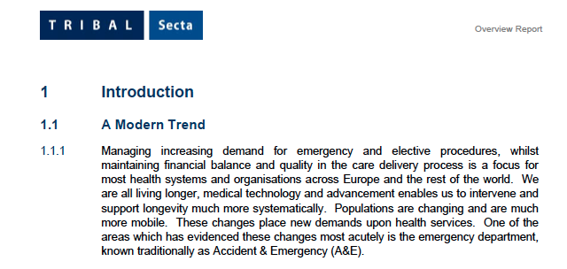
2006
Notes:
This Tribal-Secta report identified delayed discharges as a crucial issue, which is hardly surprising as the medical profession had been making this point for several years, to no apparent avail.
Attendances at A&E departments had also increased by 20% between 1988 and the year 2000,
This was described as “overheating” of the system and was put down to a number of issues, such as financial disincentives to use primary care, limited out of hours availability in primary care and societal expectations for ready availability and accessibiity of A&E services.
What does not appear to have been taken into account is that there was a concomitant population rise of 24% from 3.4 Million in 1981 to 4.2 Million by 2006.
It is difficult to match dates precisely for comparison as the sources are not aligned, but the approximate correlation cannot be ignored.
On March 28th 2006, the Minister of Health for the day, known for her Boston Versus Berlin views on healthcare provision, said that “the A&E problem had to be treated as a national emergency”.
I await developments.

Slide 41
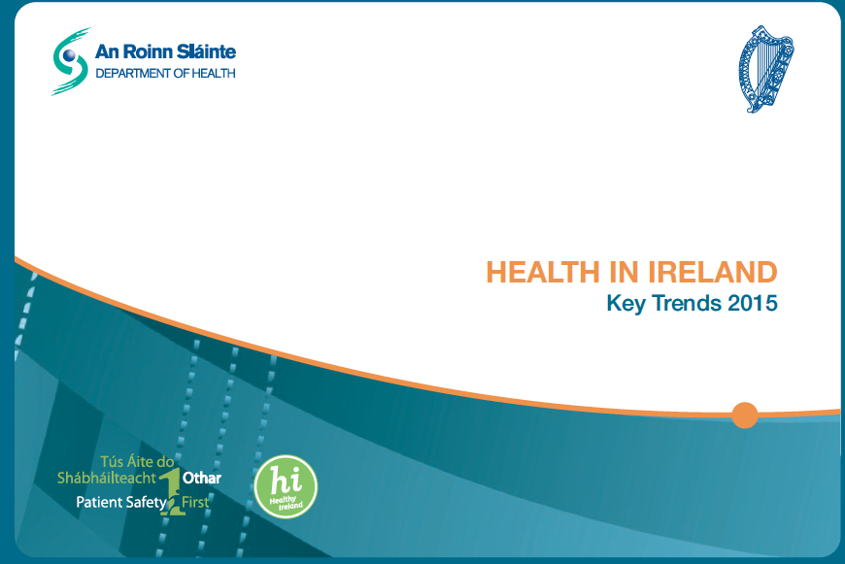
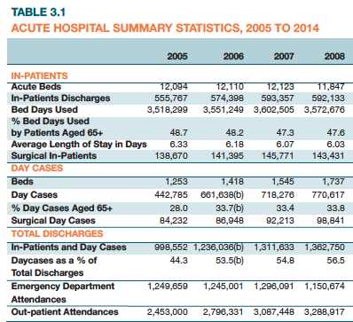
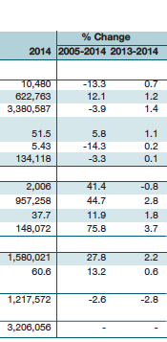
Notes:
Between 2005 and 2014, there was a further 13% reduction in acute hospital beds.
Despite this, we managed to increase hospital discharges by 12%, with a further 14% reduction in average length of stay.
Furthermore, the Irish population has risen to 4.76 million in the last census (2016), which is a 40% rise over the past 28 years.
The current census figures are even higher than were predicted in the 2015 Health Trends
The politicians may well wish to know why we still have bed availability problems, despite increased investment in the health infrastructure.

Slide 42
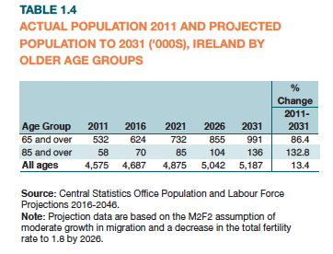
Notes:
Firstly, because we have inadequate bedstock even for the population projections of 2002, secondly, our population has risen by 40% in 36 years, with a fall in bedstock of 40% over the same timeframe, thirdly our population age-distribution has changed significantly, and fourthly, our population has expanded rather more rapidly than predicted.
Between the 1790s and the 1840s, there was a doubling of the population in Ireland, from 4 to 8 Million people.
6.5 Million of these lived in the area encompassed by the present Republic.
This gave it a density comparable to England and Continental Europe, at the time of the Great Famine of the late 1840s,
That population fell off rapidly with the death of over 1 million people and mass emigration, leaving the area covered by the present Republic with a population of 5 Million in the 1850s, falling steadily its nadir of only 2.1 Million people in 1961.
Since then we have steadily gained population and, at current rates, we are projected to achieve the Pre-Famine population of 6.7 Million people in the 26 Counties by 2060.
On a more manageable time scale, within the next 15 years, our population will probably further increase by 13%.
Of crucial importance for healthcare provision is that there will be more than a doubling of those aged over 85, with an almost doubling of those above 65 years of age.
Remember that average life expectancy at birth by 2011 was 80.19 years.

Slide 43
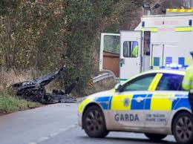
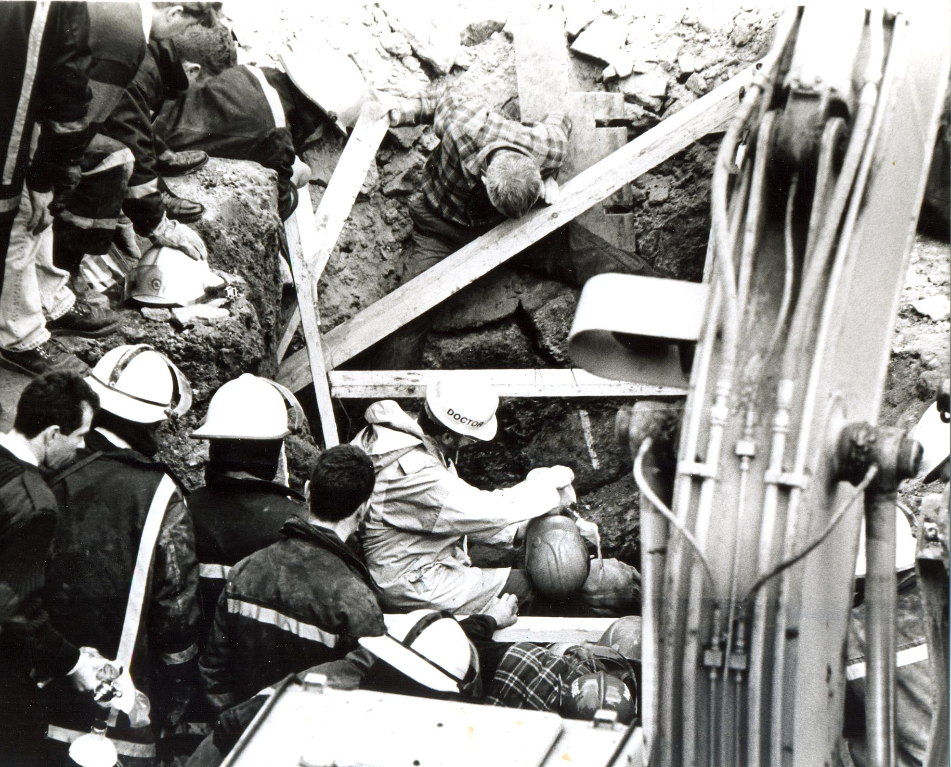
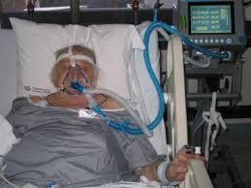
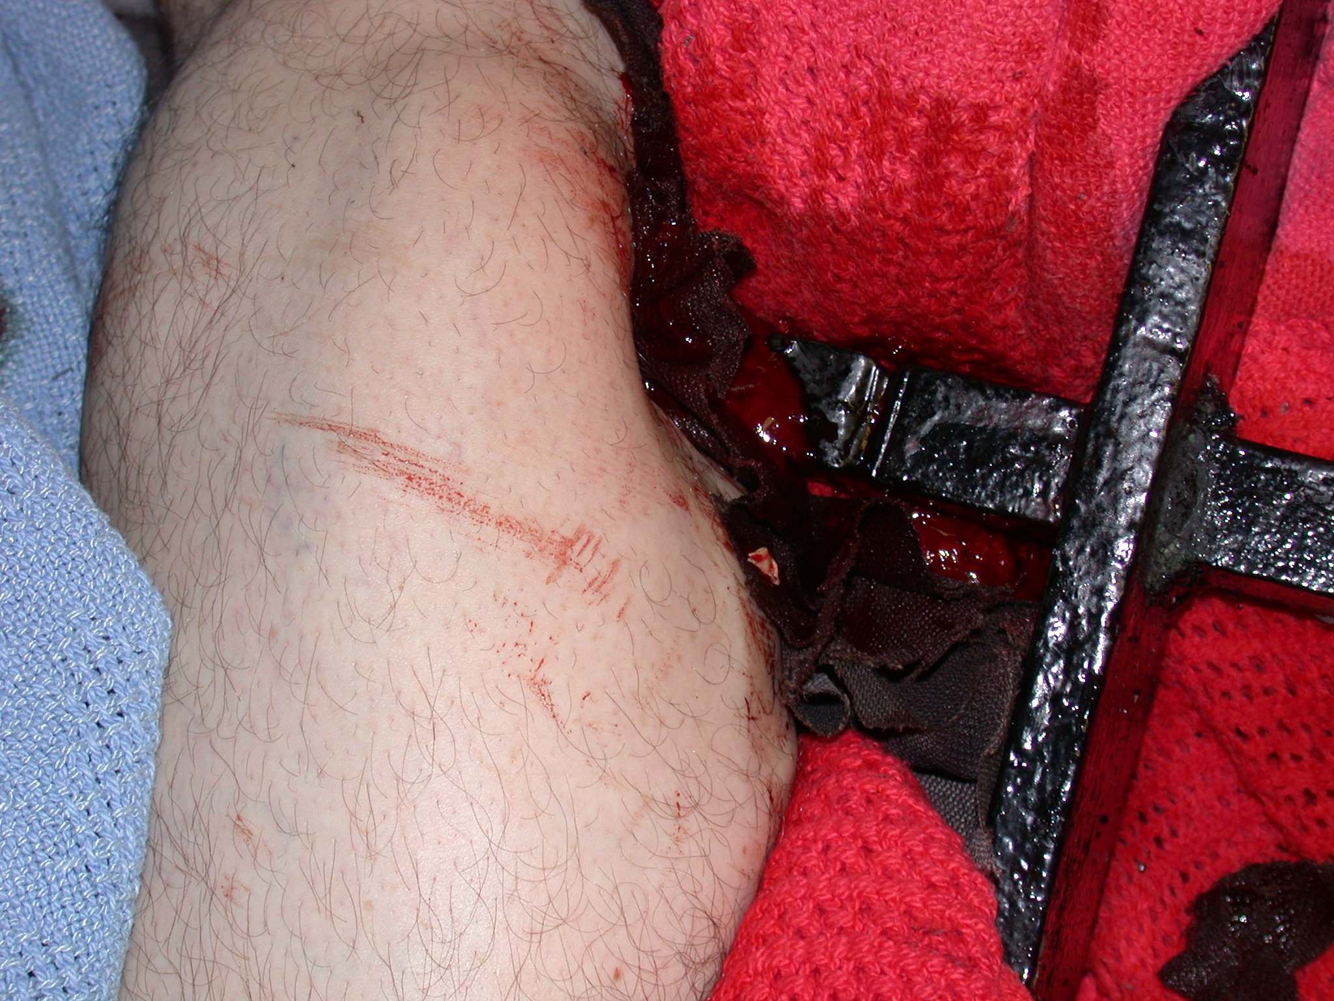
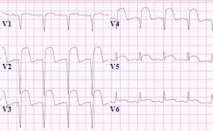
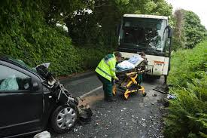
Notes:
How is this manifest in our Emergency Departments?
For my own department, the obvious change has been from a predominant surgery and trauma workload in the 1980s to a medical and particularly an elderly medical workload, with a huge increase in critical illness and multiple co-morbidites associated with marked increase in the average age fo our patients.
This has led to a situation where the complexity has led to displacement of minor injuries and illnesses, as the waiting time for those with low-level acuity has increased.
As we have neither a national unique patient identifier, nor integrated IT systems, data flow is quite constrained.
I will therefore use my own hospital’s data as an stand-alone example, although discussion with my colleagues indicates that the trends are similar nationwide.

Slide 44
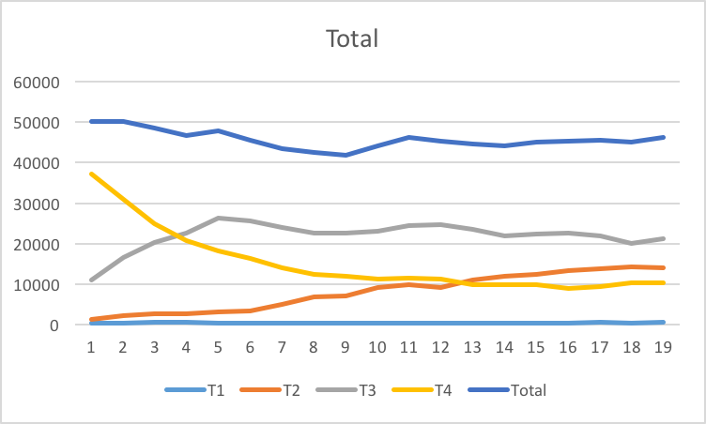
1997-2015
Notes:
Over the past 2 decades the total numbers attending my Emergency Department have been remarkably stable at approximately 45,000 per annum.
This is in keeping with the usually quoted ratio that approximately 20% of the catchment population will attend the Emergency Department each year
Initially, after the move of the Meath and Adelaide to Tallaght, there was a signnificant increase to 50,000 per annum, but this eased off after about 5 years.
Triage is a process used to attempt to assess the relative need for immediate intervention and the identification of those for whom a delay to care is not likely to lead to critical deterioration.
Triage 4, (labelled T4 on this graph) which contains many patients with so-called minor injury and illness, diminished from 75% of total attendances in 1997 to 20% by 2012, although it has climbed back to 22% over the past two years.
Many of these cases are now dealt with by Advanced Nurse Practitioners, in a separate part of the Emergency Department, which by its physical layout., does not lend itself to accumulation of trolley patients.. Triage 3, which is now numerically the largest group, steadily increased from just over 20% to 50%, whilst Triage 2, can only be described as rocketing from 3% to 30% of total.

Slide 45
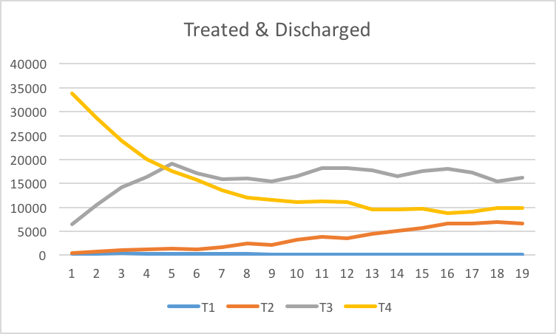
1997-2015
Notes:
If we look at those who are dealt with solely within the emergency department, going home after investigation, treatment and with a plan for further management developed, you can see, the Triage 4 category has also diminished markedly in raw numbers over the past two decades. I take this as a shift in the willingness of those with minor injuries to risk spending long periods waiting for access to care in an overcrowded department.
It might be argued that this was the aim of the previously mentioned Ad campaign, but my view is that the patients have learned the reality of access block.
However, these patients are not, and never have been, the patients featuring on trolleys for many hours.

Slide 46
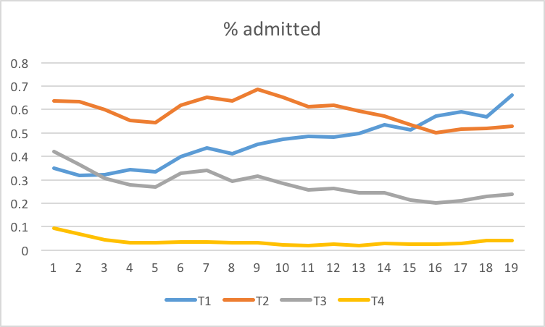
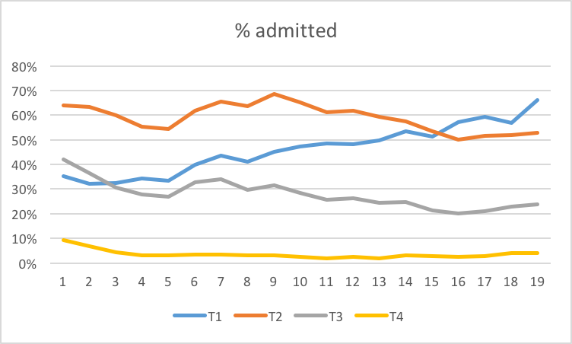
1997-2015
Notes:
It has been suggested that the change in raw numbers is due to a swing upwards in Triage categorisation, but the constant difference in admission rates between T4 and T3 negates that argument.
Although often used as a surrogate marker for workload, Triage was never designed as such.
However, different triage categories have a reliably constant risk of admission.
This ranges from a 50% risk in Triage 2 to 25% in Triage 3, but only 4% in Triage 4.
Triage 1 previously had only a 30 to 50% admission rate, as some recovered from a collapsed position and could be discharged, but many died, and were not represented in the inpatient admission cohort. In recent years, however, that trend has been replaced by an increasing tendency of Triage 1 to survive and be admitted to hospital, often with critical illness requiring intensive care within the Emergency Department for many hours, pending availability of an ICU bed, or a bed for non-invasive ventilation.

Slide 47
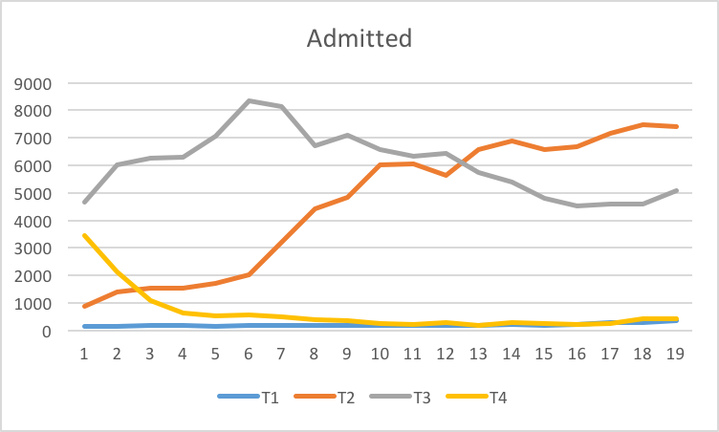
1997-2015
Notes:
Each of the T1, T2 and T3 patients takes a significant period of time to stabilise, investigate and either discharge, or admit.
Most of this cohort of patients cannot be managed by enhanced diagnostics in the community as they are acutely ill and in need of stabilisation and, often, admission for acute hospital care.
It is impossible to predict just which one will require admission, and which can be discharged until after they have had a combinaiton of assessment, investigation and a trial of therapy.
Whilst there have been calls to transfer these directly from General Practitioners to inpatient beds, my experience would suggest that this is not the ideal approach.
The fact that, in the urban departments, the vast majority of such patients self-present by private car, or by ambulance, means the GP referrals are in minority.
In my own department, they represent only 15% of attenders but, even then, 50% of them are investigated, diagnosed, treated and discharged within the same day.

Slide 48
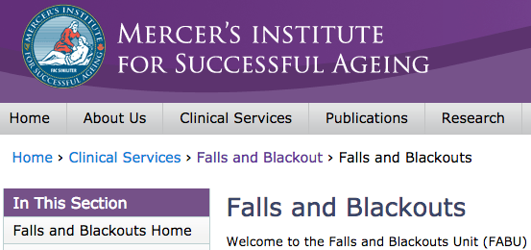

Notes:
Many ambulatory care pathways have been developed to obviate admission, streaming into acute out-patient care settings once safety has been assured.
This includes outpatient management of syncope, TIA, DVT and First seizure, each of which would have been admitted up to 10 years ago.
These pathways also take direct GP referral.
Direct GP admission would leave a greater number seeking an acute bed, at a time when we are invariably unable to supply that bed.
It would, in fact, probably aggravate the pressure on those patients, and on the others receiving emergency care.

Slide 49

1997 - 2015
Notes:
What has also changed is the proportion of our population falling into the elderly group and the increasing frailty of those we treat and get back to community living.
When I first started it was not uncommon for me to say to someone over 85 years of age:
“You must be as tough as old boots to live this long – you should carry on to reach 100”.
This is no longer a valid observation.
Although a fairly constant number of patients in this age group is still discharged directly from the Emergency Department, there has been a huge increase in the actual numbers being admitted.
These are, effectively, two cohorts of patients – those going home after acute treatment of self-limiting illness and those with significant medical and social deterioration.

Slide 50

1997 - 2015
Notes:
The admission risk, as shown here, has risen from a 50% risk to a 66% risk over the past two decades.
Whilst an increase in chronic health management in the community would, undoubtedly, reduce the frequency of attendance at the Emergency department, it is unlikely to eliminate it.
Once admitted, those patients with multiple comorbdiities, inlcuding psycho-social deterioration, have a much longer average length of stay, as they are far more complex than the younger cohort, or the relatively healthy elderly we discharge same day.

Slide 51

Notes:
A certain proportion will, ultimately, never return to independent living, and will enter the long-term care market. I use that word advisedly, for a market it is.
The HSE has reduced its direct involvement in the provision of long-term care, with the “Fair Deal” Scheme being used to filter older people into private sector beds.
Having had personal experience of the Fair Deal process for my mother, I can say that it is not simple to navigate.
I found some of the documentation extremely obtuse, having clearly been developed by a committee but with clauses added every time a new difficultywas identified.
When I rang the signatory of one letter, to attempt to clarify its meaning, I was informed by her: “Yes, I find it very confusing too”.

Slide 52

2015
Notes:
Much is made of the “Winter Pressures”.
And a “Winter Crisis” seems to attack unexpectedly every year!
I agree that admissions via the emergency department increase in winter, but not to the extent that should lead to marked overcrowding.
My personal assessment of the situation matches the graph I showed from the 1936 General Report.
Elective work falls off in summer, as many staff take annual leave and spend time with families, reducing the elective work performed.
This leaves sufficient bed availability in the hospital that the duration of stay in the Emergency Department whilst waiting for a bed reduces.
Once the surgeons, anaesthetists and nurses return from holidays, the pressure is on to catch up with elective work, and the “winter crisis” steadily builds up.
It eases again over the Christmas period, with wards able to close, yet minimal delay for patients in the Emergency Department, but come the first week in January, behold – we have another crisis. As noted in the 1936 report, Easter also eases matters slightly.

Slide 53

2016
Notes:
Let there be no mistake: this “Crisis” hinges entirely on lack of bed availability, with two competing entry streams and two exits, once of which is chronically slow.
Delay in admission of emergency patients leads to trolley waits, highlighted online every single day of the working week, although not at weekends..
This issue was on the main RTE news again last night, with a 103 year old woman spending 15 hours overight on a trolley prior to hospital admission, despite being seen within 15 minutes of arrivla and accepted for admission within 3 hours.
Failure to admit elective patients leads to Waiting List build up, where the “overcrowding” is unseen, as it occurs in the patient’s home.
This leads to Political pressure to deal with the issue, which is generally by using public funding streams to support work in the private sector, rather than by long-term investment in the public sector. Most recently, this has been problematic as the replacement of endoscopes and washers in the public sector has been deferred for financial reasons, leading to delays and breach of target times, resulting in a serious suggestion to purchase endoscopy services from the private sector.
Unless we invest in our public health service, we are doomed to repeat the mistakes made before

Slide 54


L E Samuel Beckett
Nov 17th 2016
Notes:
I have other concerns for the future, which revolve around the obvious global tensions manifest in the Far East, the North West Frontier, the Middle East, the Balkans and the Mediteranean Littoral, They include the effects of war and famine in Africa and the apparent rise of Fascism in Europe and America, allied to unstable financial markets.
Those currently fleeing Africa and the Middle East are seen predominantly as economic migrants, and do not seem to be welcome here, or indeed anywhere else.
In my view, this is reminiscent of the initial reception of Irish migrants following the Great Famine.
I am reminded of a poem by Edward Plunkett, 18th Baron Dunsany, which was published in the 1940s, entitled
The Introduction
We never met so close that we
Could know each other’s plans
Till one day on a lovely sea
Of the Mediterranean
In a hunted ship as a refugee
I met my fellow-man

Slide 55

Notes:
I may have posed more questions than I have suggested solutions - J B Lyons recorded William Doolin as saying:
“In the simplest of words, history is the story of the past told in the present for the future “
I hope that we, as a nation, one hundred years on from our modern re-birth as a republic, are capable of ensuring the implementation of the aspirations of the Proclamation of Independence:

Slide 56

Notes:
I quote selectively from that document:
“The Republic guarantees religious and civil liberty, equal rights and equal opportunities to all its citizens, and declares its resolve to pursue the happiness and prosperity of the whole nation and of all its parts, cherishing all of the children of the nation equally,
It is my fervent desire that the Irish people, and their representatives, can rise to the challenge of providing care and succour for our current and our future citizens, from wherever they may originate, as we all grow old together.

Slide 57

Notes:
Thank you

