Slide 1
Understanding Pilot Well-being, and its impact on professionalism & flight safety.
Identifying self-management strategies to promote the Bio-Psycho-Social pillars of Well-being.
Capt. Paul Cullen
Dr. Joan Cahill
Dr. Keith Gaynor

Slide 2


Mental Health Issues are on the Rise
x2
x2.5
Rates of Depression
over the last
30 years
Notes:
----- Meeting Notes (26/10/16 08:27) -----
MH issues are on the rise in the western world. This is not just someone’s opinion. It’s a fact. Scientific evidence actually backs it up.
The rates of MH problems, but especially depression, have increased dramatically in recent times. During the last 30 years, in the UK, this number has doubled. In the US, it has increased by a factor of 2.5. Similar increases are being observed across the western world. It’s in every country, every town and every family.
The experts tell us that during our lifetime, 30% of us will develop a MH issue, and right now, 16% of the general population are suffering with a MH issue. It’s inescapable, and is reaching an epidemic scale.
40% of all disability payments in the UK are due to MH issues. In Ireland, this figure is 33%, but only 4% of our health budget goes towards MH. This is no longer just a health issue. It’s now an economic problem and one that looks set to get worse.

Slide 3
Mental Health Issues are on the Rise
30% - Lifetime
16% - Right Now
Notes:
----- Meeting Notes (26/10/16 08:27) -----
MH issues are on the rise in the western world. This is not just someone’s opinion. It’s a fact. Scientific evidence actually backs it up.
The rates of MH problems, but especially depression, have increased dramatically in recent times. During the last 30 years, in the UK, this number has doubled. In the US, it has increased by a factor of 2.5. Similar increases are being observed across the western world. It’s in every country, every town and every family.
The experts tell us that during our lifetime, 30% of us will develop a MH issue, and right now, 16% of the general population are suffering with a MH issue. It’s inescapable, and is reaching an epidemic scale.
40% of all disability payments in the UK are due to MH issues. In Ireland, this figure is 33%, but only 4% of our health budget goes towards MH. This is no longer just a health issue. It’s now an economic problem and one that looks set to get worse.

Slide 4

Mental Health Issues are on the Rise
40%
33%
Disability Payments due Mental Health

Slide 5

Why Is This Happening
Statistical Glitch?

Slide 6

Why Is This Happening

Slide 7
What is “Health & Well-being”?
“Health is a state of complete physical, mental and social well-being, and not merely the absence of disease or infirmity”
World Health Organisation

Slide 8
Well-being
Bio
Social
Psycho

Slide 9
Bio
Exercise
Diet
Sleep

Slide 10
Psycho
Mindset
Attitude

Slide 11
Social
Interpersonal Relationships
Social Network

Slide 12
Well-being Inoculation
Keep your body working
Build a resilience mindset
Grow a healthy social network

Slide 13


Slide 14


Slide 15


Slide 16

Gastrointestinal disorders
Depression
Family & marital strain
Impaired cognitive function
Fatigue
Sleep
Social Marginalisation
Cardio-vascular effects
Anxiety & Neuroticism

Slide 17
Gastrointestinal disorders
Depression
Family & marital strain
Impaired cognitive function
>8 hours
Fatigue
Sleep
Social Marginalisation
Cardio-vascular effects
Anxiety & Neuroticism

Slide 18
Depression
Gastrointestinal
disorders
Impaired cognitive function
Family & marital
strain
Fatigue
>8 hours
Sleep
Social
Marginalisation
Cardio-vascular
effects
Anxiety &
Neuroticism

Slide 19
Little control of roster
Family un-friendly hours
Family & marital strain
Access to food
REMOTE WORKERS
Meal breaks
Uncontactable
Social Marginalisation
Toilet habits

Slide 20
Pilot Studies
“In the past 12 months, have you ever suffered from feelings of being depressed or anxious?” (n=701)

Slide 21
Mental Health Issues are on the Rise
30% - Lifetime
16% - Right Now
Notes:
----- Meeting Notes (26/10/16 08:27) -----
MH issues are on the rise in the western world. This is not just someone’s opinion. It’s a fact. Scientific evidence actually backs it up.
The rates of MH problems, but especially depression, have increased dramatically in recent times. During the last 30 years, in the UK, this number has doubled. In the US, it has increased by a factor of 2.5. Similar increases are being observed across the western world. It’s in every country, every town and every family.
The experts tell us that during our lifetime, 30% of us will develop a MH issue, and right now, 16% of the general population are suffering with a MH issue. It’s inescapable, and is reaching an epidemic scale.
40% of all disability payments in the UK are due to MH issues. In Ireland, this figure is 33%, but only 4% of our health budget goes towards MH. This is no longer just a health issue. It’s now an economic problem and one that looks set to get worse.

Slide 22
Pilot Studies
“In the past 12 months, have you ever suffered from feelings of being depressed or anxious?” (n=701)
54%
Correlation with duty hours

Slide 23
Pilot Studies
“In the past 12 months, have you ever suffered from feelings of being burnt out or exhausted?” (n=701)
78%

Slide 24
Pilot Studies
Assessed recently modified safety-critical SOP
19.99% of crews unsuccessful (n=332)
Correlation between Experience & Success
Captain experience ⬆,
Successful Outcome⬇
“Experienced Pilots may have become disengaged and are victims of fatigue resulting from high job demands and work overload in poor physical environments”

Slide 25
Pilot Well-being
The Lived Experience
Sources of Work Related Stress
Field study (2015-2016)
n=103

Slide 26
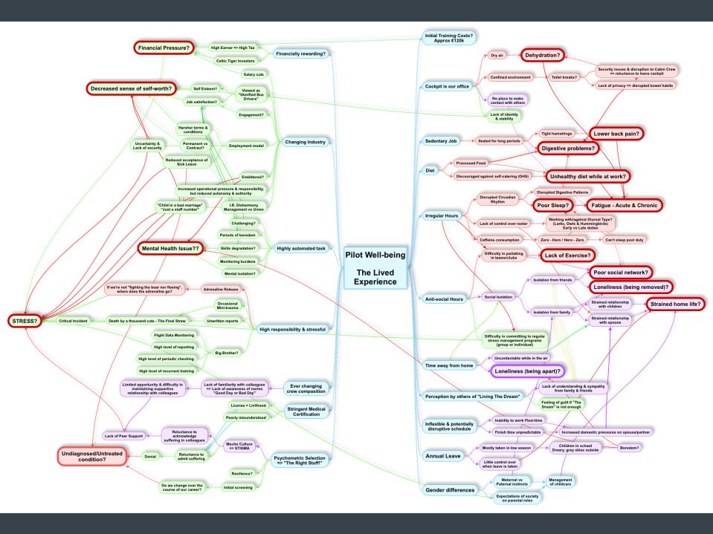
(n=103)

Slide 27
Well-being
Bio
Social
Psycho

Slide 28
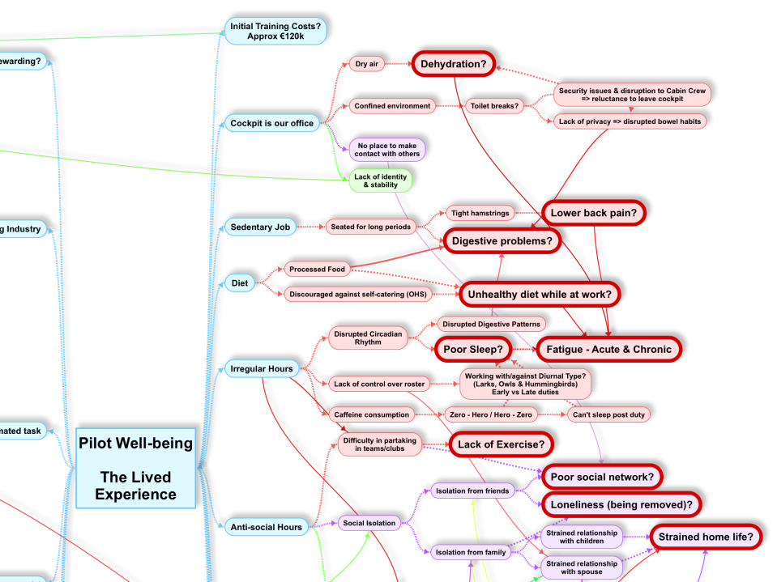

Slide 29
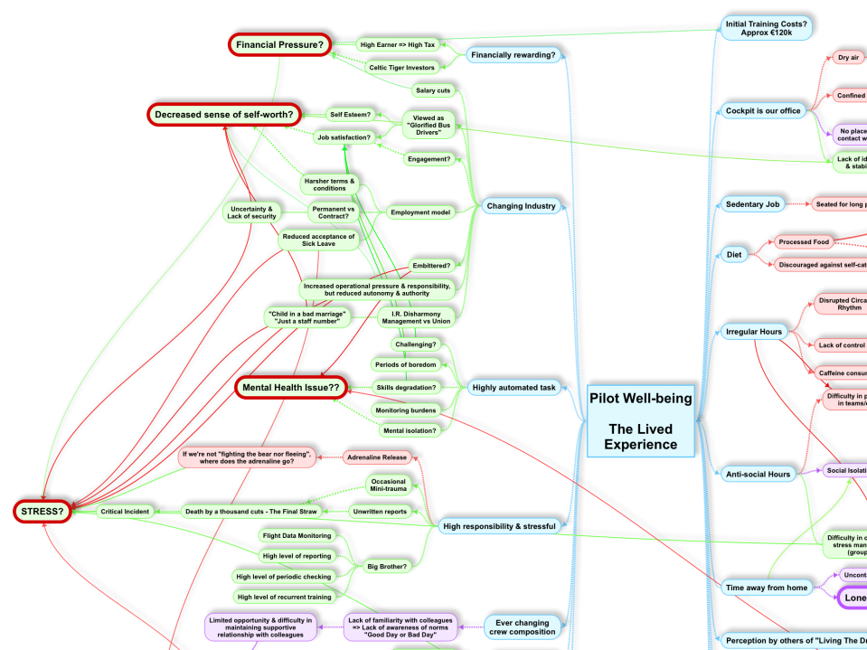

Slide 30
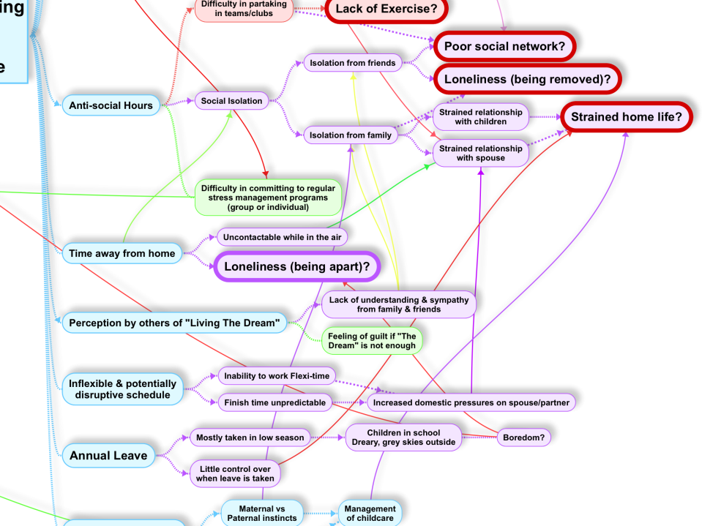

Slide 31
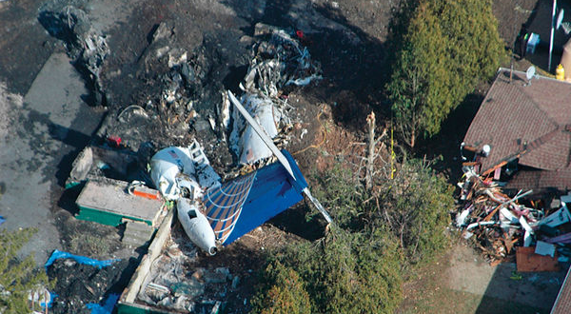
Tombstone Imperative

Slide 32

Tombstone Imperative

Slide 33


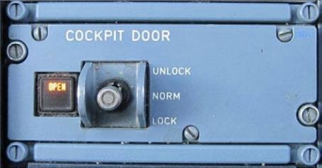

Slide 34
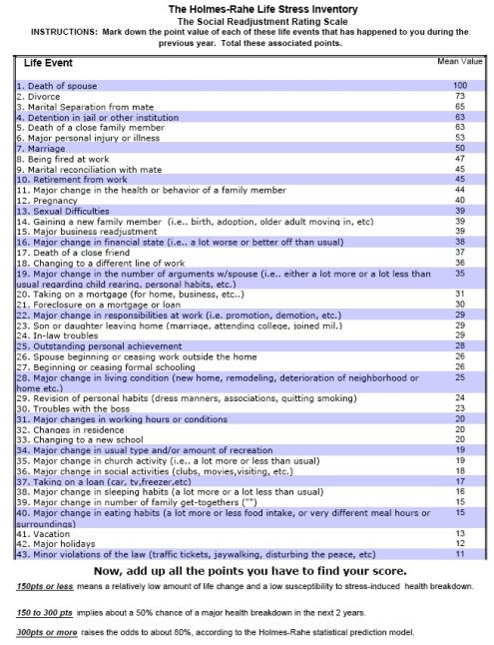

Slide 35

Isolation

Slide 36
Our Goals & Vision
Raise Awareness of Vulnerability
Destigmatise MH among Pilots
Ownership of one’s Well-being
Start the conversation…..

Slide 37
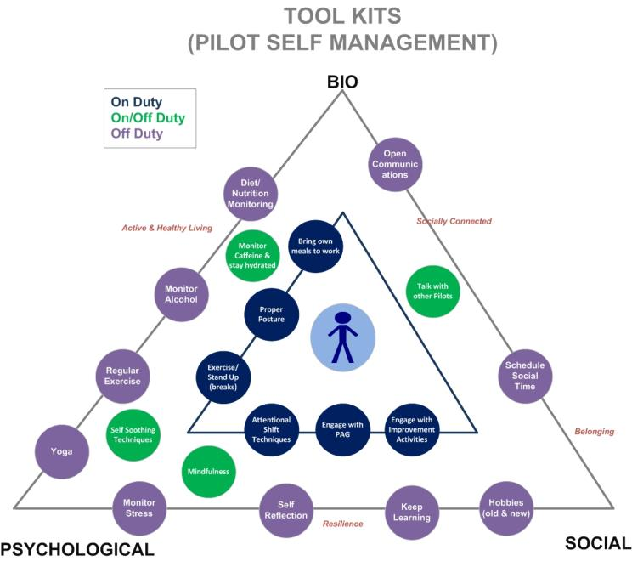

Slide 38
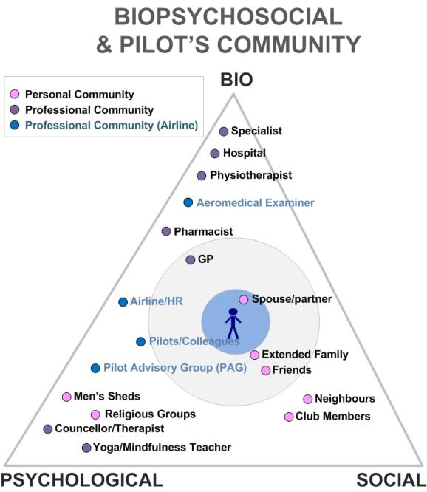

Slide 39
Next steps
Consultation with all stakeholders
  Quantitative Study
General Health Questionnaire

Slide 40
Thank You

