Slide 1
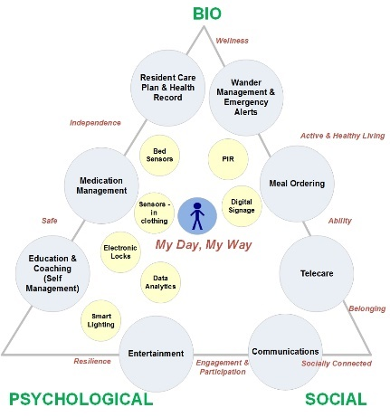
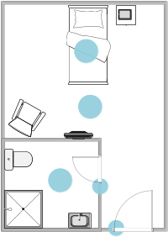
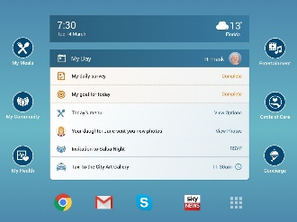
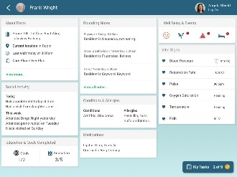


New Technology Enabling Wellbeing, Independence, Successful Ageing, and Relationship Centred Care, for Older People Domicile in Residential Homes
The purpose and functionalities of gerontechnologies are often led by the requirements of their social and caregiving environments.
Often, their functionalities do not match end user motivations and expected benefits.
Action research study: interviews/observations and co-design activities (n=40 participants).
The proposed technology is conceptualized in relation to stakeholder relationships and promoting relationship centred care.
The proposed functionality addresses the three pillars of wellbeing (biopsychosocial), promoting self-management and successful ageing.
Notes:
ONE SLIDE ONLY !!!!
Leave timer on the right hand side intact and visible
Check total display time (20 s) by stopwatch and pressing F5

