Slide 1


European Human Rights Law and Death in Prison:
Obligations and Reforms
Mary Rogan
mary.rogan@tcd.ie

Slide 2
Human rights frameworks and death in prison
Prevention
Investigation
  Strengthening powers of inspection and monitoring mechanisms
The obligations arising out of European (and other) human rights principles
Suggestions for strengthening these principles

Slide 3
Death in Prison: Prevention
Article 2 of the European Convention on Human Rights
  The right to life
  Duty not to take life intentionally or by a disproportionate use of force
  Take reasonable steps to prevent deaths

Slide 4
Prevention
Keenan v. UK: prison authorities have a duty to safeguard life
Test: was there an immediate risk of suicide and did the authorities do all they could be reasonably expected to do?
Edwards v. UK: authorities knew or ought to have known of a real and immediate risk to life

Slide 5
Prevention
Kats v. Ukraine: the fact of dying in custody in suspicious circumstances raises a concern about compliance with Article 2
Coselav v. Turkey: clear risk of death and precautions were not taken
Perisan v. Turkey: force used to quell disturbances was not absolutely necessary
Yuiry Illarionovich Shcokin v. Ukraine: reiterated importance of taking steps to protect life

Slide 6
The Committee for the Prevention of Torture
Awareness of suicide prevention must be ensured throughout the prison
Medical screening on arrival and the reception process has an important role
Prison staff should be trained in recognising indications of suicidal risk
            Third General Report

Slide 7
The Committee for the Prevention of Torture
Duty of care owed by custodial staff includes the responsibility to protect those in prison from those who wish to do them harm
Prison staff must be alert to the signs of trouble and resolved and trained to intervene when necessary
Positive relations is a decisive factor
Classification and distribution of those in prison
            11th General Report

Slide 8
The Committee for the Prevention of Torture
A medical file should be compiled for each patient and transferred with the person
Need for a proper flow of information within the establishment and between establishments (and their health care services) about people identified as potentially at risk
            Third General Report

Slide 9
The European Prison Rules
Rule 15: at admission, record any visible injuries and complaints about prior ill-treatment
  (Confidentiality) information on health
Rule 16: Medical examination as soon as possible after admission; assessment of level of security needed
Mandela Rules (30): identify any signs of psychological or other stress, including risk of suicide and self harm, and withdrawal from drugs

Slide 10
Healthcare
Inadequate healthcare can give rise to a breach of Article 2, and Article 3
Need to transfer to hospital for specialist treatment not available in prison EPR 46
Interdisciplinary teams and need for expertise in psychology and psychiatry

Slide 11
The role of medical professionals
“Potentially staff at risk” CPT Third General Report
Clinical decisions should be governed by clinical criteria
Mandela Rules (27): … may not be overruled or ignored by non-medical prison staff

Slide 12
The question of release at the end of life
Article 3 may require early release where ongoing detention is no longer compatible with dignity
Papon v. France: early release may be possible
Farbthus v. Latvia: breach of Article 3
Gülay Çetin v. Turkey: breach of Article 3
Compassionate release/medical release

Slide 13
Death in Prison: Investigation
Instigated by the state
Independent of those implicated in the death
Prompt
Allow sufficient public scrutiny
Be capable of giving rise to a finding of responsibility
Give the family an opportunity to participate

Slide 14
Investigation
Powers of compellability
Securing of evidence Mustafayev v. Azerbaijan
Public enquiries?
  When is the widest exposure possible necessary?
How to ensure the family are involved properly?
Legal aid

Slide 15
Record keeping
European Prison Rules: “meticulous record keeping … vital protective measure”
Mandela Rules: secure audit trail; prevent unauthorised access or modification
Access to records by inspectors: need for EPR reform

Slide 16
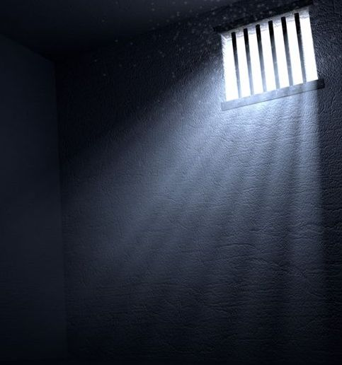
Prevention, Oversight and Human Rights

Slide 17
Prevention, Oversight and Human Rights
The connection between good oversight mechanisms and good prison outcomes:
  The prevention of ill-treatment;
  Supporting a learning culture
International human rights law requires inspection and monitoring of prisons
OPCAT
European Prison Rules

Slide 18
EPR: Inspection and Monitoring
Requires a complementary system of internal and external inspection
Internal inspection: too limited in the commentary
Independence requirement for external inspections needs to be strengthened
The powers of inspectors

Slide 19
Powers of Inspectors and the EPR
Need for an explicit power to have confidential conversations
Power to make recommendations should be explicitly stated
Power to access records, freely choose which prisons to visit
All the more necessary in the absence of ECtHR examination of inspection systems

Slide 20
Human rights frameworks and death in prison
Strong obligations on states to take steps to prevent death and recognise the vulnerability of people in prison
Strong obligations on states to investigate deaths in prison
More support needed at European level for domestic inspection mechanisms to recognise their role in preventing, and supporting learning from, deaths in prison

Slide 21
Thank you!
@MaryRogan
@prila_tcd

