Slide 1

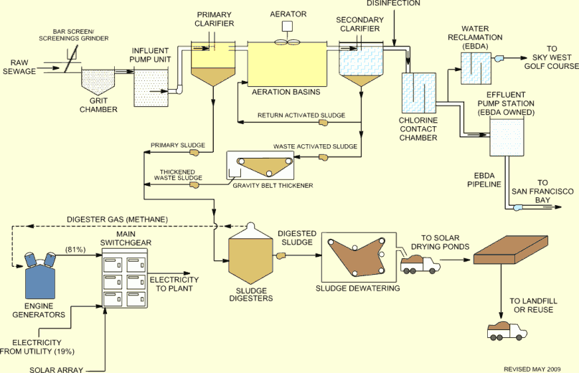
Wastewater Treatment
Introduction to Unit processes
Professor Nick Gray
Centre for the Environment
Trinity College
University of Dublin
© Tigroney Press

Slide 2

Wastewater Treatment
Introduction to Unit processes
Learning objectives:
    Understand the aims and limitations of treatment
    Introduction to unit processes and key treatment steps
    Function of preliminary treatment
    Function and design of primary treatment
    Overview of treatment steps
    Concept of plant design

Slide 3

Wastewater Treatment: Unit processes
Aims of Wastewater Treatment
To convert waste materials present in wastewater into stable oxidized end products that can be safely disposed of to inland waters without any adverse ecological effect
To protect public health
To ensure wastewater is effectively disposed of on a regular and reliable basis without nuisance or offence
To recycle and recover the valuable components of wastewater
To provide an economic method of disposal
To comply with legal standards and consent conditions placed on dischargers.

Slide 4
Wastewater Treatment: Unit processes
Design basics:
A wastewater treatment plant (WWTP or STW) is a combination of unit processes, selection dependant upon nature of wastewater itself.
By a suitable combination of these unit processes it is possible to produce a specified final of effluent quality from virtually any type of influent wastewater.
Also required to process the separated solids to a suitable condition for disposal
Treated effluents generally discharged to surface waters (primarily rivers) can also be used for groundwater recharge or be recycled.

Slide 5
Wastewater Treatment: Unit processes
The amount of treatment required depends largely on the water quality objectives of the receiving water and its dilution capacity.
Wastewater treatment is a mixture of settlement and either biological or physico-chemical processes.
The action of treatment is one of separation of suspended and soluble substrate from the water by various sorption processes to form particles large enough to be removed from suspension by settlement.

Slide 6
Wastewater Treatment: Unit processes
Unit processes in wastewater treatment
Physical
Balancing
Screening
Sedimentation
Flotation
Hydrocyclone
Filtration
Reverse osmosis
Ultra filtration and microfiltration
Adsorption
Chemical
Neutralization
Precipitation
Ion-exchange
Oxidation-reduction
Biological
Activated sludge
Fixed film filtration (aerobic, anoxic, anaerobic)
Reed beds and wetlands
Stabilization ponds
Anaerobic digestion

Slide 7
Wastewater Treatment: Unit processes
Unit processes are classified into different functions:
  Preliminary treatment
  Primary (sedimentation) treatment
  Secondary (biological) treatment
  Tertiary treatment
  Sludge treatment
Not all of these processes or stages will be present – depends on nature of wastewater and degree of treatment required.

Slide 8
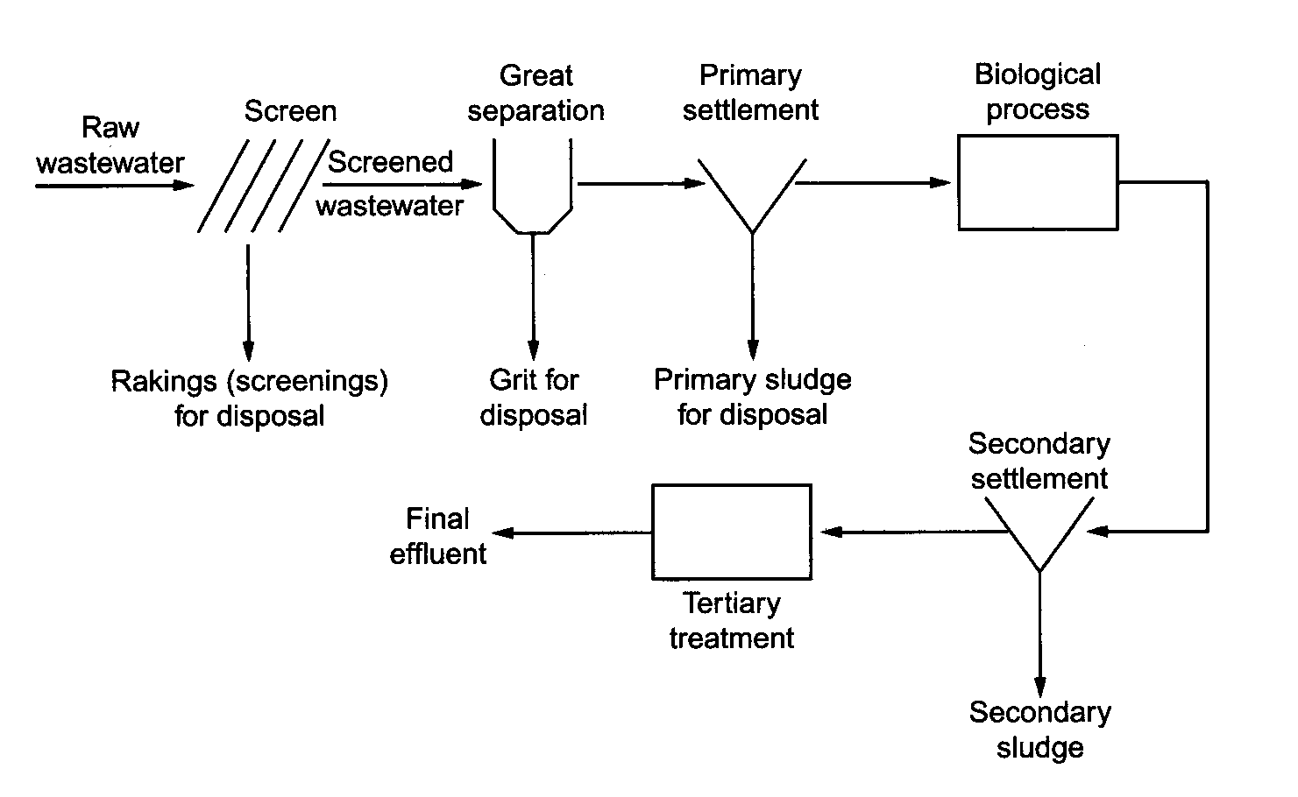
Wastewater Treatment: Unit processes
Generalized layout of simple sewage treatment plant

Slide 9
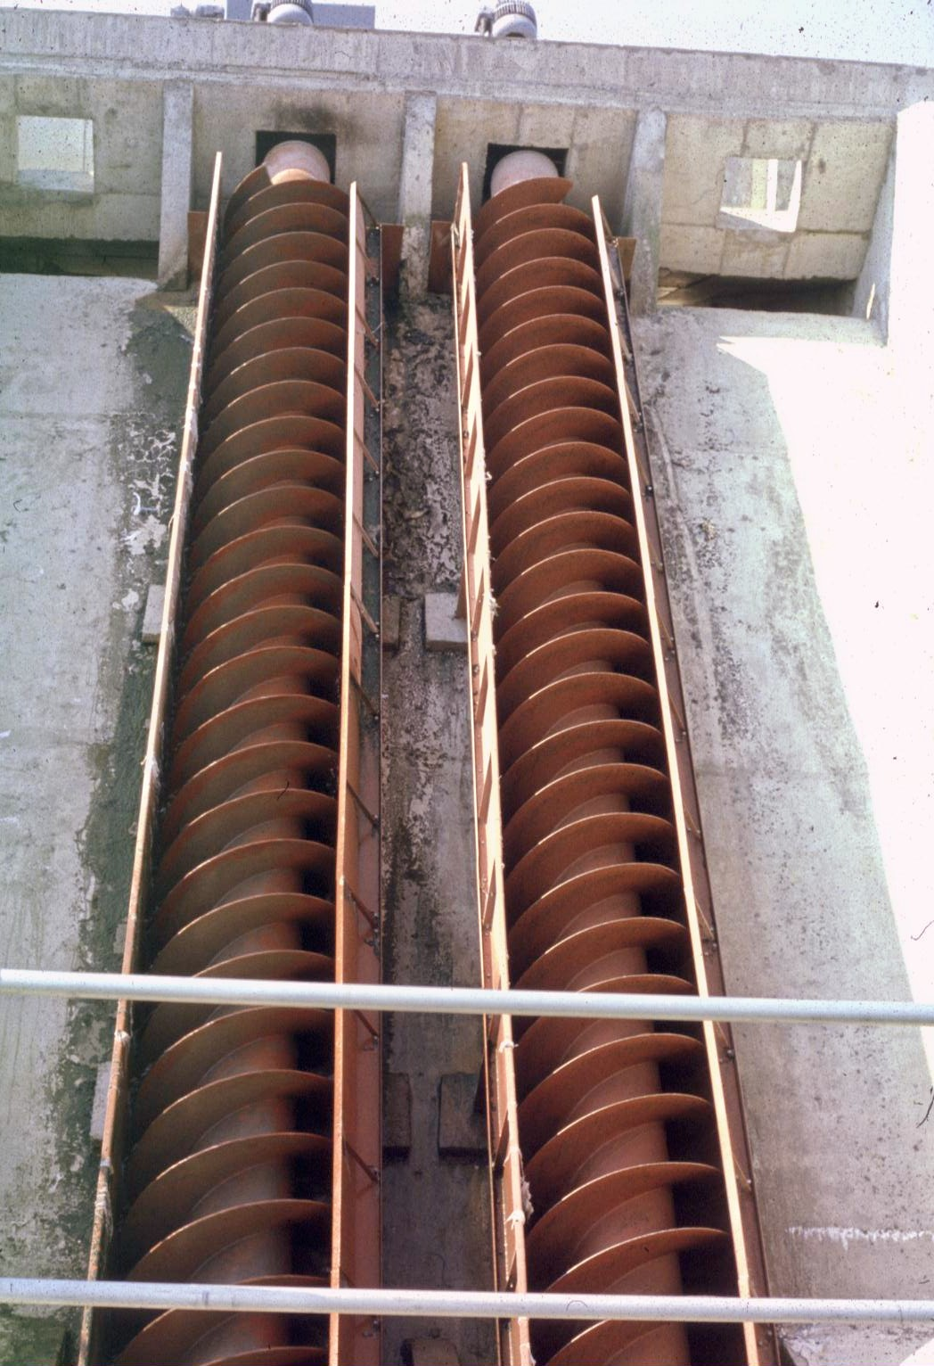
Wastewater Treatment: Unit processes
Ideally the wastewater flows through plants by gravity. So unless on a hill side, a hydraulic head will have to be created using screw pumps to provide sufficient hydraulic head from incoming sewers

Slide 10
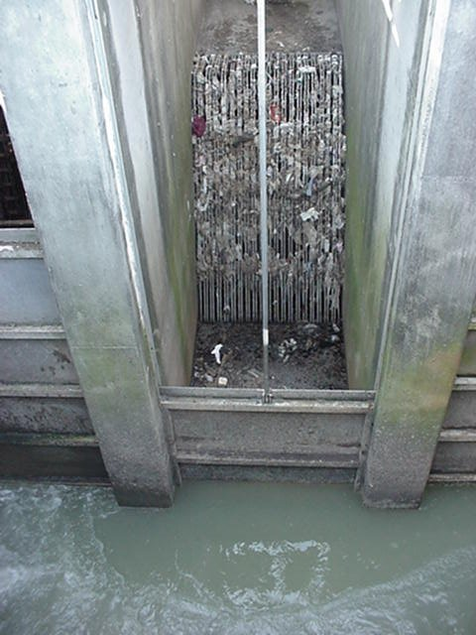
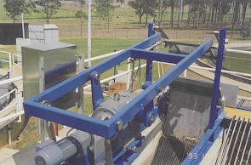
Wastewater Treatment: Unit processes
Preliminary Treatment
Gross solids
Grit removal
Oil and Grease
Storm water
Pre-treatment of industrial wastewaters

Slide 11
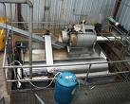

Wastewater Treatment: Unit processes
Vertical bar
Rotating drum
Screening

Slide 12
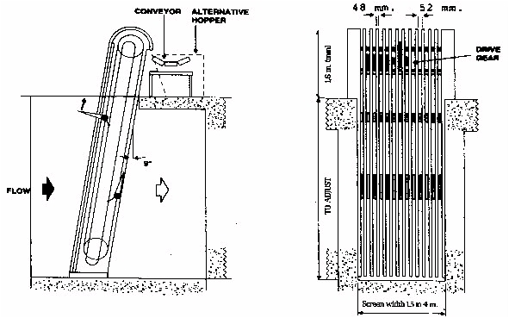
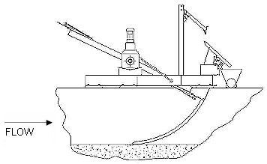
Wastewater Treatment: Unit processes

Slide 13
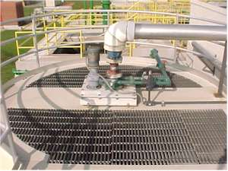
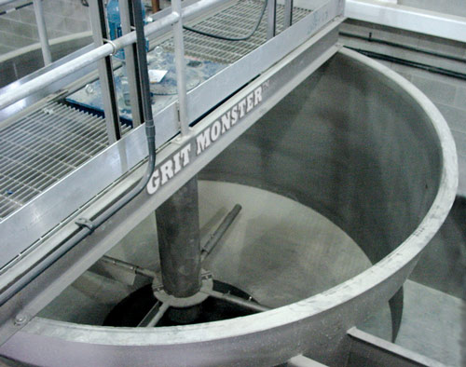
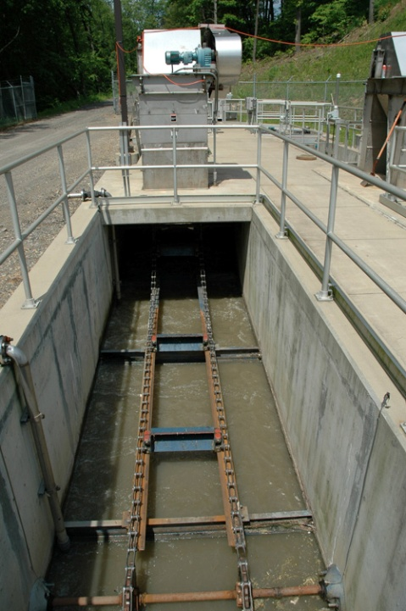
Wastewater Treatment: Unit processes
Grit separation

Slide 14
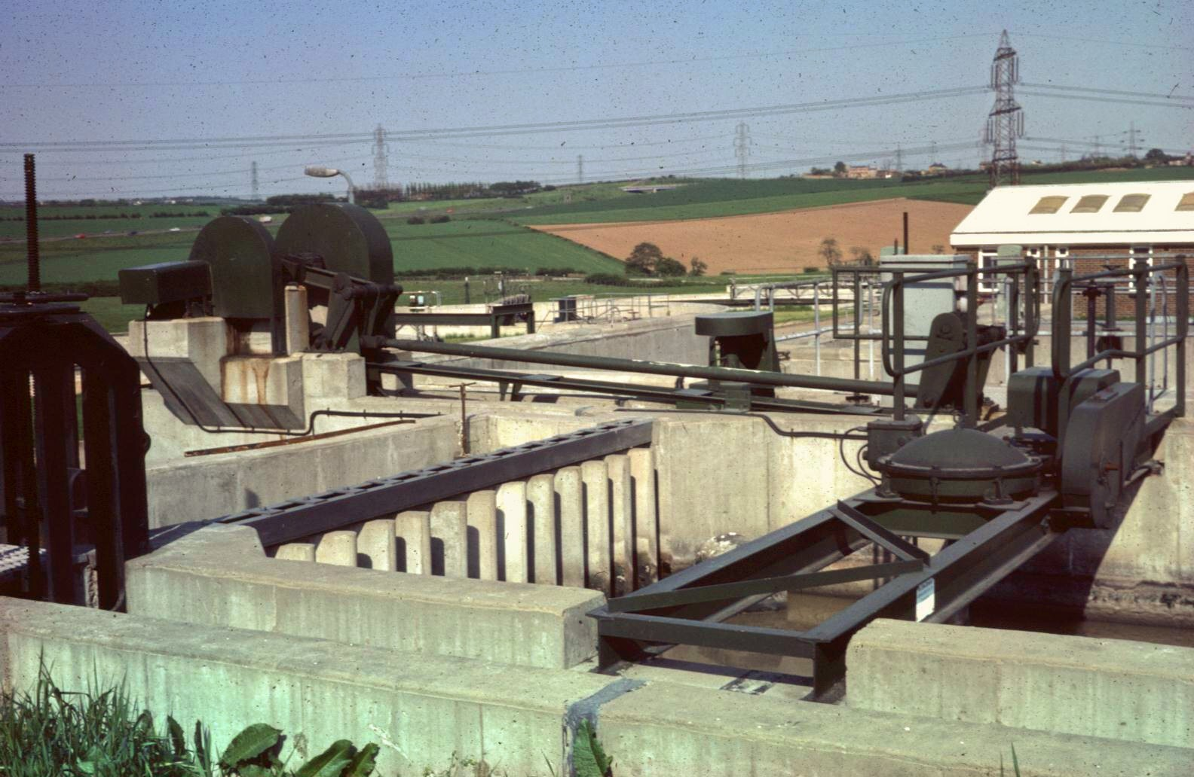
Wastewater Treatment: Unit processes
Grit Separation using a Detritor

Slide 15
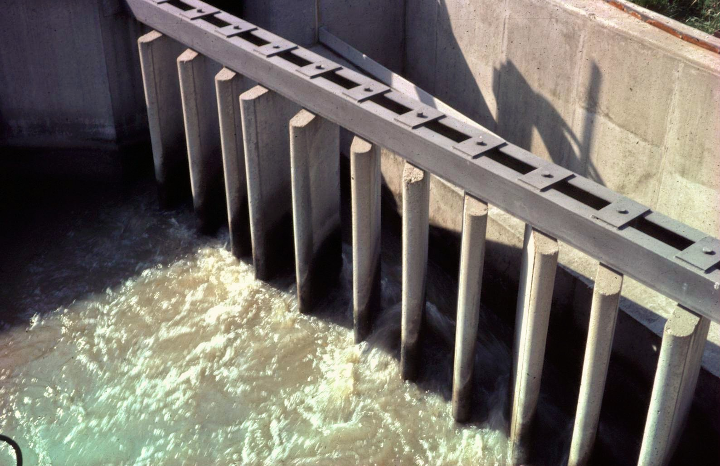
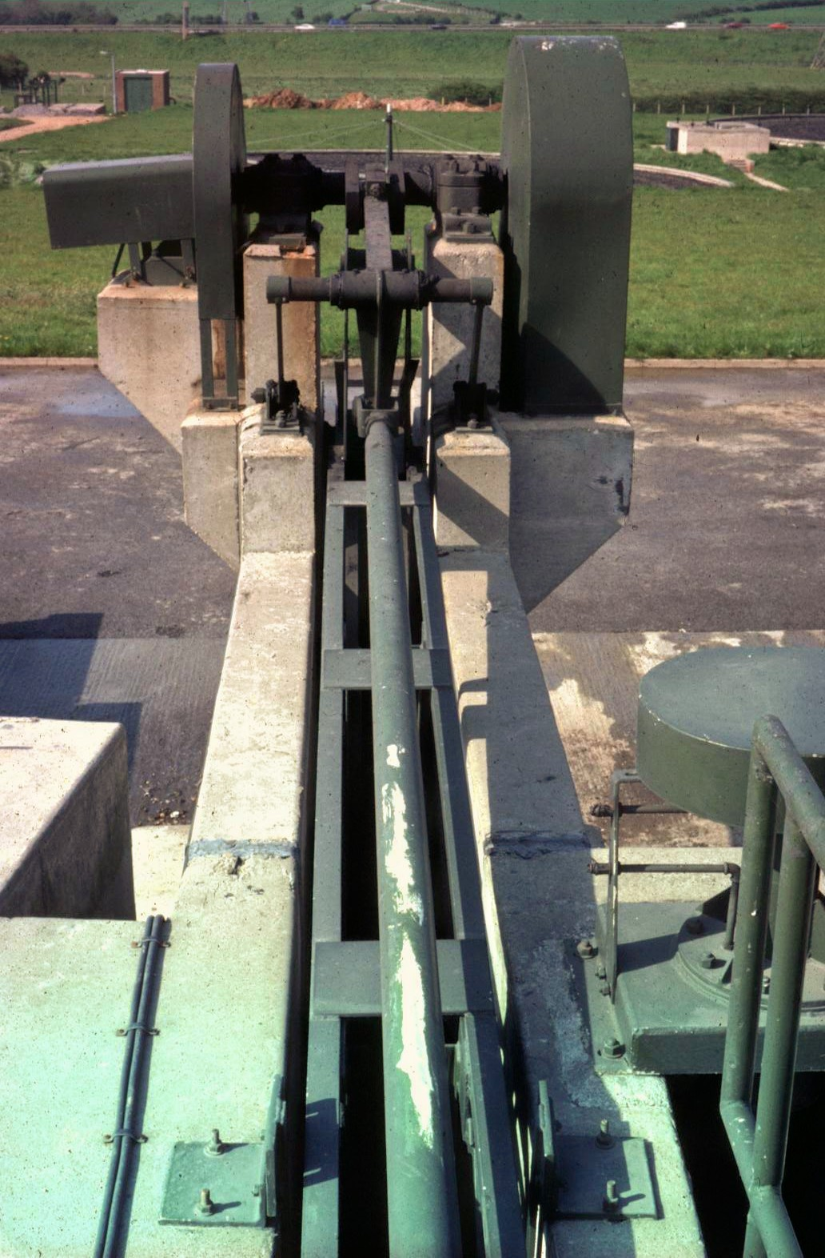
Wastewater Treatment: Unit processes
The Detritor
Above: Deflection baffles
Left: Classifier

Slide 16
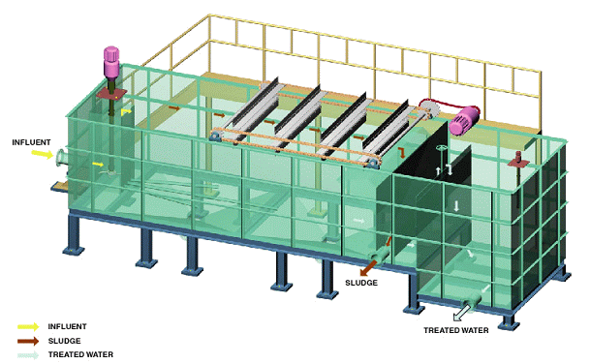
Wastewater Treatment: Unit processes
Dissolved air flotation (DAF)

Slide 17
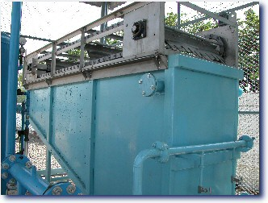
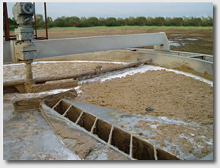
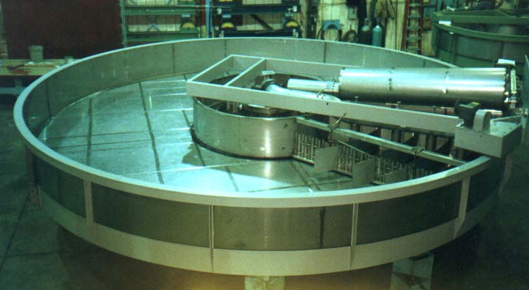
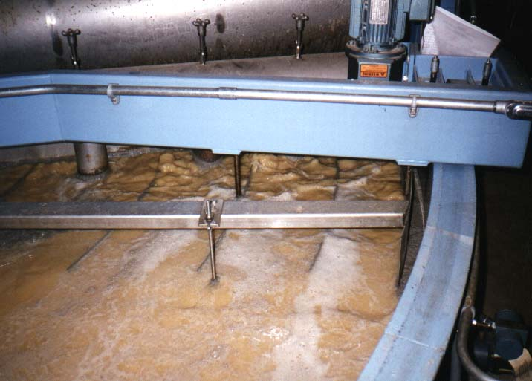
Wastewater Treatment: Unit processes
DAF: Rectangular or circular designs

Slide 18
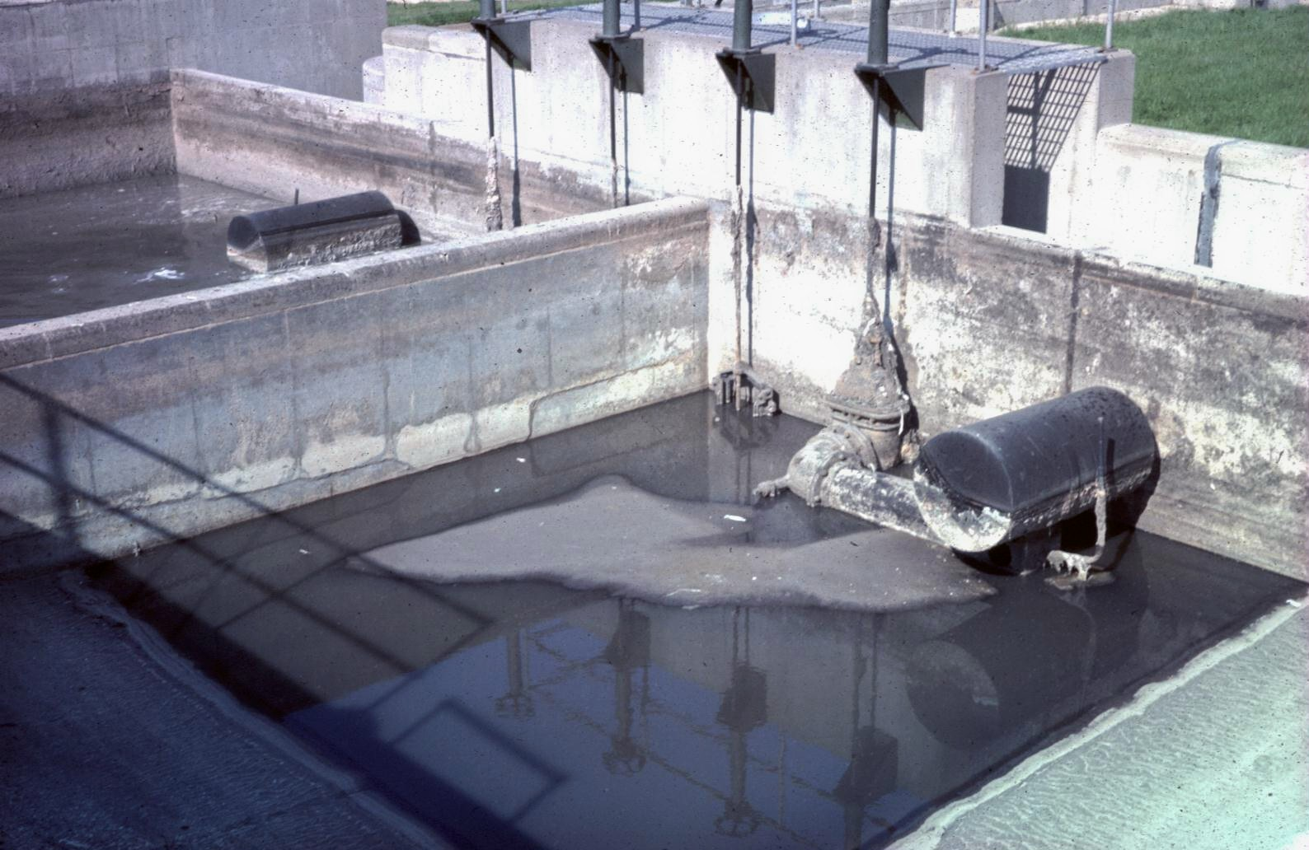
Wastewater Treatment: Unit processes
Flow balancing/equalization and flow measurement

Slide 19
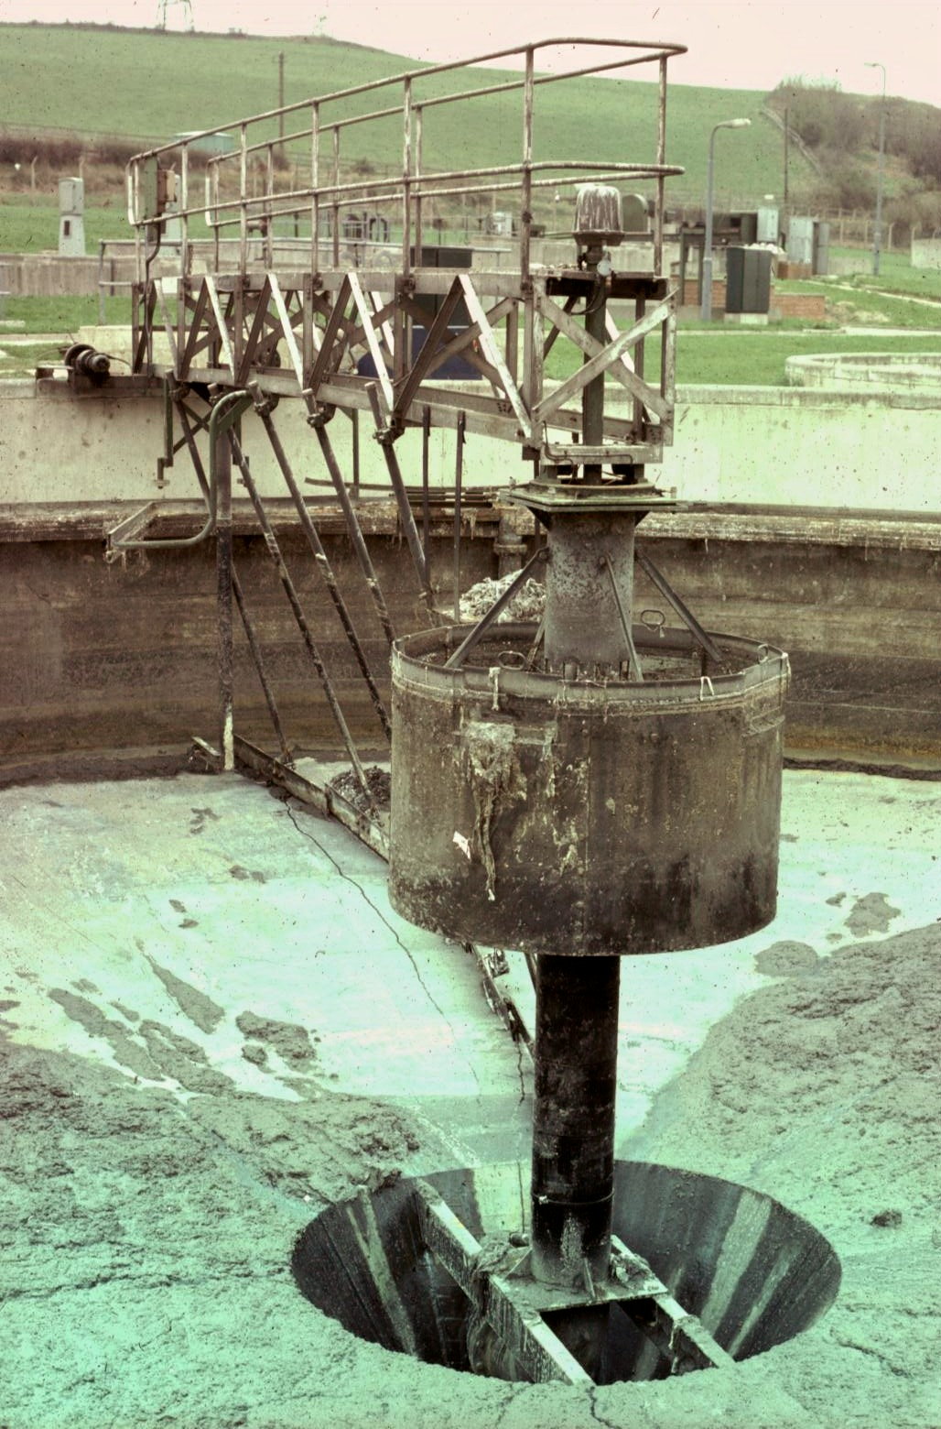
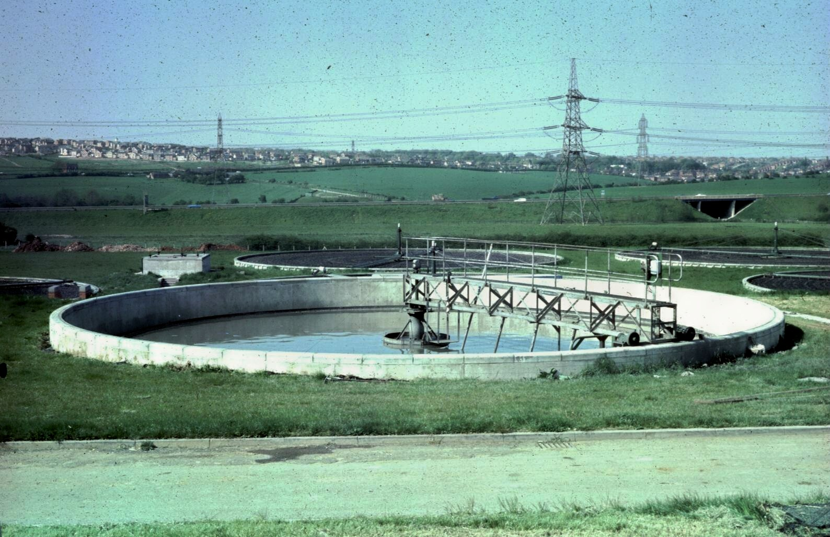
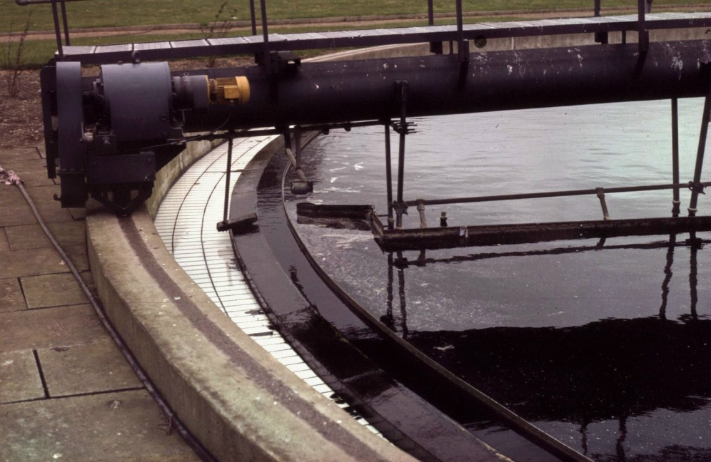
Wastewater Treatment: Unit processes
Primary sedimentation
Removal of settleable solids (Primary Sludge)

Slide 20

Wastewater Treatment: Unit processes

Slide 21
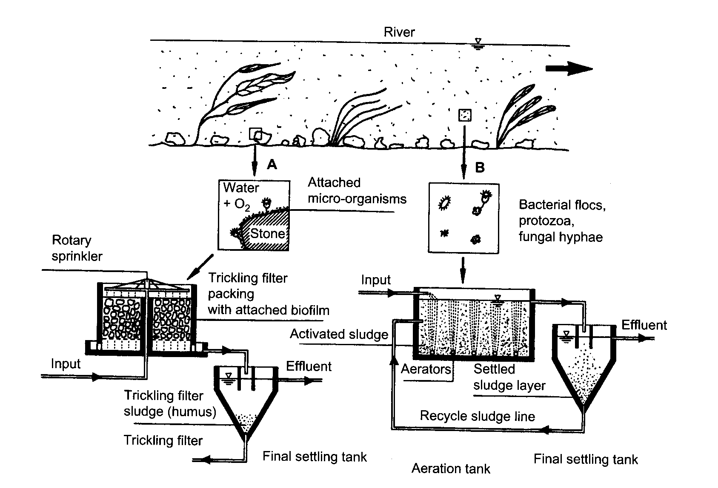
Wastewater Treatment: Unit processes
Secondary (Biological) Treatment
Soluble and colloidal fractions removed
Organic fraction oxidized by micro-organisms

Slide 22
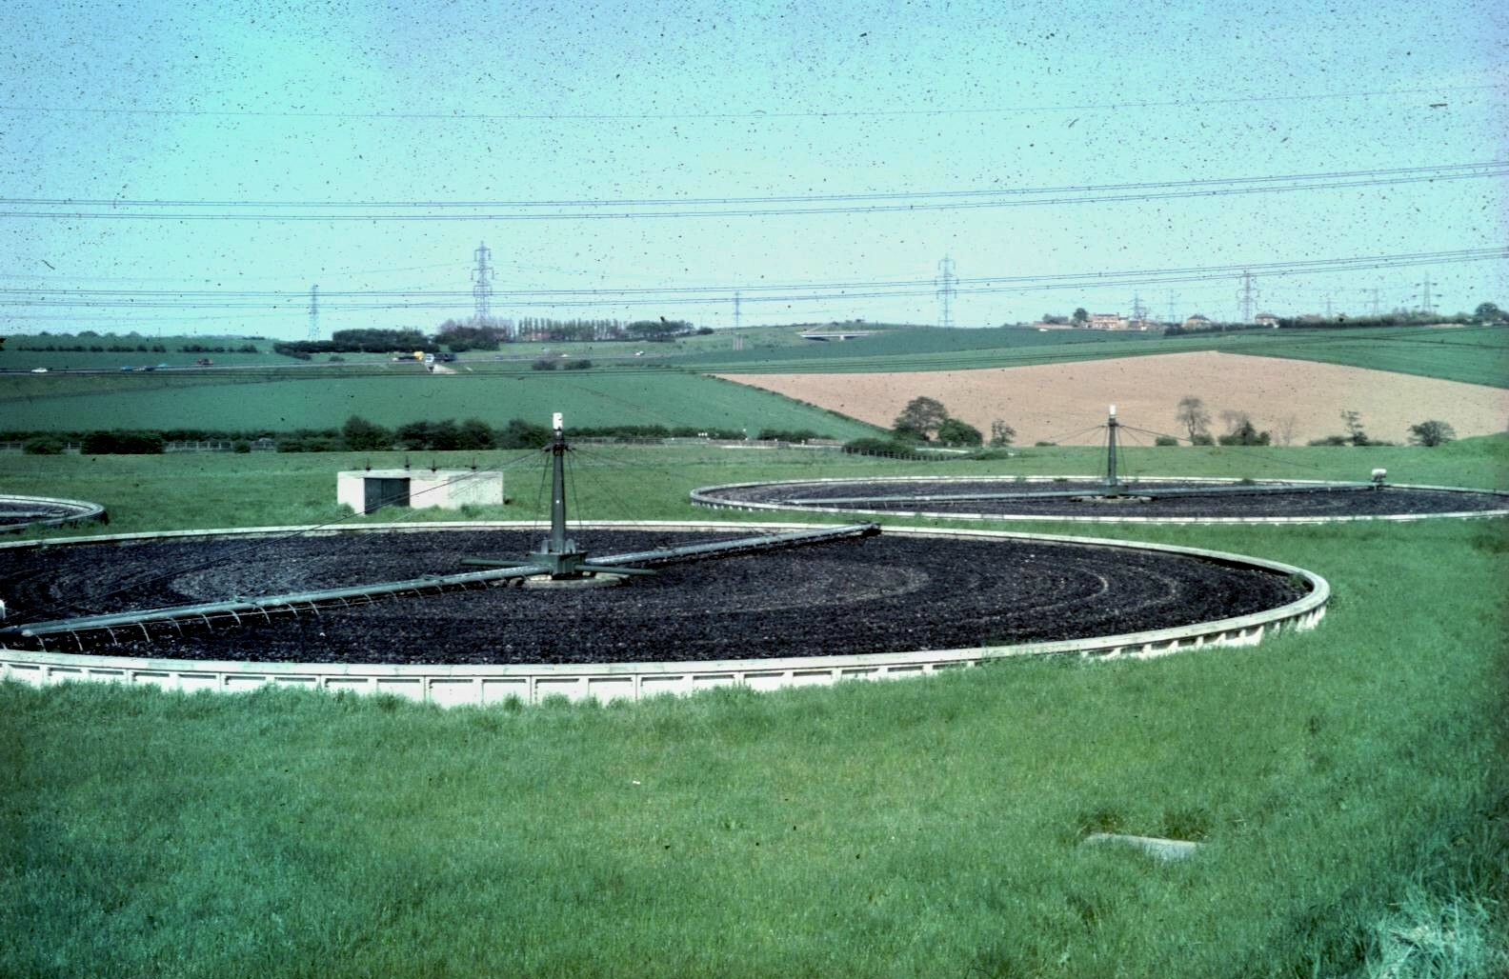
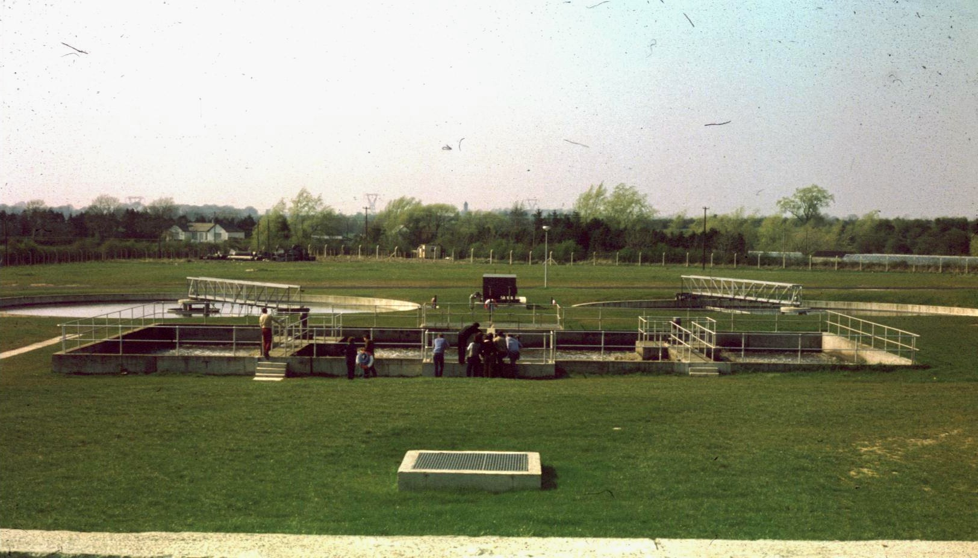
Wastewater Treatment: Unit processes
Biological Treatment

Slide 23
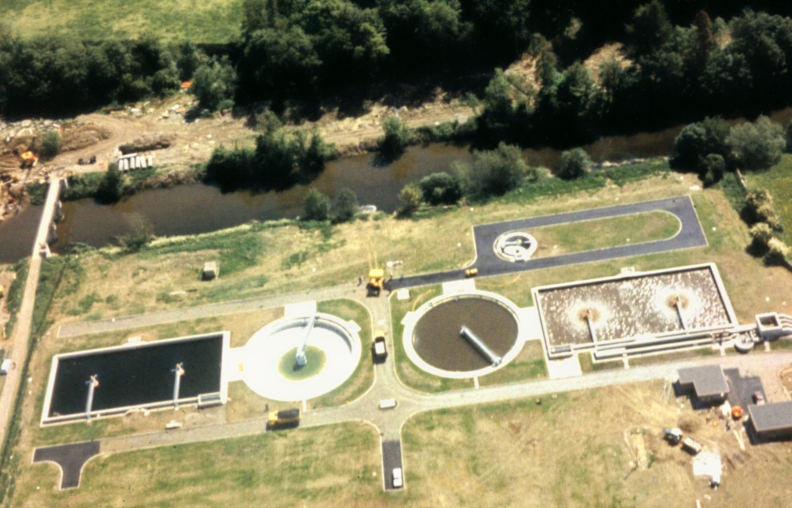
Wastewater Treatment: Unit processes
Leixlip WWTP (1980)

Slide 24
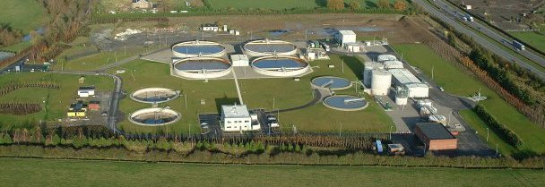
Wastewater Treatment: Unit processes
Osbertstown WWTP (2009)

Slide 25
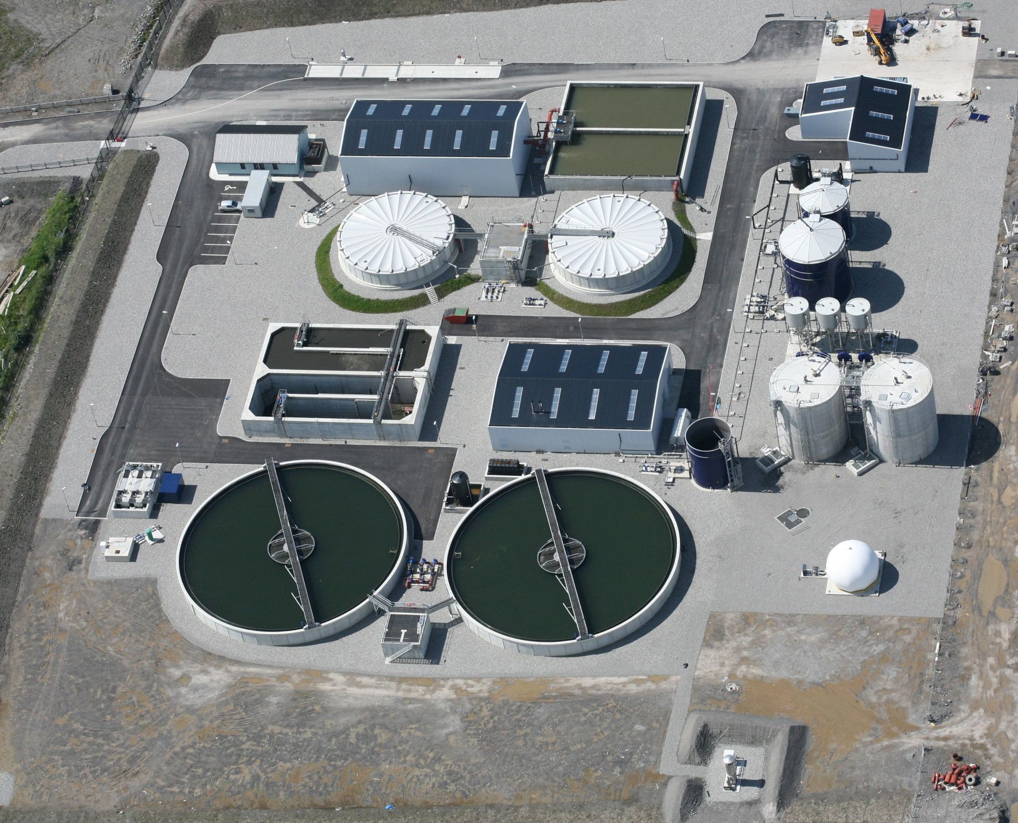
Wastewater Treatment: Unit processes
Sligo Wastewater treatment Plant at Finisklin (2011)

Slide 26
Wastewater Treatment: Unit processes
Tertiary treatment
Further treatment to reduce:
  BOD
  Solids
  Pathogens
  nutrients
  specific toxic fraction
Key methods:
  Filtration through sand or gravel
  Straining through fine mesh
  Irrigation onto grassland (land treatment)
  Prolonged settlement in lagoons
  Membrane filtration
  Disinfection/oxidation (Cl₂, O₃, UV irradiation)

Slide 27
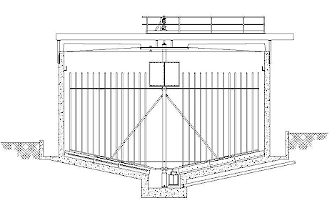
Wastewater Treatment: Unit processes
Sludge treatment
  Primary, Secondary and Tertiary Sludges
  Thickening
  Stabilizing
  Dewatering
  Disposal
Picket fence thickener

Slide 28
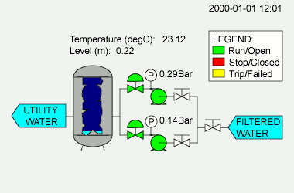
Wastewater Treatment: Unit processes
SCADA – supervisory control and data acquisition
  Computer system that collects and co-ordinates data from all equipment and displays it centrally
  allows the operator to monitor the status of operational stages in real time
  Able to make operational changes (on/off) from central location.
  Also able to makes simple decisions for itself
  Plus able to report any problems by telephone /email when unmanned.
System changes can be made from anywhere where there is an Internet connection

Slide 29
Wastewater Treatment: Unit processes
Functions:
  Control: maintaining prescribed flow rates, aeration levels; basic programming functions
  Monitoring: visual interface between process and operator in real time, trends
  Data logging: historical data; data retrieval
  Alarm: visual, audible, auto paging
  Diagnostic: on-line statistical analysis; detects when something has changed for no reason

Slide 30
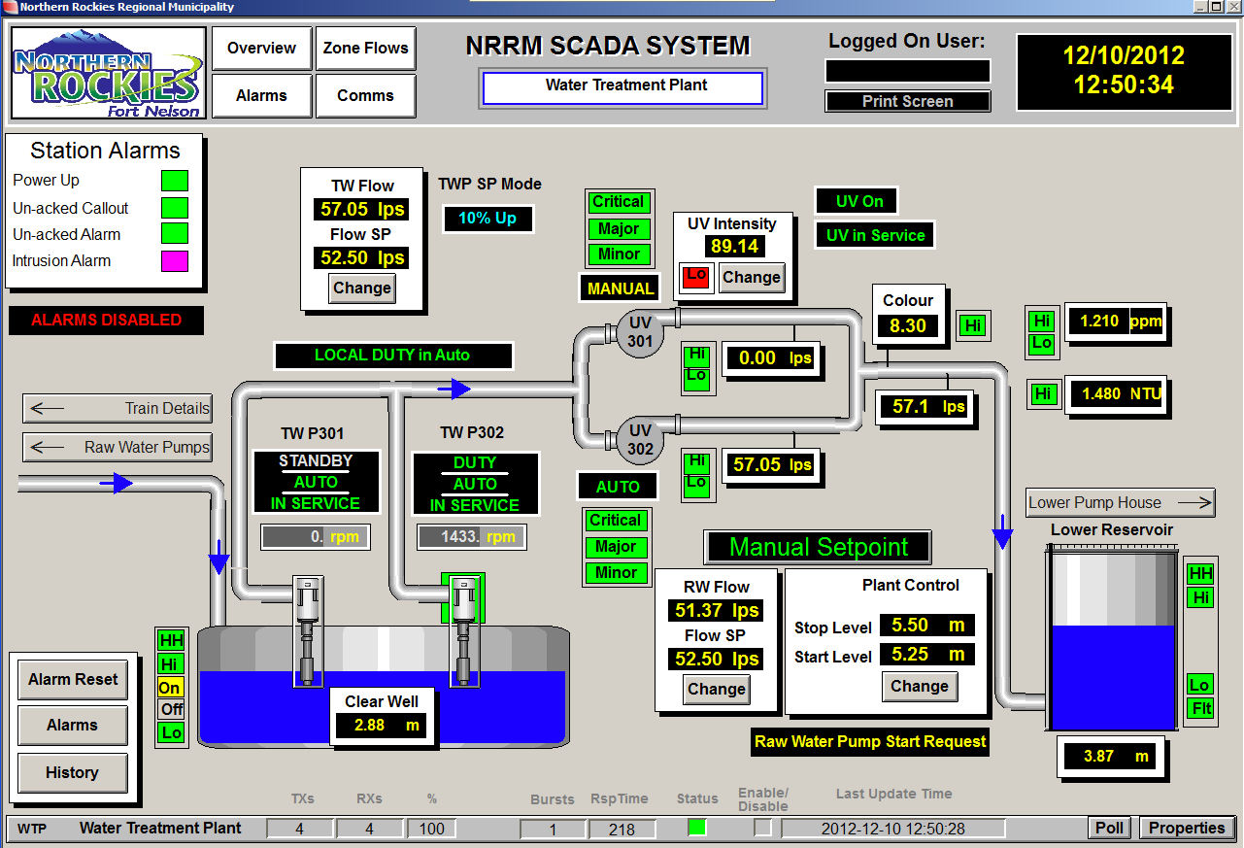
Wastewater Treatment: Unit processes
SCADA – supervisory control and data acquisition
  Used not only for water and wastewater treatment, but all utilities (gas and electricity) as well as transportation and process manufacturing and production.
http://www.youtube.com/watch?v=gpZ8ReCLQgM
http://www.youtube.com/watch?v=dVdTOPVzQGE
http://www.youtube.com/watch?v=ZSFdOjxB-1I

Slide 31
Wastewater Treatment: Unit processes

Slide 32
Wastewater Treatment: Unit processes
Required dilution for various levels of treatment employed prior to the implementation of the Urban Waste Water Treatment Directive
Ratio of receiving water to effluent | Required standard (mgl⁻¹) | Treatment level required
<8 | BOD 20 SS 30 | At least secondary and possibly tertiary
150–300 | BOD 100 SS 60 | High-rate biological treatment
300–500 | BOD 240 SS 150 | Primary sedimentation only
500 | Raw sewage | Screening only

Slide 33
Wastewater Treatment: Unit processes
Requirements for discharges from wastewater treatment plants under the Urban Waste Water Treatment Directive (91/271/EEC)
Values for total phosphorus and nitrogen only apply to discharges >10,000 pe discharging to sensitive waters (i.e. those subject to eutrophication)
Parameter Minimum Minimum percentage
concentration reduction
BOD₅ 25 mgO₂l⁻¹ 70–90%
COD 125 mgO₂l⁻¹ 75%
Suspended solids 35 mgl⁻¹ 90%
Total phosphorus 1 mgPl^{-1a} 80%
2 mgPl^{-1b} 80%
Total nitrogen 10 mgNl^{-1a} 70–80%
15 mgNl^{-1b} 70–80%
ª 10 000–100 000 pe.
^{b} >100 000 pe.
http://www.irishstatutebook.ie/2001/en/si/0254.html

Slide 34
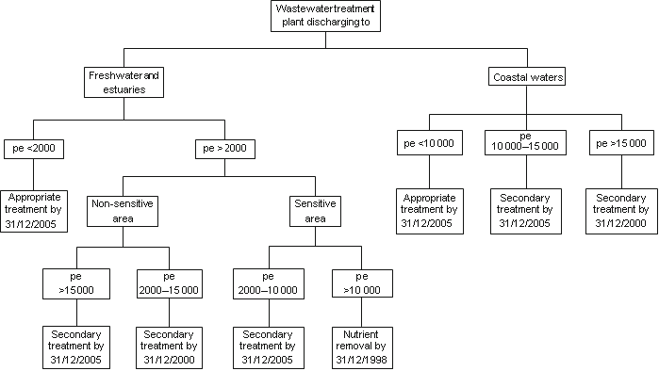
Wastewater Treatment: Unit processes
Schedule for the Introduction of UWWT Directive (91/271/EEC)

Slide 35
Wastewater Treatment: Biological treatment
Secondary (Biological) Treatment
Conversion of soluble and colloidal organic matter into a dense biomass
Subsequently be removed from purified liquid…solids collected separately as a sludge
Normally aerobic, but anoxic and anaerobic reactions can also be used
Breakdown of organic matter carried out predominately by heterotrophic bacteria that are found naturally in surface waters. Fungi, algae, protozoa and higher organisms also play roles within specific reactor designs
Reactor design provides an idea environment where maximum microbial activity can be harnessed
The micro-organisms utilize the organic matter for:
  Production of energy by cellular respiration
  Synthesis of protein and other cellular constituents for manufacture of new cells
Overall reaction in aerobic reactor:
Organic matter + O₂ + NH₄ → New cells + CO₂ + H₂O

Slide 36
Wastewater Treatment: Biological treatment
In some reactors substrate (food) is limiting
Oxidation
COHNS + O₂ + Bacteria →CO₂+NH₃+ other end products + energy
Biosynthesis
COHNS + O₂ + Bacteria → C₅H₇NO₂
Auto-oxidation
C₅H₇NO₂ + 5O₂ → 5CO₂ + NH₃ + 2H₂O + energy
All three processes occur simultaneously in the reactor
Natural systems organic matter removed primarily by oxidation
In wastewater treatment adsorption and agglomeration onto biomass main removal processes (also removes non-degradable, synthetics, metals, radionuclides)
Organic matter
Organic matter
New cells
Bacteria

Slide 37
Wastewater Treatment: Biological treatment
Better formulae for a micro-organism is:
C₆₀H₈₇O₂₅N₁₂P
With the remaining 10% of the cell composed of:
          50% P
          15% S
          11% Na
          9% Ca
          8% Mg
          6% K
          1% Fe
These and other trace elements must be present in adequate amounts for biomass formation in wastewater and optimum microbial efficiency.

Slide 38
Wastewater Treatment: Biological treatment
In order for oxidation of organic matter to occur as quickly as possible sufficient oxygen must be supplied to the micro-organisms to maintain maximum treatment efficiency.
Secondary (aerobic) treatment reactors are designed to achieve this using one of three methods:
  Spreading the wastewater into a thin film of liquid that passes over and through a thin film of biomass supported on an inert substrate with oxygen supplied by gaseous diffusion from the atmosphere (e.g. percolating filter, rotating biological contactor)
  Aerating wastewater by pumping bubbles of air or stirring vigorously (e.g. activated sludge)
  Using algae to produce oxygen by photosynthesis for the bacteria (e.g. oxidation ponds)
Artificial ecosystems controlled by operational practice - limited by food (organic loading) and oxygen (ventilation/aeration) availability

Slide 39
Wastewater Treatment: Biological treatment
Design criteria for secondary treatment reactors vary to create ideal habitats to support required community structure
Heterotrophic bacteria and fungi
Holozoic protozoa
Rotifers and nematodes
Insects and worms
Birds
All rely on heterotrophic bacteria and fungi.
Grazing levels also accommodated in different reactor types creating multiple trophic levels.
In simplest form the reactor food chain comprises:

Slide 40
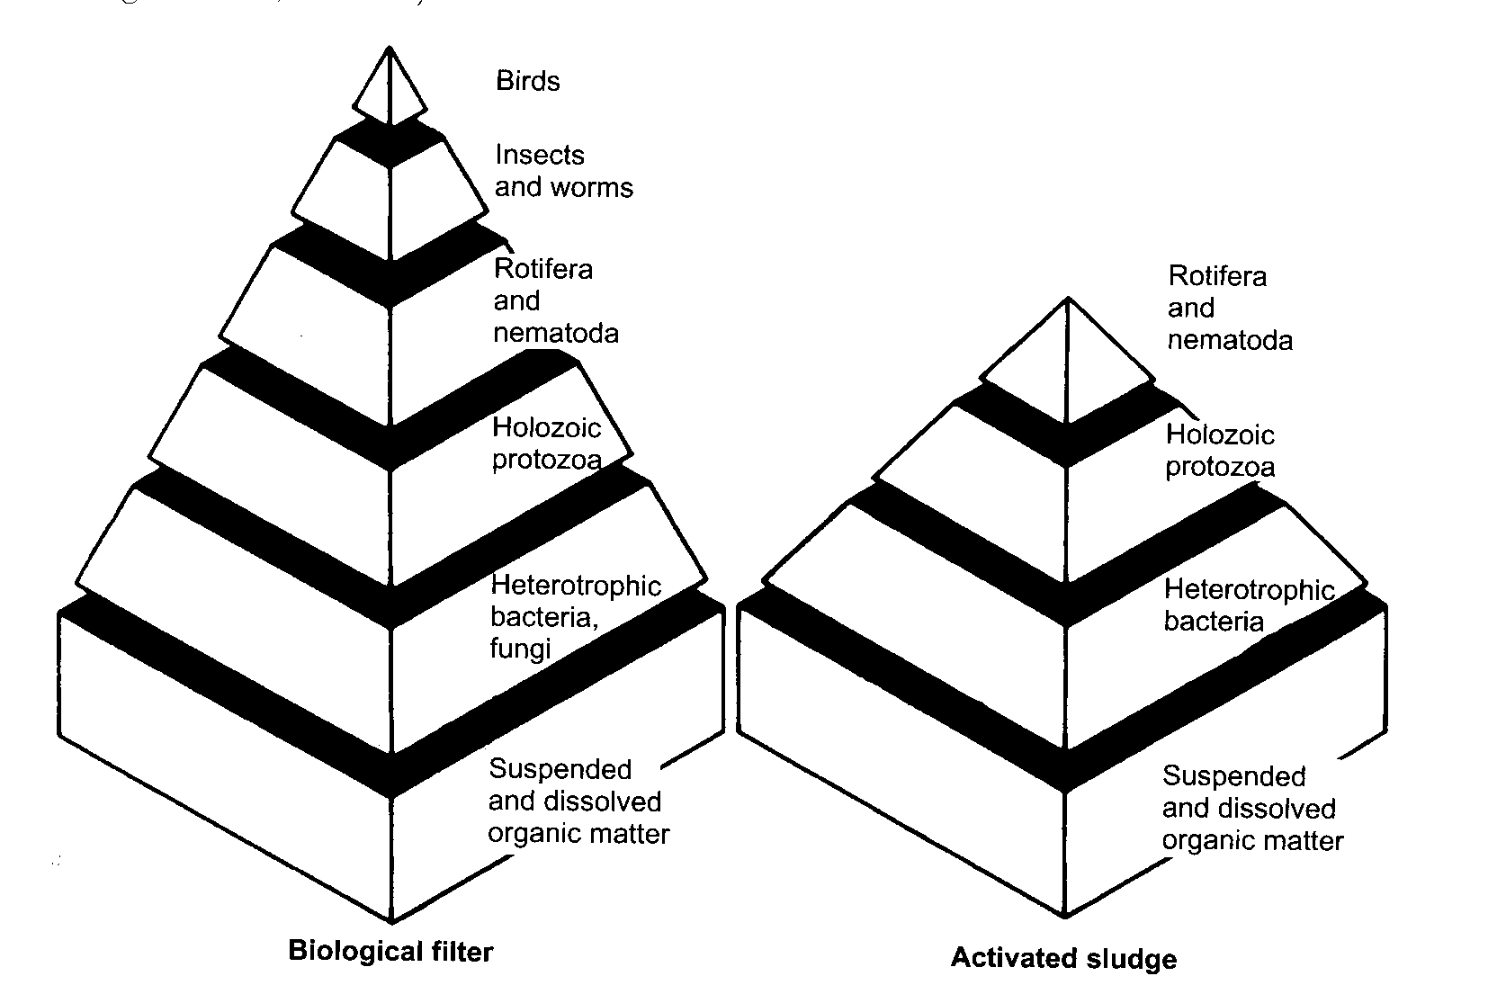
Wastewater Treatment: Biological treatment
Due to the nature of the reactor, suspended growth systems have fewer trophic levels than attached growth systems.

Slide 41
Wastewater Treatment: Biological treatment
Bacteria
Classified by source of nutrients:
  Heterotrophic - require organic matter for both energy and source of C for synthesis
  Autotrophic - don’t use organic matter but oxidize inorganic compounds for energy and CO₂ or carbonate as source of C for synthesis.

Slide 42
Wastewater Treatment: Biological treatment
Heterotrophs further subdivided:
  Aerobes require free oxygen to decompose organic matter
  Anaerobes oxidize organic matter using O₂ bound up in inorganic compounds
Aerobic processes are biochemically efficient, rapid, by-products are simple and highly oxidized – can be disposed to surface waters safely
Anaerobic processes are biochemically inefficient, slow, by-products are complex, partially oxidized, often foul smelling, unsafe for disposal without further treatment
  Facultative bacteria use free DO when available or under anaerobic conditions use oxygen bound up in inorganic compounds
  Obligate bacteria only grow in the presence of DO (obligate aerobe) or in its absence (obligate anaerobe)

Slide 43
Wastewater Treatment: Biological treatment
Portion of the total energy lost in wastewater utilized under aerobic and anaerobic metabolism
A - lost heat energy; B – respiration; C – synthesis; D – energy bound in end products; E - unused energy due to lack of hydrogen or electron acceptors

Slide 44
Wastewater Treatment: Biological treatment
Biological treatment can be carried out under aerobic, anoxic or anaerobic conditions.
This involves different micro-organisms and reactions
The reactions that occur depend on the substrate available, the redox of the reactor and the availability of electron acceptors
Electron acceptors only become involved in the oxidation of organic matter at the end of a long series of integrated enzyme chemical reactions
The hydrogen or electron donors (substrate) gives up electrons
These are transported via a complicated biochemical pathway to the ultimate terminal electron acceptor (normally oxygen)
  Heterotrophic metabolism use organic electron donors
  Autotrophic metabolism uses inorganic electron donors
Preferential use of electron acceptors is based on energy yields.

Slide 45
Wastewater Treatment: Biological treatment
Preferential use of electron acceptors is based on energy yields.

Slide 46
Wastewater Treatment: Biological treatment
Conclusions
Wastewater treatment employs aerobic, anoxic and anaerobic reactions in a wide range of reactor designs
Wastewater treatment is the key mechanism for the protection of public health and the environment.
Wastewater treatment relies on microbial processes to remove all soluble and colloidal material both organic and inert that poses a risk to environmental and human health
Wastewater treatment also removes pathogens through a mixture of adsorption onto biomass and grazing by mesofauna.

Slide 47
Wastewater Treatment: Biological treatment
Read:
Chapter 10 course text as a brief overview or Section 3.6 in Gray, N.F. (2004) Biology of Wastewater Treatment, Imperial College Press, London for a fuller picture.
References:
Gray, N.F. (2004) Biology of Wastewater Treatment. Imperial College Press, London (Chapter 3)
Bitton, G. (2005) Wastewater Microbiology. Wiely-Liss Inc. New York.
Mara, D. and Horan, N. (eds) (2003) Handbook of Water and Wastewater Microbiology. Academic Press, London.

