Slide 1


Biopsychosocial models of wellness and the human factors design of new technologies for older adults domicile in residential homes and assisted living communities
Joan Cahill, School of Psychology, Trinity College Dublin (TCD), Dublin, Ireland
Sean Mc Loughlin, Oneview Healthcare, Ireland

Slide 2


Topic & Objectives
Biopsychosocial models of wellness and the human factors design of new technologies for older adults domicile in residential homes and assisted living communities
Overview of research and specifically, human factors/stakeholder evaluation approach
Outline proposed technology & biopsychosocial approach
Discuss some issues arising in relation to introduction of new technologies
Highlight importance of engaging in Human Factors research
Biological
Psychological
Social

Slide 3
Human Factors

Slide 4


Human Factors
What
  The practice of designing products, systems, or processes to take proper account of the interaction between them and the people who use them (ISO 6385)
  Applies theory, principles, data and methods to design in order to optimize human well-being and overall system performance
  Understanding who the users of the technology are as people:
  Needs
  Preferences, values and acceptability
  Ability (cognitive, motor, vision, hearing..)
  Motivation

Slide 5

Human Factors
Why
  Enhance product usability and address user/stakeholder acceptability
How
  Stakeholder involvement & Use of Community of Practice (COP)
  Find out about end users and other stakeholders (interviews, observations, personae, requirements definition)
  Design and evaluate with end users and other stakeholders (participatory evaluation, co-design)

Slide 6
Overview of Research Project

Slide 7
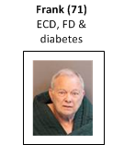
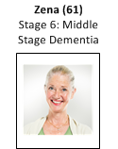
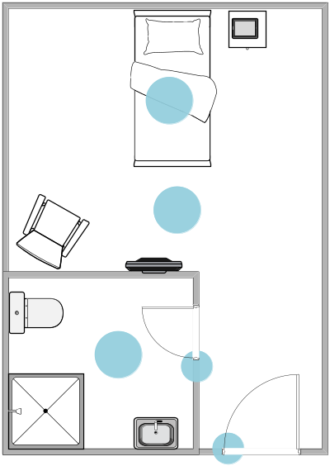
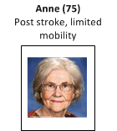
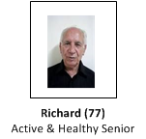
Project Background
The participatory design and evaluation of new technology to enable independent living, social participation and quality of life for older people domicile in residential homes and/or assistive living communities
Resident technology and experience
Consider technology for other actors
Industry/Academia collaboration
- Trinity College Dublin, Ireland
- Oneview Healthcare, Ireland
Notes:
Research seeks to establish the appropriate balance between enabling the independence and well-being of residents (including supporting their privacy) and protecting residents from potential hazards

Slide 8
Underpinning
Concepts

Slide 9
Underpinning Theory & Concepts
Ageing & Lived Experience
Ageing is a normal part of life
Spanning 3 to 4 decades
Meaningful and purposeful
Quality of life
Wellness
Social participation
Theory
Wellness (biopsychosocial)
Relational autonomy
Relationship centred care
Social connection and community
Self management
Ability
Ethics/rights

Slide 10
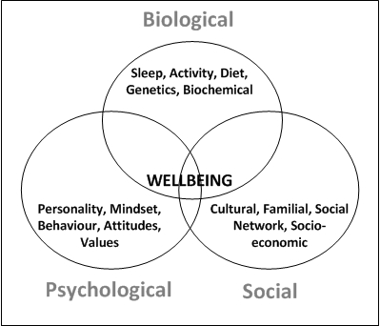
Biopsychosocial Models of Health & Wellness
Emphasize the varied determinants of wellbeing (Engel, 1977; Havelka, Lucanin & Lucanin, 2009)
  Medical
  Psychological
  Family
  Social factors

Slide 11
Methodology

Slide 12


Methodology
Action research (qualitative)
The human factors design approach is premised on the assumption that the solutions for seniors and other actors are necessarily interrelated
Stakeholder evaluation involving use of a community of practice (COP)
Lifespan perspective – home, assisted living community and residential homes
Ethics approval
Field Research
  Ethnography (interviews n = 47)
  Observations (day hospitals)
  Participatory Design/Evaluation (n=10)
  Validation/Evaluation: Post Acute Care Service (n=15)
  Evaluation: Residential Home
Notes:
Participatory Design spans – tools for residents (preadmissions, admissions, daily life), and for family and nurses etc
Ethics approval for all
Post Acute Care Service = Mater Hospital (TCD and hospital approval
Residential Home = Strathmore Lodge - Private Nursing Home (TCDl approval)

Slide 13
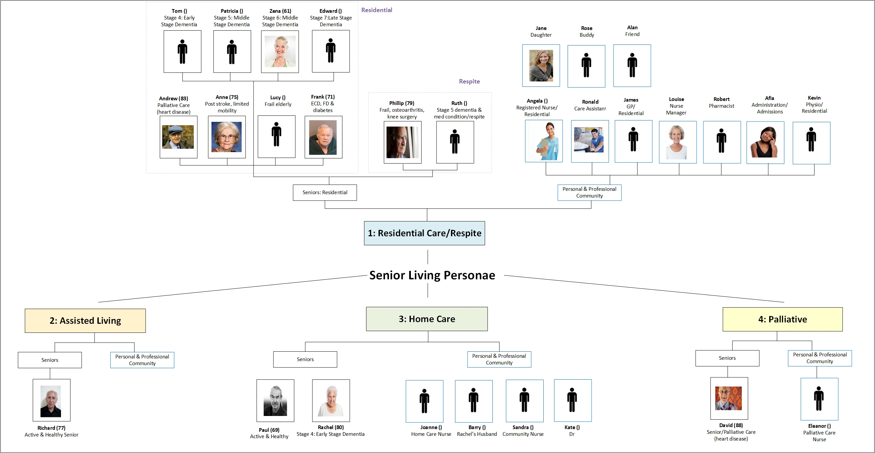
Personae

Slide 14

Name: Zena Kobitz Age: 60 years Social & Personal History: Loving family Worked as an office receptionist for 35 years – law firm Used to have active/busy social life – sang in choir, enjoyed exercise (was member of tennis and swim clubs) Dementia Background Alzheimer's Disease Four years’ ago, Zena started showing diminished cognitive ability (aged 56, early onset) Heath changes has had a profound impact on her life, level of social participation, ability to work (stopped working) Prior to moving to residential home, attended day care center daily In recent months, Zena has lost the ability to speak and her mobility has worsened Health: Mid Stage Dementia (Stage 5) Mobility & ADL: Cannot function independently (Barthel, 20) Needs assistance for most ADL, restricted movement Family: Husband Barry, Daughter Jane and Sally, and Grandchild Sarah (Janes Daughter) Interests: Nature, music and singing, tennis, swimming, being outside in fresh air | Biological: Alzheimer's Disease Mid Stage Dementia: Stage 5, Moderately Severe Cognitive Decline (GDS) Stage 6 -- Moderately Severe Alzheimer's (FAST) Limited mobility/frailty Often tired/fatigued – given sleep problems Urinary incontinence Barthel (20/100) Fall risk Psychological: Potential for depression Easily overwhelmed and confused Angry at situation – occasional outbursts Frustration with loss of communication ability, loss of independence and loss of physical liberty Barry a strong source of support and comfort Risk of depression (7: Cornell Scale) Risk of self-harm Cognitive: Difficulty understanding information Inability to complete simple tasks and/or long time Major memory deficiencies Includes major relevant aspects of current life (time of day and where they are, whether eaten), names of people and objects, recognizes husband Barry but does not recognize certain friends Social: Loss of interest in activities Limited communication ability – difficulties speaking and finding words Withdrawn from family and friends Socialization very difficult/limited Open communication lines with Barry Risk of social isolation | Needs/What Matters: Quality of life Maintaining abilities Managing frustration and agitation Keeping in touch with family Enjoying simple/everyday things (pleasure in here and now) Pain Points: Lack of independence/loss of ability Managing communication challenges Social isolation and loneliness Boredom Loss of identity Infringements on dignity/privacy Being treated as a child Technology & Ability: Was computer literate – own tablet (Internet, Email) – but not using now No prior experience of Smartphone or social media Mild hearing loss Reading glasses Reduced fine-motor control Reduced hand-eye coordination

Slide 15
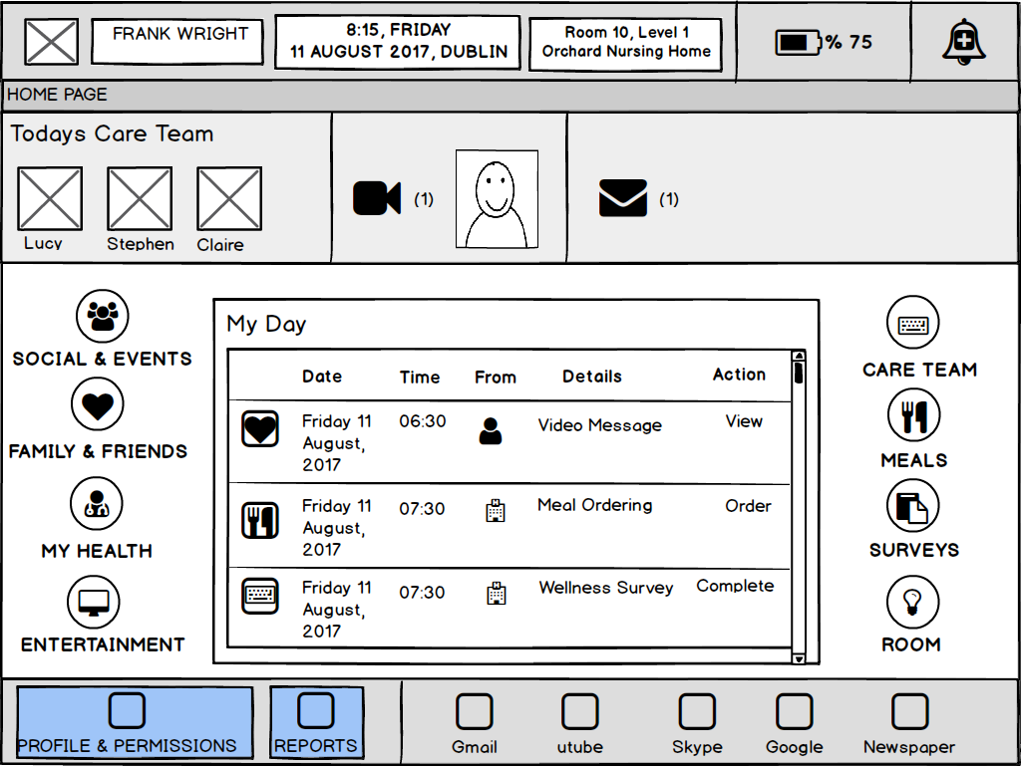
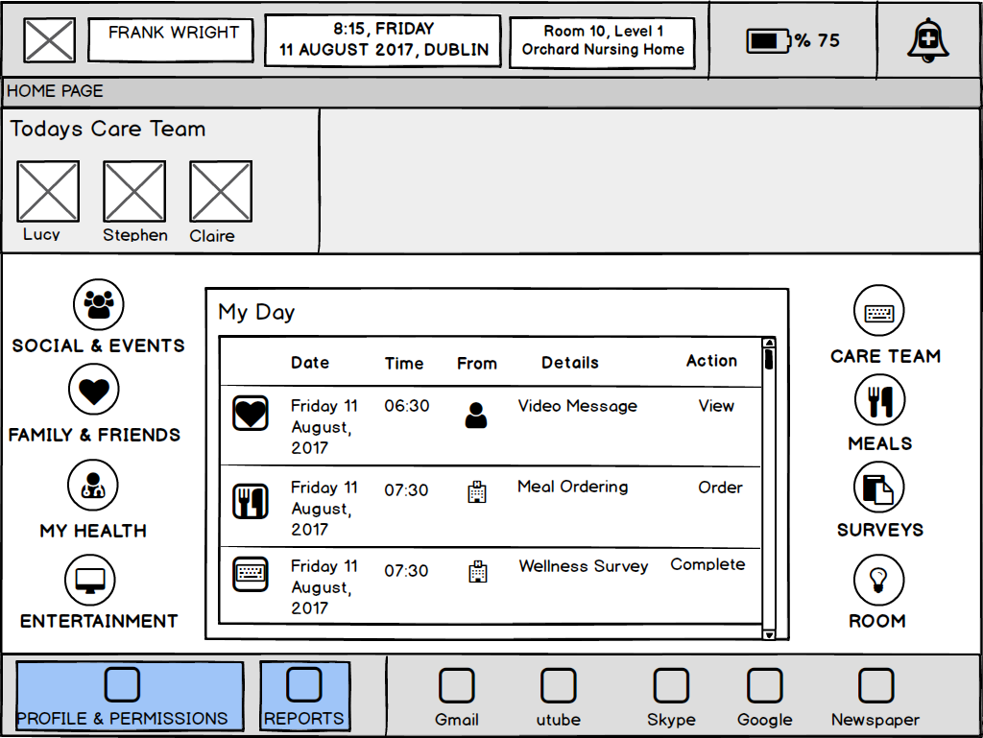
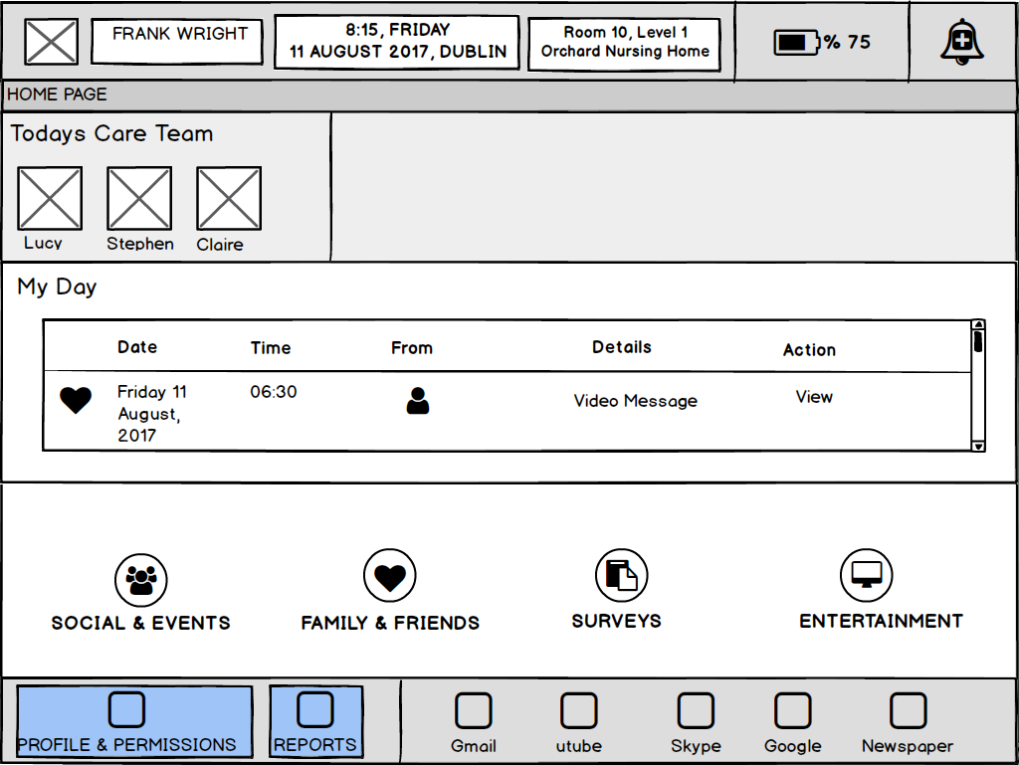
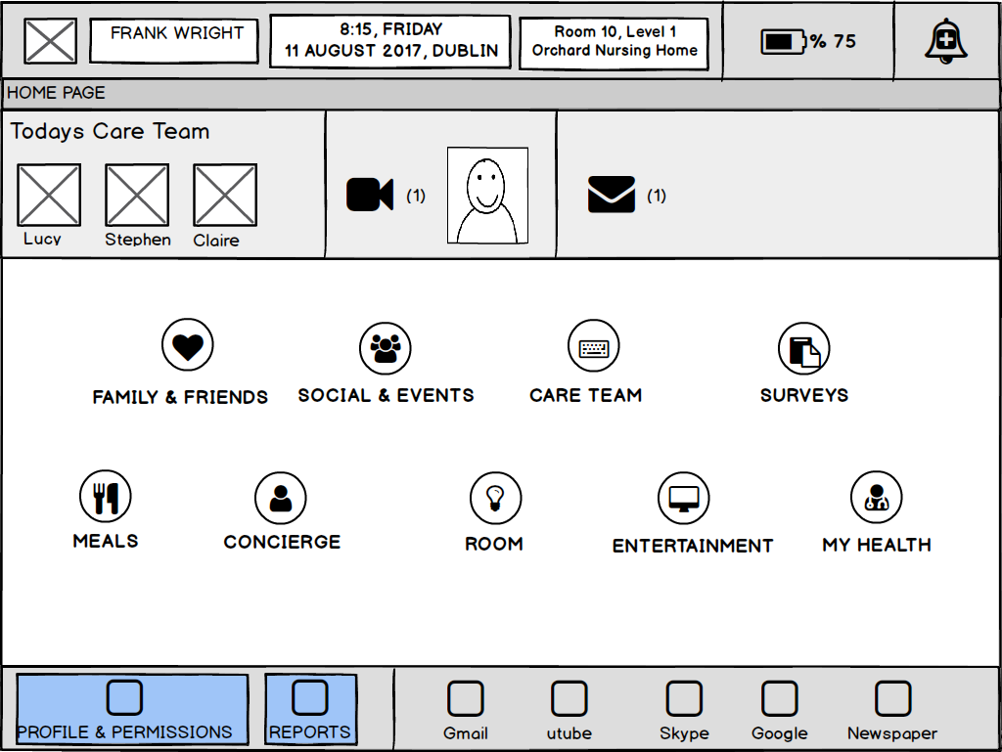
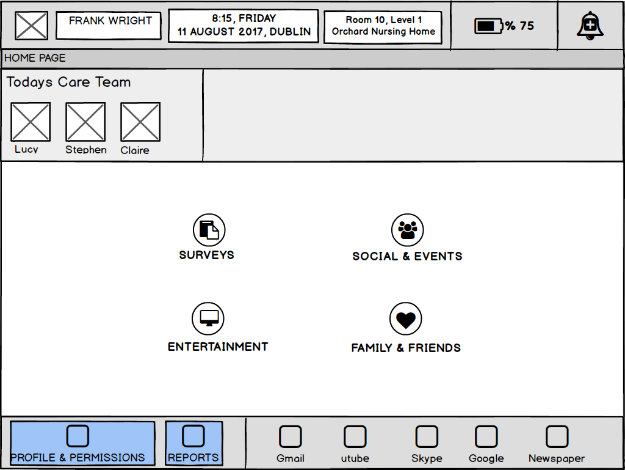
Preliminary Prototypes: Resident (Resident Dashboard)

Slide 16
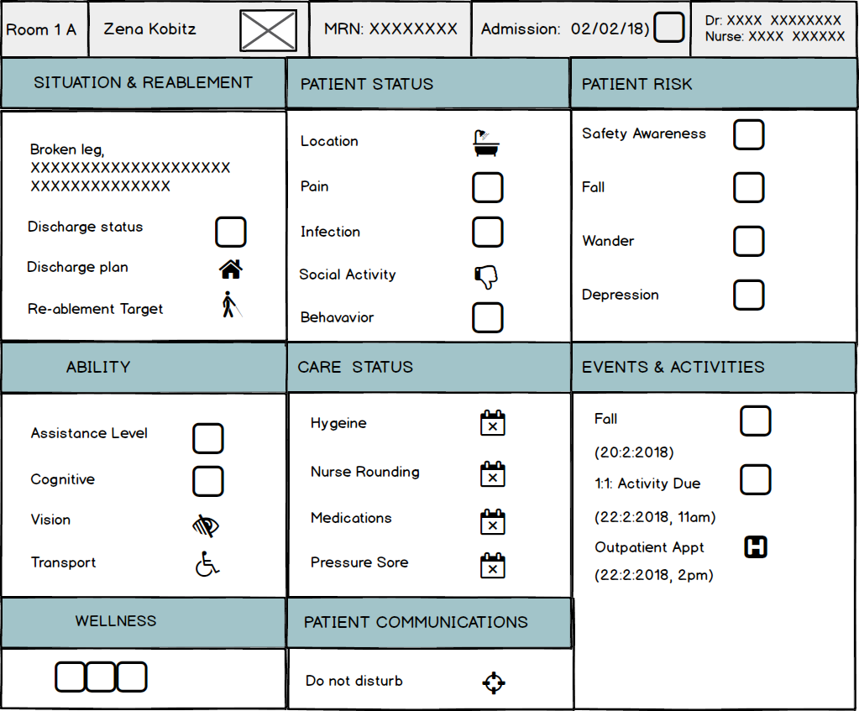
Preliminary Prototypes: Wall Mounted Display

Slide 17
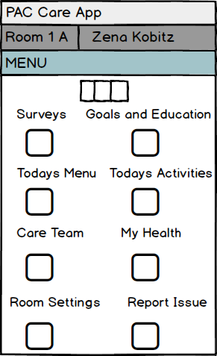
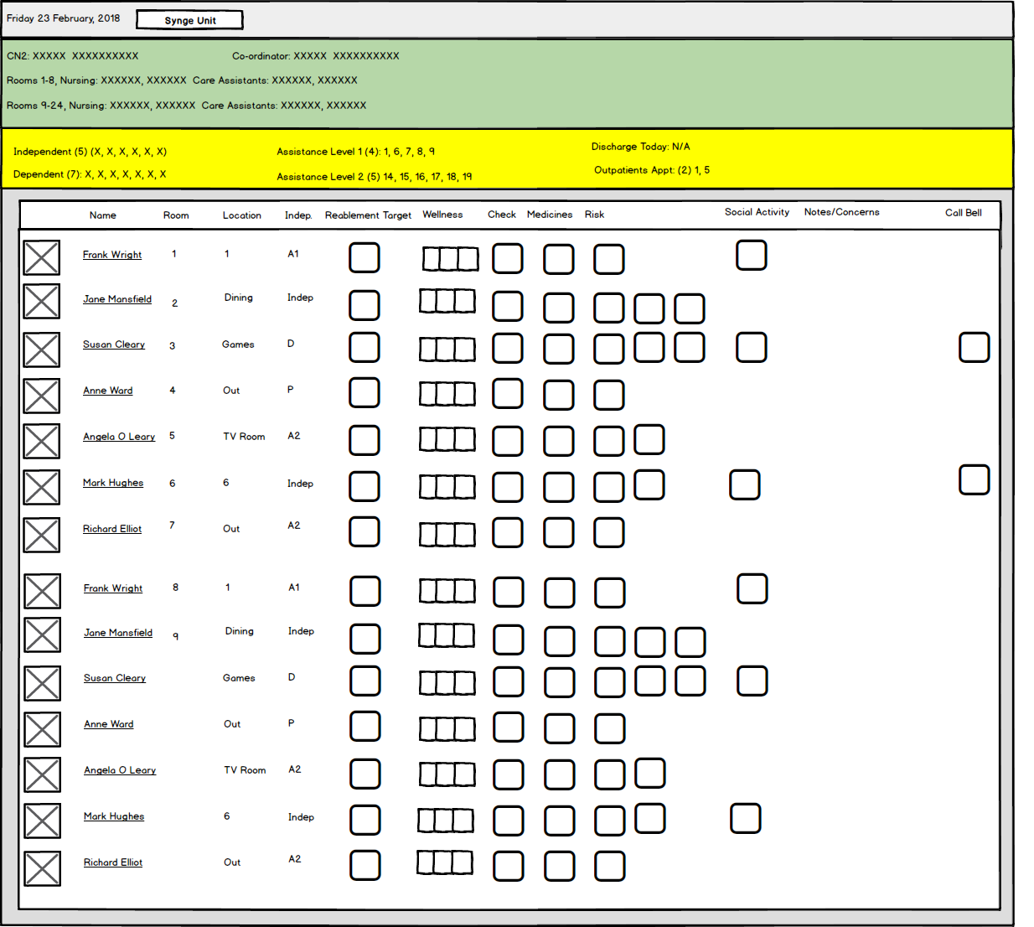
Preliminary Prototypes: Phone App & Nursing Whiteboard

Slide 18
Key Findings

Slide 19

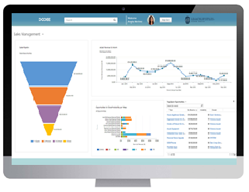
Care Context & New Technology
Historically, residential care facilities addressed societal goals as opposed to addressing the needs of those domicile in them
TECHNOLOGIES
Surveillance (risk assessment/safety)
Community dwelling, social participation, well-being
Resident analytics
Balance – ethics, acceptability, benefits
Now more attention to relationships, resident well-being, resident preferences and promoting intergenerational contact/communications
Information flows: residents, family, nursing/care staff, clinicians and administrative staff

Slide 20
Resident
Successful ageing is multidimensional and includes psycho social elements
Adaptation is a feature of the ageing experience
Loneliness and boredom is a common experience
Experience of ageism
Well-being is strongly influenced by the quality of a older person’s relationships with members of their personal and professional community
Older people want care with dignity and choice
Strong preference in relation to remaining in their own homes
Future systems should not be used to replace person centred care and/or to reduce the time that nursing and care staff spend with residents
Residents should have the option to opt in and out of sensors
Simplicity/ease of use (multimodal)

Slide 21
Delivering specific states of wellbeing
Promote/Support
Manage/Mitigate/Reduce
Avoid
Quality of life
Wellness
Independence
Social participation
Communication
Safety
Identify
Empowering person
Dignity and respect
Purposeful activity
Sense of purpose
Sense of usefulness
Resilience/coping
Self-management of health
Engagement
Sense of confidence in own ability
Awareness
Continuity
Nurturing person
Citizen participation
Active and healthy living
Loss of identity
Loss of physical liberty
Physical discomfort
Communication difficulties
Fear
Sense of powerlessness
Difficulty with new information
Restlessness
Feeling lost
Stress
Apathy/loss of interest
Wandering
Frustration
Confusion
Agitation
Negative thinking
Depression
Aggression/anger
Sleep disturbances and sundowning
Suspicion and delusion
Self-neglect
Deception
Infantilization
Isolation
Elder abuse
Objectification of the dementia patient
Unsafe behavior
Reduction in human contact
Neglect
Notes:
We are mindful of the complexities and challenges of ageing and understand the opportunities to advance technology that manages and mitigates potential challenging states and behaviours while optimising positive states.
During our requirements gathering stage, we address:
The states, or lived experience, to be achieved for each of the relevant end users and stakeholders
How Oneview’s technology will support this.
This means working with you to identify each of the states and outcomes to be achieved by implementation of the Oneview solution. This exercise will inform the ultimate solution design and implementation plan.
Our implementation team includes a number of Outcomes Managers who will work with your facility/facilities to assist in the change management process and track achievement against the target states and outcomes.

Slide 22
Proposed Concept

Slide 23

Vision
The proposed technology should enable a vision of care where older people are
  Socially engaged (connected to community, have psychosocial occupation)
  Have continuity in living experience (normalise ageing, not segregate older people)
  Have a voice (consent, participation, decision making, identity)
Connection
Purpose
Psychosocial Occupation

Slide 24
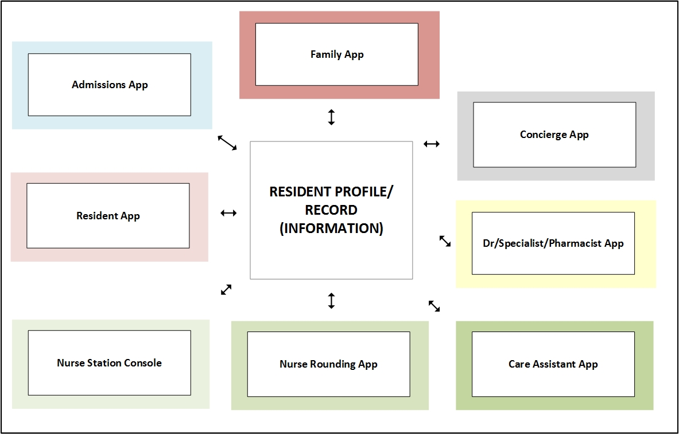
Proposed Concept
Conceptualized in relation to stakeholder relationships
Suite of interrelated technologies is being advanced for seniors and other stakeholders (i.e. nurses, care assistants, admissions/administration personnel, family members, GP etc.)
Technology enables everybody to be involved in care
In room sensors
Resident Tablet
Caregiver Tablet
Wall-mounted Display

Slide 25

Optimizing Stakeholder Relationships
Bio
Social
Psychological
Solution is premised on the knowledge that improving the social, information, and process relationships between stakeholders ultimately optimizes resident wellness.
Specialists
GP
Rehab
Hospital
Pharmacist
Care Team
Children
Spouse/Partner
Friends
Relatives
Exercise Instructor
Driver
Hairdresser
Notes:
To do this, we recognise that each resident is supported by a community of professional and personal stakeholders.
Our solution is premised on the knowledge that improving the social, information, and process relationships between stakeholders ultimately optimises resident wellness.

Slide 26
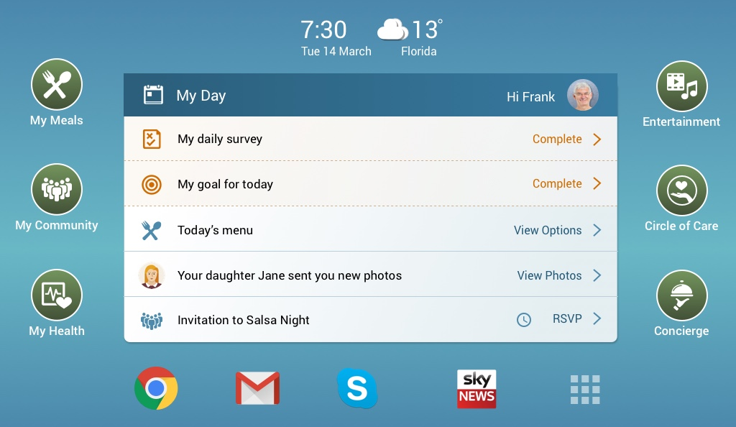
Proposed Concept: Resident
Ability philosophy
Self-decided services (opt in/out), based on what matters to older people
Design solution is adaptive in terms of age-related changes and characteristics
Allow for personalization
Specific functions promote wellness and map to the underpinning biopsychosocial model of health and well-being
Interactions are simple and natural, using touch (and potentially speech and gesture)
Solutions for family/Carer’s will yield benefits for residents with Dementia

Slide 27
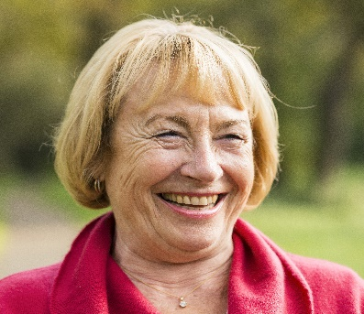
Resident-centered technology
Bio
Social
Psychological
Wander Management
Medication Management
Resilience
Independence
Telehealth
Digital Signage
Education & Coaching (Self-Management)
Safety
Health Record & Careplan
Engagement
PIR Sensors
Connection
Bed & Clothing Sensors
Communication
Ability
Active Living
Meal Ordering
Data Analytics
Belonging
Entertainment
Notes:
Other aged care technology providers have developed solutions from a base of billing management or electronic medical records.
To truly deliver care that meets the needs of consumers who want to age with dignity and retain control over their care, a resident-centred solution is needed.
This is our key differentiator.
To this end, we are conducting extensive human factors research into the role of technology in enhancing and enabling resident-centred care within an aged care environment.
Each component of our technology solution maps to one or more of these three pillars of wellness, to provide a truly resident-centred solution.

Slide 28

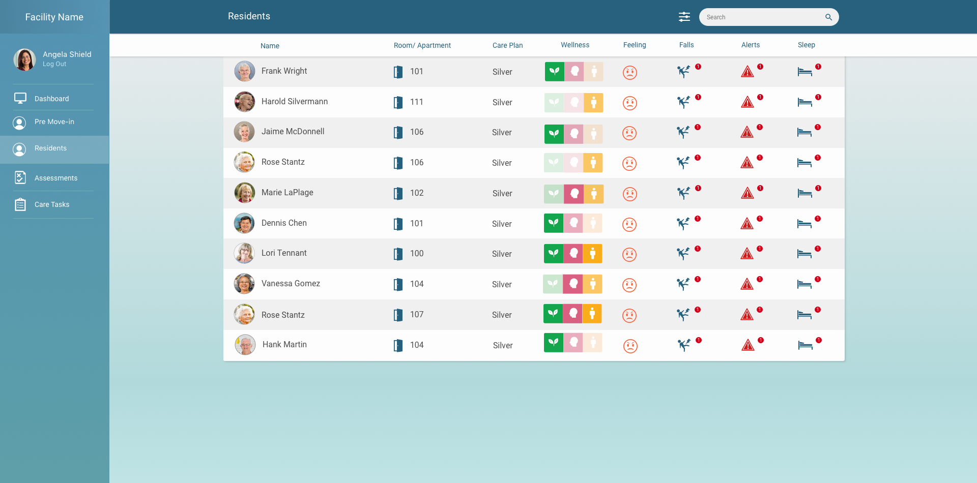
Evaluating Wellness & Wellness Indicator
Provide all care staff with a high level indicator of the wellness of the resident
  Enable holistic health care delivery
  Attention to resident wellness - staff behaviour change
  Predictive risk management
  Support staff briefing and handover
Support resident/staff communication and care delivery
Provide resident with a high level indicator of their wellness (support self-management, engagement, communication)
Provide family with a high level indicator of the wellness of their loved one
Notes:
Other aged care technology providers have developed solutions from a base of billing management or electronic medical records.
To truly deliver care that meets the needs of consumers who want to age with dignity and retain control over their care, a resident-centred solution is needed.
This is our key differentiator.
To this end, we are conducting extensive human factors research into the role of technology in enhancing and enabling resident-centred care within an aged care environment.
Each component of our technology solution maps to one or more of these three pillars of wellness, to provide a truly resident-centred solution.

Slide 29

Evaluating Wellness
Normal
(no change to baseline)
Minor change
Significant change
Very significant change

Slide 30


Slide 31
Wellness Pillar | Type | Source
Bio-medical | Health profile, ability, medications and medical directives | Care Plan and Assessments
 | Diet and nutrition, modified diet and allergies | Care Plan and Assessments
 | Current Vitals/health status | Nurse report, health monitoring wearables
 | Daily care status | Caregiver and nurse reports, Sensor - care calls, care visits
 | Medications status | Nurse report
 | Current physical activity | Sensors – falls, bed , Self-reports, Caregiver and nurse reports
 | Current Frailty and ADL | Caregiver and nurse reports, Sensors – activity, fall
Social | Communication ability | Care Plan and Assessments
 | Daily Routine | Personal Profile, Care Plan
 | Bio: personality and preferences | Personal Profile
 | Family and friends | Personal Profile
 | Interests and Activities, Club Memberships | Personal Profile
 | Current social activity – events/clubs | Events calendar (attendance, level of, change)
 | Current family visits (recent and upcoming) | Family visits log, Events calendar
 | Current visits outside | Events calendar, Concierge requests (taxi, bookings)
 | Permissions (information sharing/access) | Admissions agreement
Psychological | Mood | Self-report, Report from nurse/caregiver and family, Social activity (level of, change), Sensor - nurse calls, activity
 | Behaviour & challenging behavior | Report from nurse, caregiver, family, Sensors – bed, activity, Care Plan and Assessments (triggers and soothers)
 | Bio: who you are and what matters, important/meaningful dates, entertainment preferences | Personal profile

Slide 32
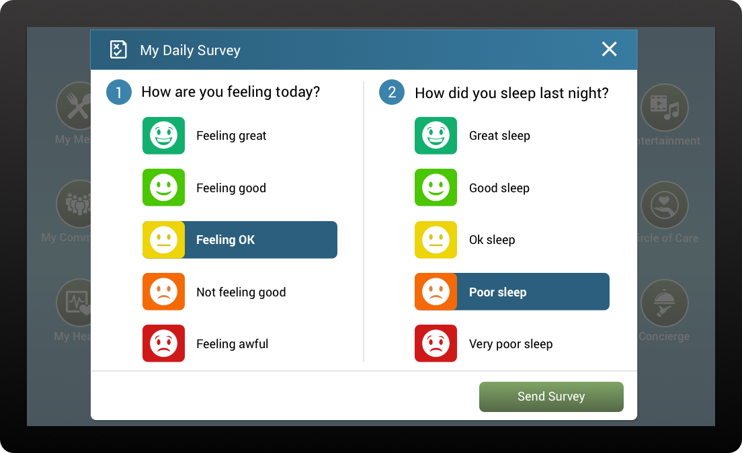
Proposed Concept (Resident)

Slide 33
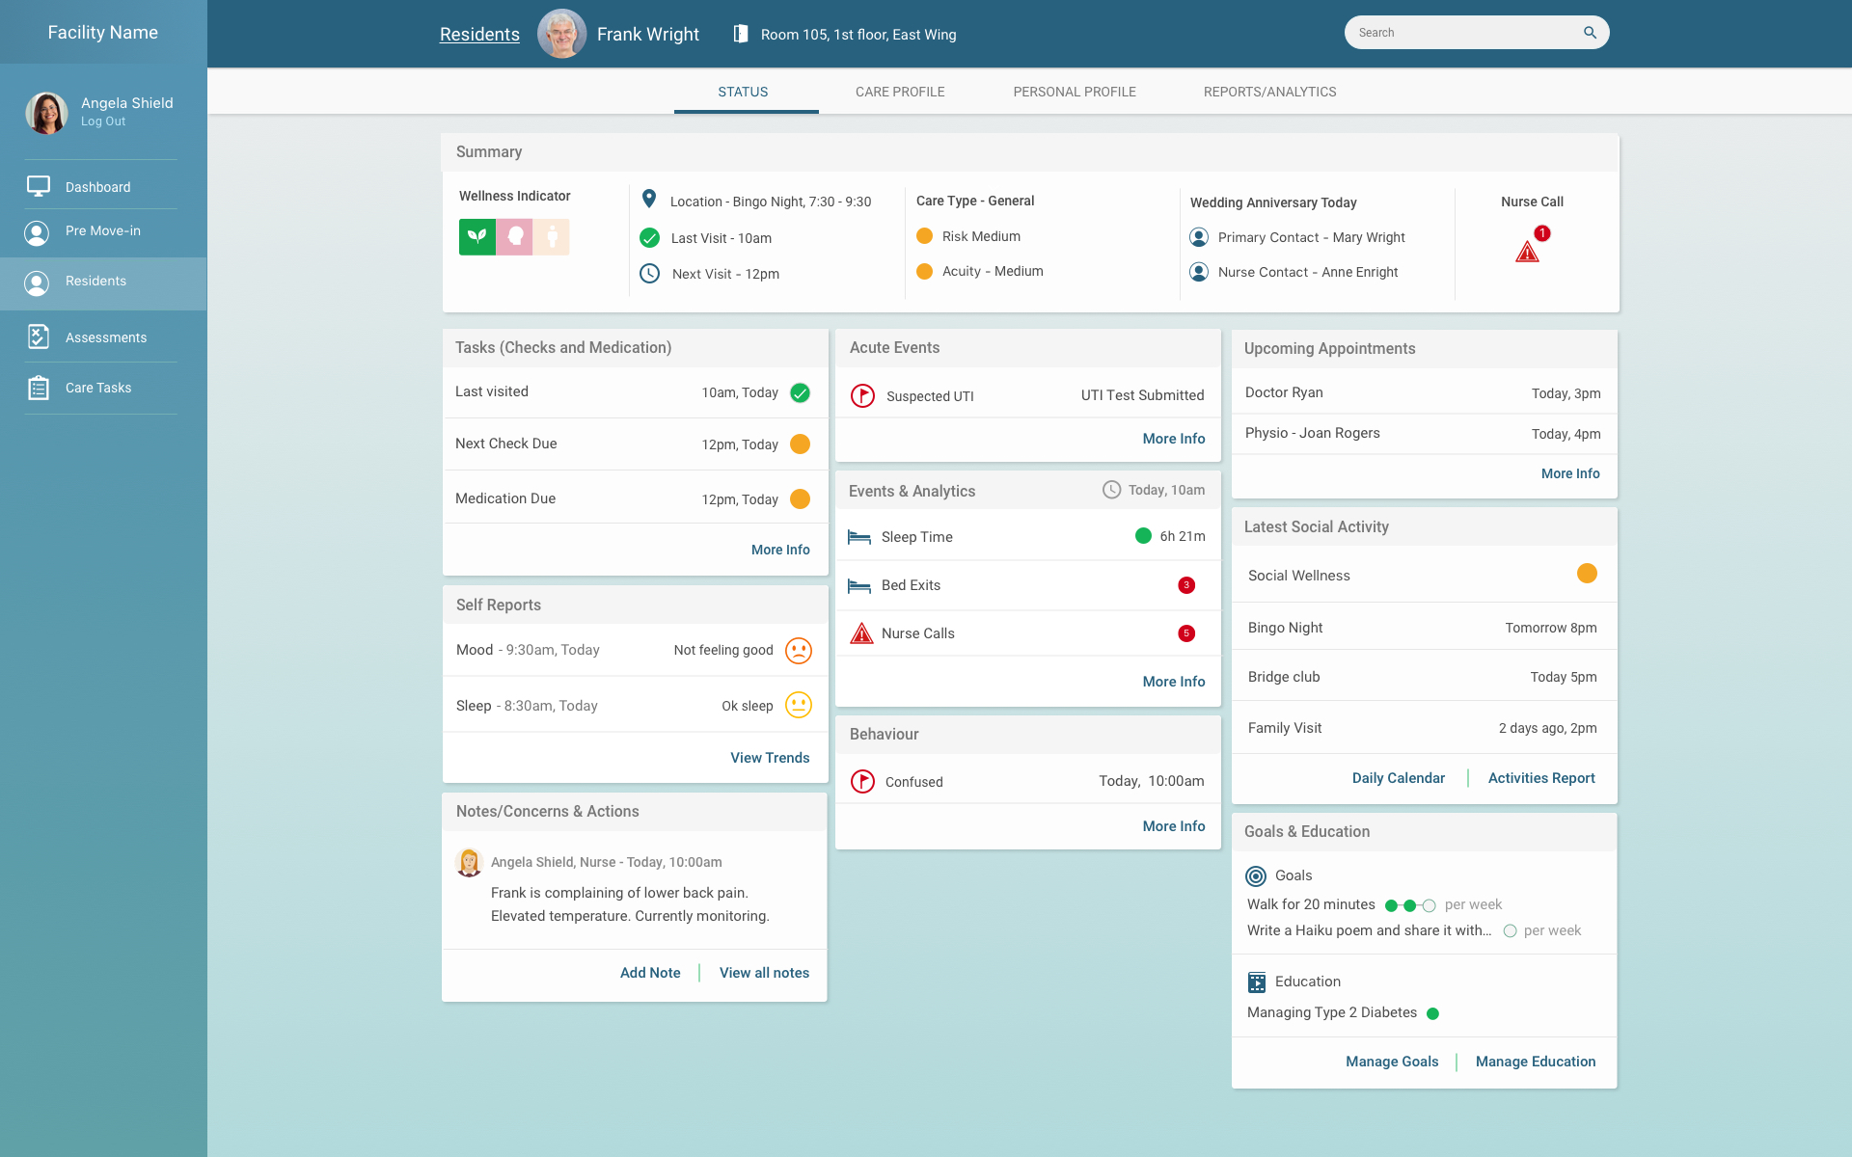
Proposed Concept (Nurse)
Get latest from demo!

Slide 34
Discussion Points

Slide 35
Discussion Points
HF research provides a roadmap for the implementation of future technology in assisted-living contexts
  Principled and theoretical basis
  Advanced in collaboration with end users and other stakeholders
Questions of values: (1) promoting autonomy, wellbeing and social participation for older adults and, (2) protecting dignity and privacy
Systems not replace person centred care or time staff spend with residents
Concern: reduction in human contact and quality of care
Changing nature of care and care roles
Sociotechnical context - technology is not the only solution!
To promote positive states of wellbeing for residents, the overall solution needs address all three pillars of wellbeing

Slide 36
Further Information

Slide 37
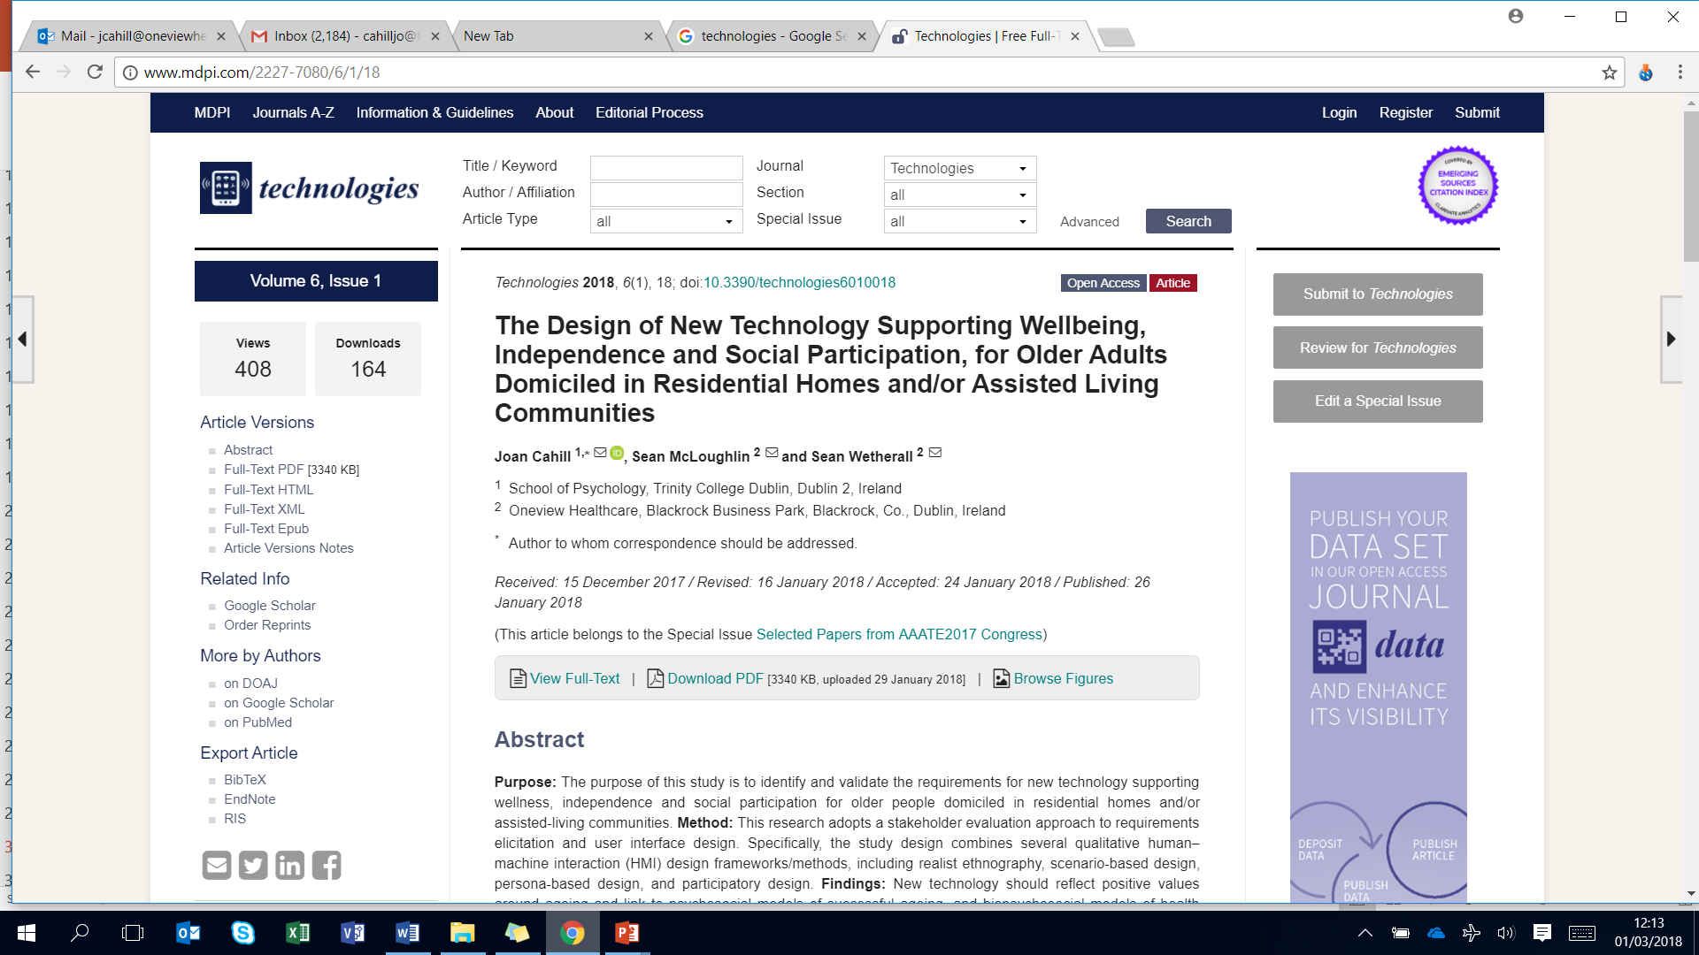
Further Information
cahilljo@tcd.ie (Joan Cahill, TCD)
smcloughlin@oneviewhealthcare.com (Sean McLoughlin, Oneview Healthcare)
Cahill, J., McLoughlin, S., & Wetherall, S. (2018). The Design of New Technology Supporting Wellbeing, Independence and Social Participation for Older Adults Domicile in Residential Homes and/or Assisted Living Communities. Technologies 2018, 6(1), 18; doi:10.3390/technologies6010018. http://www.mdpi.com/2227-7080/6/1/18

Slide 38
Thanks & Questions

Slide 39
Thanks & Questions
Thanks for attention
Any questions?

