Slide 1
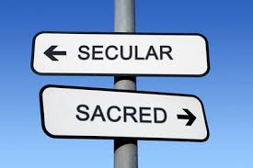
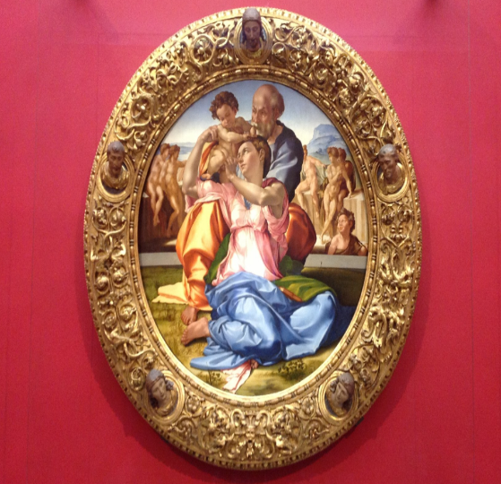
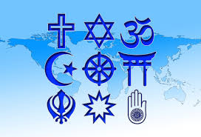

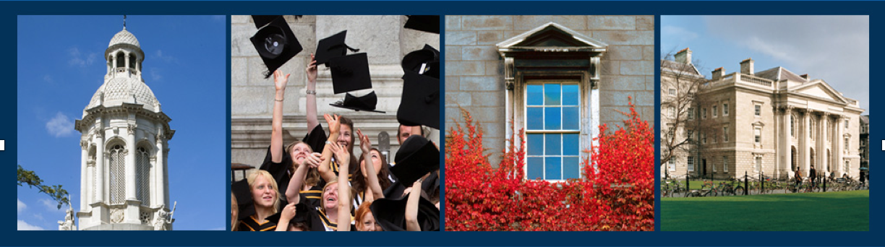
The 3rd International Spirituality in Healthcare Conference ‘Creating Space for Spirituality in Healthcare’.
Spirituality and Spiritual Care Discernment
in Nursing Education and Practice.
    Asst Professor Jacqueline Whelan Date - 22rd June 2017

Slide 2
Introduction
What do we know about the nature of spirituality and spiritual care?
How should this be addressed?
How do students perceive spirituality?
How do students develop spirituality and spiritual care giving?
What factors contribute to students perceived ability to provide spiritual care?
How do we prepare nurses to identify spiritual distress and to provide spiritual care?
How competent are students in delivering spiritual care?

Slide 3
Introduction
Who is qualified to teach spirituality?
Can it be taught?
What should be taught?
Is it a characteristic trait inherent in some students and faculty?
What issues impact when teaching spiritual care?
How can students best learn to engage in spiritual care and spiritual care provision in healthcare?
What are the perceived benefits for students?

Slide 4
Drivers – Global and International Initiatives to promote inclusion of spirituality into healthcare
World Health Organisation - inclusion of spirituality in health impact assessment (WHO 2003).
Joint Commission on Accreditation of Healthcare Organizations accrediting body in US revised its standards to require spiritual assessment (JCAHO, 2006).
NHS Scotland (Spiritual Care Matters an introductory resource for all NHS staff 2009).
RCN Study and Pocket Guide (2011) RCN on line resource (2012).
Reviews (Cockell & McSherry 2012).
Canadian provinces incorporating spirituality into health policies e.g. the Manitoba Spiritual Healthcare Strategic Plan (2012).

Slide 5
Drivers – National Initiatives to promote inclusion of spirituality into healthcare
Health Services Executive(HSE) (2009) Health Services Intercultural Guide. Responding to the Needs of Diverse Religious Communities and Cultures in Healthcare Settings.
HSE Question of Faith report…development of a spiritual care strategy (HSE 2011).
Health Information and Quality Authority (HIQA 2012) Standards for Safer Better Healthcare in the Irish healthcare system, Health Information and Quality Authority, Dublin.
Timmins F et al (2016) An exploration of current in house spiritual care resources in the republic of Ireland and review of International Chaplaincy Standards, TCD, Dublin.

Slide 6
Why now? …
Growing body of evidence that stress, burnout has roots in issues more complex than pay and conditions (Wright, 2005).
Ethical, legal, financial and clinical aspects (Fair For All Religion and Belief, 2008).
Increased evidence base of mental / physical benefits/effect on psychological morbidity and Quality of Life.
While society has become increasingly secular, patients’ spiritual needs is becoming increasing important both nationally and internationally (NMBI 2014, WHO 2012, NMC 2012, Radford 2008, ICN 2000).
Distinct concerns about standards of care (HIQA).

Slide 7
Why now? …
Nursing Code of Ethics (NMBI 2014) ’ social, emotional, cultural, spiritual, psychological and physical experiences of patients . . . ’ [6].
Demonstration of Competence - Nurses lack confidence and are underprepared for this role (Timmins 2013, McSherry and Jamieson 2011).

Slide 8
Issues
Ethically contentious
Pressure to be politically correct
Lack of structure cohesion to include spirituality and spiritual care provision in core curriculum
Minimal presence of spirituality in core nursing texts
Educational input uncertain/ sparse
Variable in terms of nature/structure/content
No standardised approach
Evidence that students are not being prepared for this role.

Slide 9
What do we know about spirituality?
  A right and cultural dimension of humanity (HSE 2009, Bethal 2004).
  Spirituality is distinguished from religion but can incorporate religious beliefs for some people.
  It can be a religious or non-religious system of beliefs and values.
  It is something that gives life meaning and purpose to people’s lives.
  La Cour and Hidvt (2010) assert that “meaning making” is a human feature that subsumes religious/non religious beliefs.
  It provides a sense of connectedness to things or with others.
  It is a transcendental phenomenon (Weathers et al 2015, Sessanna et al 2007).

Slide 10
Concept of the Spiritual Dimension
Spirituality is conceptually defined as:
‘A way of being in the world in which a person feels a sense of connectedness to self, others, and/or a higher power or nature; a sense of meaning in life, and transcendence beyond self and everyday living’ (Weathers, 2015).
These dimensions are interrelated in a complex way.
Dimensions can change according to changes in religious beliefs and philosophical worldview.
This conceptual framework provides a multi-dimensional definition of spirituality that is congruent with perspectives on the topic in nursing, psychology, sociology, and theology literature.

Slide 11
What do we know about spiritual care?
Little consensus about what spiritual nursing care entails.
Spiritual component of care has been separated from other domains.
Risk that complex, holistic, spiritual beings will be reduced to a collection of needs that can be objectively measured and routinely treated by implementing standardized nursing interventions (Bradshaw, 1996; Mayer, 1992;Walter, 1997).
This approach runs the risk of placing the nurse as the spiritual expert while devaluing the patient’s spiritual capacity and resources (Hall, 1997).

Slide 12
Concept of the Spiritual Care Dimension
‘Spiritual nursing care is an intuitive, interpersonal, altruistic, and integrative expression that rests on the nurse’s awareness of the transcendent dimension yet reflects the patient’s reality’ (Sawatzky and Pesut 2005, p.25).
Spiritual nursing care begins from a perspective of being with the patient in dialogue but may emerge into therapeutically oriented interventions that take direction from the patient’s religious or spiritual reality.

Slide 13
Subject Content
A diverse body of theoretical and empirical literature
Historical review, ‘ Lighting the Lamp’ (Bradshaw )
Philosophical approaches (Pesut 2003)
Concept of the Spiritual Dimension (Lemmer 2002)
Definition of Spirituality – how this is defined has the potential to inform what is taught and how it is taught to develop worldviews, meanings, interpersonal and intrapersonal connectedness (Pesut 2003)
Definition of Spiritual Care
Assessment of Spiritual Needs (Lemmer 2002)

Slide 14
Subject Content
Spiritual Needs of Nurses as a means of enhancing spiritual care provision to patients (Cockell & McSherry 2012).
Consider “meaning making” as a conceptual framework when providing spiritual care (RCN 2011).
An understanding of the skills needed to develop in order to provide spiritual care. Six core competencies of spiritual nursing care: a) handling one’s own beliefs b) addressing spirituality, c) collecting spiritual assessment information, d) discussing and planning spiritual interventions, e) providing and evaluating spiritual care, and f) integrating spirituality into institutional policy (Van Leeuwen and Cusveller 2004).
Ways of knowing in nursing, communicating and listening

Slide 15
Subject Content
HIQA (2012:17) have encapsulated the standard that ensures a respect for religious beliefs and/or diversity within a key theme of “person-centred care and support”.
Religious faith and needs. Culturally competent safe care (HSE, 20110
Collecting Spiritual Assessment Information (Van Leeuwen and Cusveller 2004)
Frameworks for identifying patients’ spiritual needs to include models ie . SPIRIT, FICA, ETHNICS , HOPE.
Informal assessment approach where patients are encouraged to talk about the “story of their illness and admission” (Power 2006), or spiritual beliefs (Tanyi et al 2006) with nurse observing for particular cues about spirituality (Mc Sherry and Ross 2002).

Slide 16
Subject Content
The concepts of planning, evidence based spiritual interventions support and evaluation of patients’ spiritual care.
Recognition of spiritual distress and other spiritual concerns (Caldeira 2016).
Critical reflection
Care of the dying -religious considerations (HSE 2009).
RCN Guidelines (2011) associated NICE Guidelines
HIQA Standards, Palliative Care Standards
Governmental policies ie Intercultural Strategy and Values
Role of Chaplain and pastoral care team (Timmins et al 2016)

Slide 17
Teaching Methods
Interactive lessons
Seminars
Debate
Dialogue
Case Studies
Small Group Discussion

Slide 18
Conclusion
We are not human beings having a spiritual experience. We are spiritual beings having a human experience.
Pierre Teilhard de Chardin

Slide 19
I welcome your questions and comments
Thank You

