Slide 1
Can Music Performance Anxiety be managed through Mental Skills Training?
Vourneen Ryan

Slide 2
About me
Studied flute at the GSMD
MA in Arts Management and Cultural Policy from UCD
Awarded the position of Co-Principal Flute at the RLPO
Career and Enterprise Skills Co-ordinator at the RCS
Moved to Ireland – freelance flautist and teacher
RIAM Career Strategy Lecturer and flute teacher
MSc in Sports, Exercise and Performance Psychology
Set up THE SCHOOL OF PERFORMANCE www.theschoolofperformance.com
Currently working as a freelance flautist (orchestral and chamber), Flute teacher at the RIAM, Career Strategy Lecturer and Co-ordinator at the RIAM and owner of THE SCHOOL OF PERFORMANCE

Slide 3
My research
Does mental skills training enable musicians to manage performance anxiety through engaging in a mental skills training programme?
Does a mental skills training programme impact on musicians’ performance anxiety experiences?
The study explored the effects of a music specific mental skills training programme to be delivered to ten classical music professionals from the Wexford Festival Opera orchestra.
Results showed a significant relationship between MPA and mental skills training.

Slide 4
Procedures
Twenty classical music professionals from the Wexford Festival Opera orchestra voluntarily participated in the study.
The study took place over a four week period.
Participant’s ages ranged from 25-50 years – 4 males and 16 females.
Control group and experimental group (SCAT test).
Experimental group took part in a mental skills training intervention over a 4 week period.
Control group did not receive any mental skills training intervention during the same period.

Slide 5
What is MPA?
The persisting, disruptive apprehension about performing in public, to a degree that is unjustified given the individual’s musical aptitude, training and level of preparation (Salmon, 1990).
Music performer’s stress syndrome (Brodsky, 1996).
Anxiety that is caused by the potential for mishaps that in turn evokes a fear of exposure for the musician (Nagel, 1990).

Slide 6
Research
From 2,212 classical musicians, 40% reported that anxiety interfered with their performances (Kirchner, Bloom & Skutnick-Henley).
Quarter and a half of professional musicians suffer from performance anxiety (Wilson, 2002).
40% of professional musicians thought that performance anxiety was a serious problem and had tried medication (Fishbein et al, 1988).

Slide 7
Research (cont)
More apparent in settings where the musician feels evaluated or the event is of high perceived importance to the musician.
Performers reported higher anxiety levels when dealing with anxiety related to competitions as opposed to anxiety connected with rehearsal conditions.

Slide 8
Research (cont)
Coping mechanisms used by professional orchestral musicians – 28% tried distraction techniques, 61% relaxed themselves and 34% used sedatives and alcohol (Steptoe, 1989).
MPA affected musicians throughout their careers and it was partially independent of training, practice and level of musical expertise.
Musicians require a broad range of musical, physical and mental skills to prepare effectively for performing (Williamon & Thompson, 2006).

Slide 9
What are mental skills?
The 3 C’s
Concentration (Concentration grid, thought stopping, imagery, mindfulness)
Coping (Control, coping strategies, evaluation, expectations, goals)
Confidence (Highlight list, take action, be your best self, affirmations, perception)

Slide 10
How do you train to be mentally fit?
The 4 M’s
Mental maps - Goal setting - SMART, Self Talk (park and replace)
Mental moods - PMR, Mindfulness
Mental movies - Imagery/Visualisation
Mental moves - Pre- performance routines

Slide 11
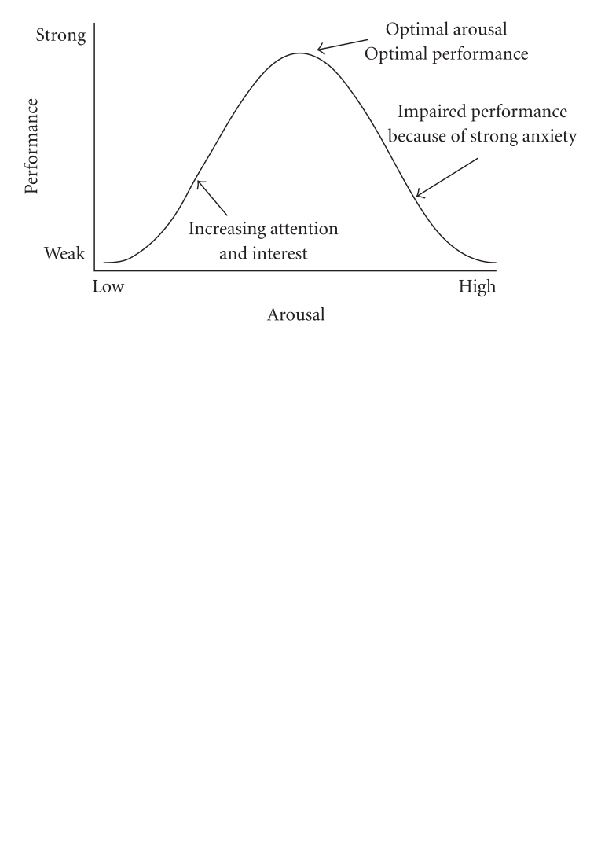
How do we achieve peak performance

Slide 12
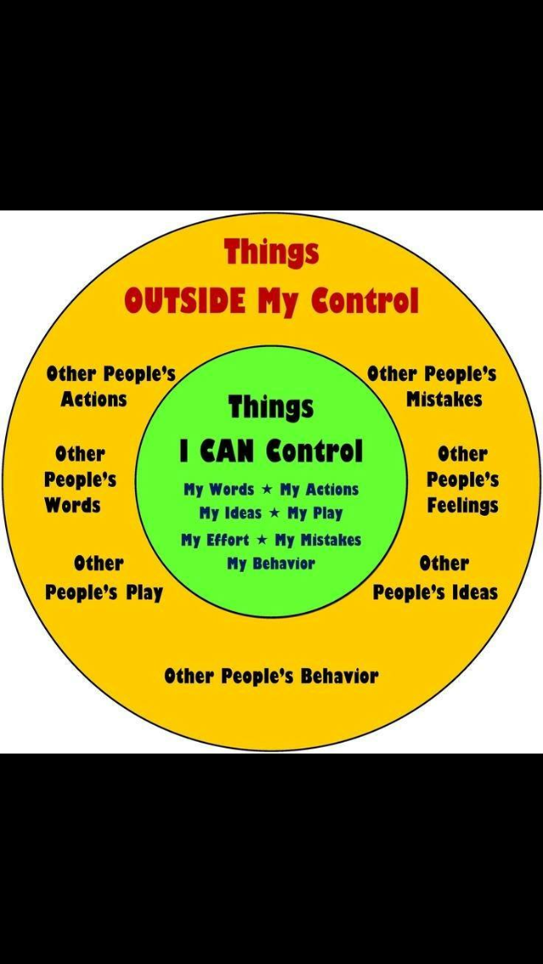
Control
What you can control
Effort
Attitude and
How you choose to Respond

Slide 13
Physical- control heart rate
Centering - Use pre performance and during performance
Warm up - Take 2 deep breaths in and out
Breathe in - count 5 beats
Breathe out - count 7 beats

Slide 14
Cognitive restructuring technique
Turn negative thoughts into positive thoughts.
Thought Records
What are you saying to yourself? – statements.

Slide 15
Mantra
Pre-performance ritual
Statement or slogan repeated often - Calm, Confident, Focus.
Create your own mantra.

Slide 16
Park and Replace
Negative thought
STOP (Sign, traffic light, hand)
Replace with mantra
The mind can only hold one thought at a time
Ironic rebound theory
Our subconscious mind does not process ‘don’t’.

Slide 17
Cue Card
Key words can be a reminder or trigger
Technique (mental skill)
A reminder where you are on performance model (1-10).
Your mantra
CENTER
+3
FLOW
FOCUS
RELAX

Slide 18
Evaluation
Evaluate after not during your performance.
Evaluation form

Slide 19
Confidence
Confidence comes from action
Use affirmations - positive self-talk statements
Fire the inner critic
Use the first person
Replace outcome thoughts with process thoughts
Focus on what you want, not what you don’t want
Avoid what if’s
1-1-1 exercise (1 thing I did well, 1 thing that improved, 1 instance of great effort)

Slide 20
Visualisation
When we visualise we actually stimulate the same brain regions as you do when you physically perform the same task.
It is a way of conditioning your brain for successful outcomes.

Slide 21
Practice
Visualise what you want
Shift perspective - associated/disassociated
Pump it up - paint with more colour, spinning the dial
Follow a system
Imagery script - write

Slide 22
Research study
Alan Richardson
Tracking Improvements to Basketball Free Throws
Group A - Practised free throws 20 mins daily
Group B - Visualised making free throws 20 mins daily
Group C - Nothing at all
RESULT - GROUP B IMPROVED 23% in 20 days (1% less than Group A - improved 24%)

Slide 23
Mindfulness
Sharpens your focus
Awareness of what mental gear you are in - to disengage or engage.
Mindfulness exercise - Headspace, Simply being, Mindshift, You tube (franticworld.com)

Slide 24
Pre-performance routine
Thought element - what do you think about before you are about to perform that helps you perform well?
Behavioural element - What action will you take after your thought that will let you know you are ready to begin?
Breathing element - What type of breath lets you know you are ready to perform?
Trigger/activation word or phrase - What word or phrase gets you activated to perform immediately?

Slide 25
Literature Review
Personality and MPA
Anxiety
Theories of MPA
Factors that influence MPA
Causes of MPA and MPA among classical musicians
The nature of performance
Coping mechanisms and mental skills training

Slide 26
Personality and MPA
Strong relationship between personality and MPA (Arneson, 2010; Meharg, 1988).
Neuroticism, introversion, low self-esteem and perfectionism are associated with MPA.
Clinical perfectionism leads to an individual’s sense of self- worth being closely linked with the individual’s ability to accomplish and meet challenging goals.
MPA may originate from past negative experiences (Abril, 2007).
Parental involvement has been proven to influence performance levels and self-esteem (Chilampikunnel, 1995).

Slide 27
Anxiety
Trait and state anxiety
Trait anxiety is a behavioural tendency to perceive as threatening, circumstances that are in fact not dangerous, and to respond with excessive state anxiety (Weinburg & Gould, 2003).
State anxiety involves symptoms of anxiety that relate specifically to a set of circumstances or event (Spahn, 2006).
State-Trait Anxiety Inventory (Spuelberger, 1973) – measures anxiety levels and interconnection between arousal, state anxiety, and trait anxiety.
Individuals with low trait anxiety experienced elevated heart rate levels but not behavioural or cognitive symptoms in the performance condition used in the study. Individuals with high trait anxiety reported significant elevations in all three levels.

Slide 28
Theories of MPA
Lang’s three- system model of fear model included three interactive independent systems (behavioural, physiological and verbal) to describe various elements of fear reactions (Craske & Craig, 1984).
Salmon’s theory of MPA (1990) – similar to Lang’s three system model of fear. Salmon (1990) believed MPA consisted of physiological, behavioural and cognitive elements.
Salmon (1990) noted that the anticipation of a stressful event could create an anxiety response that could be as strong as the event itself and in some cases more powerful.
Psychotherapeutic interventions for MPA were successful as they addressed the specific elements of anxiety (physiological, behavioural, and cognitive) (Salmon, 1990.)

Slide 29
Factors that influence MPA
Age (Fishbein et al., 1988) – 17% under 35, 19% 35-45, 11% over 45
Instrument type – Harp, percussion and keyboard 17%, singers 35% (Wilson, 1992)
Size of ensemble – (Ryan and Andrews, 2009) – solo more stressful than ensemble.
Gender differences – MPA affects females more than males (Osborne and Kenny, 2008) – perhaps due to males being less willing to express their feelings than females.

Slide 30
Causes of MPA (Emmons & Thomas)
Presence of an audition panel
Presence of a teacher/coach during an audition or competition
Another musician playing performing the same repertoire
Press night
Accompanist arriving late
Conductors
Twenty- two ranked causes of MPA in Orchestral Musicians (Kenny, 2011)

Slide 31
Nature of performance
Solo, orchestral, ensemble and choral
Solo performance contributed more to performance anxiety than group performances (Cox and Kenardy, 1993).
Audition or concert - increased heart rate under jury conditions(Brotons, 1994).
Perception of the performance situation - challenge or threat (Mendes, 1999).
Rehearsal and performance situations- Zajonc (1965) believed that arousal levels increased in the presence of others.

Slide 32
Coping mechanisms
Medication – beta-blockers (Fishbein et al., 1988)
Alcohol
Distraction

Slide 33
Research design
Questionnaires (experimental and control group)
The Artists Performance Survey (Greene, 2002)
State Anxiety Test (Martens et al., 1990)
Sport Competition Anxiety Test (Martens, 1977)
Mental Skills Training workbook
Workshop
At the end of the 4 week period – Questionnaires completed again
Survey (feedback and shared experiences)
SPSS (Statistical Package for Social Science).Paired samples t-test.

Slide 34
Results
Significant changes noted for cognitive state anxiety, somatic state anxiety and self-confidence anxiety when comparing the experimental group pre-intervention and post-intervention.
Comments provided by the experimental group post intervention indicated changes in their perception of MPA - assisted them to manage their anxiety symptoms.
Mental outlook, determination, poise, emotional approach, controlling attention, concentration and resilience - experimental group reported a change post-intervention, as demonstrated by the significant difference in their scores on the State Anxiety test and the Artists Performance Survey when compared with the control group.

Slide 35
Results (cont)
Increase in self-confidence.
Ability to deactivate self talk due to increase in self-confidence .
Increase in concentration levels (mindfulness and motivation).
Ability to control attention (centering).
Performance activation decreased post-intervention.
Mental skills training may not be suitable for individuals with a general anxiety disorder.
Lack of behavioural data made it difficult to measure the demand characteristics of an individual.
Optimal score ranges were still not reached perhaps due to time limitation.

Slide 36
Conclusions
Centering, imagery and breathing techniques were effective in reducing MPA.
Targeted interventions could be a cost effective and time friendly solution for musicians.
Need to compare musicians with high and low anxiety in further research which could help identify which treatment suits which individual musician.
Many musicians are reluctant to commit time to activities that encroach on valuable practice time - teacher training needed.
Mental skills interventions may only work for musicians with mild performance anxiety, and not a serious anxiety disorder.
More information regarding the effects on each specific individual would provide a broader picture.

Slide 37
Recommendations
When an evidence-based treatment for MPA is finally recognised, music institutions should include the treatment in their curriculum.
The development of more reliable assessment scales.
Gender difference should be included in a reliable assessment of MPA.
Technology should be used as a cost effective and time friendly solution to deliver mental skills training for musicians.
Further studies are needed to inform effective, individualised interventions for elite performers.
Music institutions need to draw on the field of sports psychology where the area of mental skills training is significantly more developed.
Professional music institutions need to provide a mental skills training facility for musicians.

Slide 38
Questions?

Slide 39
READING LIST - BOOKS
Emmons, S., & Thomas, A. (1998). Power performance for singers: Transcending the barriers. Oxford University Press.
Fleming, N. D. (2006). Teaching and learning styles: VARK strategies. ND Fleming.
Goleman, D. (2006). Emotional intelligence. Random House LLC.
Greene, D. (2002). Performance Success. New York: Routledge.
Gallwey, T. W., (1986). The inner game of tennis. London: Pan Macmillan.
Nairn. R., (2001). Diamond Mind: A Psychology of Meditation. U.S: Shambhala
Orlick, T. (2000). In pursuit of excellence: how to win in sports and life through mental training. Champaign, IL, Human Kinetics.
Thomas, K. W. (1974). Thomas-Kilmann conflict mode instrument. Tuxedo, NY: Xicom.
Weinberg, R. S., & Gould, D. Foundations of Sport & Exercise Psychology. 2003. Human Kinetics, Champaign.
Whitworth, L. (2007). Co-active coaching: New skills for coaching people toward success in work and life. Davies-Black Publishing.
Williams, M., & Penman, D. (2011). Mindfulness: a practical guide to finding peace in a frantic world (Vol. 360). London: Piatkus.
Buswell, D. (2006). Performance Strategies for Musicians. UK: MX Publishing.

Slide 40
ONLINE RESOURCES
The Bullet Proof Musician - https://bulletproofmusician.com
Beyond stage fright - http://www.beyondstagefright.com
The musicians way - https://www.musiciansway.com
The School of Performance - http://theschoolofperformance.com
https://performancescience.ac.uk/performershealth/
http://musicalimpact.org/network/
https://www.youtube.com/channel/UCKuf52cLEX3MuT3aor9qLBw
MindShift app - https://www.anxietycanada.com/resources/mindshift-app
https://www.ism.org/images/files/ISM-Performance-anxiety.-A-practical-guide-for-music-teachers.pdf

Slide 41
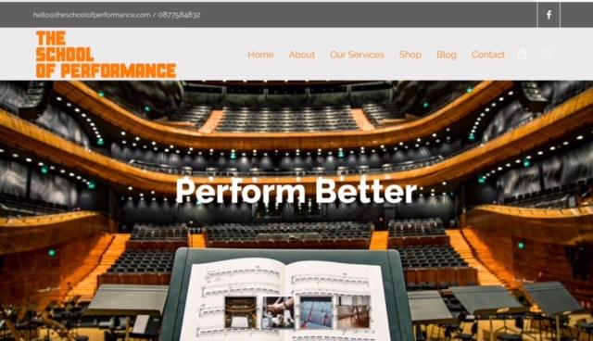
FIND US: hello@theschoolofperformance.com
j

