Slide 1

Bridging the gap: The European Language Portfolio and L2 Irish Sign Languages Learners at A2-B1 level
Carmel Grehan and Lorraine Leeson
IDRN2018
November 2018 – TLRH

Slide 2
Overview
Introduce the European Language Portfolio
Outline our ELP pilot project at Trinity College Dublin (TCD) with A2-B1 learners
Consider how students self-evaluate using the ELP in contrast to teachers (what is the knowledge gap)
Consider how students struggle to understand how they can bridge their language knowledge gap (getting from where I am to where I need to be)

Slide 3
The ELP

Slide 4

Notes:
The European Language Portfolio a document in which language learners/users - at school or outside school - can record and reflect on their language learning and cultural experiences.
It has been widely implemented to support the development of learner autonomy in the teaching and learning of spoken languages.
To date, the ELP has not typically been implemented with learners of sign languages.
However, in 2017-18, this changed! We looked at an Irish cohort…. And Christian and Thomas looked at a German cohort.

Slide 5
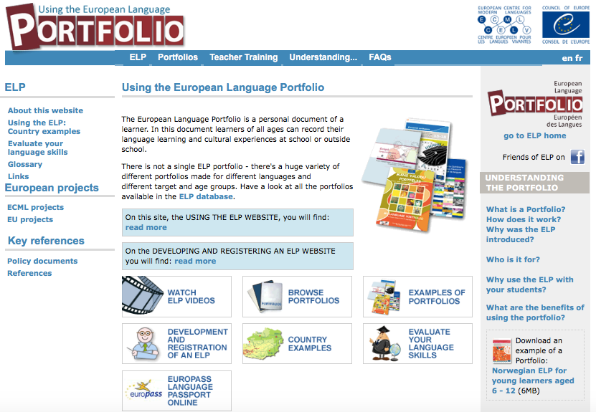
http://elp.ecml.at
Notes:
Note that the URL is useful…

Slide 6
ELP: 3 components
A Language Passport – learner summarises their linguistic & cultural identity, language qualifications, experience of using different languages & contact with different cultures.
A Language Biography – this helps the learner to set learning targets, to record and reflect on language learning and on intercultural experiences, & regularly assess progress.
A Dossier – the learner can keep samples of their work in the language/s they have learned or are learning.
Notes:
Our focus in this presentation is on the Language Biography.
Some other important points to note are:
The ELP is the property of the individual learner, which in itself implies learner autonomy. Learners can plan, monitor and evaluate their progress.
Self-assessment is ongoing, formative self-assessment (We use “can do” checklists attached to the language biography)

Slide 7
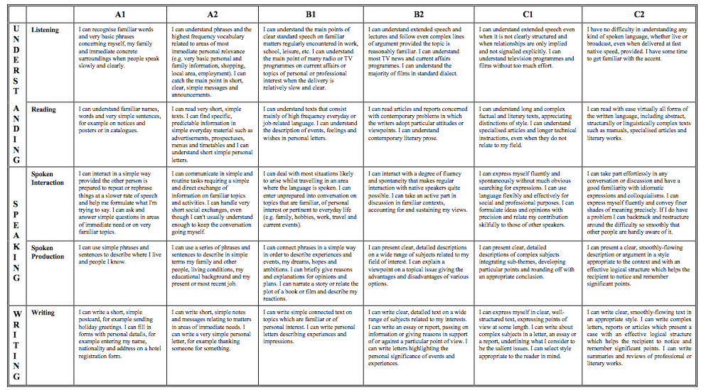
Notes:
CHANGE THIS – THIS IS THE SPOKEN LANGUAGE DESCRIPTORS!!!
Our sample were learners of A2-B1, in their second year of intensive ISL learning in a university setting at Trinity College Dublin.

Slide 8
Our Context

Slide 9


Trinity College Dublin
4 year degree programme.
Total 80 ECTS ISL - 20 ECTS Irish Sign Language in each year (will reduce due to university level changes “The Trinity Education Project (TEP)”)
Years 3 & 4 - Content Learning in Language (CLIL) – e.g. ethics, Deaf education, etc.

Slide 10
Centre for Deaf Studies, TCD (Ireland)
Study took place across the academic year 2017-18
13 Senior Fresher students (Year 2) took part in the ELP pilot
This included:
  Using ELP related tools in class & for teaching and learning
  Participating in 4 x focus groups across the year
  Teacher (CG) also documented her experience of the process
Notes:
Focus Groups asked students for their perspective on how ELP may have helped (or not) as part of their ISL learning experience. We also gathered feedback that may inform modifications to approach taken with implementing the ELP for sign languages in tertiary education classrooms across Europe. Each focus group lasted approx. 45 minutes. These were video recorded to allow for the researchers to create an anonymized transcript after each meeting.

Slide 11
What we found
Notes:
We will start by looking at what students said about working with the ELP.
Then we will look at how the students self-assess their skill versus how I assess their skill.

Slide 12
What was the key concern raised by students?
This cohort are second year students – A2-B1 (productive)/B2 level (receptive)
They reported (by focus group 2 – December 2017) that the issue of performance anxiety had dissipated. This is the big concern for first year student learners (Sheridan, in prep).
Key Concern: knowing how to get to where they needed to go, how to bridge the gap between what they can do and what they need to do…. But they don’t know what they need to do differently in order to get there….
And this is where they found the ELP useful.

Slide 13
Things students said
Introduce the Language Biography as soon as classes start.
Revisit it at least once a semester.
Statements like the following are really helpful:
  “I am learning this language because….” [MOTIVATION]
  “In this language I want to be able to…” [GOAL-SETTING]
  “Things I like doing in language class…” [REFLECTIVE LEARNING]
  “Things I am good at….” [REFLECTIVE LEARNING]
  “Things I find difficult….” [REFLECTIVE LEARNING, GOAL-SETTING]

Slide 14
KEY CONCERN - BRIDGING THE GAP
Students grapple with knowing that they will be able to do something (e.g. constructed action/ use of non-manual features) but don’t know how to get from where they are now to where they need to be.
      “So, it kind of felt like you’re starting from scratch then last year, that I kind of felt like I’d just wasted three years in evening classes.”
General comments from teachers like “that isn’t deaf friendly” are not helpful [For us to consider: how do we frame feedback to students in a way that will be helpful? How do we help bridge the gap?]

Slide 15
ELP AIDS PRACTICING AUTONOMY
  CEFR and ELP support learner autonomy (Little 1991, Ridley et al. 2003, O’Rourke & Carson 2010). Our pilot group demonstrated embodiment of learner autonomy principles when they talk about:
    Using ELP as a mechanism for self-monitoring development
    Leveraging video feedback from tutor
      “We’ve had to do like a self-analysis we’ve had to watch it and actually pick out what’s wrong so that when you go back to do a similar thing you actually know where the problems lie.”
  Looking at video feedback several times to inform learning
  Taking 1:1 sessions with tutor

Slide 16
ELP – VIDEO – AIDS LEARNING RECURSIVELY/ REFLECTING
Students suggest that opportunities to re-do pieces of work, following from feedback (a submit-feedback-edit-resubmit cycle) would be very helpful and allow them to integrate learning into their performance rather than moving on to the next topic. (“LESS IS MORE”; LEARNING RECURSIVELY)
    “It’s such good feedback that you know where to go next time you do a video.”
    “Everybody hates watching themselves back but- especially this year because we’ve had to do like a self-analysis we’ve had to watch it and actually pick out what’s wrong so that when you go back to do a similar thing you actually know where the problems lie.”
Notes:
Video feedback in a SL is helpful. It allows them to review feedback relative to performance (LEARNING RECURSIVELY, SCAFFOLDING LEARNING) (Commented on in all 4 focus groups).
But as we will see, practicing autonomy in these ways does not necessarily mean that the student is self-evaluating themselves in the same way as the teacher will.

Slide 17
ELP helps with THEORY BUILDING
  Students report that they value the description that is outlined in CEFR/ELP that captures “what I can do”
  Students value the description outlined in CEFR/ELP that show “where I need to get to”
  Students value seeing other students further along the process – reassures “that I can get there” (BRIDGING THE GAP).

Slide 18
ELP – A roadmap to help in BRIDGING THE GAP
      “It was much easier to fill out the thing on receptive skills than the thing on productive skills. I think you can judge a lot more, your receptive skills” . (FG3)
      “Yeah so it’s more to say, we’re definitely not there yet so, within a lot of the topics”.(FG3)
      “But then there’s a lot of places that we are at, you know? Having a general conversation - we’re able to do that.You know? So there would have been a lot where I would say that I fully understand. Yeah it was kind of half and half.” (FG3) –
    Students were SURPRISED by their progress. Reflected that RECURSIVE evaluation of progress is essential to show how far they had progressed.
Notes:
More analysis of data in progress. Next step – build a cohesive GT from the data linked to how intermediate ISL learners engage with the learning process. MOTIVATION literature is key. Process of developing a new identity in the L2 (“growing up”, “being a baby”, “teacher as linguistic parent”, more advanced students as “older siblings”, etc.)

Slide 19
The teacher’s perspective
Notes:
Finally, a few comments about the teacher’s perspective. That would be my perspective!

Slide 20
Teacher’s perspective
What I had in the classroom with Senior Freshers Students
Self-assessment using the marking rubric
Can-do checklist
Issues arising
  The language of feedback – using ISL
  Telling students that their signing is/is not “Deaf friendly” What does it mean to student’s perspective?
  Student wants to know: How do I get from ‘here’ to ‘there’
  What language can teachers use to help students?

Slide 21
Summing Up
For students, our study suggests that as they move from A2-B1, they go through a range of somewhat recursive phases, which we are currently (nominally) labeling as:
STRUGGLING <> NEGOTIATING<>NAVIGATING<>ENGAGING
A2 -------------------------------------------------------------------------------B1

Slide 22
Key points
Students “stall” [STALLING]at certain times, but learn to “bridge the gap”[BRIDGING]
Teacher feedback (video recorded) is crucial to support recursive autonomous learning
The ELP is a tool for helping students navigate[NAVIGATING] where their learning is heading
Humour, opportunities for authentic engagement promote motivation.
Notes:
We are in the process of writing up our work and hope to share it with you before too long!

Slide 23
Thank you!

