Slide 1
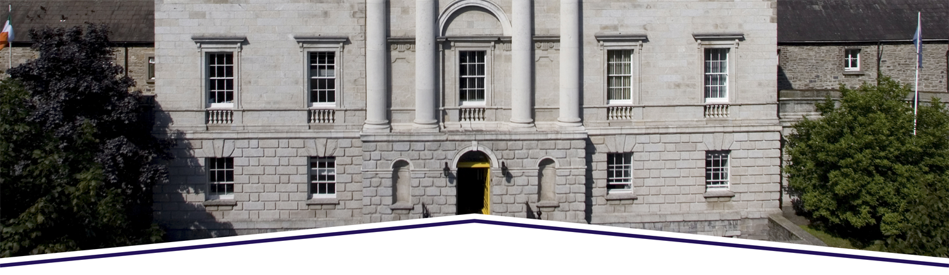

Towards pre-trial detention as ultima ratio?
Pre-trial detention and alternatives across Europe
Mary Rogan
27th November 2018

Slide 2
‘Pre-trial detention’ and the use of bail
• Findings from an empirical project across 7 EU countries:
IE; DE; RO; LT; NL; BE; AT
• The legal framework for bail in Ireland
• Influential factors behind Ireland’s approach to pre-trial detention
• Looking to the future

Slide 3
‘Pre-trial detention’ and the use of bail in Ireland
• Ireland has comparatively low rates of pre-trial detention in the European context
AT: 23.7;
BE: 28.3;
DE: 13.2;
IE: 12.5;
LT: 34.3;
NL: 23
RO: 12.2

Slide 4
‘Pre-trial detention’ and the use of bail in Ireland

Slide 5
‘Pre-trial detention’ and the use of bail in Ireland

Slide 6
‘Pre-trial detention’ and the use of bail in Ireland

Slide 7
The legal framework
A prima facie right, not automatic, but an important aspect of the right to liberty and the presumption of innocence
Grounds for refusing bail:
  Where it appears likely that the accused will, if admitted to bail, abscond or otherwise evade justice by failing to appear for court to answer the charges;
  Where it appears “reasonably probable” that the accused will pervert the course of justice by interfering with evidence or disposing of illegally-acquired property
  Where there is a real risk that the accused will commit serious offences if granted bail

Slide 8
The legal framework
Section 2: may refuse
  Factors to be considered: seriousness of the offence; previous convictions; drug addiction; length of time until trial
Criminal Justice (Burglary of Dwellings) Act 2015
  ≥18, charge of burglary of a dwelling, s. 2 objection raised
  Where accused has a conviction for burglary of a dwelling within 5 years immediately prior to application +
  ≥ 2 convictions and/or pending charges for burglary within a period of 6 months before and ending 6 months after alleged offence (after 18)

Slide 9
The legal framework
Taken as evidence that the accused is likely to commit a burglary offence in a dwelling if granted bail
Criminal Justice Act 2017:
  Where the court takes into account a factor listed under s.2, may also take into account the extent to which the number and frequency of any previous convictions for serious offences indicates persistent serious offending by the accused and the nature and likelihood of any danger to the life or personal safety of any person or danger to the community that may be presented by release on bail of a person charged with an offence which may be punished by ≥ 10 years

Slide 10
The legal framework
  Can hear from the alleged victim to consider effect of release
  Court must give reasons for decision

Slide 11
Bail conditions
‘Necessary and proportionate’
Explicit power to impose a restriction on contact condition
A condition not to drive when offence relates to driving
Specific timeframe for curfew (9pm-6am)

Slide 12
Factors contributing to the Irish position
• Empirical study: observations; 26 semi-structured interviews with judges, lawyers, staff of the Probation Service
• Replicated across all seven countries
• Influential factors behind Ireland’s approach to pre-trial detention
The constitutional and legal framework
The role of conditions
European dimension

Slide 13
Liberty and the presumption of innocence
“It's a serious application by the State to deprive somebody of their liberty and I have to keep in mind number one the presumption of innocence and number two constitutional right to bail and that is the whole system and that's how it works”. (Judge 6).
"There is obviously a constitutional presumption from what I’ve seen that’s taken very seriously by the judiciary." (Prosecution Practitioner 2)
"Certainly the first thing that always comes to my mind that there is a presumption in favour of the applicant for bail on the basis of O’Callaghan. So, every applicant does have a constitutional advantage …. [to] get bail fixed..." (Prosecution Practitioner 1)
“[the system] it is underpinned … by the presumption of innocence” (Prosecution Participant 4).

Slide 14
The legal framework matters
“Well I mean I know you said it’s going to take an hour (the interview) but, in truth, I think it can all be done in 30 seconds because I mean the be all and end all of bail in Ireland is the O’Callaghan case. And it’s, you know, quoted in criminal courts across the country every day of the week again and again and again and it’s taken seriously”. (Judge 3).
“… obviously there’s certain things that you are and you aren’t allowed to bring in, the 1997 Bail Act tells us what we’re allowed and the O’Callaghan case. So, it’s not random, they’re very specific, the factors that we have to rely on or not rely on” (Prosecution Practitioner 3)
"I think the simple fact of the matter is that, you know, it’s like, you know, plumbers debating conduit piping. They may have their own individual opinions but at the end of the day you have to plumb in a toilet right and that’s the way it’s kind of regarded." (Prosecution Practitioner 2)

Slide 15
The legal framework matters
"The big thing is bench warrant history, whether or not they have previously demonstrated disregard to turn up in court. That would be the number one factor." (Defence Practitioner 4)
"Warrant history. Always warrant history. It's the first question asked: how many warrants? … But the first thing is always warrant history." (Defence Practitioner 10)
“I think first and foremost would be warrant history, people who have failed to appear in the past and how many times that they have failed to appear, that would be significant”. (Judge 2)
“And if it’s the case that, you know, that you don’t treat the courts with respect, if you don’t turn up for your court cases, it’s likely to have an impact if you’re charged in the future”. (Judge 3)

Slide 16
Conditions: not a binary decision between liberty and detention
Detention vs gradations of liberty
"I have no difficulty saying that some of the conditions are just put there, sometimes there’s no real reason for them, you know." (Prosecution Practitioner 1)
"There is a kitchen sink approach sometimes, which there shouldn’t be." (Prosecution Practitioner 3)
"You come with a very limited toolbox as an applicant representative. You only have so many rabbits in that box ... Your biggest one is money and after that there's maybe around eight conditions between, you know, stay away, staying in, staying at a certain place and all of those. So, [it’s] very rare that you'll come up with something surprising." (Defence Practitioner 1)

Slide 17
The European Dimension
Pre-trial detention must be a measure of last resort
“The PTD-rates of the project countries suggest that the countries focusing on preventive aspects in PTD decisions in the tendency have higher pre-trial detainee rates than the others focussing primarily on securing the criminal investigation, the trial and punishment”.

Slide 18
The European Supervision Order
2009/829/JHA
Allows a person granted an alternative to PRD in one EU Member State to be supervised in another MS
Avoids concern about high levels of foreign prisoners in PTD population
Low awareness
Feeling that EU nationals are more likely to get bail than non-EU nationals

Slide 19
Future Directions?
Increasing numbers on remand
Increased focus on the risk of offending while on bail ground (lessons from Europe)
Concerns about high levels of PTD in EU
Electronic monitoring – what is its purpose?

Slide 20
Thank you!
mary.rogan@tcd.ie

