Slide 1

Census 2011 Results
This is Tallaght West

Slide 2
History of Irish Census
The first full census of Ireland was in 1821
At ten-yearly intervals from 1831 to 1911
The first census of Irish Free State was in 1926
From 1951, censuses have been undertaken at five-yearly intervals
The latest Census was on Sunday 10 April 2011

Slide 3
Census Themes
Themes | Themes
Theme 1: Sex, age and marital status | Theme 9: Social class and socio-economic group
Theme 2: Migration, ethnicity and religion | Theme 10: Education
Theme 3: Irish language | Theme 11: Commuting
Theme 4: Families | Theme 12: Disability, carers and general health
Theme 5: Private households | Theme 13: Occupation
Theme 6: Housing | Theme 14: Industries
Theme 7: Communal establishments | Theme 15: PC and internet Access
Theme 8: Principal status

Slide 4
Census Geographic Levels
Geography | Numbers
Provinces | 4
Gaeltacht Areas | 7
Regional Authority Areas | 8
Dioceses | 24
Counties | 34
Dáil Constituencies | 43
Legal Towns and Cities | 85
Local Electoral Areas | 171
Dublin Parishes | 197
Towns/Cities (Settlements) | 824
Electoral Divisions | 3409
Small Areas | 17488

Slide 5
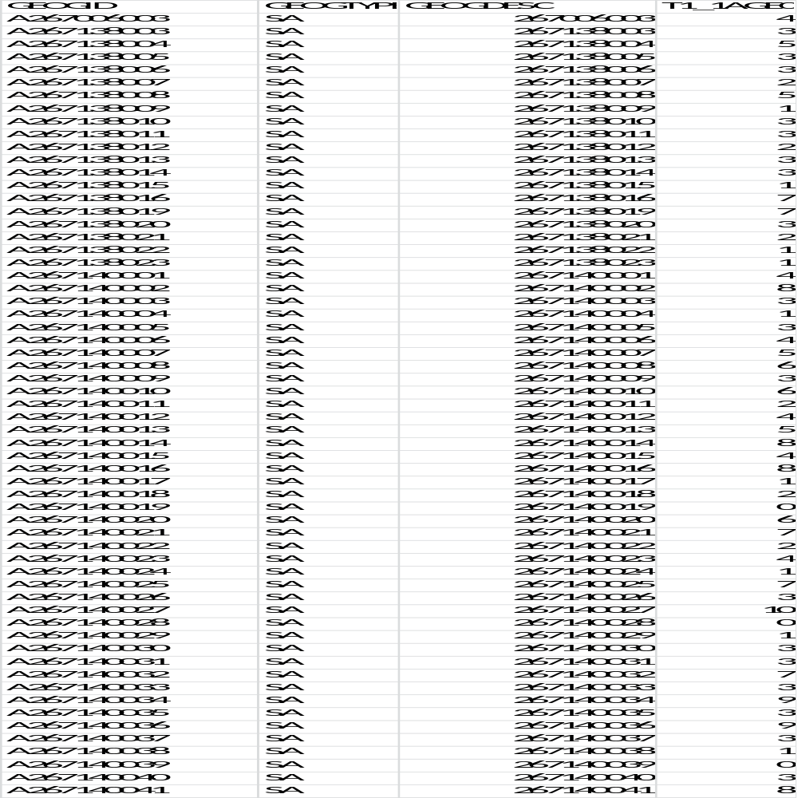
Small Area Data File

Slide 6
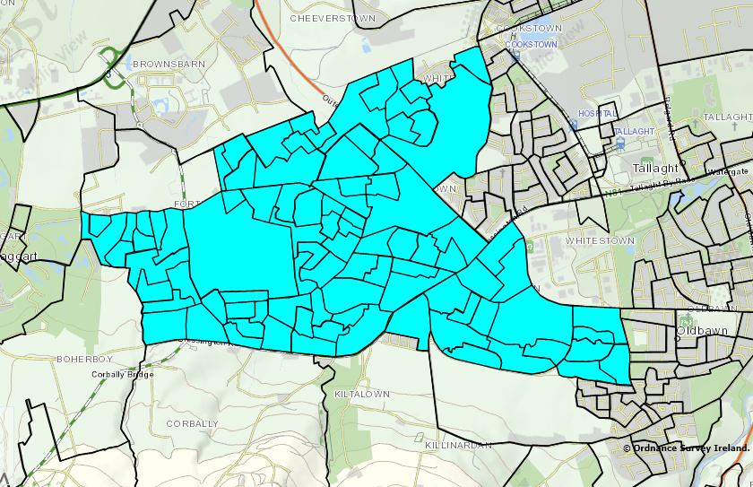
Tallaght West - Map
* The Revitalising Areas by Planning, Investment and Development (RAPID) area 2006

Slide 7
Tallaght West- Profile
Electoral Divisions : Fettercairn, Jobstown, Killinardan, Kiltipper, Ballinascorney.
No. of Small Areas : 92
Population Density : ~ 5800 persons/sq.km
Total Population : 29,241
No. of Children (0-18) : 11,146
No. of Families : 7767

Slide 8
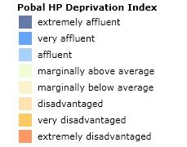
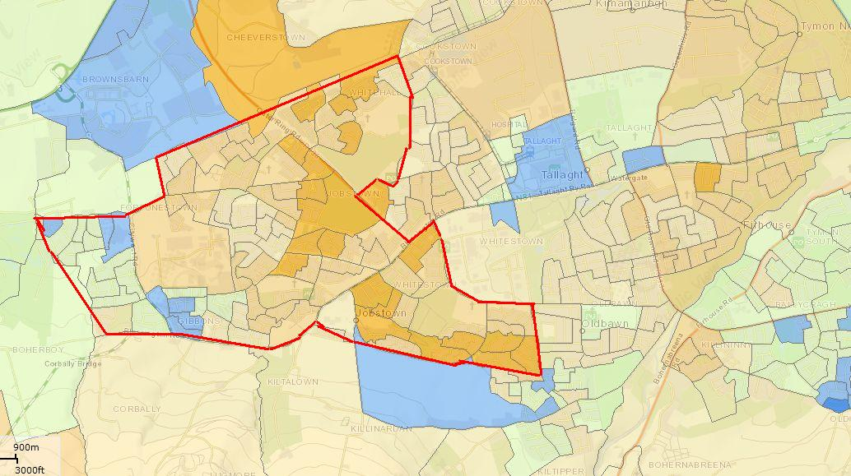
Pobal HP Deprivation Index
Average Deprivation Score: -11.69
Range: -23.70 to 13.20
Source: http://maps.pobal.ie/#

Slide 9
Demographic Details
Total Population | No. | Percentage
Male | 14039 | 48.01
Female | 15202 | 51.99
Total | 29241 | 100.00
Children (0-18) | No. | Percentage
Male | 5802 | 52.05
Female | 5344 | 47.95
Total | 11146 | 100.00

Slide 10
Age Distribution

Slide 11
Dependency Ratio
A measure showing the number of dependents
Tallaght West = 53.07
Ireland = 49.30

Slide 12
Ethnicity

Slide 13
Marital Status (%)

Slide 14
Family size (%)

Slide 15
Families with Children (%)

Slide 16
Lone Parent Families (%)

Slide 17
% Children Live in Lone Parent Families

Slide 18
Type of occupancy (%Households)

Slide 19
Social Class (% Persons)

Slide 20
Principal Economic Status (% 15+)

Slide 21
Highest level of education (%)

Slide 22
% of Households with No. of Car

Slide 23
Thank You

