Slide 1
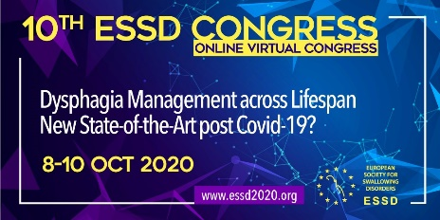


“Just being alive was a struggle each day”
A Qualitative Investigation of the Lived Experience of Oral Stage Dysphagia in Adults with Rheumatoid Arthritis affecting the Temporomandibular Joint.
Ó., Gilheaney & I.P., Walsh, Department of Clinical Speech and Language Studies, Trinity College Dublin, Ireland
Other
4914765
Introduction
Results
Rheumatoid arthritis (RA) is a multi-system autoimmune disorder affecting 1-3% of adults globally¹⁻².
RA affects the jaw joint in up to 93% of patients, which can cause temporomandibular disorders (TMDs)³⁻⁷.
RA-related TMDs can result in eating and swallowing difficulties, including impaired mastication (31%) and swallowing (25%), and masticatory pain (36%) and fatigue (21%)⁸.
However, research on the development or impact of these problems is sparse. Therefore, management may be limited and patients may experience reduced activity, participation, and quality of life.
Four themes were identified: 1) the nature of physical signs/symptoms of OD, 2) the personal, social, and lifestyle impact of OD, 3) the impact of these difficulties on patient’s engagement with healthcare services and treatment use, and 4) emotions evoked by TMD-related OD. Subsequently, 13 categories emerged which illustrated these themes in greater detail, with a further 10 subcategories. Participants most frequently expressed concerns regarding difficulties eating solids, the need to modify their diet to accommodate masticatory issues, and uncertainty related to the intermittent nature of TMJ flares and subsequent eating and swallowing issues.
Objectives
Conclusions
This study aimed to explore the lived experience of adults with RA who experience TMD-related oral stage dysphagia (OD).
Findings from this study are noteworthy as they confirm that people with RA commonly experience under-recognised eating and swallowing problems, with discernible, yet apparently overlooked, impact on physical functioning, socialisation, and emotional well-being, which may negatively impact clinical outcomes, and exacerbate an already tenuous lived experience with this condition. Future research should build on this early investigation and involve patients themselves in the design of supports to guide individuals to living well with these issues.
Methods
A quasi-observational qualitative study was conducted.
Data was collected from comments posted on a popular online website regarding descriptions of the lived experience of patients with RA.
Thematic analysis techniques with inductive and deductive methods were used to manually analyse data.
Use your phone to scan the QR and gain access to further infographics of results and participant comments
References
Helmick et al., Arthritis Rheum. 2008; 58(1):15–25.
Woo et al., Otolaryngol-Head Neck Surg Off J Am Acad Otolaryngol-Head Neck Surg. 1995;113(1):147–50.
Lin et al., J Chin Med Assoc JCMA. 2007;70(12):527–34.
Sodhi et al., Contemp Clin Dent. 2015;6(1):124–7.
Delantoni et al., Oral Surg Oral Med Oral Pathol Oral Radiol Endod. 2006;102(4):e37-40.
Seymour et al., Oral Surg Oral Med Oral Pathol. 1975;40(5):584–9.
Helenius et al., Int J Oral Maxillofac Surg. 2006; 1;35(11):983–9.
Gilheaney et al., Dysphagia. 2017; 1-14.

