Slide 1

Evaluation of an eLearning teaching innovation to assist clinical radiation therapy educators in the provision of student feedback
Maeve Kearney
Assistant Professor
Discipline of Radiation Therapy
Trinity College Dublin
mkearne@tcd.ie

Slide 2

Feedback – What the literature tells us
Developing clinical skills central to education and training of all healthcare professionals.
Feedback and formative assessment is key to developing clinical skills – supervision alone is not sufficient
Without feedback mistakes can go unchecked – student can mistakenly assume that they are doing well
Students and clinical assessors report dissatisfaction with feedback processes
Clinical supervisors have stressed the importance of developing knowledge about the different types of feedback and how they can be adapted to different clincial contexts

Slide 3
Purpose of our study
Instruct and support radiation therapy clinical educators involved in giving feedback in the clinical learning environment by providing an eLearning innovation – online module
Evaluate participants' attitude to feedback and current feedback practices before and after completing the eLearning innovation

Slide 4

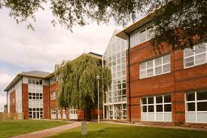
Materials and Methods
Creating an online module
Dr Siobhan Davis from the TCD Dental School received Dean’s Award for Innovation in Teaching
Created this e -Learning innovation – online module covering theory behind feedback – feedback models – videos demonstrating examples of good and bad feedback practices in the CLE
Asynchronous content – offered flexibility
Recruitment
Flyer distributed to radiation therapy departments in Republic of Ireland inviting RTs to register to complete the module

Slide 5
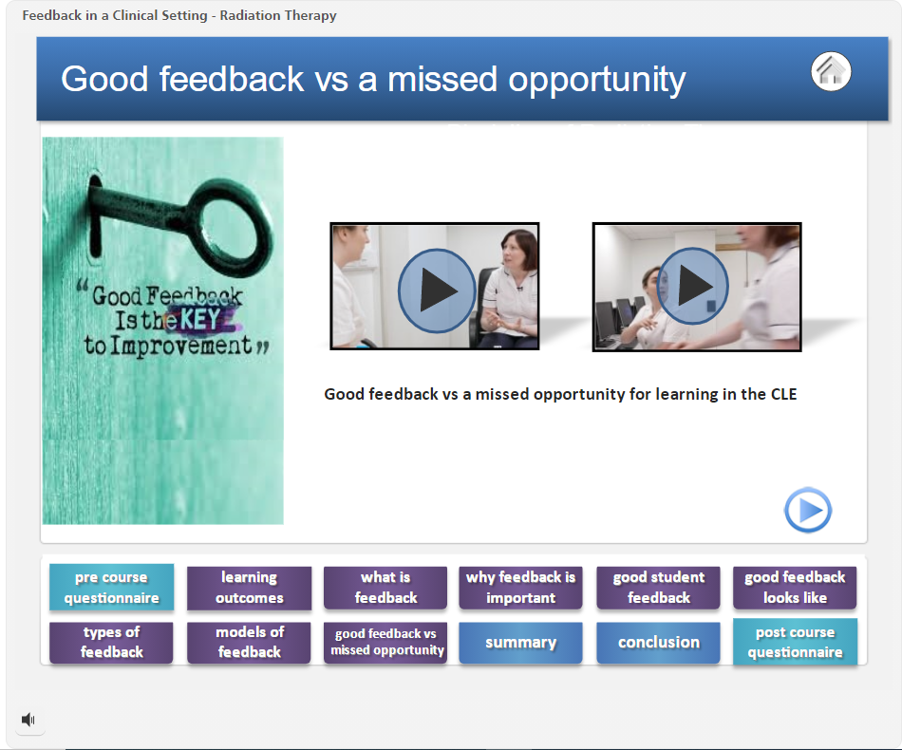
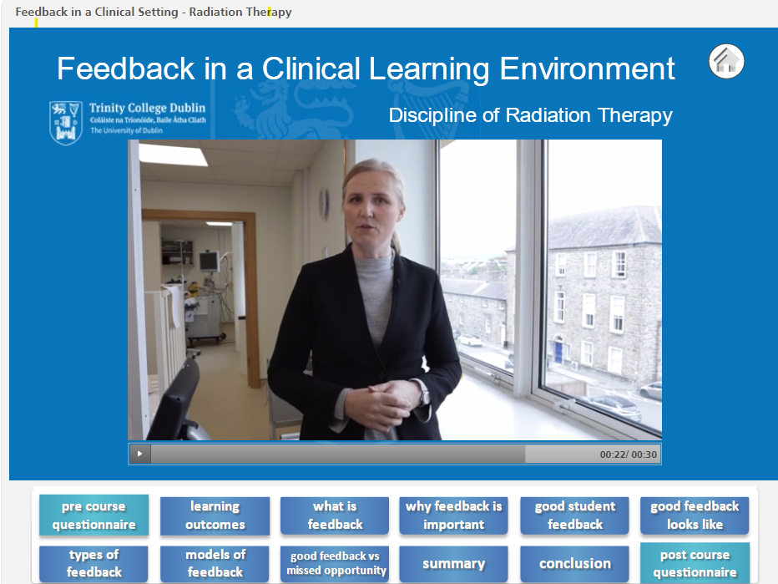
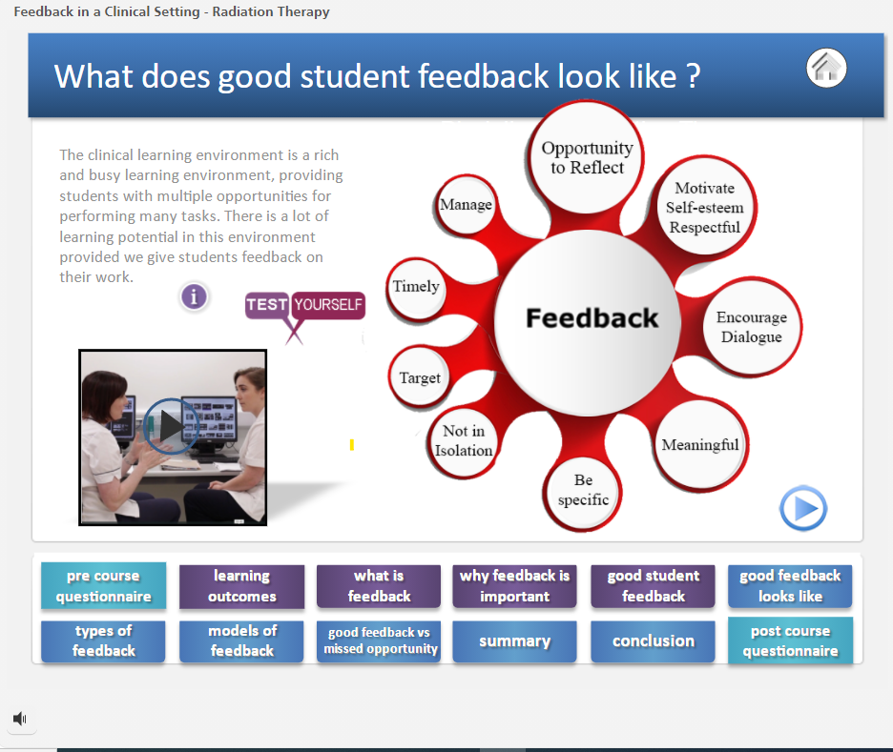
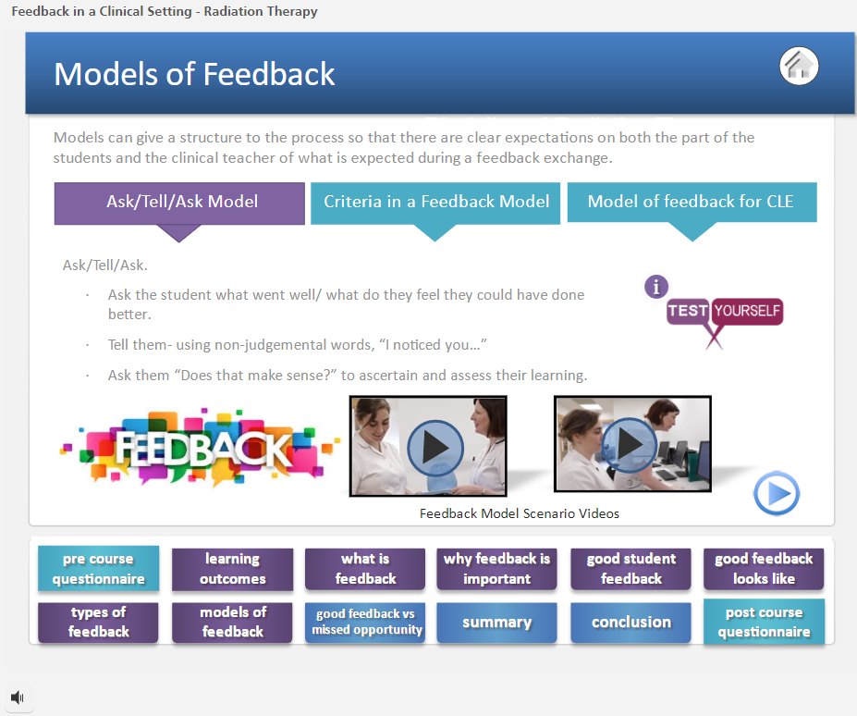

Slide 6
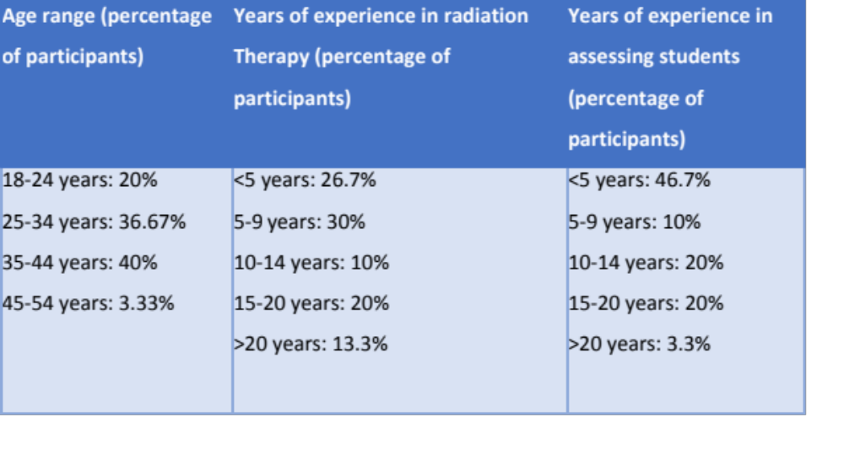
Results – Pre Innovation
Quantitative and qualitative data analysis
30 RTS registered and completed the innovation
Prior to taking the module just over half stated that they offered continuous feedback during a placement
Confidence level of 6.47 out of 10 reported in provision of feedback
Spearman’s correlation – no significant association between years of experience working as a radiation therapist and confidence in providing student feedback
Barriers and challenges

Slide 7
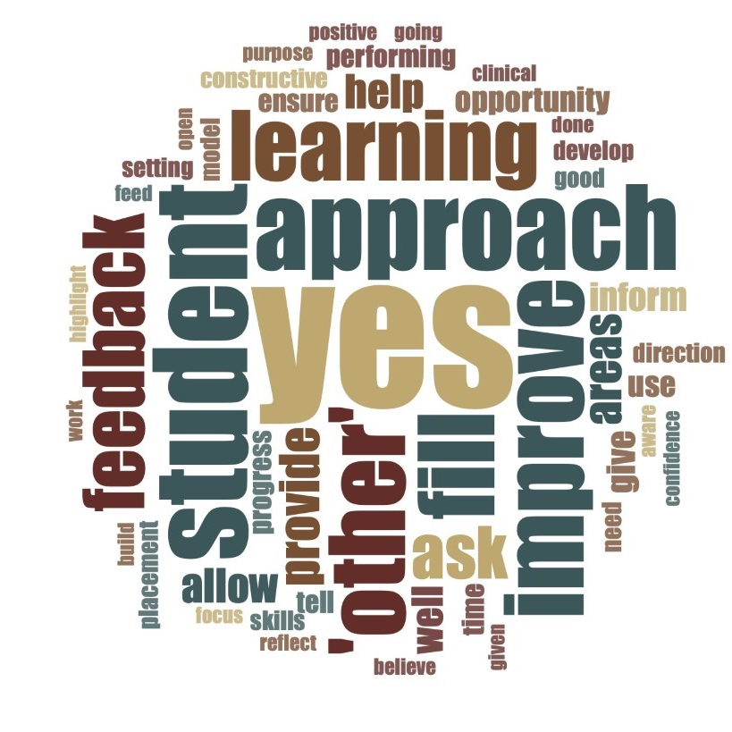
Results – Pre Innovation
Qualitative Data
Radiation Therapist reported positive attitudes to the purpose of feedback – open ended question
Frequency cloud
Thematic analysis – ‘improvement’ and ‘encouragement’ 'progression' highest number of coding references
Specific statements
to enable students to know what areas they need to focus on, what they are not doing so well in, to encourage and praise them for good work and to encourage learning’
To improve learning opportunities and encourage students when they are making good progress
Frequency word cloud to capture participants’ attitudes towards the purpose of feedback.

Slide 8
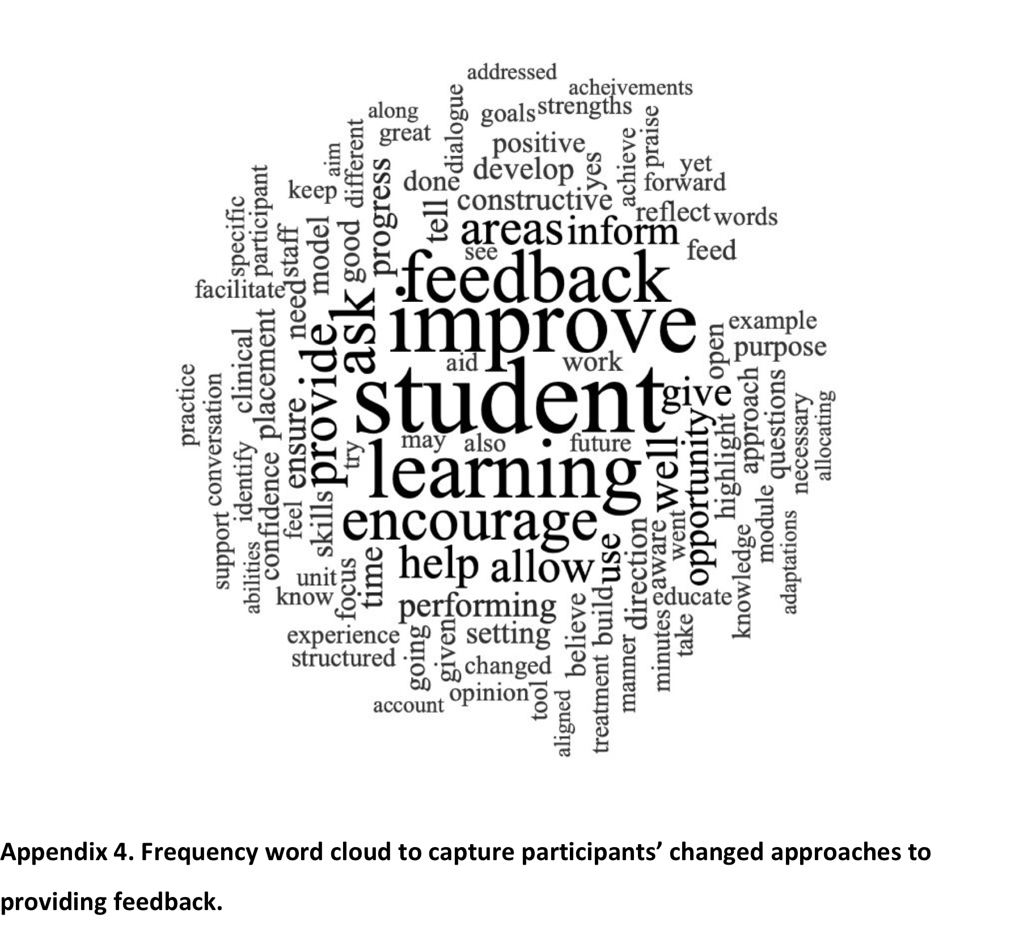
Results – Post Innovation
Impact of innovation on feedback practices and attitudes
Confidence levels in providing feedback to students increased to 8.97 (from 6.47)
69.7% of respondents stated ‘Yes’ when asked if the teaching intervention had changed their approach to providing student feedback
When responses were analysed for themes and coded, the theme of ‘feedback models’ had the highest number of coded references (n=9).
Ask tell Ask is beneficial. I will use that’
‘I feel I will have a more structured approach to feedback now and a more structured approach in creating two-way dialogue in feedback.’
‘I must consider allocating time to provide timely and thorough feedback away from the pressures of the treatment unit’
‘I realised that it doesn’t take a long time to give feedback. It can be as little as 2-3minutes with the student. 2 minutes can provide a student with the information they need regarding how they are performing daily and how they can improve’

Slide 9
Conclusions
Good quality and timely feedback essential to meet learning objectives and build clinical competencies
This eLearning innovation was well received with nearly 70% of respondents stating that they would change their approach to feedback
It is important to create a culture where students expect, participate (through self assessment and reflection) and are receptive to feedback

