Slide 1
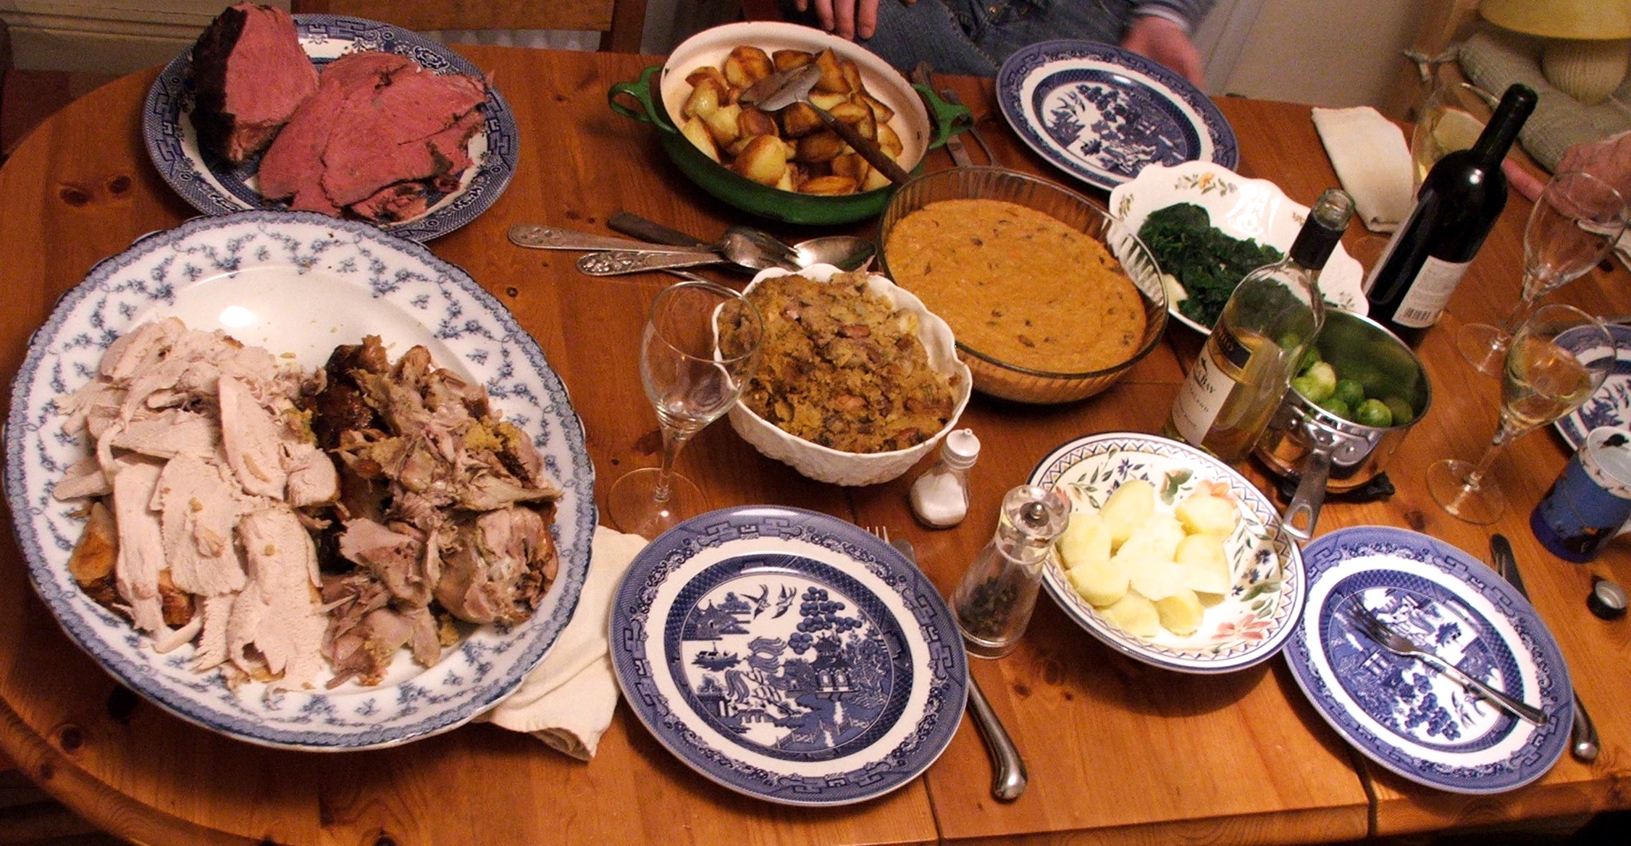
ICE on Food: Talk related to foodways in the International Corpus of English
Jeffrey Kallen, Trinity College Dublin
SSS6: Sociolinguistics Summer School 6, 2015

Slide 2
Foodways and the language of food
Jones (2007): 'Food choice, symbolism, and identity'
Before we even start to eat:
'Who prepares the food, serves it, and cleans it up; where people take their meals; the shape of a table; and who sits where and talks about what – all these convey roles, values, and ideas about gender, hierarchy, and power' (p. 130)
  What do we eat – food vs. non-food
  Jones (2007: 131): cultural versus pathological perspectives on clay eating
  forbidden versus permitted foods: religion, culture, gender roles, age ('baby food'), social status, health
  temporal constraints: time of day, day of week, time of year

Slide 3
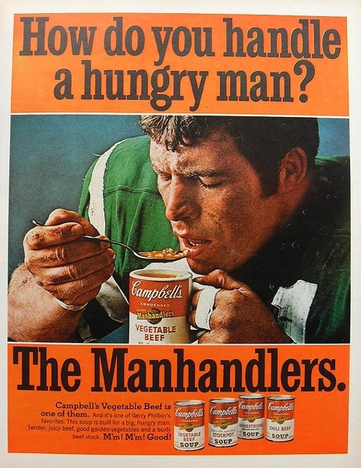
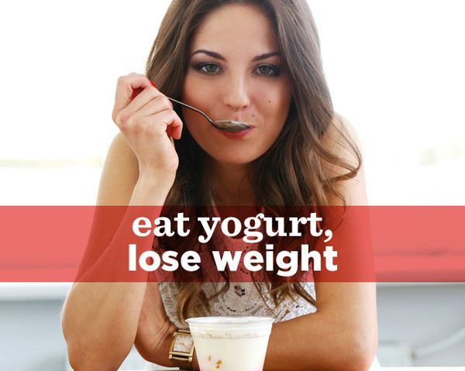
Food and identity: gender
'Many foodstuffs bear the mark of gender': 'for many people in Western society, milk and eggs have feminine associations, as do vegetables that contain seeds ... and that are round, smooth, small, soft, sweet, and juicy. ... Red meat is masculine – as in "he man food," "hero" sandwiches, and bowls of Campbell's hearty beef stew referred to as "the manhandlers" – while the more delicate chicken and fish tend towards the feminine' (Jones 2007: 139)
'One likely eats what one already is': 'statistics compiled by Domino's Pizza about sales and deliveries indicate that men wearing muscle shirts when answering the door order pepperoni three times more often than they order any other topping, and people with pierced noses, lips, or eyebrows ask for a vegetarian toppings [sic] 23 percent more often than they ask for meat toppings'. (Jones 2007: 140)

Slide 4
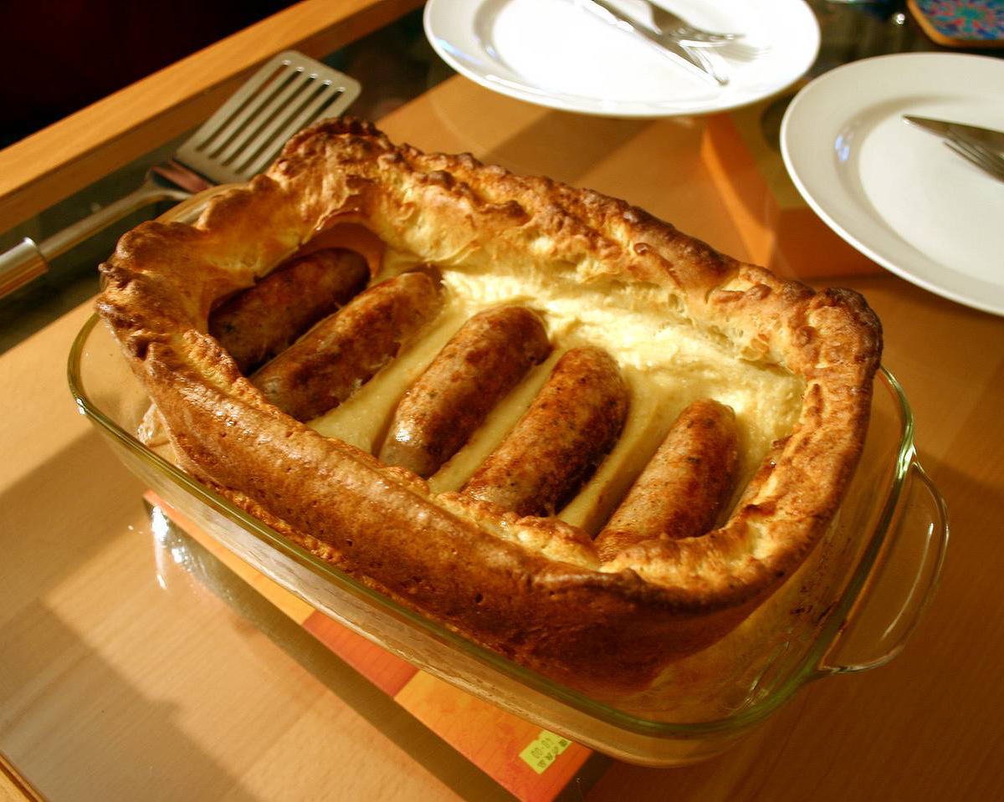
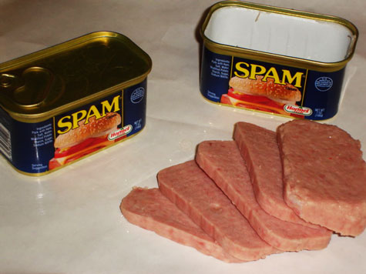
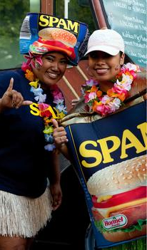
Food and identity: social groups
'You cannot trust people who have such bad cuisine. It [Britain] is the country with the worst food after Finland' (attributed to Jacques Chirac by Jones 2007: 136)
' "Cold or hot, Spam hits the spot" might be true for some – and .... Hawaiian identity seems to revolve around this canned meet – but Spam is not prestigious to all. "Being an African-American, looking good was always important, showing some kind of status" ... "Being associated with Spam would take away from that good image".'
'Toad in the hole', made of sausage and batter; may include gravy (British)
People in Hawai'i consume 6 million cans of Spam per year

Slide 5
Food and identity: personal identity
Range and manner of eating
  'junk food junkie ... fast-food freak, meat-and-potatoes man, salad lover, sushi addict, adventurous eater (or culinary tourist ...), or pasta person'
  'hearty eater, a light eater, a nibbler, or a person who eats like a bird or, conversely, like a horse ... the regular eater, a stable eater, or someone who "grabs lunch when I can".' (Jones 2007: 142–143)
  Salience of food
  'I love to eat, I love to cook' versus 'I eat to live, not live to eat'
  Ourselves and others:
  'We and others select and reject certain foods, prepare the selected foods in particular ways, and serve them to specific individuals because we identify them or ourselves as Southerners, natural food addicts, men or women, old or young. ... We also often eat what we do because of who we and others think we and they are'. (Georges 1984: 255–256).

Slide 6
Metaphor, food, and language
  FOREIGN is BAD, NATIVE is GOOD
  'What kind of American consciousness can grow in the atmosphere of sauerkraut and Limburger cheese? Or, what can you expect of the Americanism of a man whose breath always reeks of garlic?' (Sarah Mitchell Guernsey quoted by Jones 2007: 136)
  As 'American as apple pie', 'As British as roast beef and Yorkshire pudding', 'As French as champagne'
  Foods use metonymy (the part refers to a wider whole) to point to cultural values: collocated Nouns and Verbs share in the process
  IDEAS are FOOD
  Let's digest that for a while 'consider'
  I found that theory hard to swallow 'accept'
  Don't just regurgitate the lectures in the exam 'repeat mindlessly'

Slide 7
Faycel (2012): metaphors in Tunisian Arabic proverbs
GENERIC is SPECIFIC
— 'honey in excess is no longer sweet'
SWEET is GOOD, BITTER is BAD
— 'if your mother is onion and your father is garlic, how will you then smell good?’
— 'my sister is like the honey in my mouth'
— 'whose origin is apple never turns bitter and whose origin is oleander never turns sweet'
— ‘the sweeter you eat the bitterer you vomit’ (i.e., the sweeter the experience of love, the more bitter the experience of separation)

Slide 8
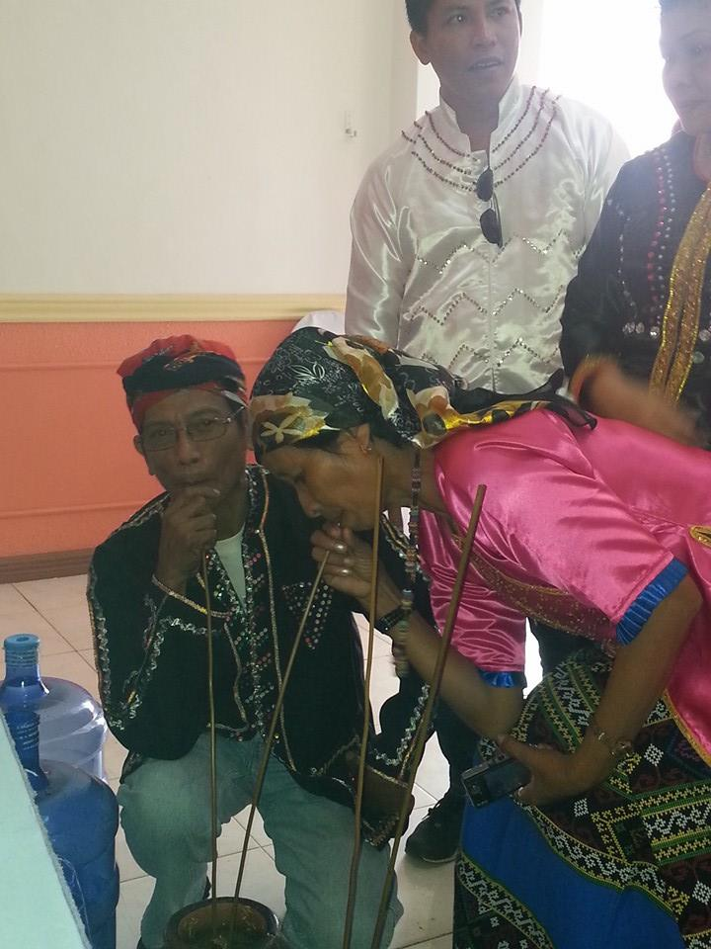
Discourse and food: Frake (1964: 131)
The Subanun drinking encounter thus provides a structured setting within which one's social relationships beyond his everyday associates can be extended, defined, and manipulated through the use of speech. The cultural patterning of drinking talk lays out an ordered scheme of role play through the use of terms of address, through discussion and argument, and through display of verbal art. The most skilled in "talking from the straw" are the de facto leaders of the society.

Slide 9
Structuralism: Lévi-Strauss's 'Culinary triangle'
Lévi-Strauss (1965) draws an explicit parallel between phonemic systems and culinary systems. RAW, COOKED, and ROTTED form fundamental oppositions (like /i, a, u/) based on normal vs. transformed food and nature vs. culture. Intermediate values develop as features (air, water, etc.) are added.

Slide 10
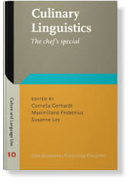
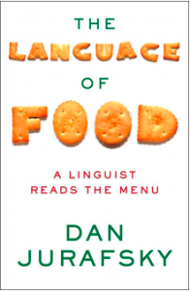
Corpora and the internet facilitate new linguistic study
Gerhardt et al. (2013) consider television chefs, recipes, food writing in EFL classes, workplace food discourse, literature, health discourse, resaurant names.
Jurafsky (2014) traces etymology and food history, and considers menus, advertising, food technology, and metaphors of 'sex, drugs, and sushi rolls'.
Gerhardt et al. 2013
Jurafsky 2014
Jurafsky's (2014: 14) corpus study shows that 'every increase of one letter in the average length of words describing a dish is associated with an increase of 18 cents in the price of that dish'.

Slide 11
Language and foodways: an agenda
Discourse perspectives: about food (conversation, reviews, cooking instructions, shopping lists), accompanying food (mealtime conversation, workplace breaks, ritual uses), invoking food (metaphorical uses). Many text types are rich in narrative.
Text types: conversation, service encounters, television shows, blogs, cookbooks, recipes, toasts, menus, journalism, literature, Linguistic Landscape (visual display of language), regulations, informational prose, packaging, advertising
Semantics: metaphors understanding other things as FOOD ('I am like the meat in the sandwich', PEOPLE are FOOD) or FOOD as other things 'those pancakes were historic', i.e. FOOD is an EVENT.
Syntax: syntax of specific text types (recipes, reviews etc.), verbs and verbal morphology
Lexicon: words and meanings, lexical innovation, lexical categories and relations, semantic fields (taste words, food preparation words)

Slide 12
A challenge from cookbook syntax
  Cookbook syntax: imperatives, lack of objects, lack of articles. Texts may involve terms of art or assume the reader's knowledge.
  1 c. cornmeal; 1 c. flour, sifted; 2 tsp. baking powder; 1 tsp. sugar; ½ tsp. salt; 1/8 tsp. cayenne pepper; 2 eggs, beaten; ¾ c. milk; ½ c. onion, minced; ¼ c. vegetable oil. Mix Ø dry ingredients. Add Ø moist ingredients. Spoon Ø into well-greased muffin tins. Bake Ø at 425° F. for 10 to 15 minutes. (Patricia B. Mitchell, True Grist. Chatham, Va: The author, 1992.)
  1 lb. cherries, 3 ozs. sugar (about), 6 ozs. flour, 4 ozs. brown sugar, 4 ozs. margarine. Place Ø pitted cherries in Ø baking tin and add sugar to taste. With Ø finger-tips work together flour, margarine and brown sugar until Ø mixture resembles coarse breadcrumbs. Spread Ø flour mixture over Ø fruit and bake Ø 30 mins. in a 375° oven (Reg. 4). Serve Ø hot or cold with cream. (Maura Laverty, Full and Plenty. Dublin: Irish Flour Millers Association, 1960.)

Slide 13
What's ICE got to do with it?
ICE – the International Corpus of English – a transcribed corpus of 'standard English' worldwide, defined by
speaker selection – native speaker, completed secondary education
text type – using a standardised list of text types covering distinctions such as
  speech vs. writing
  formal vs. informal
  planned vs. spontaneous
  monologue vs. multi-party

Slide 14
What is an ICE corpus?
One million words per corpus:
300 spoken texts
200 written texts
Each text approximately 2,000 words, transcribed orthographically
Core ICE years 1990-94, but some data and projects are newer; ICE-Ireland (for example) includes data up to 2005

Slide 15
Spoken texts and word counts (ICE-Ireland)
Broadcast discussion 42,632
Broadcast interview 20,931
Broadcast news 40,579
Broadcast talks 40,964
Business transactions 21,447
Classroom discussion 43,345
Demonstrations 22,069
Face to face conversation 210,540
Legal cross-examinations 20,013
Legal presentations 21,110
Parliamentary debate 22,390
Scripted speeches 20,468
Spontaneous commentary 43,028
Telephone conversation 20,673
Unscripted speeches 62,777
Total word count 652,966

Slide 16
Written texts and word counts (ICE-Ireland)
Administrative prose 21,328
Business letters 30, 224
Creative writing 44,947
Examination essays 21,088
Learned humanities 21,437
Learned natural sciences 20,822
Learned social sciences 21,530
Learned technology 21,124
Popular humanities 21,111
Popular natural sciences 20,591
Popular social sciences 22,203
Popular technology 20,865
Press editorials 20,693
Press news 43,362
Skills and hobbies 22,758
Social letters 31,792
Student essays 20,934
Total word count 426,809

Slide 17
Where have ICE corpora been compiled?
Existing corpora: Partial corpora:
Canada Nigeria
East Africa Sri Lanka
Great Britain USA
Hong Kong
India
Ireland
Jamaica
New Zealand
The Philippines
Singapore
Other ICE teams (work in progress):
Australia Malta
Fiji South Africa
Ghana
The ICE website: http://ice-corpora.net/ice/

Slide 18
ICE-Ireland
500 texts, split evenly within text types between Northern Ireland (NI) and the Republic of Ireland (ROI).
Available from the ICE website – includes ICE-Ireland: A User's Guide (Kallen and Kirk 2008).
Also available from the ICE website is the SPICE-Ireland corpus, which is a version of the spoken component of ICE-Ireland, annotated for pragmatic and prosodic features. The download package includes SPICE-Ireland: A User's Guide (Kallen and Kirk 2012).
Funding:
Arts and Humanities Research Board (Council)
Social Sciences Committee, Royal Irish Academy and British Council Social Sciences Committee
Trinity College Dublin; Arts, Humanities, and Social Sciences Benefaction Fund

Slide 19
ICE corpora: food-rich text types
Face to face conversations (S1A-001 to S1A-090): conversation about food, conversation while eating and drinking
Classroom discussions (S1B-001 to S1B-020): lessons may be about cooking, nutrition
Demonstrations (S2A-051 to S2A-060): cookery demonstrations (televised and face to face)
Student essays (W1A-001 to W1A-010): courses may include food-related topics
Social letters (W1B-001 to W1B-015): similar to conversation about food
Skills and hobbies (W2D-011 to W2D-020): cookery may be the focus
Creative writing (W2F-001 to W2F-020): reminiscences, atmosphere, character portrayal, other uses

Slide 20
A few examples from ICE corpora
(1) <ICE-HK:S1A-008#X213:1:Z> So uh from young I am used to eating all the Malay food and Indian food and uh Chinese food uh so uh I I really like to eat uh <.> s </.> spicy hot curry uh so so <.> whenev </.> whenever in Hong Kong I I find that sometimes the food here is not hot enough for me <{5> <[5> <,> </[5> so I have to <,> I have to go to a a <{6> <[6> Malaysian restaurant or </[6> Indian restaurant
(2) <ICE-NZ:S2A-053#77:1:J> and when you're cooking in the microwave just be aware that flavours don't cook away to the same extent as they do in a standard oven so don't overdo spices um for microwave <&>6:00</&> cooking or <.>th</.> the flavours'll be too strong <,,> <&>10</&>
(3) <ICE-IRL W2D-012$A> <h> <#> The Big Apple </h> <p> <#> <bold> There are few things to match the sweet flavour and crunch of home grown apples – whether they be eaters or cookers. <#> I like to use eaters in many desserts as they are less tart and more aromatic. <#> However, they can be difficult to puree down so a good whizz in the processor may be needed. <#> Apples combine so well with other savoury ingredients such as nuts, blackberries and elderberries for tarts, pies, puddings and crumbles or with plums, damsons, onions and tomatoes to create chutneys and relish which bring that wonderful aroma of autumn in the kitchen.
(4) <ICE-CAN:S1B-003#87:1:B> In exchange what you'll do is you'll go out and get me the <,> the missing pieces that I put stars on here <$A> Right <$B> Uh <,> so <,,> what else is cooking <ICE-CAN:S1B-003#90:1:B> You're taking a break from <@> GD A </@> to finish <ICE-CAN:S1B-003#91:1:B> <{> <[> They're going to give you the permission or </[> <$A> <ICE-CAN:S1B-003#92:1:A> <[> Uhm ya
(5) <ICE-JA W2F-006> <p> <#> <h> <bold> Putus </bold> </h> </p><#> Jamaicans are very warm-hearted people. <#> Would share our last dumpling with another person or even give it all to them if we felt the person needed it more (qualification – most Jamaicans). <#> But we are not too up on the little European polite niceties and have a disturbing (to some) penchant for talking the brutal truth in an equally brutal tone of voice.

Slide 21
ICE on food: the search is on
Some principles arising from the ICE project:
ICE is a corpus of standard English (defined by speaker background, text type, and method), not a dialect corpus.
If ICE reflects global standard English, the default expectation is that ICE results should be the same everywhere: standard is standard, and standards eliminate variation.
The testable hypothesis is that variation will exist across corpora, reflecting local differences and change in progress.
Variation based on speaker variables is not a major feature of ICE corpus design, but can be anticipated for further study.
Search in ICE-Hong Kong, ICE-New Zealand, ICE-Jamaica, ICE-Ireland, and ICE-Canada.

Slide 22
Some points about nouns: take 'tea'
ICE-NZ: N = 91. Collocates with and (N=18), morning (N=15). Greater frequency of use to refer to a meal (also afternoon N=6). Nouns include 'high country tea stations', 'kitchen tea evening', 'tea shop'.
ICE-IRL: N = 79. Collocates with of (N=23), and (N=14). Usually a beverage or substance for making beverage (tea leaves). Also a meal: 'apple tart for tea and jelly and icecream for afters'. One proper noun: Tea Service (name of a racehorse).
ICE-HK: N = 53. Collocates with and (N=10), with (N=8), house (N=8). Meal: 'breakfast, afternoon tea, evening cocktail'. Lin Heung Tea House (N=8); 3 other tea houses. Proper noun: Boston Tea Party.
ICE-JA: N = 44. Collocates with the (N=10), and (N=8). Beverage use extended: 'The leaves are used as a tea for colds, as a laxative, blood cleanser, for toothache, mouth infections; its bitter taste notwithstanding'; 'use fresh cool mint tea as an astringent to clean pores'. Includes meal. Activity: 'tea meetings and social dance'.
ICE-CN: N = 24. Collocates with the (N=5), and (N=5). Usually a beverage, incl. rose hip tea, herb tea. Labrador tea (N=3) refers to a local plant which can be used to make tea. Meal: 'going over to one another's houses for tea and dinner'.

Slide 23
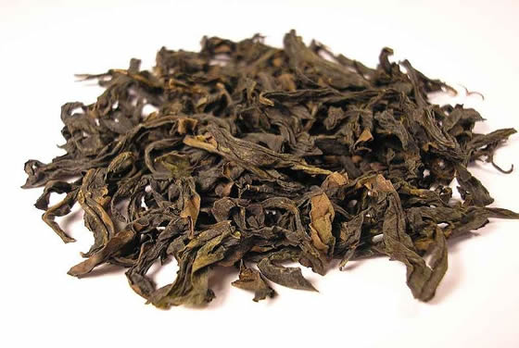
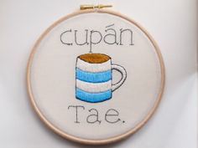
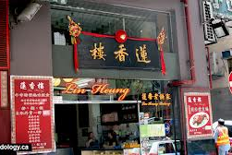
Conclusion: the view of tea from ICE
The sense of 'beverage' made from steeping leaves of the Camellia Sinensis plant is common to all. Though extensions to other plants are possible for all, ICE-CA shows extension which includes a native plant name; ICE-JA extends the range of leaves (including native plants) most widely, and includes medicinal teas not drunk for pleasure.
All corpora reference tea as a meal linked to time, but ICE-NZ shows the meal reference with most frequency and elaboration (recessive in Ireland). Tea as a social and commercial institution is referenced by tea meetings (JA), tea houses (HK), and tea stations (NZ).
Even this limited evidence suggests that how the user (or learner) will encounter tea varies across ICE areas.

Slide 24
ICE on food: searching for verbs
Verbs have a special interest for food and language study. They lend themselves to feature-based analysis (similar to phonological oppositions); they constitute more of a closed class with grammatical consequences. Recall the cookbook syntax: the verbs operate in a way that invokes object-hood and discourse features.
Consider Lehrer (1969: 45) on feature analysis related to COOK. Differentiations between verbs are made on the basis of features such as ±non-fat liquid (water, wine, etc.), ±fat (oil), ± direct heat, etc.

Slide 25
Towards an ICE food verbs search list
How do we choose verbs to search for? Previous research, native speaker intuition, random searching, or otherwise?
Development of a 'Cookbook Corpus' based on 14 publicly-available cookbooks from countries NOT in the ICE sample. Most texts from Great Britain and the US, but corpus includes Australia, Trinidad and Tobago, and India. Cookbooks contain more than recipes, including discursive content about food, household management, health, and other topics. Corpus makes no attempt to be exhaustive or to represent a particular time or place: contains 898,686 word tokens (29,407 distinct types).
Most common words: first 19 are function words (the, and, of, etc.) Most common content word (N=3826) is water, then ingredients (N=2938), followed by sugar (N=2785), butter (N=2547), and salt (N=2492). You could see four terms in a fundamental opposition consisting of ±fat and ±sweet, with ingredients as a term of art. (Tea ranks at 308, N=391). The most common main verb is put (N=2446), followed by add (N=2408).

Slide 26
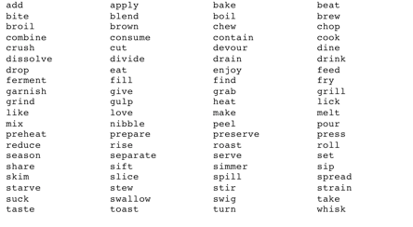
The ICE food verbs search list
Includes the most commonly-used verbs in the Cookbook Corpus, adapted to exclude some overly-general verbs (e.g. put) and to include others, overcoming the cookbooks' bias towards food production. List uses bare stem forms only: favours the inclusion of imperatives, infinitives, 1st person present tense, and some nominalisations. Note that 3rd person singular –s is not universal in ICE.

Slide 27
Inclusion criteria
Direct reference to food
Cut fat into flour mixture and aerate. <#> Add other dry ingredients. <ICE-JA>
Nominal forms directly related to verbs
After early morning tea and toast, Stanley, Mother and Will would go to the cowshed to milk the cows. <ICE-NZ>
Metaphor and other uses not directly about food
On top of this many manufacturers garnish their products with extra festive packing in order to tempt the season 's shopper. <ICE-IRL>
They say that without transparent and independent monitoring it will be too easy to cook the books <ICE-CN>
Method is based on interpretation: may underestimate metaphors and indirect reference, but does not overestimate direct reference.

Slide 28
A first glance: the raw data (ICE-JA)

Slide 29
Question 1: How frequent are the cooking verbs?
ICE-HK has the highest number of tokens (1047), but adjusting for corpus size, ICE-JA (0.86) and ICE-IRL (0.85) show a nearly-equal greatest frequency per 1,000 words of text. ICE-HK (0.71) and ICE-NZ (0.70) are also almost identical, but at a rate that is nearly 20% less frequent. ICE-CN (0.43) is substantially lower.
Type: token ratios (TTRs) tend to reduce as the number of tokens increases: the maximum number of types available is 80. The ratio of cooking verb word types to all word types is remarkably similar in each corpus (ca. 0.16), though the ratio for ICE-CN is reduced.
ICE-HK and ICE-CN show relatively few cooking verbs: the large token count in ICE-HK leads to a low TTR (fewer verbs used more often), while the low token count in ICE-CN leads to a high TTR (fewer verbs used infrequently).The overall ICE TTR is very low: verb types reach a ceiling, but tokens continue to increase.

Slide 30
Question 2: How are the verbs distributed?
Verbs are far from equally distributed. The 10 most frequent verbs account for 2754 tokens (64%) of the total. Adding the next 14 verbs (accounting for all verbs with more than 1% of total) gives 3585 tokens (84%). Cross-corpus hierarchy holds roughly but not completely for each corpus: like favoured in ICE-HK, rare in ICE-JA; drink favoured in ICE-IRL; add absent in ICE-CN. Love slightly more common than like in ICE-CN; elsewhere like much more frequent than love (cf. language change).

Slide 31
Looking at the least common verbs
The 24 least frequent verbs account for only 151 tokens (3.5%) of the total. Broil and swig are not present, and are thus discounted. Some verbs have restricted technical meanings (drain, garnish, brown, dissolve, rise, preheat, preserve); others encode several manner features (grab, lick, devour, gulp, nibble) and may be restricted as to subject type.

Slide 32
Question 3: what about nominals and metaphors?
The distribution is far from random or even. Consider a range from high rates of nominalisation to zero, despite the large number of tokens:

Slide 33
Nominalisation examples:

Slide 34
Classifying the nominalisations
Types favouring nominalisation include
1. Outcome of a process: TOAST, ROAST, BREW.
2. Instrument: GRILL.
3. True verbs, following Wierzbicka's (1982) comments on experiencer, finite quantity, etc. Can all be used with have a: BITE, DRINK, TASTE.
Types allowing for nominalisation at a lower rate:
1. Less definite outcomes: SLICE, FRY
2. Agents which are less definite: HEAT, COOK
3. Tendency toward incomplete outcomes: CHEW
4. Tendency toward animal agents: FEED
Types blocked in line with Wierzbicka (1982): EAT, MAKE

Slide 35
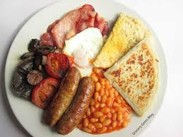
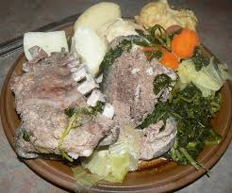
Local variations: the fry (up) and the boil up
Fry shows a high degree of nominalisation in ICE-IRL (67%), both as a simple noun and with completive particle up.
Boil shows a relatively high degree of nominalisation in ICE-NZ (44%). Though examples are from one text, boil up is well attested.
Variations on verb nominalisations show system expansion
Fry Boil

Slide 36
Some principles I
Semantic features are needed to account for the distribution of verbs
The most common verbs (eat, drink, make, like, cook, feed, taste, add, and take) are general in their application (relatively 'light verbs'): eat applies to any solid ingestible, drink to any liquid, etc. The less common verbs (e.g. devour, lick, grind) incorporate manner, goal, and other features.
The prominence of Wierzbicka's generalisations shows a common system to English world-wide.
Nevertheless, the rarity of some permitted nominalisations in the corpus suggests that what the system permits is not a guide to what users do: the corpus adds to our grammatical knowledge.
Local variations expand the grammar in ways not predictable by the system.

Slide 37
Question 4: what about metaphors and metaphoricals?
True metaphors follow Lakoff and Johnson's (1980: 5) view of conceptual metaphor, 'understanding and experiencing one kind of thing in terms of another'.
Explained by Lakoff (1993: 206–7), metaphors are usually understood in terms of mappings from a SOURCE DOMAIN to a TARGET DOMAIN, as in TARGET-DOMAIN IS (or AS) SOURCE DOMAIN. Thus 'our relationship isn't going anywhere' and 'our marriage is on the rocks' show people on a JOURNEY (SOURCE) in order to understand LOVE (TARGET). This mapping yields the conceptual metaphor LOVE IS A JOURNEY.
Metaphoricals here are not necessarily true metaphors, but involve the use of food verbs without ingestion or food preparation. For inclusion they must involve concrete physical actions of a type related to food consumption or preparation, but not involve the actual ingestion of foodstuffs. Collocations count as an inclusion factor.

Slide 38
Examples of metaphors:

Slide 39
Distribution of metaphors and metaphoricals
Metaphors are also unequally distributed across the verb types, though they are not blocked by grammatical principles. Many factors influence use rates.

Slide 40
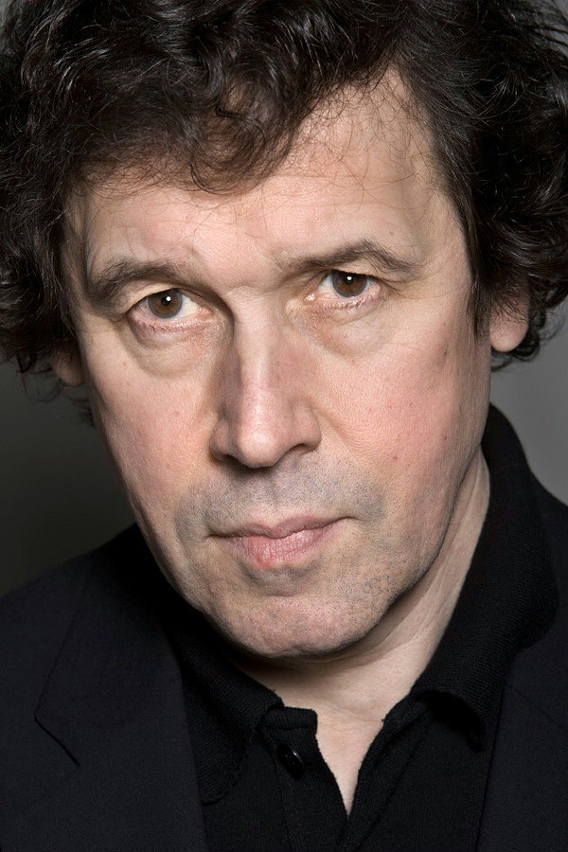
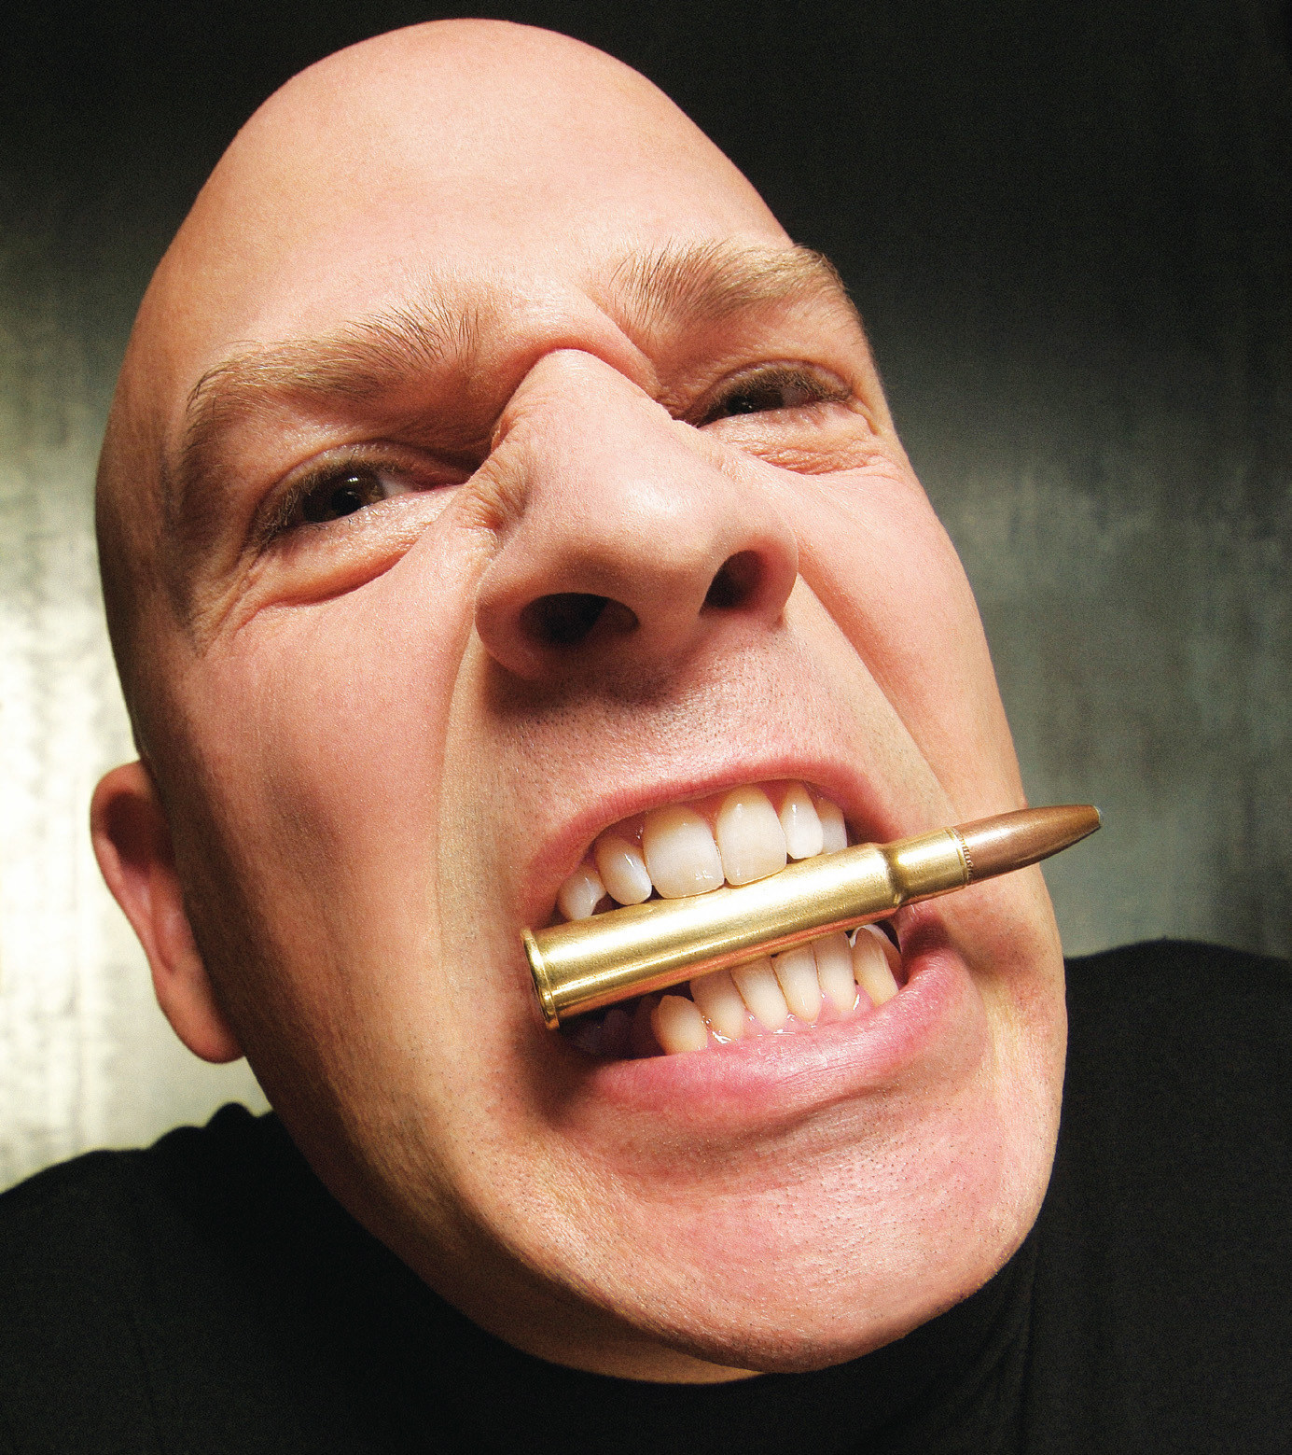
Some insights about life from ICE verbal metaphors
X AS FOOD
  take panadol (MEDICINE AS FOOD)
  consume money and talent (MONEY & TALENT AS FOOD)
  taste of political freedom (FREEDOM AS FOOD)
  give you feedback (KNOWLEDGE AS FOOD)
  eat him for breakfast (HUMAN BEING AS FOOD)
X AS LIQUID
  frustration spills over; boil with rage (FEELING AS LIQUID)
  pour money into that (MONEY AS LIQUID)
  EATING AS THREAT
  swallow contaminated dirt (SWALLOWING AS THREAT)
  bite the bullet (BITING AS THREAT) ('do s. unpleasant but needed')
  reduce our fat intake (FAT AS THREAT)
  FOOD AS MEDICINE
  apply avocado to face and let it dry (FOOD AS MEDICINE)
Stephen Rea

Slide 41
Some principles II
Metaphors are less easily predictable than nominalisations: the system allows for idiosyncratic and original metaphors
Some metaphors are also idioms (e.g. bite the bullet) and recognisable as linguistic chunks: they may be (or become) 'dead metaphors'.
Metaphors show that we often understand the world in terms of foodstuffs and their properties. A taste of political freedom is positive, even if limited to a finite amount (as per nominalisation rules); giving feedback (a complex metaphor) provides nourishment to the mind. Bad things can also enter the body through the mouth: we may swallow dirt (so not all swallowing is for food), and conventionally we must bite the bullet (unpleasant and not for food).
Food metaphors and identity: to turn vegetarian is to turn away from an established identity
A cyclical discourse of health suggested by metaphors of food, drugs, and medicine: medicines and drugs can be food, food can be medicine.

Slide 42

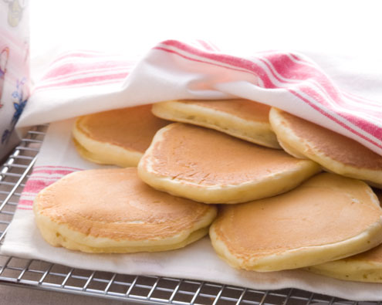
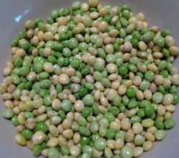
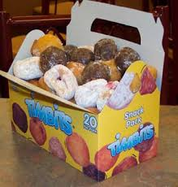
In conclusion I
Nouns show local variation: lexical change, relatively little impact on system
Superpass dinner, superpass breakfast 'ceremony for wishing to get a good examination result among university students'
ICE-HK
Pikelet, a type of pancake (NZ, Aus); cf Staffordshire pikelet, a different kind of griddle cake ICE-NZ
Gungo peas, aka pigeon peas; cooked with rice, etc.
ICE-JA
Timbits: 'bite-sized morsels of our traditional donuts' (Tim Hortons chain)
ICE-CN

Slide 43
In conclusion II
The frequency of occurrence of food verbs across ICE corpora is remarkably consistent, though ICE-CN is remarkably lower
Food verbs favour light verbs, with decreasing frequency accounted for by semantic features: manner of action, type of subject, type of object, generality of outcome, desirability of outcome, etc.
Observed frequencies do not necessarily correlate with grammatical expectations: some things are grammatically possible but rarely mentioned in ICE corpora.
Food verbs interact with nominalisation: some potential verb forms occur more often as nominals, and nominalisations may fulfil various roles. Grammatical blocking applies despite the frequency of some light verbs.
Food verbs interact with metaphor: FOOD may be a source by which TARGETS are understood, but FOOD may also be a target. Metaphors may point towards cognition, identity, experiences and conceptions of the body, health, pleasure, and pain.

Slide 44
Implications for the future
This talk has only provided a taste of foodways discourse in ICE corpora
Further areas of investigation could include
  — Content: beliefs, practices, recipes, patterns of production and consumption
— Discourse features (text types; speech acts – offers, requests, etc.)
— Nouns, Adjectives, Word Formation Rules
— More on metaphor, metonymy, simile, and idiom
Evidence of change in progress (e.g. tea as a meal; fry as a noun; love versus like food)
— Language change by linguistic principles (feature changes, lexical change)
— Language change reflecting social practice (superpass dinner): see also Jurafsky (2014) and more widely Civitello (2011).

Slide 45
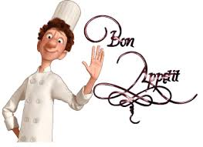
And further implications ...
Cross-linguistic analysis: other languages, other corpora
These investigations could be significant for other fields:
Language teaching (corpus-based syllabus design)
Language learning (learning about use; learning about language and culture)
Public health and nutrition
Gender studies
The study of language, culture, identity, and society more generally

Slide 46
References ...
  Civitello, Linda. 2011 [2004]. Cuisine and Culture. 3rd edn. Hoboken: Wiley & Sons.
  Faycel, Dakhlaoui. 2012. Food Metaphors in Tunisian Arabic Proverbs. Rice Working Papers in Linguistics 3. Available at http://hdl.handle.net/1911/64168.
  Frake, Charles O. 1964. How to ask for a drink in Subanun. American Anthropologist 66 (6/2): 127–132.
  Georges, Robert. 1984. You often eat what others think you are: food as an index of others' conceptions of who one is. Western Folklore 43 (4): 249–256.
  Gerhardt, Cornelia, Maximiliane Frobenius, and Susanne Ley, eds. 2013. Culinary Linguistics: The Chef's Special. Amsterdam: Benjamins.
  Jones, Michael Owen. 2007. Food choice, symbolism and identity: bread-and-butter issues for folkloristics and nutrition studies. Journal of American Folklore 120: 129–177.
  Jurafsky, Dan. 2014. The Language of Food: A Linguist Reads the Menu. London: W. W. Norton.
  Kallen, Jeffrey L. and John M. Kirk. 2008. ICE-Ireland: A User's Guide. Belfast: Cló Ollscoil na Banríona.
  Kallen, Jeffrey L. and John M. Kirk. 2012. SPICE-Ireland: A User's Guide. Belfast: Cló Ollscoil na Banríona.

Slide 47
References.
  Lakoff, George and Mark Johnson. 1980. Metaphors we Live by. London: The University of Chicago Press.
  Lakoff, George. 1993. The contemporary theory of metaphor. In Metaphor and Thought, ed. Andrew Ortony, pp. 202–251. Cambridge: Cambridge University Press.
  Lehrer, Adrienne. 1969. Semantic cuisine. Journal of Linguistics 5 (1): 39–55.
  Lévi-Strauss, Claude. 1966 [1965]. The culinary triangle. Trans. Peter Brooks. In Carole Counihan and Penny Van Esterik (eds.) Food and Culture: A Reader, pp. 40–47. 3rd edn. Abingdon: Routledge, 2013.
  Wierzbicka, Anna. 1982. Why can you have a drink when you can't *have an eat? Language 58 (4): 753–799.
  Cupán Tae embroidery: https://www.pinterest.com/hextrovert/crafting-up-a-storm/

